Slide 1

Progress Update T39-P3
Improvement opportunities for policies and certification schemes promoting sustainable biofuels with low GHG emissions
Part 2: Robustness of GHG emission certification and verification – a case study of selected biofuel supply chains and policies
José Muisers, Kiki Klerks, Aafke Jansen
Leipzig, 26 October 2023
Notes:
What I would like to talk about is the progress made so far in the IA report.

Slide 2
Task 39 – P3 Part 2 background
Policies steer increasingly towards (further) reducing CO2 emissions. There are several policy differences on how this should be achieved.
Task 39
Task 45
Differences in the degree of stringency and robustness of policy frameworks (and related certification schemes) for biofuel GHG emissions
Different outcomes in GHG emission data in biofuel policy frameworks (and related methodologies/tools)

Slide 3

Objectives
understand sensitivities in selected biofuel supply chain/policy combinations in relation towards GHG emission certification and verification – SAF case studie
examine the (im)possibility of assurance bodies to notify and verify these sensitivities (assurance on paper vs implementation in practice);
gain insight into how these sensitivities impact biofuel flows globally (preferred routes)
make recommendations for potential improvement opportunities for the robustness of GHG emission assessment in policies and related certification schemes promoting sustainable biofuels with low GHG emissions

Slide 4
Meeting frequency
Check-in meetings with all project partners are scheduled to take place every 6 weeks
Previous meetings
Kick-Off meeting with project partners (1st of August 2023)
First (6-weekly) Check-In Meeting with all project partners (12th of September 2023)
In-person/hybrid interactive workshop on WP1-WP2 (25th of October in Leipzig)
In-person coordination meeting with T45 (25th of October)
Upcoming meetings
1 to 1 contact on outstanding detailed information (policy updates)
Virtual coordination meeting with T45 scheduled for November
Next check-in meeting with all project partners is scheduled 5 December

Slide 5
Work packages
Part 2: Robustness of GHG emission certification and verification
Work package 1 | Setting the framework:
  start update policy frameworks;
  analysis IRA
Work package 2 | ‘Building blocks’ of selected SAF biofuel supply chains
  Inventory current SAF supply chains
  Sensitivities/risks SAF supply chains
Work package 3 | ‘Robustness’ of the GHG assurance system (‘on paper’)
Work package 4 | Verification of data quality (‘on paper’ vs ‘in practice’)
Work package 5 | ‘Benchmarking’ the GHG mitigation potential of selected SAF biofuel supply chains (qualitatively)
Work package 6 | Project management and dissemination
Additional:
Work package 7 | Synthesis: findings and reflections T39 & T45 activities

Slide 6
Update Work package 1 | Setting the framework
Completed activities:
Project partners were requested to update the mapped policy frameworks of Part 1 – EU (AT/JRC/DE/NL), Brazil, CA and CORSIA
Initial analysis on the US Policy Framework (IRA) by Guidehouse
Project partners e.o. have submitted the updated policy frameworks; pending CA
Next steps
Input and cross-check Task 39 members - EU (AT/JRC/DE/NL), Brazil, CORSIA on framework update and added elements (WP2)
Additional information on specific elements by Task 45
To establish a representative set (limited number) of relevant case studies for assessment - Task 39 project partners
Results:
Updated policy frameworks specified to the needs of the assessment
Additional fact sheet on US policy framework (IRA)
Representative set of case studies: # SAF biofuel supply chains * # policy frameworks

Slide 7
Update Work package 2 | ‘Building blocks’ of selected SAF biofuel supply chains
Completed activities:
Brainstorm of countries’ SAF supply during the first Check-In meeting (12th of September)
Project partners (Brazil/AT/DE/NL) were requested to submit an overview of their countries’ SAF supply chains (feedstock, production technology, planned production etc.)
Project partners (Brazil/AT/DE/NL) have submitted their overview of SAF supply chains and Belgium provided additional input.
Brainstorm on the sensitivities was held during the workshop on the 25th of October:
  (technical) input of Task 39 partners on structures of SAF supply chains and mapping
  input of different stakeholders (Task 39/Task 45) on the occurrence of specific risks a.o.:
    when moving from mass balance to book and claim;
    in case of mutual recognition with changing certification schemes between steps in supply chain
    in case of overlapping certificates and policies
Results:
a structure of building blocks of different parts of the supply chain per selected SAF supply chain (see figure for illustration - simplistic representation)
defined sensitivities per selected policy framework/supply chain combination
Note: The inventory/data collection is for a large part intended for WP3

Slide 8
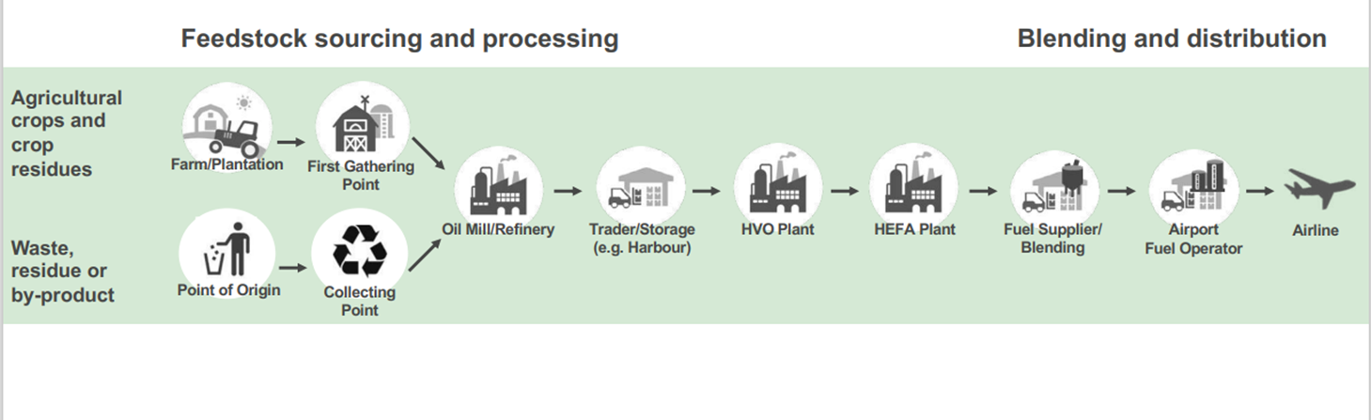




WP2 |”Building blocks” of different SAF biofuel pathways (case study)
  How does the pathway look like, and where do the sensitivities lie within/between the selected policy frameworks (C-O-C, feedstock categorization, etc)
Example (after ISCC):
Sensitivities / risks in SAF supply chains
Notes:
Template to collect country market/supply chain info: sourcing, producing (techniques), uptake SAF
Up to HVO plant: results relate to biofuels in general; from that point on they become aviation specific

Slide 9
Update Work package 3 | ‘Robustness’ of the GHG assurance system (‘on paper’) – case studies
Completed activities:
Project partners have submitted the updated policy frameworks – EU (AT/JRC/DE/NL), Brazil, US and CORSIA
Project partners (Brazil/AT/DE/NL) have submitted their overview of SAF supply chains and Belgium provided additional input
Next steps:
Cross-check on need to add additional elements to mapped frameworks (including elements to make them specific for the selected supply chains, based on WP2)
Additional: US Inflation Reduction Act
Update already mapped frameworks (Part 1)
What is additionally required:
Input and cross-check from Task 39 members a.o. AT/JRC/DE/NL, Brazil, US, CORSIA on framework update and added elements (WP2)
Additional information on specific elements by Task 45
Input from US policy makers (cross-check, filling in the framework / interview format, providing the information necessary) – contact via Task 39 members
Results:
Updated policy frameworks specified to the needs of the assessment
Additional fact sheet on US policy framework (IRA)

Slide 10
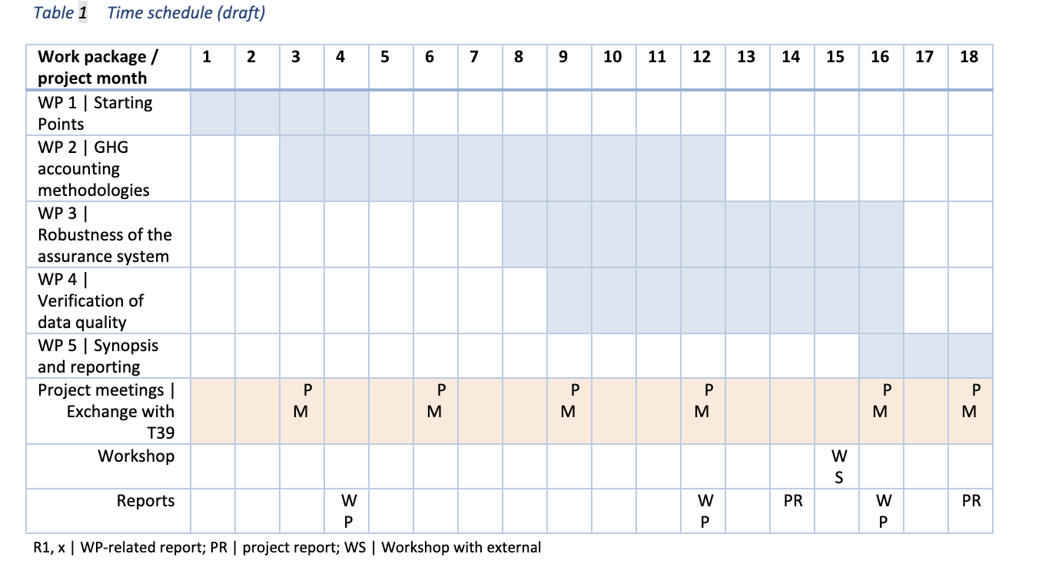

Slide 11
Next steps
Execution:
Continuation of WP1-WP2: processing and review/cross-checks of the project partner’s input and combining these in WP3
After completion of WP1-WP3, the planning of WP4-WP7 will be updated

Slide 12

What do you consider the most relevant US policy on SAF supply chains: IRA / LCFS / other?
Please share with us:
your contacts of companies involved in SAF supply chains
sensitivities in policies with respect to in SAF supply chains
relevant studies in the field of SAF sustainability/GHG certification

Slide 13
Thank you!
José Muisers
Jose.Muisers@rvo.nl
Kiki Klerks
kklerks@guidehouse.com
Aafke Jansen
Aafke.Jansen@rvo.nl

