Slide 1


The Netherlands
Country Update
José Muisers
RVO Netherlands
Leipzig, Germany, 25 October 2023

Slide 2

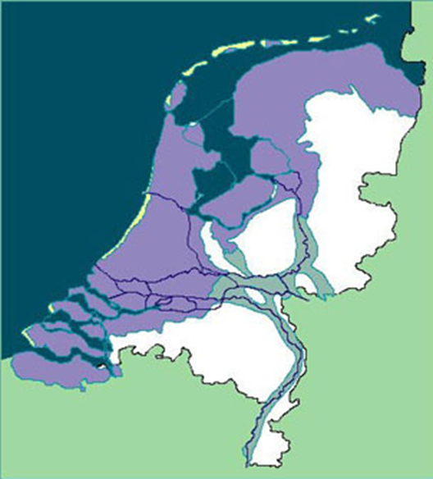
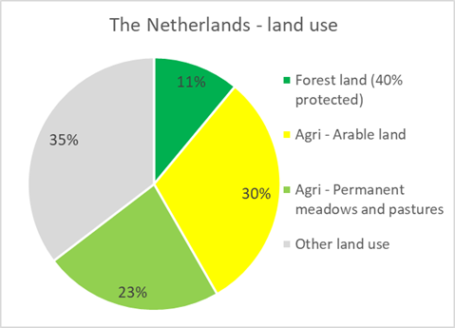
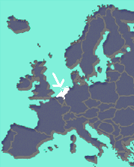
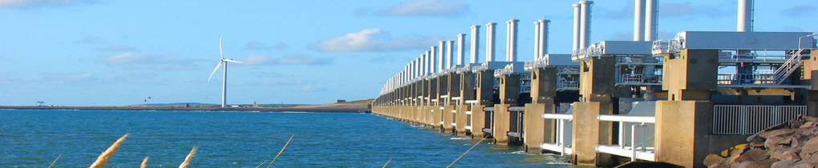
The Netherlands
17,1 million inhabitants
on 33,670 sq. km
Delta downstream large European rivers, 2/3 of the country below sea level
Surrounded by industrialized areas of Belgium, Germany
>> Focus on environment
Notes:
2

Slide 3
NPE = National Plan Energy System
The government presents the first National Plan Energy System (NPE) in 2023. This is a vision on the energy system of the future and the path that leads there.
Transition roadmaps for all sectors (mobility, industry, agriculture and built environment) and development paths for energy chains (carbon, hydrogen, heat and electricity) and their relationship.
Provides insight in necessary system change and connects long term vision to short term choices.

Slide 4
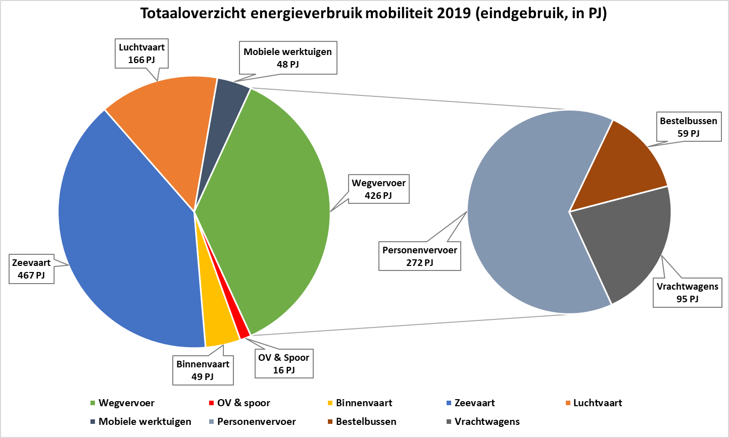
Current energy consumption mobility
CO2-emission national transport sector: 30,5 Mton
CO2-emission international transport sector (bunker fuels): 43,8 Mton

Slide 5
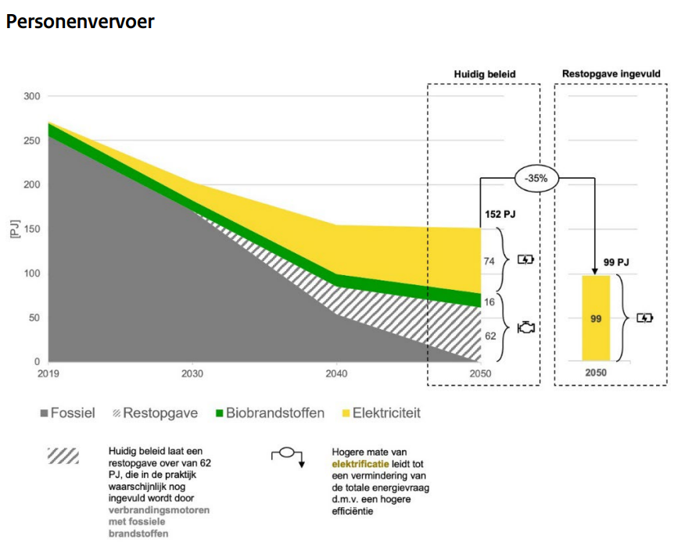
Passenger transport

Slide 6
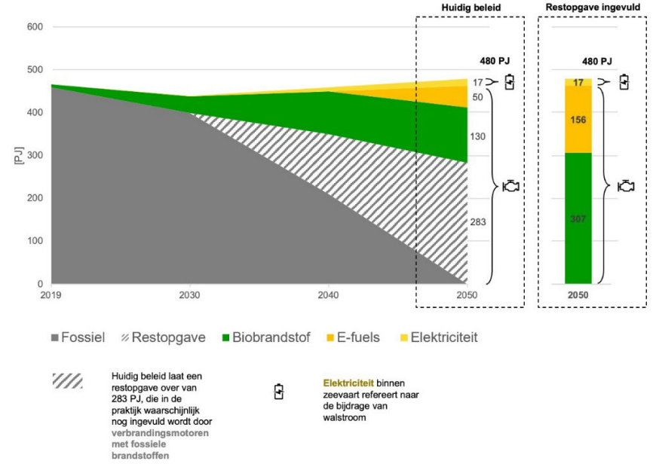
Maritime

Slide 7
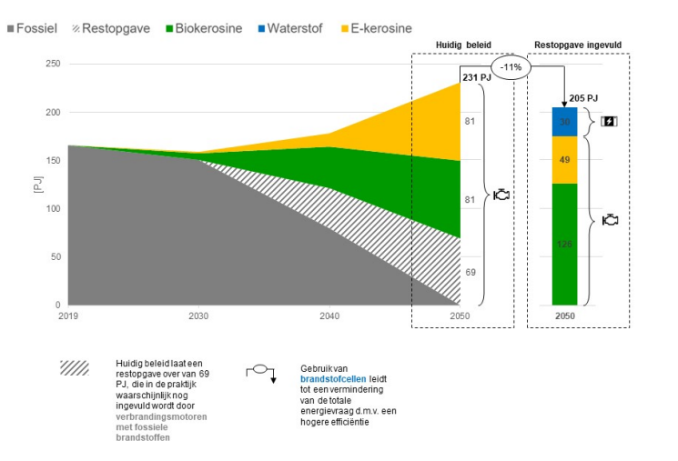
Aviation

Slide 8
Potential demand in 2050 -> Civil service estimate
Potential demand energy carriers 2050 (PJ) | Renewable electricity | Renewable hydrogen | Biofuels | E-Fuels | Total
Passenger transport | 99 |  |  |  | 99
Rail and public transport | 14 | 1 |  |  | 16
Light goods transport | 21 |  | 7 |  | 28
Heavy road traffic | 41 | 11 | 11 |  | 62
Mobile machinery | 19 |  |  |  | 19
Inland shipping | 8 | 12 | 11 | 10 | 41
Maritime | 17 |  | 307 | 156 | 480
Aviation |  | 30 | 126 | 49 | 205
Total | 219 | 54 | 462 | 215 | 950
Notes:
Nu: 37 PJ , bijna 12,5x zoveel in 2050 nodig

Slide 9
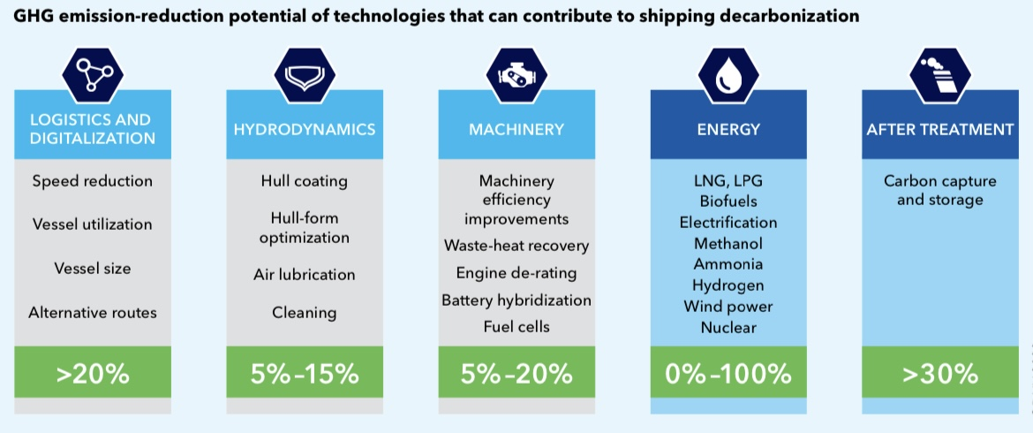
Maritime: ways to reduce GHG emissions
Source: DNV Maritime Forecast to 2050 (2022)
Technical and operational measures can significantly reduce GHG emissions
Few advanced energy-saving techniques on board, but e.g. with wind energy (sailing) 3-15% of the propulsion energy can be saved
Climate-neutral shipping by 2050 requires a fuel transition!

Slide 10
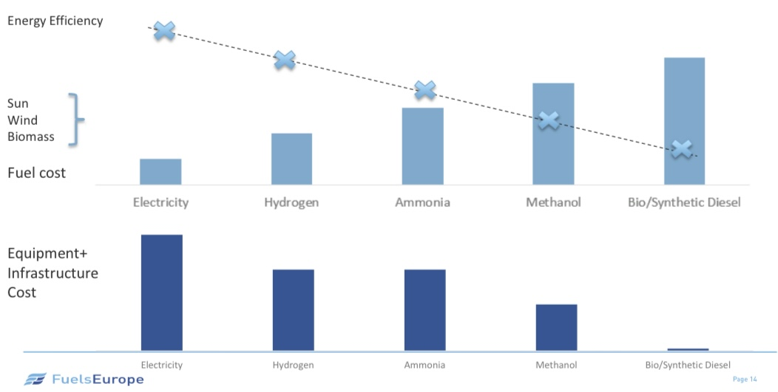
Maritime: why is fuel choice complex?
Bron: John Cooper, Fuels Europe (EU-Shipping-BCE, 2022)
Notes:
Brandstofkosten oplopend van links naar rechts
Energie efficiency neemt af van links naar rechts, idem voor infrastructuur kosten!

Slide 11
Maritime: why fuel transition complex?
Multitude of options with different properties => which one to choose?
Diversity of ship types, sailing profiles, etc.
Uncertainty about future…
Prices of renewable electricity, CO2 (incl. DAC) bio-raw materials
Costs of CCS, production installations, distribution infrastructure
Availability of raw materials, fuels, distribution infrastructure
Competition from other modalities/sectors (see NPE)
Technological development and safety issues
And: conventional marine fuels are strong because of their low price, existing infrastructure and high energy density
Notes:
Wordt gewerkt aan een road map maritime

Slide 12
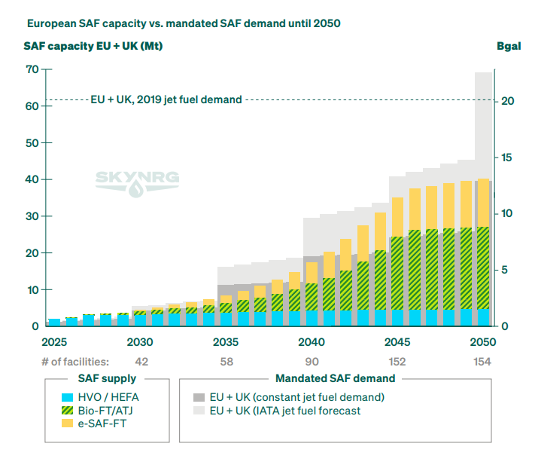
SkyNRG Market outlook EU 2023
Aviation - Background: Current SAF market (EU + UK)
HEFA: now commercial
Based on waste oils and fats
Sustainable but not sufficient availability of raw materials in the long term
Announced production from 2030 onwards is not sufficient to achieve the EU target
Diversification of raw materials and production routes necessary (bio and e-fuels)

Slide 13
Bottlenecks for stimulating SAF production via alternative techniques
Insufficient demand (still sufficient HEFA production until 2030 to meet ReFuel EU target)
Higher cost
Technological challenges
Limited availability of raw materials
Certification
E-fuels: insufficient green H2 available

Slide 14
Possible national stimulation options
Climate fund: early phase scale-up
Goal: Scaling up techniques that can contribute system-wide to a climate-neutral society
Fiches relevant to SAF production:
Gasification: already honored (2024 budget)
Pyrolysis: submitted
Alcohol-to-Jet: submitted
E-fuels: submitted

Slide 15
Challenges
EU Fit for 55 package – integration of international sectors
  RED III
    Change of national steering system: Renewable energy -> GHG reduction
    Obligation on fuel suppliers: 14,5% GHG reduction
    1,7% Annex IX CAP (waste oils/fats)
    Accounting international sectors (particularly challenging for the Netherlands)
  ReFuel EU Aviation
    6% blending target – EU wide bunkering (no mandatory top up allowed)
    Duch ambition 14%
  FuelEU Maritime
    6% reduction obligation to ship owner
    Risk of tankering outside country/EU

Slide 16
José Muisers
Jose.Muisers@rvo.nl
Thank you!

