Slide 1
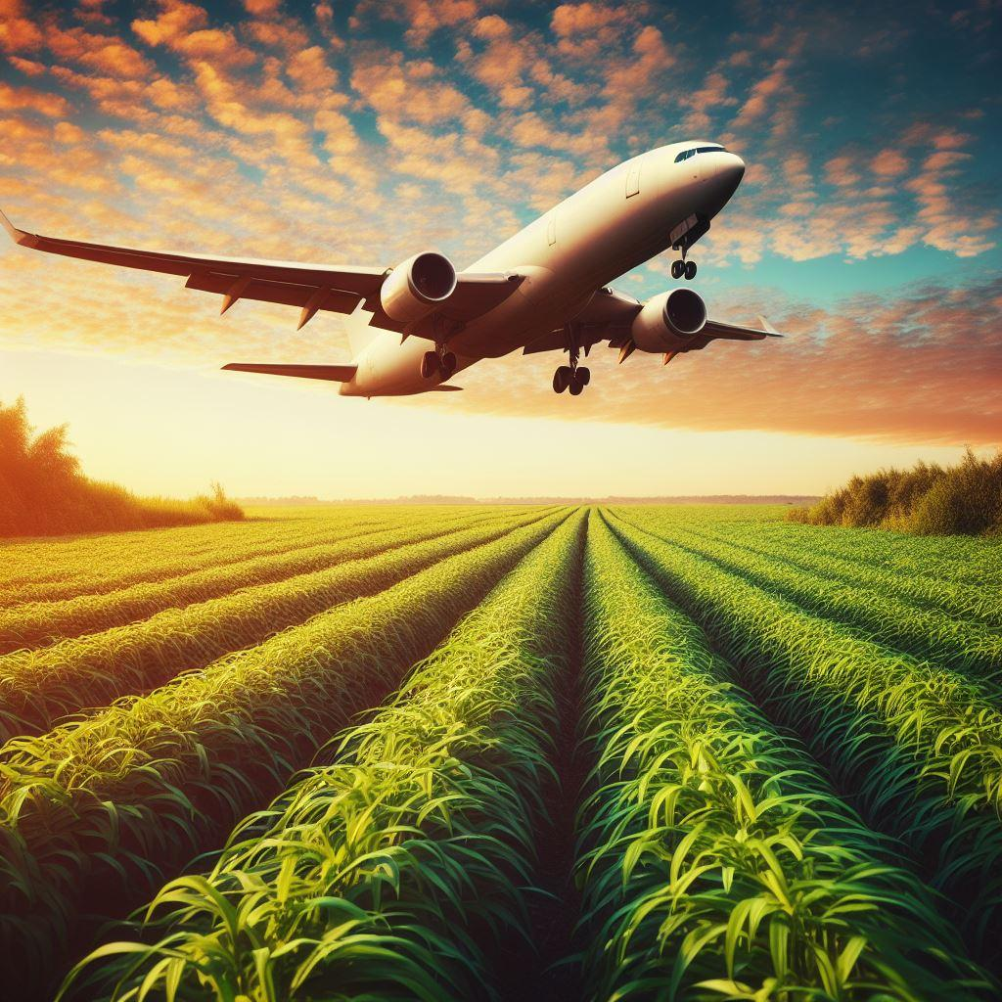
LCA of Sustainable Aviation Fuels (SAF)
Brazilian Team:
Glaucia Mendes Souza, Heitor Cantarella, Luiz Horta Nogueira, Raffella Rossetto, Rubens Maciel Filho and Joaquim Seabra
Canadian Team:
Jack Saddler, Susan van Dyk
Collaborator:
Jean Felipe Leal Silva
2023
Notes:
So, I will try to summarize our work on LCA in Task 39 and Task 45. In Task 39 we are conducting an analysis on biofuels in emerging markets.

Slide 2
LCA of Sustainable Aviation Fuels (SAF) BR team
Calculate the carbon footprint of SAF produced via the following routes:
  Hydroprocessed Esters and Fatty Acids (HEFA)
  Biomass gasification and Fischer-Tropsch synthesis
  Alcohol-to-jet (ATJ) based on sugarcane ethanol
  Co-processing of bio-oil in oil refineries
Describe and discuss the sustainability requirements, other than GHG, in CORSIA, with a specific focus on ILUC in the case of feedstocks that are “low risk” for land use change and considered to have zero emissions from land use change.

Slide 3
Thank you for your attention!
Glaucia Mendes Souza
✉ glmsouza@iq.usp.br

