Slide 1

Assessment of the Sustainability of Biofuels Pathways, Including Social and Environmental Aspects of Sustainability — A Case Study of Industrial Exhaust Gas-Bioethanol in China and Brazil
Glaucia Mendes Souza and Rubens Maciel Filho (Brazil)
Fuli Li and Yanli Yang (China)
Collaborator:
Jean Felipe Leal Silva
2023
Notes:
So, I will try to summarize our work on LCA in Task 39 and Task 45. In Task 39 we are conducting an analysis on biofuels in emerging markets.

Slide 2
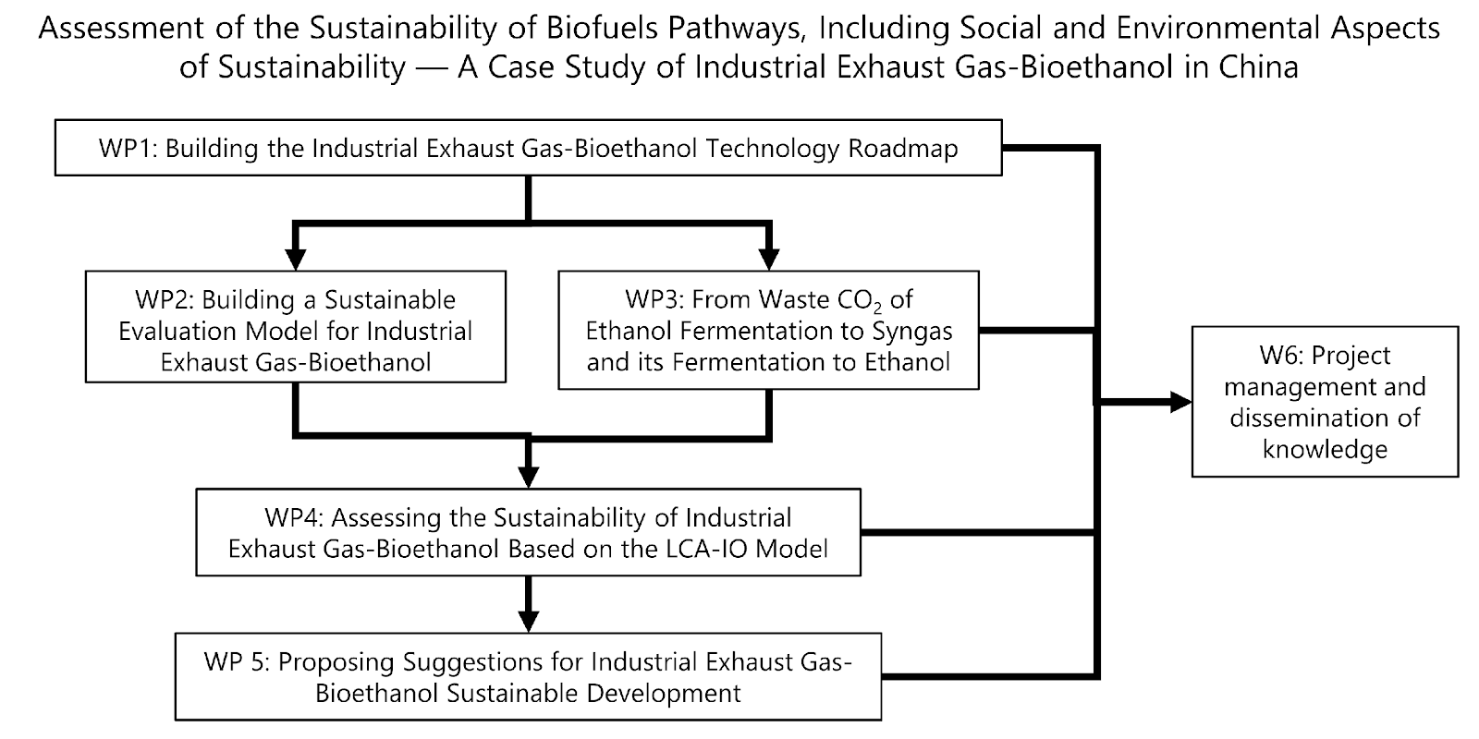
Structure of the project
LCA of exhaust gas-to-bioethanol

Slide 3
LCA of exhaust gas-to-bioethanol
Work package 1 | Building the Industrial Exhaust Gas-Bioethanol Technology Roadmap
Investigate the emission of industrial exhaust gases from different types of industries such as iron, steel and chemical in China and ethanol fermentation in Brazil and analyze the technology used in the fermentation of industrial exhaust gases to produce ethanol. Construct a variety of possible industrial exhaust gas-biofuels technology roadmaps.
WP Lead: Fuli Li (China) and Rubens Maciel (Brazil)
Work package 2 | Building a Sustainability Evaluation Model for Industrial Exhaust Gas-Bioethanol
Collect life cycle inventory data for industrial exhaust gas-biofuels, including input data on energy consumption, material consumption, labor, capital, equipment, and output data on products, by-products, pollutants, etc. Build a SAM that includes industrial exhaust gas-biofuels. Integrate IO model with LCA to build a sustainable evaluation model.
WP Lead: Yanli Yang (China)
Work package 3| From Waste CO₂ of Ethanol Fermentation to Syngas and its Fermentation to Ethanol
Special attention will be given to the conversion of the waste CO₂ stream produced during the conventional fermentation of carbohydrates to ethanol. This gas stream has better purity than other CO₂ streams of other industrial processes. Routes to produce syngas from this stream will be simulated and analyzed, including the reduction of CO₂ to CO via electrocatalysis or the water-gas shift reaction using green hydrogen produced via water splitting using renewable electricity. The produced syngas will be used in syngas fermentation to ethanol, based on previous studies developed by the research group of Prof. Rubens Maciel Filho (Brazil). A techno-economic analysis will be used to compare process routes and discuss their feasibility and the bottlenecks of this approach.
WP Lead: Rubens Maciel Filho (Brazil)

Slide 4
LCA of exhaust gas-to-bioethanol
Work package 4| Assessing the Sustainability of Industrial Exhaust Gas-Bioethanol Based on the LCA-IO Model
Analyze the life cycle cost and carbon intensity of industrial exhaust gas-biofuels under different technology routes in China. Analyze the economic benefits (including impact on regional economy, etc.) and social benefits (employment impact) of the large-scale development of industrial exhaust gas-biofuels in China.
WP Lead: Yanli Yang (China)
Work package 5| Proposing Suggestions for Industrial Exhaust Gas-Bioethanol Sustainable Development
Based on the above research, put forward proposals for the large-scale development path of industrial exhaust gas-bioethanol in China and Brazil
WP Lead: Fuli Li (China) and Rubens Maciel (Brazil)
Work package 6| Project management and dissemination of knowledge
Production of a report on the potential of the conversion of exhaust gas to bioethanol as an alternative route to produce bioethanol and alternative for carbon capture and utilization.
WP Lead: Fuli Li (China) and Glaucia Mendes Souza (Brazil)

Slide 5


METHODOLOGY
Carbon capture from ethanol fermentation + green H₂ to produce syngas followed by syngas fermentation to ethanol
Process simulation in Aspen PlusTM
  Fermentation process based on industrial data
  Composition of CO₂ stream based on process simulation
Conversion of CO₂ to ethanol
  Chemical reduction of CO₂ to CO
  Chemical routes to green H₂
  Fermentation of syngas (H₂+CO mixture)
hydrogen production
TEA
LCA
gas-to-bioethanol fermentation
sugarcane juice fermentation
CO₂
CO₂ reduction
ethanol

Slide 6
Thank you for your attention!
Glaucia Mendes Souza
✉ glmsouza@iq.usp.br

