Slide 1

Identifying and lowering hinders for increased use of maritime biofuels
Task 39-T3 Project proposal
Tom Walsh, NTL, Ireland
David Bauner, NTL, Ireland
Lepzig, Germany, 25.10.2023

Slide 2
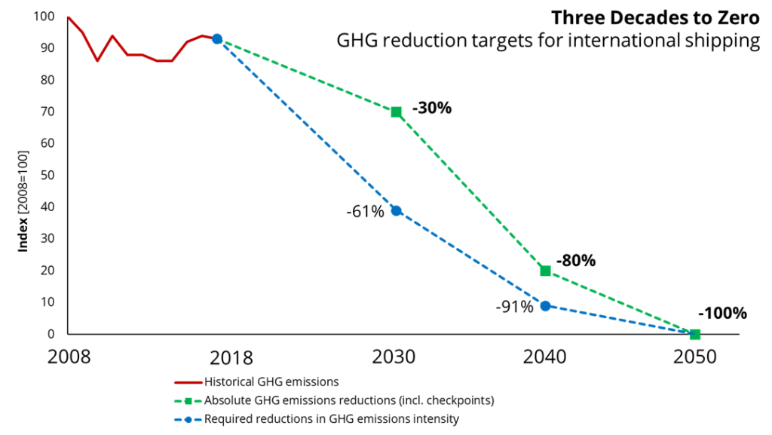
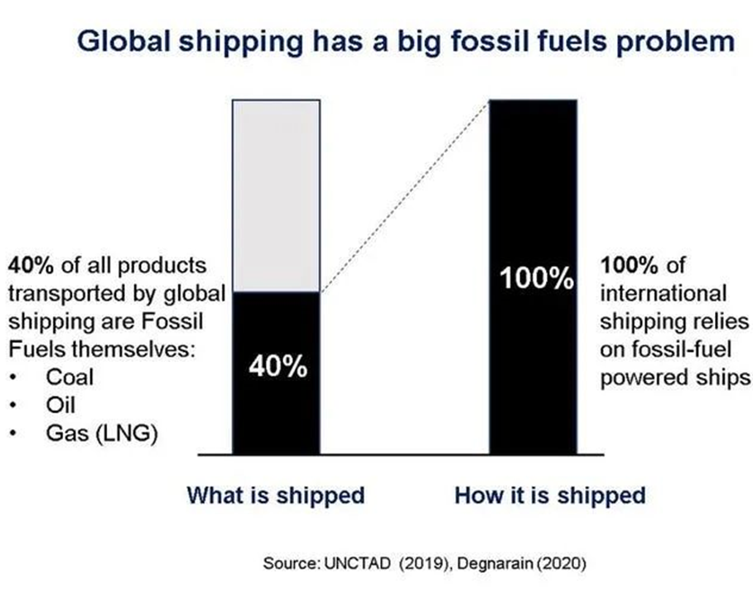
Background

Slide 3
Background
Maritime fuels go under radar in terms of initiatives to decarbonize, CO2 emission & local pollution of air & water.
Technological, logistical and political barriers for utilization of maritime biofuels. Price being the main barrier, exacerbated by global fossil fuel subsidies and political instability in biofuel incentives.
Shipping accounted 11 EJ , resulting ~ 1B ton of CO2e (2.5-3%). Emission expected to rise with demand to 20% by 2040. HFO, MGO, VLSFO and, LNG (small scale) cover ~ 99% of the sector’s final energy demand.
Transporting fuel from producers to consumers amounts to up to 40% of all shipping volume. Thus, more regional production and use of maritime biofuels considerably reduce emissions from maritime sector.

Slide 4
Background
In the EU, shipping accounted 14% of total CO2 emissions in 2019. A provisional agreement reached in March 2023 b/n the European Parliament and Council negotiators on fuel standard for ships.
Ships to reduce GHG in the energy they use by 2% by 2025, 6% by 2030, 31% by 2040, 62% by 2045 & 80% by 2050, relative to 2020 level. This applies to ships above a gross tonnage of 5K tons, responsible for 90% of GHG in the EU.
Ireland aims carbon neutrality by 2050, with a target to reduce GHG by 51% by 2030, relative to 2018 levels. Irish ports handle > 55M tonnes of goods (2018), with vessels fueled with heavy oil, except 300 ships fueled by LNG.

Slide 5
Problem statement
How can the industry extend the use of electro-based and biomaritime fuels for the maritime transport sector? What are the current trends of push and pull mechanisms in the market?
What are the main barriers and hinders for the deployment of use of electro-based (e-fuels) and maritime biofuels? What is needed to realize the potential?

Slide 6
Objectives and scope of work
Assess the promising potential routes to accelerate the transition to a carbon neutral shipping sector with maritime biofuels
Evaluate technical, regulatory, legal & economic barriers to success, also possible synergies of e-fuels, exemplified: hydrogen addition enhancing yield of biofuels
Define mitigation strategies for the identified barriers
Develop a sustainable fuel roadmap for the maritime industry

Slide 7
Methodology and approach
Based on research and analytical studies of publicly avilable resources
The report will draw information from groups such as IEA, IMO, ASCENT, CORSIA etc., peer-reviewed publications, from relevant organisations (e.g. ICF, ICAO, IATA, CAAFI etc.), and other literatures.
Collaboration with reserachers, private, national and multilateral organizations in the project & reference group.
Collaboration with IEA Advanced Motor Fuels Task 64: E-fuels and end-use perspectives and Task 60: The Progress of Advanced Marine Fuels

Slide 8
Activities and expected results
WP1 | Assessing the current market(s) for maritime fuels
WP2 | Assessing feedstocks and production pathways for maritime biofuels
WP3 | Economic and regulatory controls:
WP4 | Identifying barriers to maritime biofuels (including e-fuels)
WP 5 | Project management and dissemination
Deliverables:
WP1: Main fossil (>97%) and renewable (<3%) value chains for maritime fuels, and emerging (>1% market share globally) products on the market.
WP2: Additional candidates for innovation – Potential scalable value chains in context of regions and maritime sector.
WP3: Regulatory barriers and incentives for use of biofuels in the maritime sector. Barriers & mitigation to allow proliferation of maritime biofuels.
WP4: Sustainable roadmap for the maritime fuel sector. Synthesis of hinders and barriers with recommendations for extending use of maritime biofuels for accelerating projects and technologies.
WP5: Main project report and status reports with conference paper.

Slide 9
Organization and time schedule
Project leader: Tom Walsh (Ireland)
Participating countries(conf.): Sweden, Denmark, New Zealand, The Netherlands

Slide 10
Budget and financing
Overall project budget: 72,750 USD

Slide 11
Thank you!
Tom Walsh
tom.walsh@renetech.net

