Slide 1
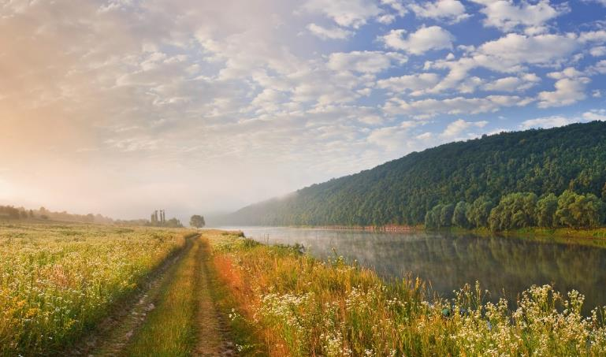
T39-T4 Assessment of demonstration plants and commercialisation progress
Task 39 Business Meeting – Annual progress report
Andrea Sonnleitner, BEST - Bioenergy and Sustainable Technologies GmbH
26.10.2023, Leipzig, Germany

Slide 2
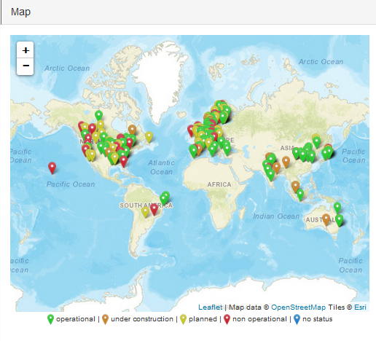
Database on facilities for the production of advanced liquid and gaseous biofuels for transport
https://demoplants.best-research.eu/
~250 active entries
Many facilities planned or announced – Start-up?
Main technologies: Fermentation, Hydrotreatment, Gasification, Fast pyrolysis
Rising number of E-Fuels biomass hybrids
Notes:
Alcohol to jet – 6
E-Fuels Biomass hybrids – 14
Fast pyrolysis – 25
Fermentation – 82
Gasification – 51
HTL – 8
Hydrotreatment – 66
Lignin depolymerisation – 2
Other Technologies – 3

Slide 3
Collaborations and information exchange
IEA Bioenergy
IEA Bioenergy Task 33 (Gasification of biomass and waste)
IEA Bioenergy Task 34 (Direct thermochemical liquefaction)
ETIP Bioenergy – European facilities
Requests from:
IEA Bioenergy data analists
Project Study on development of outlook for the necessary means to build industrial capacity for drop-in advanced biofuels
Researchers, Experts and consultants from DNV, Bain, IMO, Studio gear up

Slide 4
Public outreach
Date | Title | Event
11/22 | Advanced Biofuels Overview | Presentation at European Bioenergy Future
01/23 | Production capacity and outlook for advanced biofuels worldwide | Presentation at CEBC Central European Biomass Conference
06/23 | Sustainable Aviation Fuels (SAF) - Production and challenges for market uptake | Presentation and paper at EUBCE European Biomass Conference
06/23 | Sustainable Aviation Fuels (SAF) Production and Challenges for Market Uptake | Poster at BEST centers day
09/23 | Biofuels for defossilisation of long-distance transport [GERMAN] | Presentation at national networking event for IEA TCPs
10/23 | Overview on transport biofuels in Austria and worldwide [GERMAN] | Presentation at GARANTA Future Talk

Slide 5
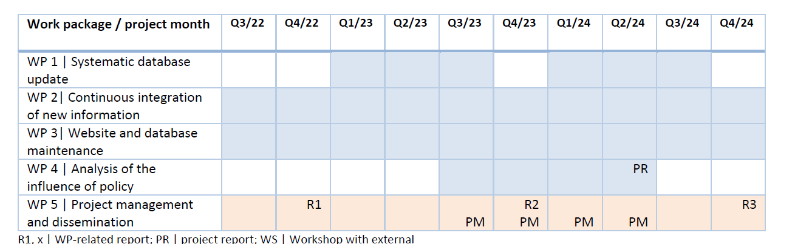
Time Schedule - Progress

Slide 6
Next steps
Finishing systematic update (until end of the year)
Work on WP4 Critical analysis of development and deployment of advanced biofuels facilities

Slide 7
Thank you!
Feedback and new information is welcome!
Andrea Sonnleitner
andrea.sonnleitner@best-research.eu
https://demoplants.best-research.eu

