Slide 1

Project Progress:
Update on developments in SAF/biojet fuel commercialisation (2022-2024 Update)
Susan van Dyk, Jack Saddler- Canada
Task 39 meeting,
Leipzig, Germany
Notes:
What I would like to talk about is the progress made so far in the IA report.

Slide 2
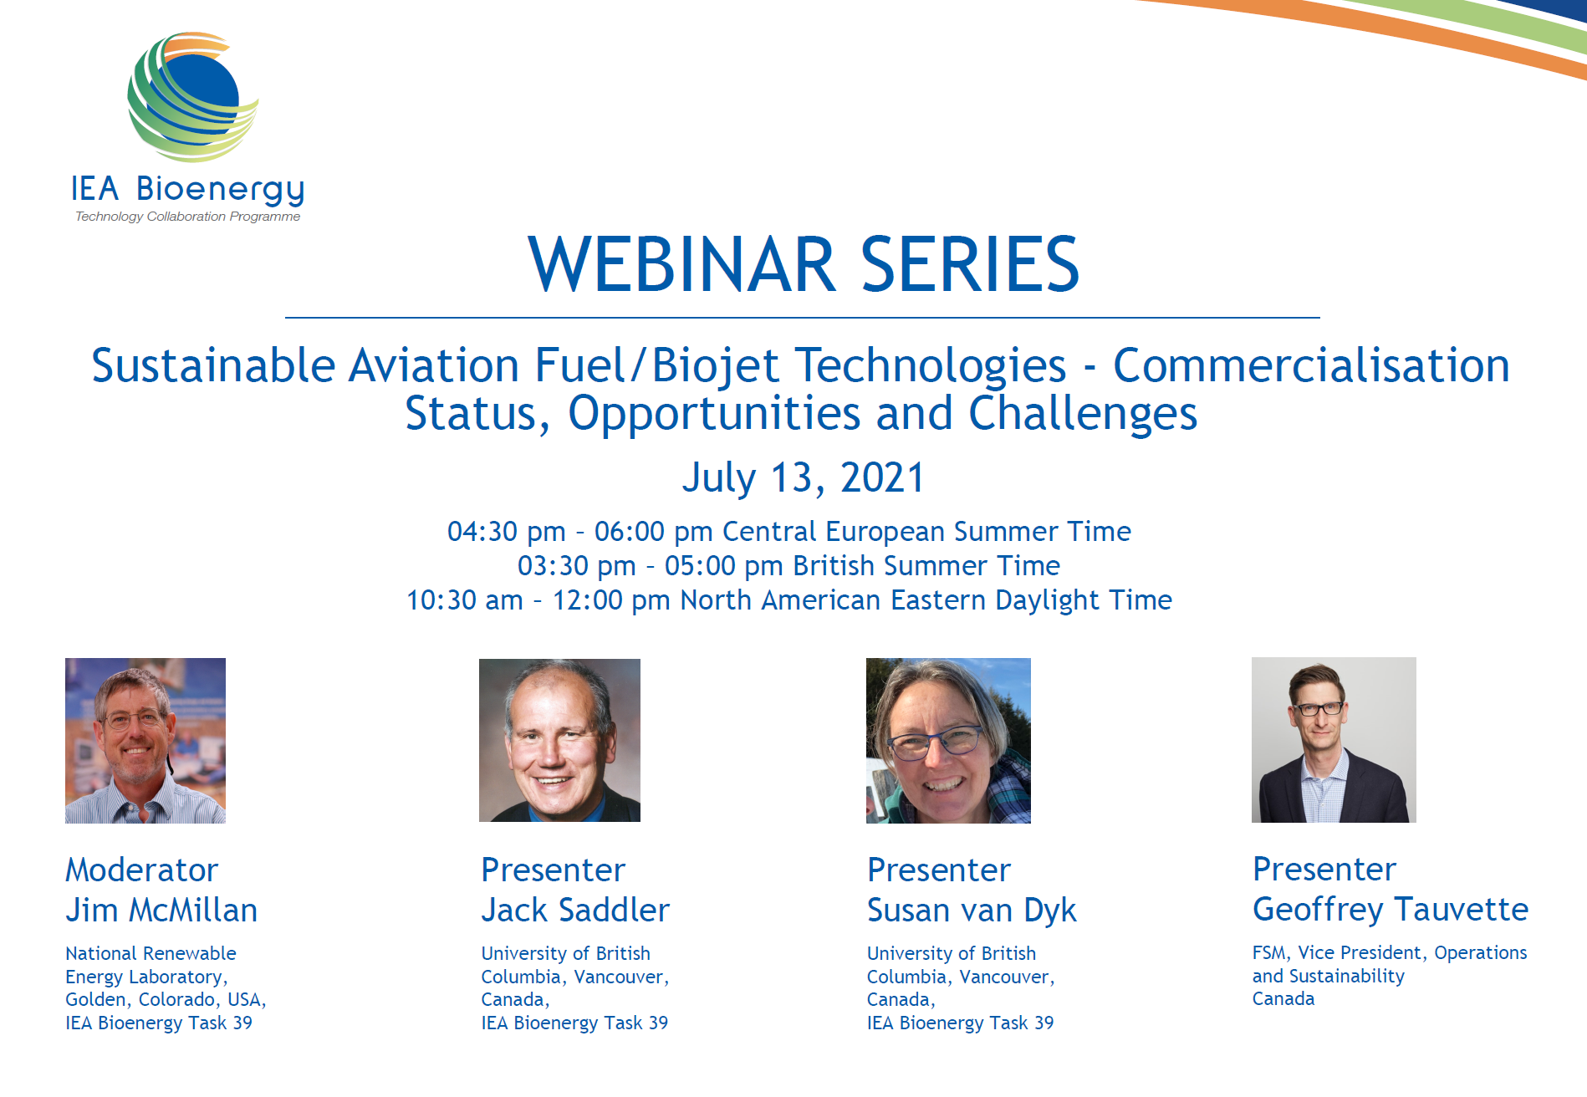
Continuation of past Task 39 Biojet/SAF work
Link to the webinar video and the presentation slides:
https://www.ieabioenergy.com/blog/publications/iea-bioenergy-webinar-sustainable-aviation-fuel-biojet-technologies-commercialisation-status-opportunities-and-challenges/

Slide 3
A range of topics will be covered in the report update
Commercialisation status of technologies, announced facilities and projected production volumes by 2030
Technical and other challenges and opportunities of technologies and an assessment of trends and targets for improvement
A deep dive into PtL through the methanol-to-jet and Fischer-Tropsch pathways
  Analysis of the impact of various CO2 and electricity sources
  Electricity requirements, potential and challenges
Developments in ASTM certification of technologies, new and pending pathways
Potential development of 100% SAF, biobased aromatics and cycloalkanes
Feedstocks
  Availability of low CI lipids (UCO, Tallow, etc.), higher CI lipids (e.g. vegetable oils), new and emerging feedstocks and commercial development
  Developments in feedstock pretreatment technologies
Techno-economics – comparison of estimated production costs for different technologies and potential cost reductions by 2030/2050
6. Global policy developments used to promote production and use of SAF
7. Brief section on carbon intensity of pathways and ICAO CORSIA – key takeaways

Slide 4
Current status, “take-home” messages, expected completion date
About 70% of the report has been completed
SAF/Biojet fuel likely to always be more expensive than fossil jet/kerosene
“Enabling” policies will be critical to commercialisation
Ongoing competition for lipids feedstocks to make bio/renewable diesel (HVO) and SAF/Biojet fuels
Expected date of completion – end of December 2023
Draft report will be sent for review in early January 2024

Slide 5
SAF production: volumes, future capacity, long-term demand
CURRENT PRODUCTION
IATA estimated that (SAF) production reached 300-450 million liters by 2022- (this is a significant increase from 2021 production of 100 million liters!).
Volume of SAF required by 2050? >400 Billion LPY
FUTURE PRODUCTION?
IATA estimates 69 BLPY of total renewable fuel production by 2028 (But SAF/biojet fraction not specified)
Probably overly optimistic as based on announcements and planned facilities with multiple challenges still present
ArgusMedia lists 142 planned SAF facilities

Slide 6
SAF Technologies – status of commercialisation
HEFA technology (hydrotreatment upgrading of fats, oils and greases) is currently the only fully commercial pathway and will be the main supplier of SAF over the next 10 years
BUT actual SAF/HEFA production will rely on shifting renewable diesel (from lipids) to SAF – will be driven by policy
Pioneer commercial scale facility for Gasification-Fischer Tropsch completed and first Alcohol-to-Jet almost completed
Lower CI jet fuel via co-processing – seven petroleum companies in Europe are already producing lower-CI jet fuel (BP, Repsol, OMV, ENI, TotalEnergies), and more to follow
Other technologies, such as Power-to-Liquids, are at lower TRL levels (ReFuelEU mandate requires 600 MLPY of e-kerosene by 2030 which will be challenging)

Slide 7
SAF-specific policies will have the greatest impact on SAF expansion
ReFuelEU agreed mandate (volumetric) – 2% by 2025, moving to 6% by 2030, 20% by 2035, 34% by 2040, and reaching 70% by 2050 PLUS a dedicated target for PtL kerosene - 1.2% by 2030, 5% by 2035, reaching 35% by 2050
Inflation Reduction Act (USA) – blenders (BTC) and producers tax credit (PTC); linked to carbon intensity reduction
  BTC - $1.25 per gallon up to $1.75 per gallon for 100% emission reduction (2 years – 2023- 2024)
  PTC - $1.25 per gallon up to $1.75 per gallon for 100% emission reduction (2 years – 2025-2027)
  SAF earns higher tax credits than renewable diesel
UK SAF mandate – 10% by 2030 PLUS proposed revenue certainty mechanism
Japan proposed a 10% SAF mandate by 2030

Slide 8

Jack Saddler
jack.saddler@ubc.ca
Susan van Dyk
svandyk100@gmail.com

