Slide 1

Project Proposal:
Update on developments in drop-in biofuel commercialization and co-processing (2022-2024 Update)
Susan van Dyk, Jianping Su, Jack Saddler
Leipzig, Germany
October 2023
Notes:
What I would like to talk about is the progress made so far in the IA report.

Slide 2
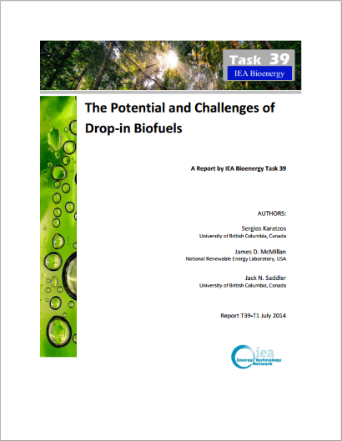
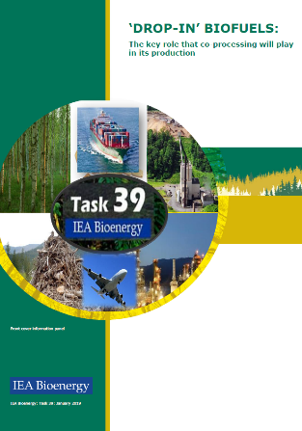
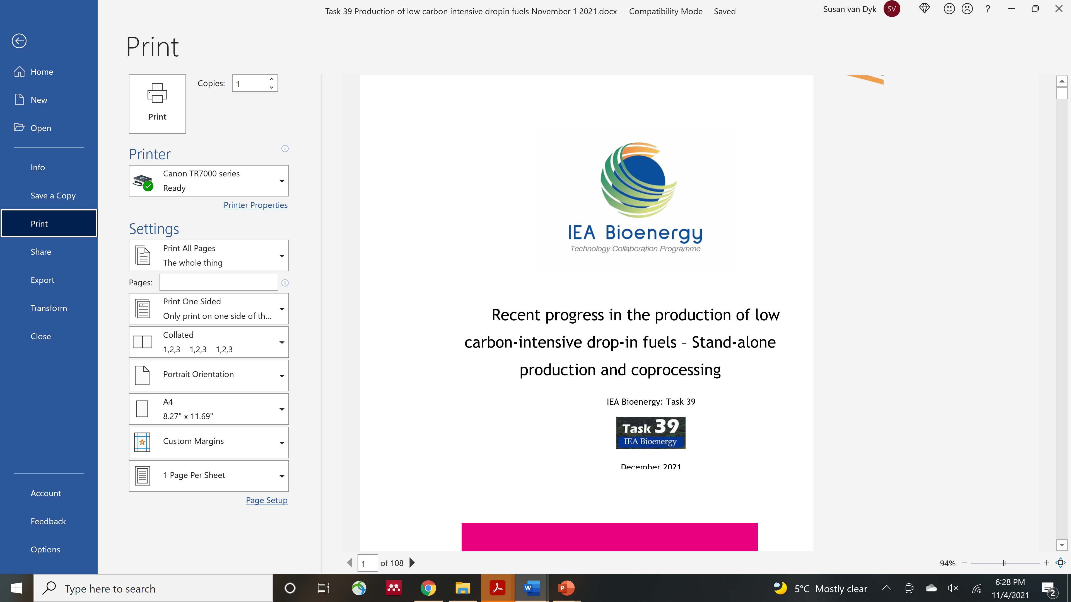
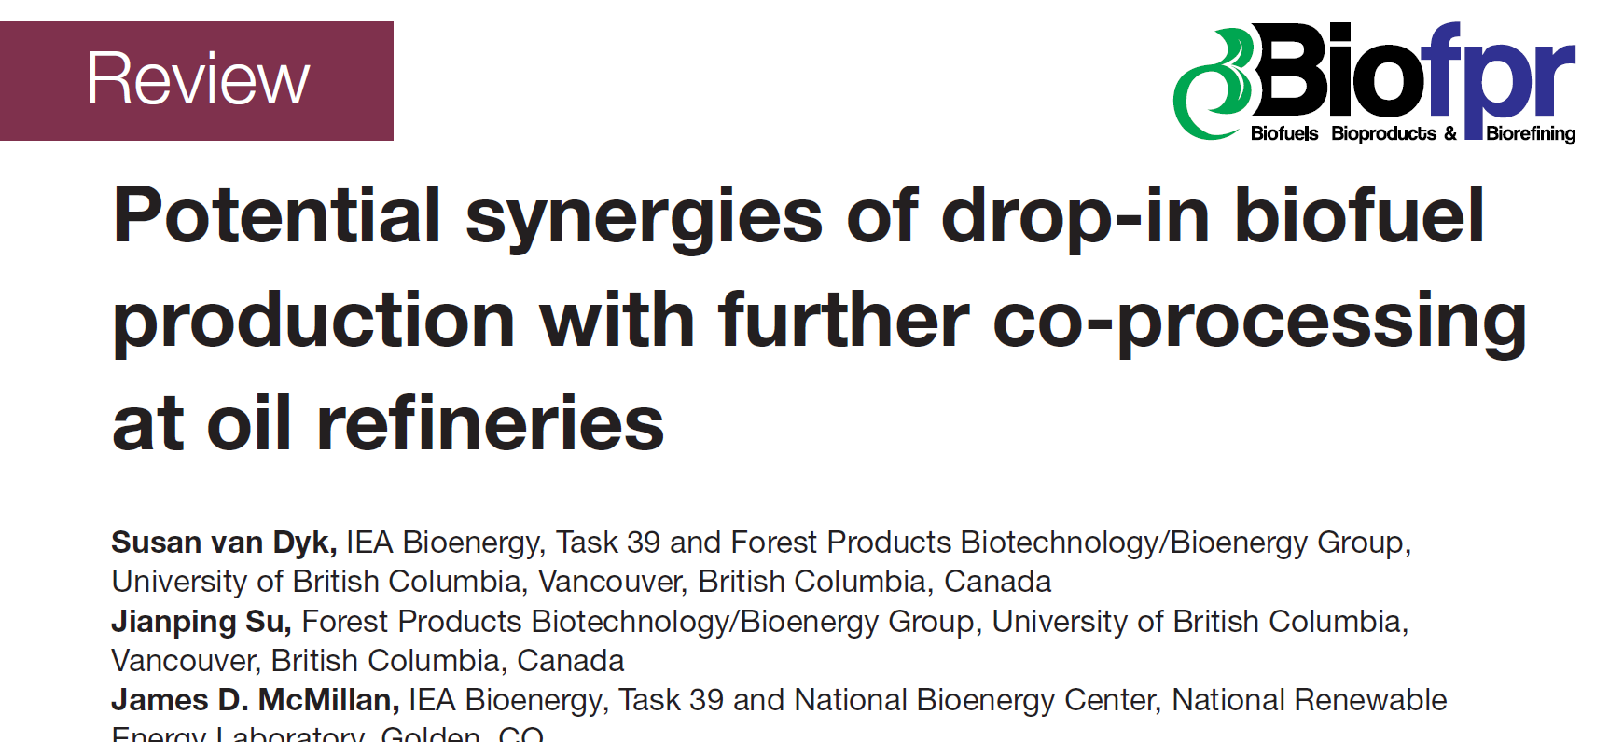
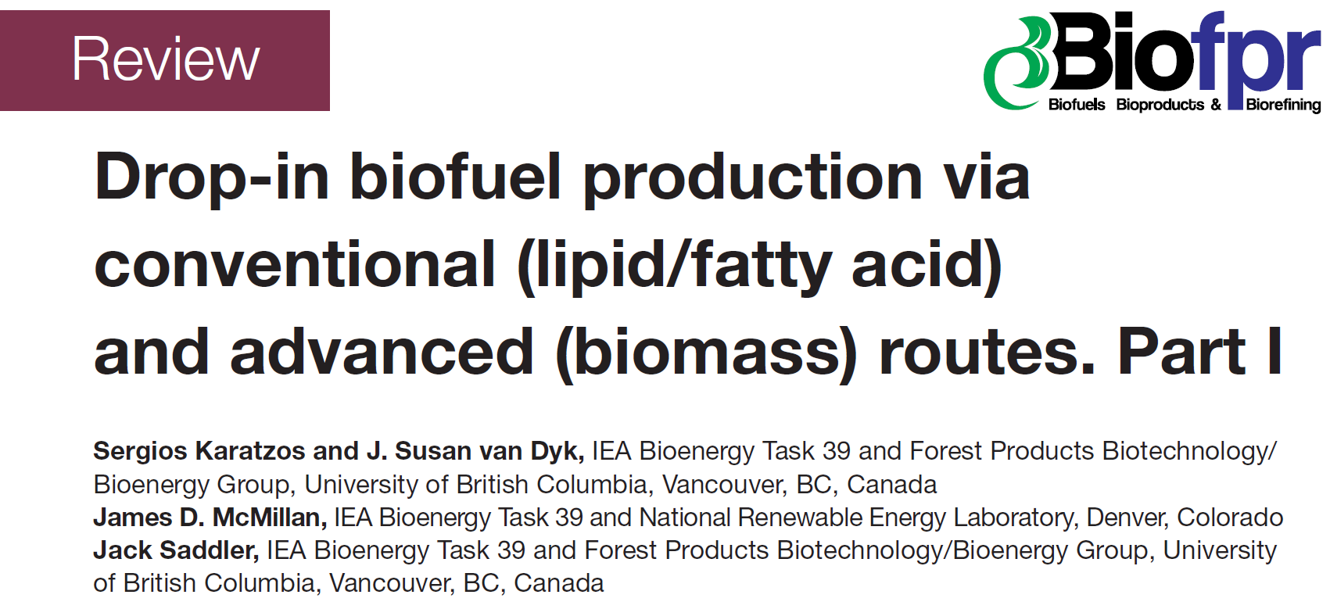
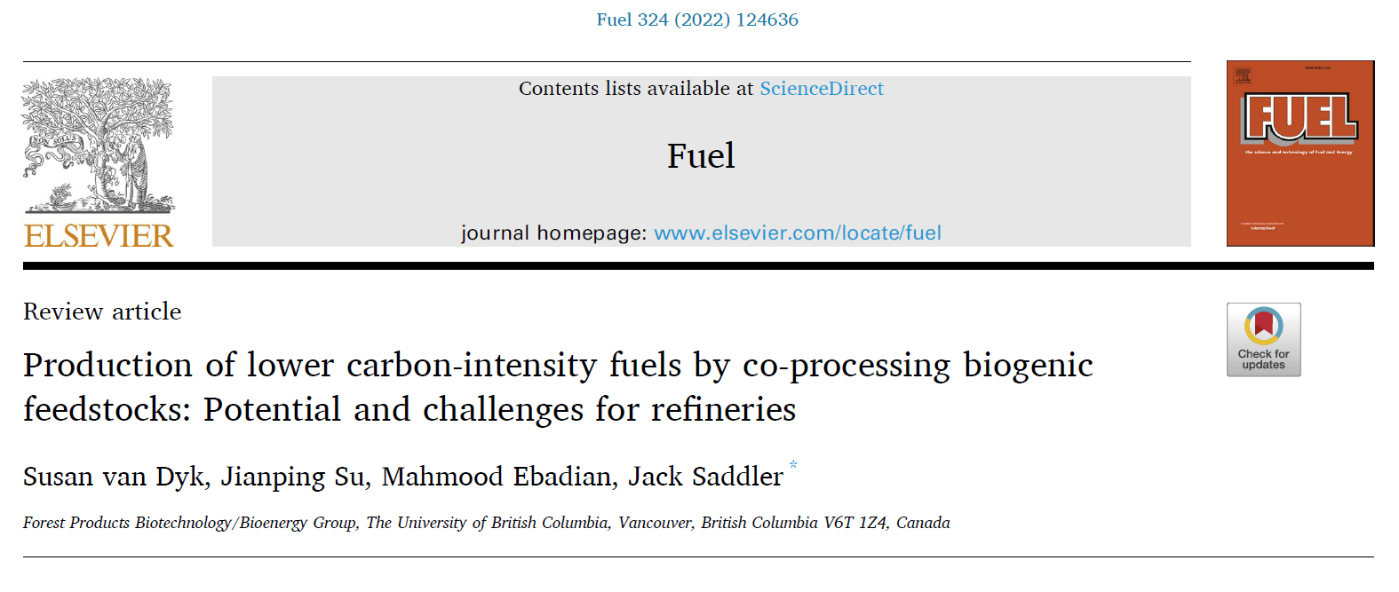
Previous drop-in biofuels reports (2014, 2019 & 2021)

Slide 3
Global and “commercialisation” status, plus expected report completion
Lots going on in this area globally (stand alone/co-processing refineries)
One of the major ways of getting oil companies involved in Task 39 work
Increased focus on how the Carbon Intensity (CI) of the final fuel is determined
Vast majority of the feedstocks are lipids (“wastes” (e.g., FOG’s/virgin oils), but with increasing attention paid to “biocrudes” (fast/catalytic pyrolysis/HTL)
Good linkages with other Task 39 activities (e.g., SAF/Biojet, LCA, etc.) and other Tasks (e.g., pyrolysis, sustainability, etc.)
About 20% of the report has been completed
Expected date of completion – end of March 2024

Slide 4
Topics that will be covered
Assess the expansion of commercial drop-in biofuel facilities and current volumes of production
  HVO technology and renewable diesel facilities
  Gasification and Fischer-Tropsch
  Thermochemical liquefaction – progress in HTL and pyrolysis
  PtL (efuels)
  Assess co-processing activities world-wide and volumes
Update on technology pathways and new emerging technologies
  TRL levels, latest developments,
  Main companies and significant technology features
  An update on the latest research for drop-in biofuel production
Notes:
Before strat taling about the prograss I would like to review the scope of theIA report

Slide 5
Topics to be covered
Co-processing
  Lipid co-processing – key developments and trends
  Biocrude co-processing
    Developments in biocrude production and volumes available
    Co-processing by Preem (tall oil and pyrolysis bio-oil)
    Update on key research areas and progress (e.g. Renewell project)
  Tracking the green molecules in co-processing and determining the carbon intensity of co-processed fuels – assess the latest developments
Techno-economic evaluation of production costs based on literature and reports
Discussion on the sustainability and carbon intensity of drop-in fuels
  Modified agricultural practices, renewable energy, green hydrogen and CCS to reduce the carbon intensity of fuels

Slide 6
Commercialisation update on drop-in biofuels
HEFA/HVO
Significant expansion of number of facilities
56 freestanding facilities announced and operational (ArgusMedia) with a total capacity of 25 billion litres per year
Availability of renewable diesel will depend on the fraction diverted to SAF and competition with biodiesel
Waste feedstocks will become limited
International Energy Agency warns that: “demand is approaching the supply limits of the most-used wastes and residues”
Total waste oils and fats estimates - (38 million tonnes total)
Used cooking oil (UCO) (avg. 12 million tonnes), animal fats (13 million tonnes) and other waste oil (13 million tonnes) collection potential from the World Economic Forum-Clean Skies for Tomorrow Coalition

Slide 7
Other technologies that should become commercial in the short-to-medium term
Gasification/FT
  Fulcrum Bioenergy completed their gasification/FT facility based on MSW feedstock and produced their first syncrude. Further upgrading will be carried out at Marathon Petroleum (coprocessing) – no updates on volumes produced
  Red Rock Biofuels – foreclosure in early 2023 (a setback)
  Many other facilities under construction, but high CAPEX and lengthy construction time
Alcohol-to-jet
  Lanzajet Freedom Pines facility - Construction will be completed in 2023 with commission and startup in 2024. Recently approved EPA pathway indicates sugarcane ethanol will be used (qualifies for D4 RINs) – 55-64% reduction in carbon intensity
  A methanol intermediate alcohol is being explored by several companies (can be produced with PtL technology

Slide 8
Technologies that should become commercial in the medium-to-longer term
Pyrolysis and HTL based drop-in fuels
  Pyrocell commercial production and upgrading at Preem through coprocessing of biocrudes in the FCC at commercial scale (but low %)
  Alder Renewables attracting significant attention but only at pilot scale
PtL developments and commercialisation status
  27 companies made announcements in this space but very little detail
  Carbon engineering (direct air capture) acquired by Occidental

Slide 9
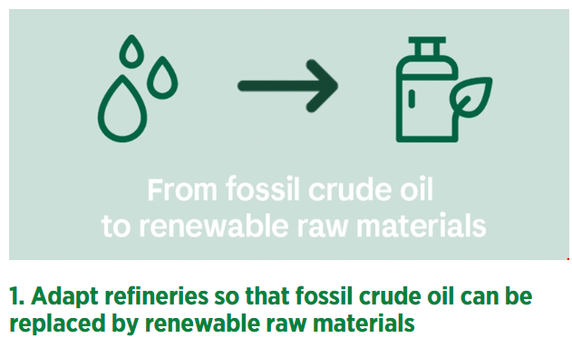
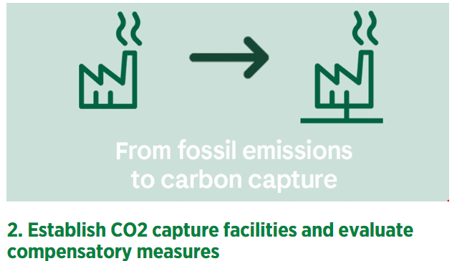
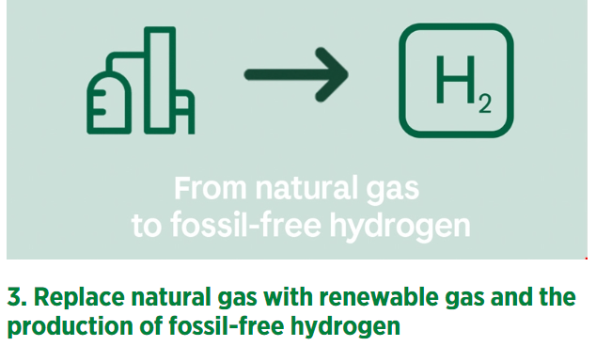
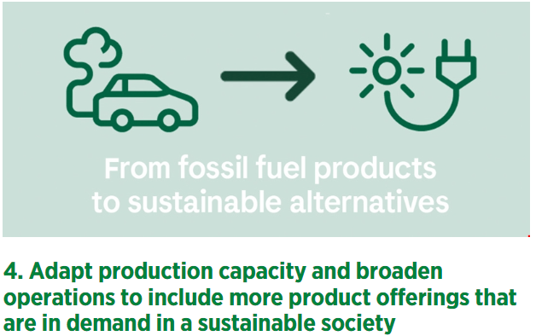
Preem’s plan to become climate-neutral by 2035
https://www.preem.com/in-english/environment/climate-target-2035/#:~:text=By%202035%20at%20the%20latest,than%20the%20previous%20climate%20target.

Slide 10

Jack Saddler
jack.saddler@ubc.ca
Susan van Dyk
svandyk100@gmail.com

