Slide 1
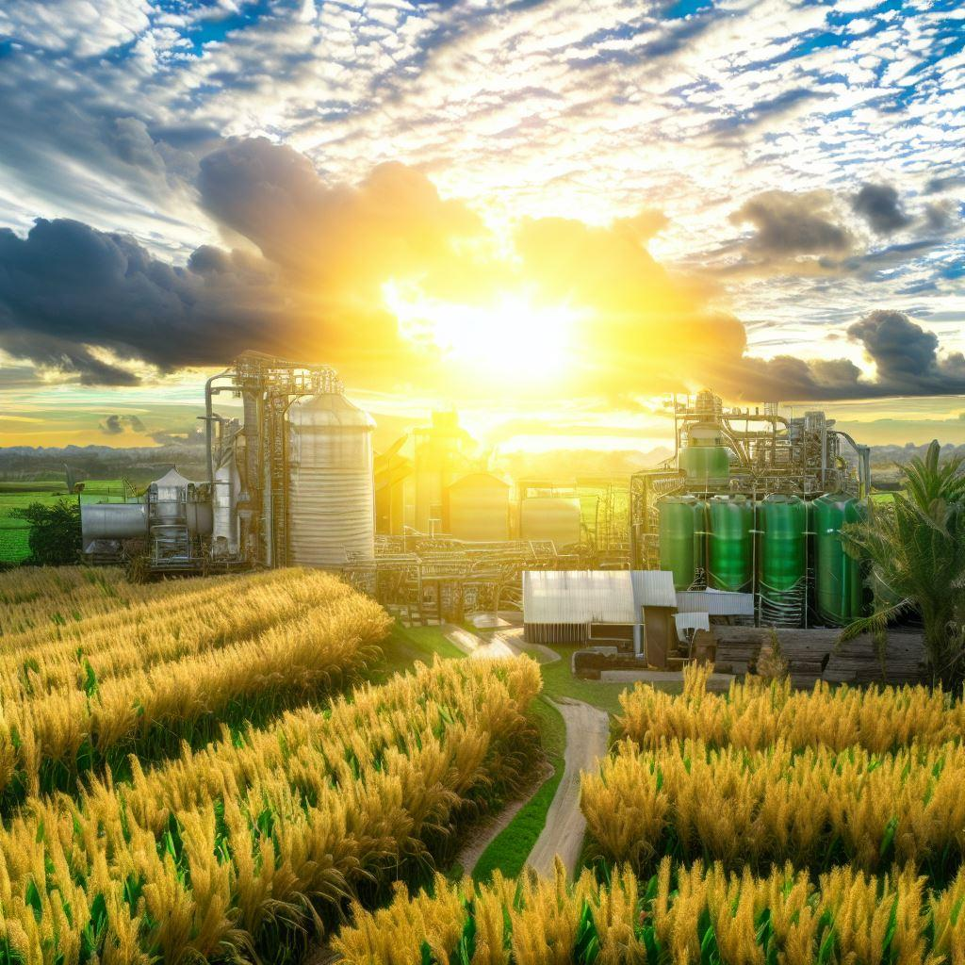
Biofuels in Emerging Markets:
Potential for sustainable production and consumption
Environmental and economic assessment of biofuels production in countries of Africa and Asia
Brazilian Team:
Glaucia Mendes Souza, Heitor Cantarella, Luis Fernando Cassinelli, Luiz Horta Nogueira, Raffaella Rossetto, and Rubens Maciel Filho
Collaborator:
Jean Felipe Leal Silva
2023
Notes:
In Task 39 we are conducting an analysis on biofuels in emerging markets...

Slide 2
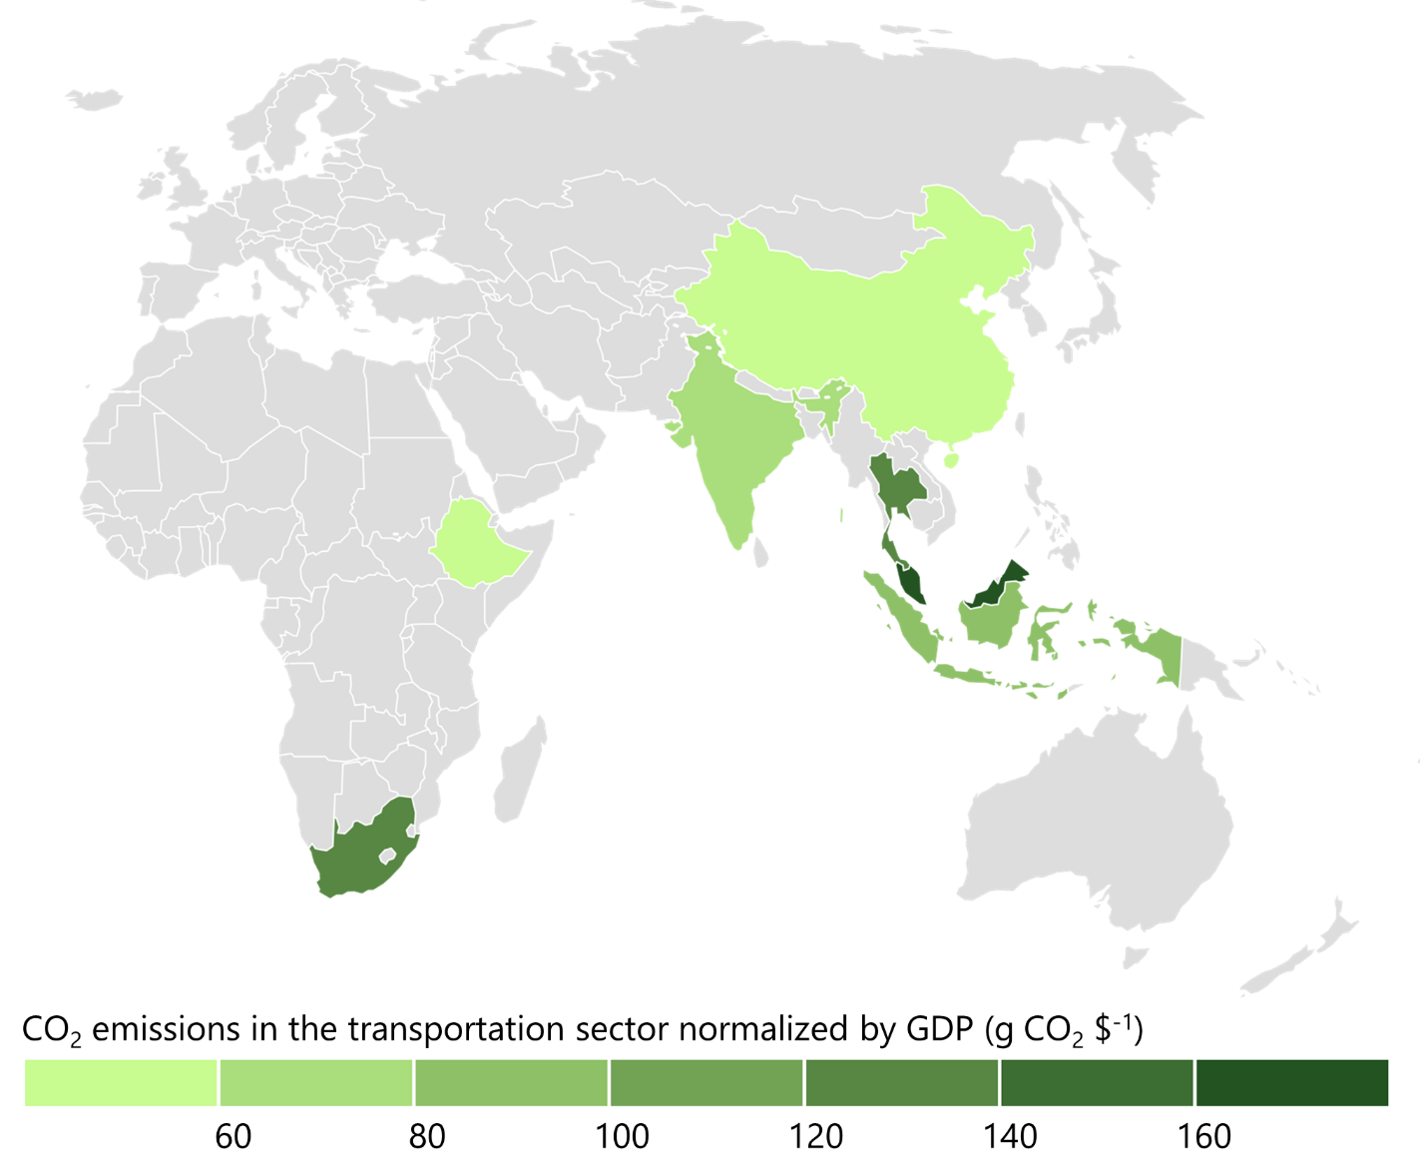
Africa and Asia
Developing countries with large populations, high energy demand, biofuels policies
China, Ethiopia, India, Indonesia, Malaysia, South Africa, Thailand
42.8% of the world’s population
22.7% of the CO₂ emissions of the transportation
If this group of seven emerging economies were to achieve the same per capita carbon intensity of the transportation sector as the OECD average, worldwide emissions of the transportation sector would more than double (+103%).
Notes:
In the second phase of this project, we are considering China, Ethiopia, India, Indonesia, Malysia, South Africa, and Thailand. These countries, together, represent 43% of the world’s population, but only 23% of the CO2 emissions of the transportation sector.
Here in this graph, we present the CO₂ emissions of the transportation sector normalized the gross domestic product (GDP) of these countries. If this group of seven emerging economies were to achieve the same per capita carbon intensity of the transportation sector as the OECD average, worldwide emissions of the transportation sector would more than double.

Slide 3
Africa and Asia — METHODOLOGY
Developing countries with large populations, high energy demand, biofuels policies
Expected results: GHG savings, required land to produce biofuels, fuel cost (blending mandate)
LCA
emissions in agricultural phase
Cradle-to-grave, attributional LCA
Inventory: based on literature data and ecoinvent 3.8
Emissions allocated among products based on energy content
Distribution: same as current fueling infrastructure
emissions in industrial phase
TEA
crop yield
emissions in distribution phase
conversion process data
feedstock cost
price of co-products
MARKET ANALYSIS:
Determine economic and environmental feasibility of replacing gasoline and diesel
market conditions
Notes:
In this study, the main tools of these analyses will be the life cycle assessment and techno-economic analysis, based on data we’ve been gathering on crop yields, conversion processes, emissions in all phases, feedstock costs, price of co-products and market conditions. Based on the results of LCA and TEA, we will conclude our study by presenting different hypothetical scenarios of blending mandates, in which we will estimate the GHG savings, the required land to produce biofuels, and the fuel cost according to blending mandate.

Slide 4
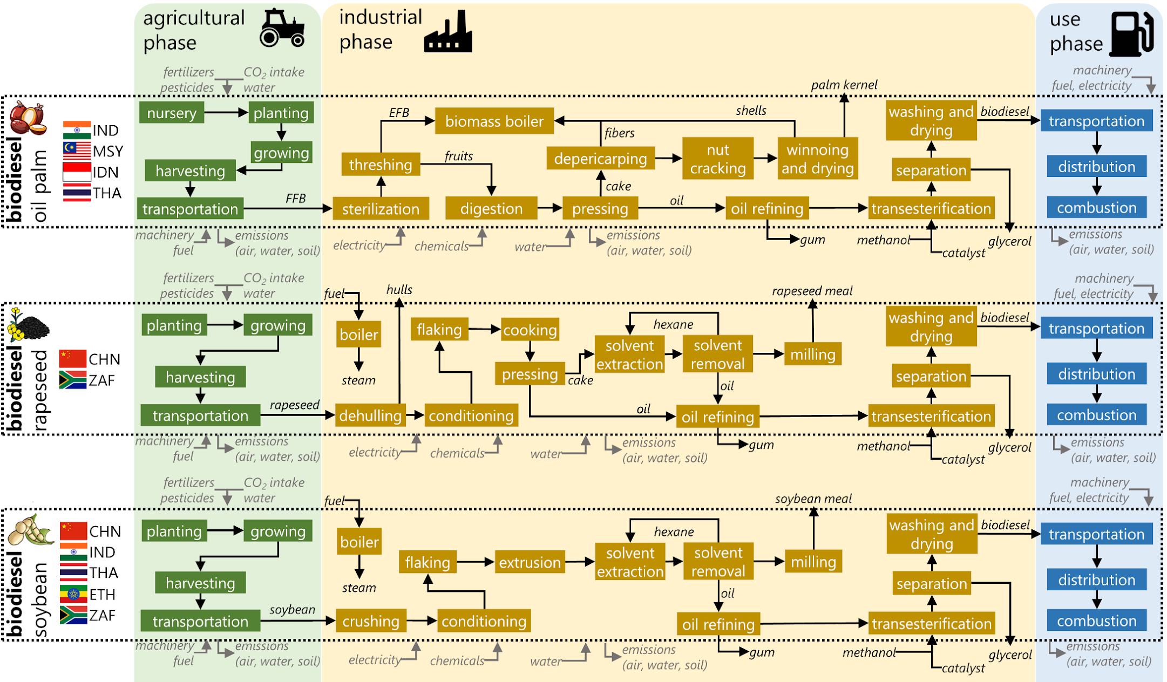
Fuel production models
Biodiesel (oil palm, rapeseed, and soybean)
continues....
Notes:
In biodiesel production, we considered the following feedstocks for these respective countries (ACTION: indicate the flags with your laser pointer, no need to read the countries). Production of these crops is either established or incentivized in these countries, based on data from Food and Agriculture Organization of the United Nations (FAO) . In our models, we included the crop yield as a variable using country-specific data from FAOSTAT. Here in this illustration, you can see all process steps that we considered, showing that our models are very comprehensive.

Slide 5

Fuel production models
Ethanol (corn and sugarcane) and fossil fuels (benchmark)
Notes:
Ethanol was assumed to be produced from corn and sugarcane in these countries (ACTION: point to the flags). However, here we have a very specific distinction for Indonesia and Malaysia. For these two countries, we decided to include ethanol imported from the US (as corn ethanol) and Brazil (as sugarcane ethanol). Next slide I explain why.
We also calculated the LCA of different fossil fuels (gasoline and diesel) in each country. We included some particularities. For example, the sulfur level of diesel, which is high in countries such as Indonesia, and the coal-based synthetic fuels of South Africa.

Slide 6
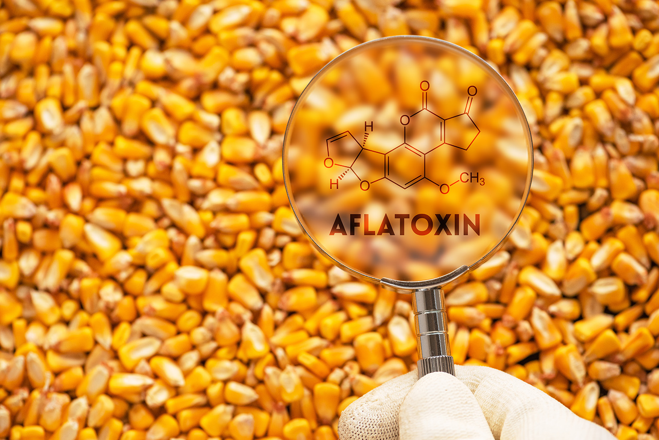
Indonesia and Malaysia with imported ethanol
Indonesia
Sugarcane ethanol production limited to molasses
Sugarcane used for sugar production to make Indonesia self-sufficient by 2028
Corn in Indonesia has aflatoxins (>20 ppb)
Distiller’s grain unsuitable as animal feed
Malaysia
The country’s production of corn and sugarcane is almost non-existent
Corn ethanol: New Orleans (US)
Sugarcane ethanol: Santos (BR)
Indonesia: Tajung Priok
Malaysia: Port Klang
Notes:
Indonesia uses sugarcane mainly for sugar production, and corn ethanol is a bit problematic in the country because of the high aflatoxins content, which renders the dried distiller’s grain unsuitable for animal feed. As for Malaysia, production of corn and sugarcane is almost non-existent in the country because of several factors. Therefore, we decided to consider that ethanol is imported instead of produced in these countries. This ended up being a good idea to test the LCA impact of overseas transport and international trade on LCA of biofuels.

Slide 7

Gasoline and Diesel in South Africa
South Africa has no significant production, but it has abundant, inexpensive coal reserves 🡺 coal gasification and Fischer-Tropsch Process
coal, air and steam
CO₂
Big source of CO₂ emissions!
Coal gasification
Fischer-Tropsch synthesis
Product recovery
Hydrocracking
synthetic diesel and gasoline
Reaction produces about 6 kg of CO₂ per kg of synthetic fuel
Additional energy requirements increases this to 7-12 kg of CO₂ per kg of synthetic fuel!
Notes:
In South Africa, almost half of their gasoline and diesel comes from coal, which is inexpensive in the country. In this process, (ACTION: POINT TO THE FIRST GREEN BLOCK AND THEN THE CHEMICAL REACTION) coal is used to produce hydrogen and carbon monoxide, which are reacted to produce synthetic diesel and gasoline. The reaction itself produces about 6 kg CO2 per kg of hydrocarbons, and this carbon footprint increases to 7 to 12 when considering the energy demand of the process. Right here, we can ask ourselves: is it worth all this environmental damage? Why can’t we replace coal with biomass?

Slide 8
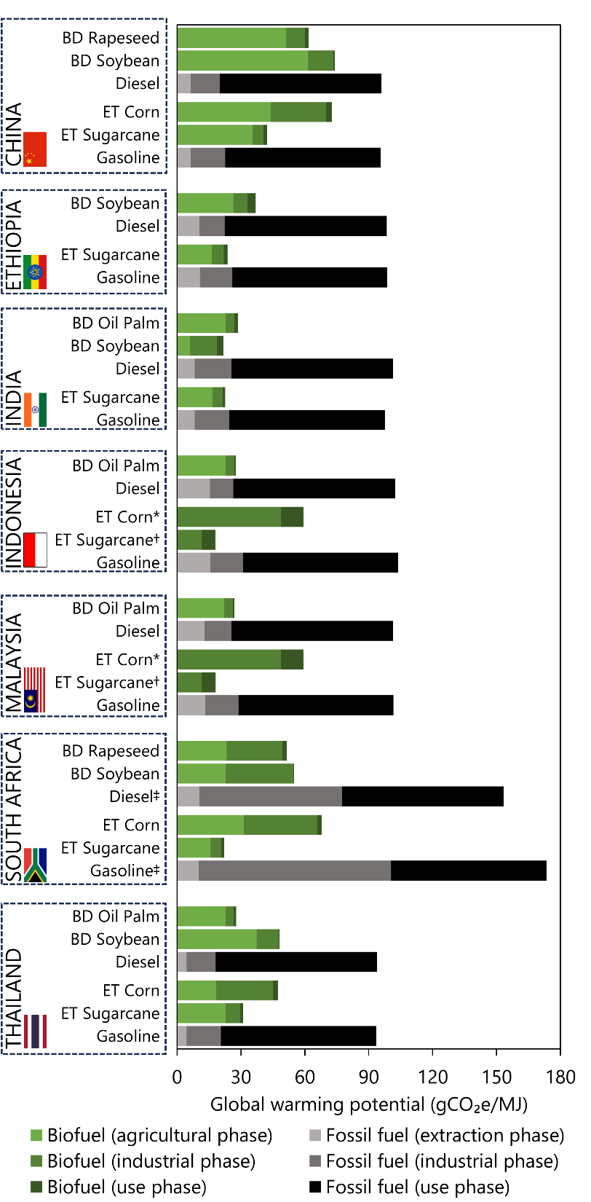
Life cycle assessment
Global warming potential
Biofuels always presented lower global warming potential than their fossil counterparts
The advatange is not as big when fossil fuels are part of the production process:
  Coal-based ammonia used in the production of N fertilizer
  Coal or natural gas used as energy sources in the conversion process
Other categories were assessed as well: fossil resource scarcity, human toxicity, and terrestrial acidification
Notes:
The first result that I’m gonna show you is the global warming potential of biofuels compared to the global warming potential of fossil fuels. (ACTION: show graph) In this graph, we have results grouped by country and, for each country, first you have results for biofuel, in shades of green, followed by the result for fossil fuell in shades of black and gray.
Clearly, biofuels have a lower global warming potential than fossil fuels in all scenarios, especially in biofuels produced in industries that are self-sufficient in terms of energy, such as sugarcane ethanol that uses bagasse as boiler fuel and palm oil biodiesel that uses empty fruit bunches.
We also see that some biofuel pathways do not have the same great reduction, especially in processes located in China and South Africa. In the case of China, besides the impact of using fossil fuels in the industrial phase of corn ethanol, the agricultural phase had a large impact because of the emissions related to coal-based ammonia, used to produce nitrogen fertilizers. In the case of South Africa, coal is used in the industrial phase of some pathways. However, the carbon footprint is still less than the results for gasoline and diesel in South Africa.
Other categories were assessed as well. If you need more details, you can check with our collaborator Jean Felipe – I can give his e-mail so you can contact him.

Slide 9
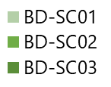
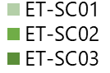
Land Use Analysis
Low land use requirement compared to total country area
Blending scenario
Land use requirement
demand for land
BIODIESEL
demand for land
ETHANOL
Notes:
We calculated the required land to produce the volume of biofuels to reach the blending mandate of each hypothetical scenario. We noticed that the demand for land area in each country is in general rather low when compared to the country’s total land area, but if you consider only the land area that is currently used for meadows and pastures, Malaysia resulted in a very strange result because only 1% of the country’s land area is composed of meadows and pastures. Just for the sake of comparison, meadows and pastures in the European Union and the US occupy 17% and 27% of total land area, respectively. Forest cover in Malaysia is 58%, against 40% in the European Union and 34% in the US. Therefore, expanding biofuel production in these countries with high forest cover will demand the use of high yield crops to reduce land demand.

Slide 10

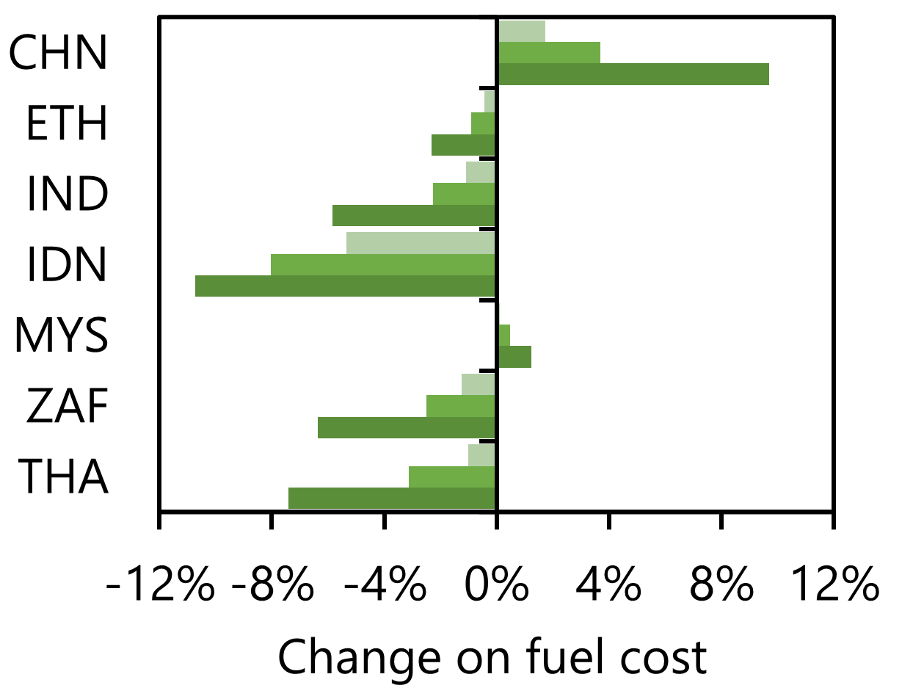
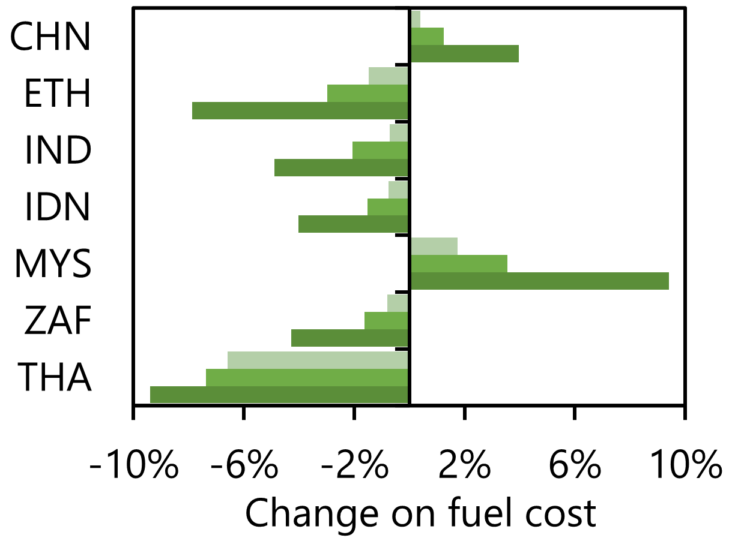
Market analysis
Impact of fuel cost (energy basis) will be minimal
Biofuel is more expensive when feedstock is expensive or subsides are in effect (Malaysia: ~$0.50/L of subsides on gasoline, $0.36/L import tax on ethanol)
Potential GHG savings of scenarios 3
158 million tonnes of CO₂e in the heavy-duty transport sector
105 million tonnes of CO₂e in the light-duty transport sector
Notes:
Finally, the market analysis of hypothetical biofuel blends demonstrated that you can generally reduce the overall cost on an energy basis when using biofuels. The exceptions were China, where biofuel feedstock is costly, and Malaysia, where fossil diesel is subsidized, about $0.50/L for gasoline in 2021, and ethanol import tax was about $0.36/L.
We also calculated the GHG savings. Considering the seven countries, and scenario 3 would provide 158 million tonnes of CO2e savings only in the heavy-duty sector and 105 million in the light-duty sector.

Slide 11







Conclusions
Sugarcane ethanol and palm oil biodiesel have a strong potential
  Industrial phase is self-sufficient in terms of energy – no fossil fuels
  High crop productivity
Biofuel pathways with low performance
  … use coal-based ammonia to produce N fertilizers
  … use coal or other fossil fuel as energy source in the industrial phase
  … are based on costly feedstocks
International trade of biofuel has low impact on the carbon footprint of biofuels and does not compromise local land use
Blending mandates with the adequate biofuels
  Reduce the cost of fueling up to 10% in studied countries (energy basis)
  GHG savings of up to 158 MtCO₂e from diesel and 105 MtCO₂e from gasoline in scenario 3 of blending mandates
  Land requirement is rather low compared to total country area
  Diversification of energy mix ➔ security of supply
THA
ETH
IND
ZAF
CHN
ZAF
IDN
MSY

Slide 12
Recomendations
Supporting exchange of information about best management practices of bioenergy crops to reduce environmental impact and increase productivity of biofuels
  eg. Sugarcane management: Brazil
  ➔ Ethiopia, India, South Africa and Thailand
Replace coal-derived products and coal as energy supply in biofuel production to further reduce the carbon footprint of biofuels
  Support the development of green or blue ammonia processes to reduce the carbon footprint of nitrogen fertilizers
  We need to move fast from fossil fuels, and there is a huge opportunity in replacing coal-based fuels with biofuels in South Africa
International trade of biofuels is being overlooked
  Overseas transport has a small contribution to cost and total emissions of biofuels
  BR and US have plenty of land availability and every liter of fossil fuel replaced by biofuel is important.
THA
ETH
IND
ZAF
CHN
ZAF
ZAF
IDN
MSY
CHN

Slide 13
Thank you for your attention!
Glaucia Mendes Souza
✉ glmsouza@iq.usp.br

