Slide 1
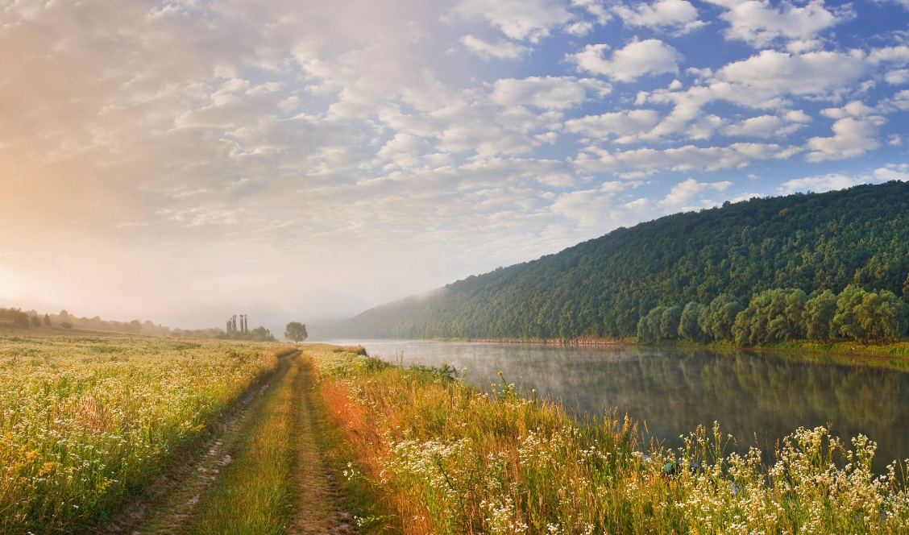
Country Report - Ireland
Task 39
Tom Walsh, NTL, Ireland
David Bauner, NTL, Ireland
Lepzig, Germany October 2023

Slide 2
RTFO Policy
RTFO set at 17% by energy as of January 2023
ABO set at 0.3% for 2023 – target to be increased annually from feedstocks listed in Annex IX Part A (EU RED)
NORA implementing agency - https://www.nora.ie/rtfo

Slide 3
Biomethane Strategy under Formulation
176 prospective producer responses received
in volume terms, responses total to 14.8 TWh annual production
Median plant production capacity is 40 GWh per annum
Median distance from producers to the gas network is 5km
Emissions reductions from 14.8 TWh of biomethane of 3.94 Mt CO2 eq per annum by 2030
Gas Networks Ireland Biomethane Energy Report https://www.gasnetworks.ie/business/renewable-gas/biomethane/report/

Slide 4
DHL 80 M Euro Biomethane Investment
DHL commits to a 10-year deal with Stream BioEnergy in its biomethane production facility – enabling the creation of 130 jobs and supporting an annual carbon reduction of 15,000 tonnes
Fleet of 150 trucks
https://www.dhl.com/global-en/home/press/press-archive/2023/dhl-supply-chain-to-drive-biomethane-use-in-its-irish-transport-network-with-80-million-euro-investment-in-production.html

Slide 5
Thank you!
Tom Walsh
tom.walsh@renetech.net

