Slide 1

Database on facilities for the production of advanced liquid and gaseous biofuels for transport
Joint Meeting IEA AMF ExCO 66 and IEA Bioenergy Task 39
Andrea Sonnleitner, BEST - Bioenergy and Sustainable Technologies GmbH
26.10.2023, Leipzig, Germany

Slide 2
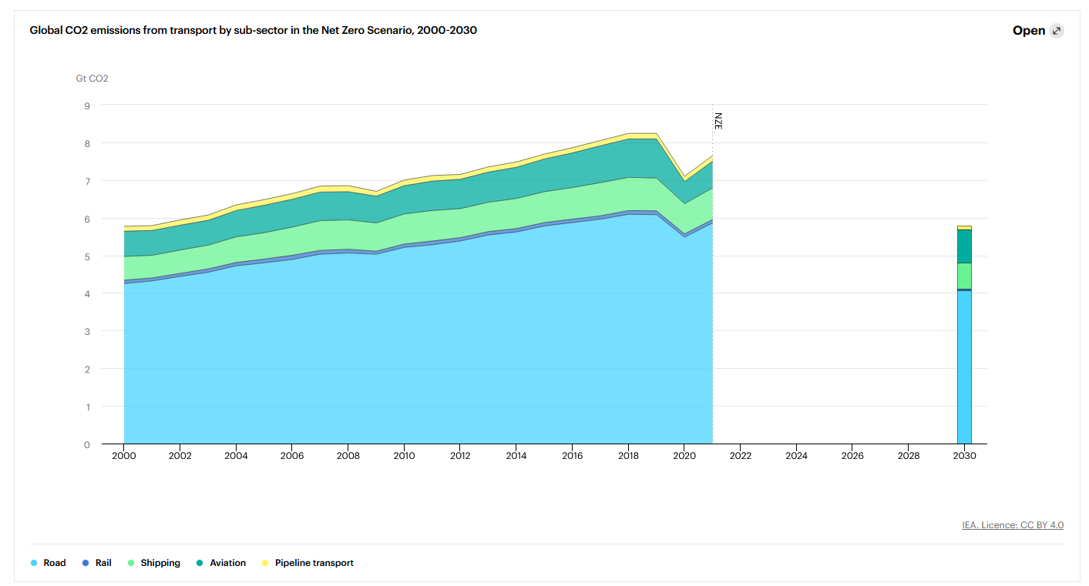
CO₂ emissions in the transport sector
https://www.iea.org/data-and-statistics/charts/global-co2-emissions-from-transport-by-sub-sector-in-the-net-zero-scenario-2000-2030

Slide 3
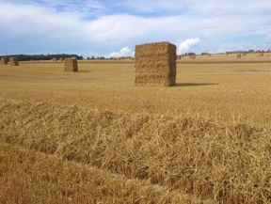
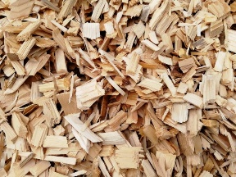
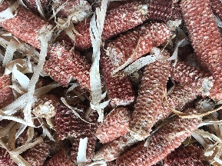
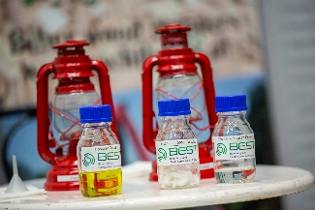
Defossilisation of transport sector
Biofuels
Renewable Fuels of Non-biological origin
Conventional
Advanced
Hydrogen
E-Fuels
Renewable Electricity
Advanced Biofuels:
Definition: fuels produced from following feedstocks¹:
Biomass residues from forestry and agriculture, animal manure, sewage sludge, algae, biowaste derived materials, …
¹ Renewable Energy Directive (RED II) 2018/2001 Annex IX Part A

Slide 4
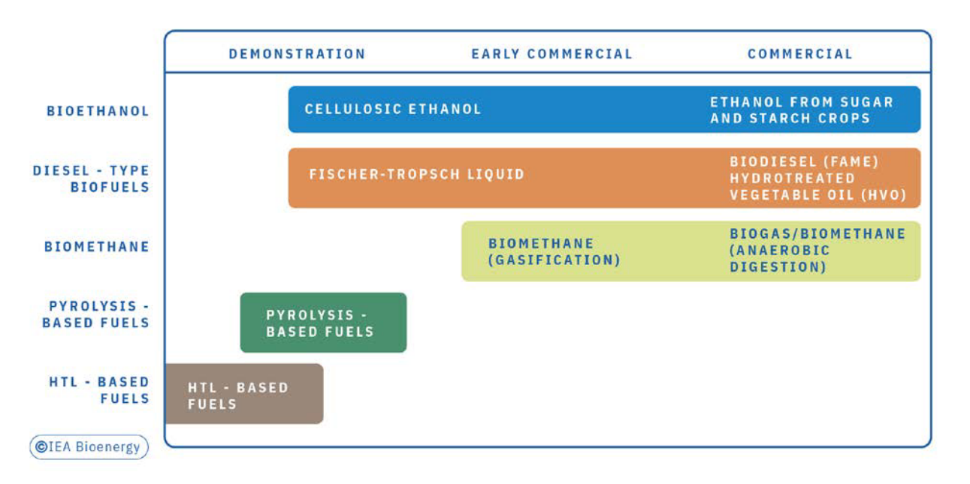
Production routes and Technology Readiness Levels for advanced biofuels
Biochemical – thermochemical - oleochemical

Slide 5
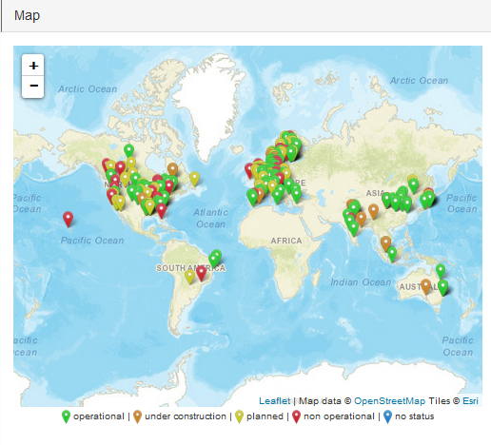
IEA Bioenergy Task 39 – Demoplants Database
Database on facilities for the production of advanced liquid and gaseous biofuels for transport
https://demoplants.best-research.eu/
~250 active entries
Main technologies: Fermentation, Hydrotreatment, Gasification, Fast pyrolysis

Slide 6
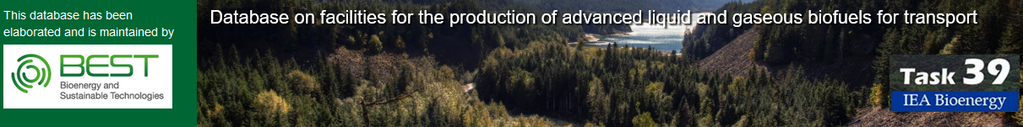
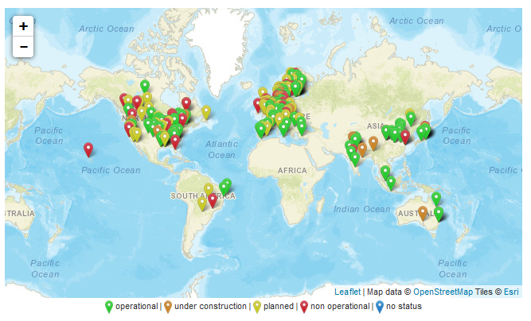
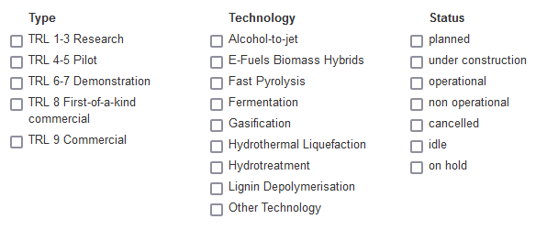
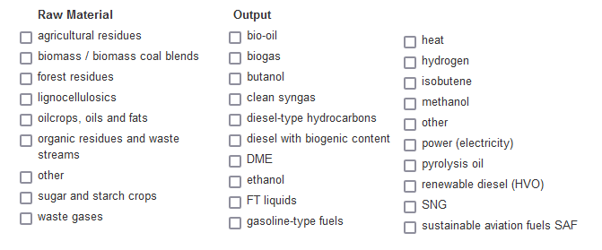
https://demoplants.best-research.eu/

Slide 7


Database: SAF Production facilities
50 plants with (planned) SAF capacity, < 20 operational
Hydrotreatment plants:
  BP (Spain)
  Eni (Italy)
  Neste (Finland, Netherlands, Singapore)
  Pertamina (Indonesia)
  Preem (Sweden)
  Repsol (Spain)
  Total (France)
  World Energy (USA)
Operational ATJ plant:
  Gevo (USA)
Operational e-fuels plant:
  Haru Oni (Chile)
Notes:
Companies written in bold letters are already producing SAF
SAF production will be mainly located in North America, Europe and South America.

Slide 8

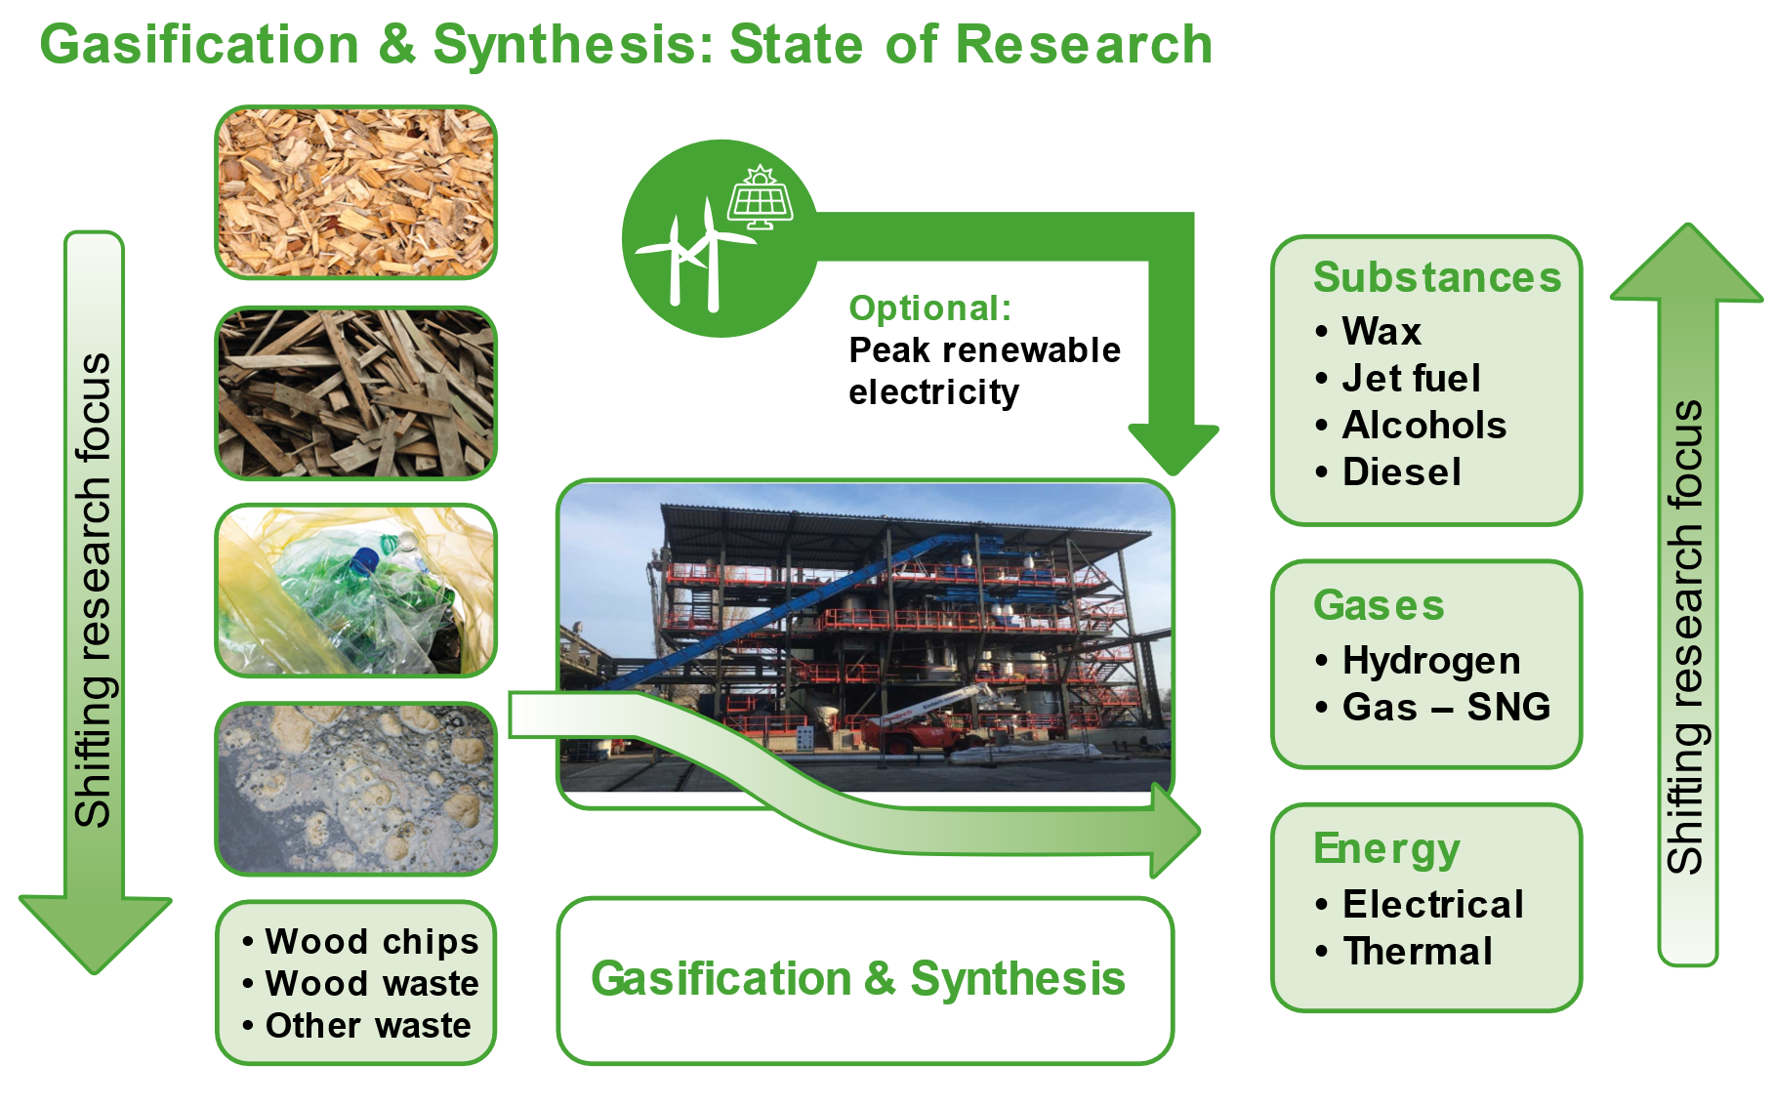
Example Gasification: Syngas Platform Vienna
1 MW gasification unit with
FT-synthesis pilot
Variety of feedstock and residues
Variety of possible products
Notes:
Evt. bogen – oil based feedstock wird limitiert sein in Zukunft – lignocellolose feedstock interessant wie z.b Syngas platform, pyrolyse, fermentation

Slide 9


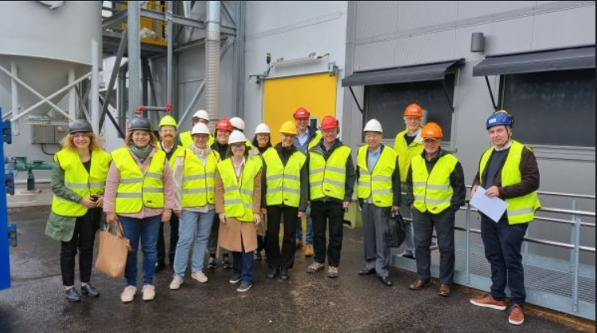
Example Pyrolysis: Pyrocell plant
Starting operation 2021
Setra and Preem
BTG-BTL pyrolysis technology
Saw-dust from nearby sawmill
Production capacity:
25,000 t pyrolysis oil
Site visit at the last physical IEA Bioenergy Task 39 Business Meeting

Slide 10
Recent developments
Diversification and combination of technologies (including E-Fuels, Hybrid Systems, Co-processing, …)
Utilization of waste streams and waste streams from non-biologic origin for advanced fuels production
Rising number of Hydrotreated Vegetable Oil HVO and Sustainable Aviation Fuels SAF facilities and many in planning phase
Decarbonization targets demand large amounts of biofuel and volumes and production capacity needs to be increased
The commercialization progresses for some technologies f.e. Hydrotreatment – but generally slow commerzialization progress?

Slide 11

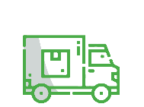

Challenges and implementation barriers
High production costs of fuel
Financial risks of demonstration and First-of-its-kind facility
Uncertainty of regulatory framework and policies
Availability and sustainability of Feedstock
Competition with electrification and other technologies or fuels
Opportunity:
Defossilisation of long-distance transport sectors
Aviation and shipping sector:
  each 2-3 % of global CO₂ emissions
  Less than 1 % sustainable fuels used
Dependance on liquid fuels with high energy density
lengthy replacement of the existing fleet – drop in

Slide 12

Outlook for demonstration of advanced biofuels production
Advantages of biobased fuels:
  Variety of technologies and utilization of different feedstock/residues possible
  Utilization in existing fleets and infrastructure – drop-in fuels
  Liquid energy-dense fuel for long-distance transport
Drive commercialization forward – need of:
  Demonstration and scale-up
  Reduction of costs and financial risks
  Long-term policies and comprehensive strategy
Promising opportunities:
  Focus on long distance transport –
  → Defossilisation in aviation, maritime and heavy-duty sector
Notes:
Chancen von Biotreibstoffen
Vielfalt an Technologien und Nutzung untersch. Rohstoffe/Reststoffe möglich
Nutzung bestehender Flotten und Infrastruktur, Drop-in Fuels
Flüssiger energiedichter Treibstoff für den Langstreckenverkehr
→ Defossilisierung im Flugverkehr, der Schifffahrt, im Schwerlasttransport
Herausforderungen müssen überwunden werden
Meisten sind nicht technologisch – politische, administrative und wirtschaftliche Barrieren
Kommerzialisierung muss vorangetrieben werden

Slide 13
Thank you!
Feedback and new information is welcome!
Andrea Sonnleitner
andrea.sonnleitner@best-research.eu
https://demoplants.best-research.eu

