Slide 1
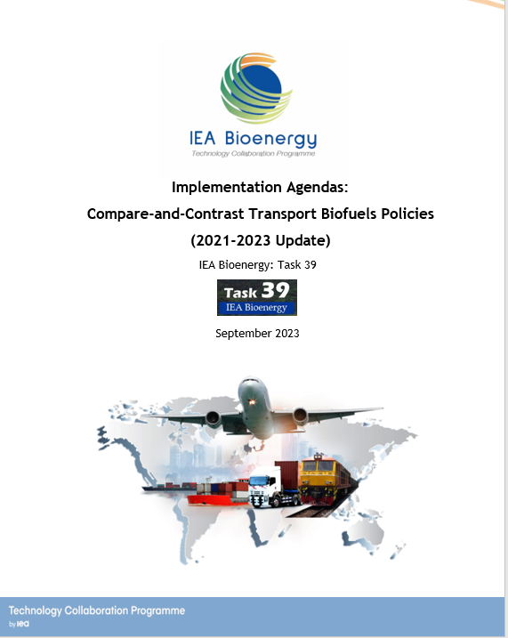

Implementation Agendas
“Compare-and-Contrast Transport Biofuels Policies”
(2021-2023 Update)
Hana Mohammadi & Jack Saddler

Slide 2
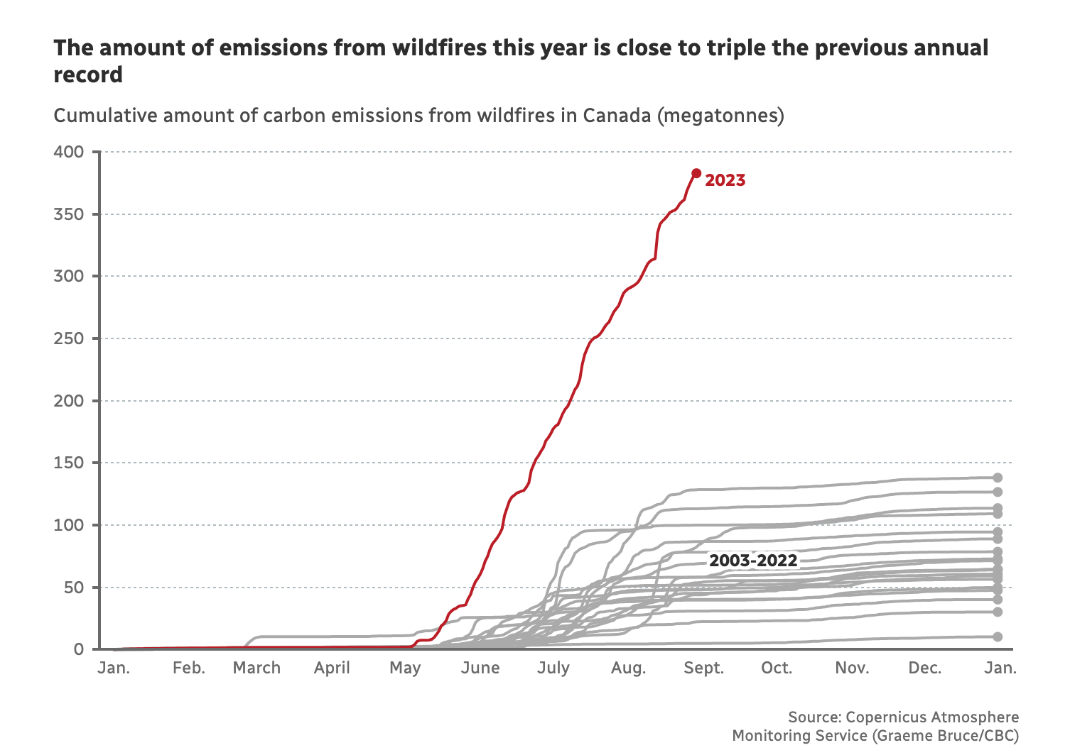



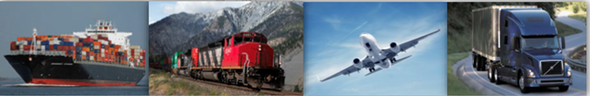
This is 2-3 times more than the annual Carbon Emissions of the whole Canadian economy!! (https://www.cbc.ca/newsinteractives/features/canadian-wildfires-boreal-forest-tipping-point?cmp=newsletter_CBC%20News%20Morning%20Brief_9747_1258278)

Slide 3
Acknowledgements
Thanks to all IEA Bioenergy Task 39 members (country representatives) for their invaluable contributions in providing updated questionnaire!
Are there any suggestions on how the template/questionnaire might be improved?
Thanks to Hana for continuing/evolving the good work of Mahmood!
Consensus that the “right” Policies are needed
Increasing focus on the Carbon Intensity (CI) of biofuels and its tie to Policies.
The international nature of Task 39 predisposes it to continue its work in this compare-and-contrast area

Slide 4
Take-home messages
Task 39 countries have used market-pull and technology-push policies to promote biofuels. Policies have included targets, incentives and blending mandates, all of which have driven the growth of biofuels.
Many Task 39 countries have a goal of achieving carbon neutrality in transport by 2050 (including short-term GHG reduction goals). The ICAO and the IMO have established international carbon reduction goals for airlines/shipping
Policies such as the US IRA and EU’s Fit-for-55 package have a goal of reducing the price gaps between fossil and low-CI fuels. The US, in particular, is an attractive location for biofuel investments due to its supportive policies.
Long-distance and hard-to-electrify transport sectors will need low-carbon, drop-in biofuels. Although volumetric blending/energy mandates have been successful in promoting biofuels, policies are shifting towards carbon intensity reduction policies (e.g., Technology-agnostic LCFS policies).
LCA models used for CI measurement of biofuels are challenging and complex due to multiple influencing factors. (E.g., ILUC, assumptions, boundaries, allocation methodology, etc.)

Slide 5



Climate Change Emergency!
Many of the changes that scientists thought would occur later this century are already here!
Extreme Weather Events Are Increasing in Frequency and Intensity
  Intense rainfall events
  Wildfires
  Hurricanes, heatwaves, droughts, etc.
Canada forest fires, August 2023
This year, heat records have been smashed, and global ocean surface temperatures are at the top of their projected range (NASA 2023).
China floods, August 2023
US floods, July 2023

Slide 6
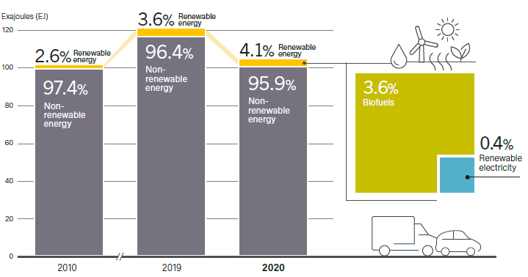
Transport Sector Energy profile in 2021
Transport consumed 113 exajoules (EJ) of energy which is 1/3 of global demand.
  Road transport (78%)
  Marine (11%)
  Aviation (8%)
  Rail (3%)
Transport Sector Decarbonization Strategies
Transport emitted 7.7 Gt CO2 in 2021 (20% of total).
Road transport led with 77% of emissions (5.9 Gt CO2).
Although “green” electricity will increase, Biofuels contribute 9 times more to decarbonizing roads
Long-distance and heavy-duty transportation will be hard-to-(green) electrify, with low-CI, drop-in biofuels will play a major role in decarbonising aviation, shipping, rail and trucking.
Active exploration by aviation and shipping companies to meet carbon reduction goals (ICAO, IMO).
Global commitment to carbon neutrality by 2050 in many countries, emphasis on transport
(REN21, 2023)

Slide 7
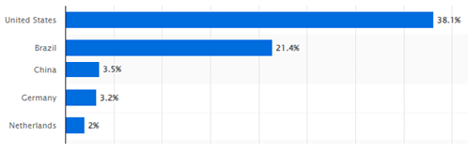
Global growth in biofuels
In 2022, the global biofuel production was estimated at 144 BL
  (114 BL of ethanol, 45 BL of biodiesel, 12 BL of renewable diesel)
Leading Biofuel Producers: US (38%), Brazil(21%) and China (3.5%)
The EU represents approximately 7% of the global biofuel market, primarily in the form of first-generation biodiesel
  (20 BL of biofuels in 2020).
China is one of the largest fuel ethanol producers
  (3.8 BL in 2022)
Canada has experienced moderate biofuels growth, with a focus on biodiesel production.

Slide 8
Key features of the biofuel policies used by T39 countries
Policy plays a critical role in decarbonizing transportation. Task 39 countries have successfully promoted transport biofuels through Market-pull (e.g., Volumetric blending/LCFS) policies and Technology-push (R,D&D) policies (targets, incentives, mandates).
Tax incentives to promote biofuels and low-carbon fuels in energy and transportation sectors (US, Brazil, Canada, Japan, China, Germany, Austria, the Netherlands, and New Zealand).
Fundings and grant incentives to support research, innovation, and infrastructure development in clean energy technologies and sustainable fuels are implemented in most of the member countries.
Sustainability by addressing environmental, economic, and social aspects, with measures like feedstock exclusions, biodiversity preservation, and balanced food-vs-fuels strategies, double counting and sub-targets for advanced biofuels.
US's IRA and EU's Fit-for-55 package have played a significant role in promoting low-CI fuels, stacking the incentives to help narrow the price gap between fossil fuels and low-CI alternatives (tax credits for biojet/SAF, clean fuel production, and clean hydrogen).

Slide 9
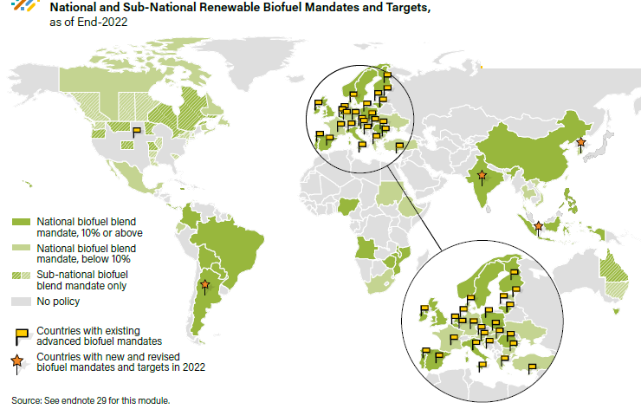
Biofuel blending mandates
Brazil increased blending mandates to E27 and B12.
Canada federal and provincial blending mandates (B2 to B5 and E5 to E15).
Belgium has 8.5% energy-based biofuels blending mandate.
China has promoted E10, trials B2 and B5.
Japan E3 and E10 for ETBE and B5 for cars, buses, trucks.
EU: The member states have a choice of:
  Meeting a binding target of a 14.5% reduction in GHG intensity by using renewables
  or, having 29% of renewables within the final transportation related energy sector by 2030.
Austria employs energy content-based substitution targets (E5 and B7).
Netherlands has developed a 18.3% energy-based biofuels blending mandate.
(REN21, 2023)

Slide 10
Low carbon fuel standard (LCFS) policies
The shift towards CI reduction policies instead of volumetric/energy mandates for the production and utilization of biofuels.
LCFSs are technology agnostic policies and have been successful in promoting low-CI, drop-in biofuels, particularly in the aviation and marine sectors.
However, LCA models are used to derive the CI of biofuels. This is challenging and complex and might result in differing CI results due to multiple influencing factors:
  E.g., assumptions, boundaries, default values, methodologies, direct and indirect land use changes (ILUC’s), allocation methodology, baseline year, incorporating “climate-smart" agriculture practices, using different databases, regional disparities in feedstock production and processing , source of electricity (fossil/green), etc.
CORSIA is an International sustainability scheme established by ICAO for calculating aviation fuel’s CI. However, “devil-is-in-the-details”
Co-processed fuels blend biogenic feedstocks with fossil fuels, driven by policies such as the LCFS and RFS programs. (“Blend” at the refinery!)

Slide 11
LCFS policies / CI reduction mandates
US mandates reducing the CI of transportation fuel’s
  California (LCFS), Oregon Washington: 20% by 2030
  Illinois, Minnesota and New York have proposals.
  Federal (IRA): Minimum 50% CI reduction for eligible SAF mixtures
Canada mandates reducing the CI of transportation fuel’s
  BC-LCFS: 30% by 2030 (from 2010 levels )
  CFR: Starting at 3.5 g CO2eq/MJ in 2023 reaching 14 gCO2eq/MJ in 2030.
EU: The member states have a choice of
  Meeting a binding target of a 14.5% reduction in GHG intensity by using renewables or,
  Having 29% of renewables within the final transportation related energy sector by 2030.

Slide 12
Concluding remarks:
Policies Driving Biofuels Growth and Sustainability concerns
Policies are essential if we are to decarbonize transport and increase biofuel markets.
Task 39 countries have succeeded with market-pull and technology-push policies with expected growth of EU's REDs, Fit-for-55, Canada's CFR, and regional LCFSs.
Increasing number of policies that prioritize reducing the CI of all fuels (technology agnostic, e.g., LCFS)
However, the hard-to-(green)electrify sectors (e.g., aviation, marine, etc.) are predisposed to using low-CI, drop-in biofuels.
The US is an attractive destination for biofuel investment and feedstock imports. US policies (e.g., IRA, RFS, RINs, CA-LCFS) prioritize biofuel CI reduction.
However, determining the CI of biofuels is complex, influenced by many factors (the devil-is-in-the-details)
Advanced biofuels are expected to play an increasing role in transport due to sustainability criteria.

Slide 13
Thanks!
www.BC-SMART.com

