Slide 1
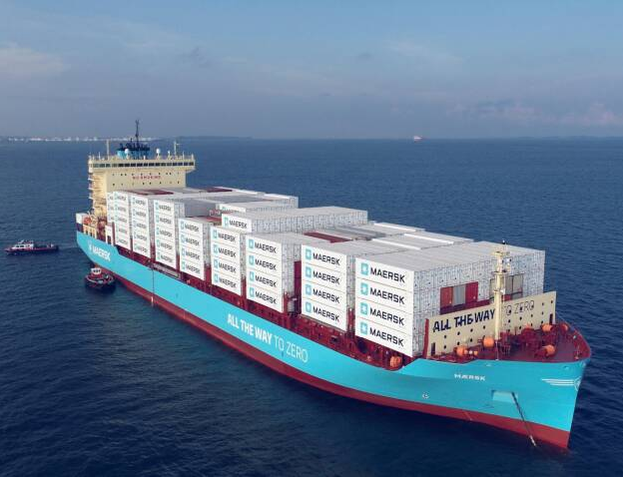

Country update – Denmark
October 2023
Sune Tjalfe Thomsen
Picture: © Maersk, Ritzau, Scanpix

Slide 2
Biofuels production and consumption
A bit of country specific statistics...
Follow the EU blend-in mandates

Slide 3
Biofuels production and consumption
A bit of country specific statistics...

Slide 4
Biofuels production and consumption
A bit of country specific statistics...
Stock of motor vehicles by propellant
 | January 2018 | September 2023
Gasoline | 1,781,826 | 1,845,755
Diesel | 1,136,656 | 1,041,824
Electric | 9,304 | 175,209
Plugin hybrid | 2,340 | 119,849
Natural gas | 256 | 222
Hydrogen | 81 | 86

Slide 5
Politics
A broad coalition across the Danish parliament agreed to stop for drilling for new oil and gas in the Danish part of the North Sea (2020)
However, The current government found a loophole in the law text.
  It allows so-called mini-tenders, which allows companies to submit unsolicited applications to search for more gas in areas close to where oil or gas is already being extracted.
Extensive political discussion – with no final agreement

Slide 6
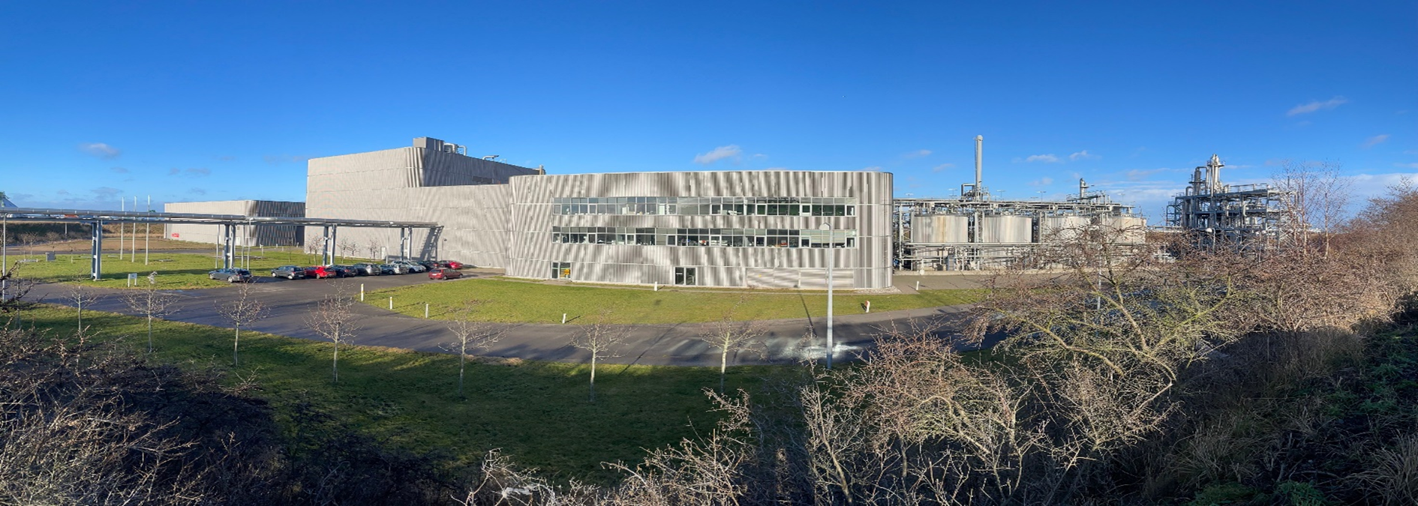
Meliora Bio
– and the interesting case of the faith of their products...
Commercial production of cellulosic ethanol
Co-production of arabinoxylan, as pre-biotic fiber food ingreedience in partnership with Comet Bio Inc.
Almost up to production – plans for increasing (building new)

Slide 7
Innovative Production – Meliora Bio and Comet
Water re-use
Steam
Hemicellulose (C5) clean-up
Arabiono Xylan Prebiotic fiber
to Comet Bio
Straw
Pre-treatment
Separation
Hydrolysis and Fermentation
Distillation
Advanced Biofuel for cars
Organic waste to biogas production
Lignin for fuel or polymer replacement

Slide 8
Meliora Bio
– and the interesting case of the faith of their products...
Despite the biorefinery being co-located with a major Danish oil refinery, and even with existing blend-in mandates, the ethanol is being sold in the German market.
Arabinoxylan is only approved as a prebiotic fiber food ingredient in North America (For now).
Although the biorefinery is co-located with a combined heat and power (CHP) plant burning biomass, the lignin residue is sold to a company in the Netherlands.
-> Legislation is still not fitted to accommodate the bio-sector...

Slide 9
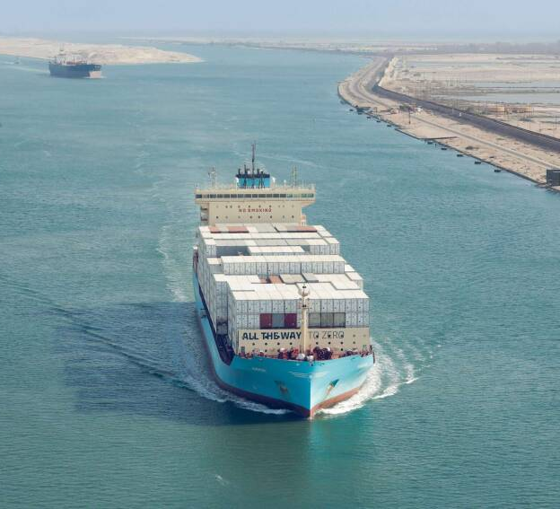
Maersk launches first methanol ship
The first container ship ever built to sail on green methanol, which emits at least 65 percent less CO2 than traditional bunker oil.
Maersk has ordered a total of 25 ships to sail on green methanol out of their fleet of 700 ships. However, more orders will follow as it becomes successful to secure more green methanol.
The very first fuel used to sail the new container ship to Esplanaden in Copenhagen is made from green methanol derived from biogas. It will continue to be used until spring next year when the ship will be powered by so-called e-methanol.
The first e-methanol is produced in Denmark from European Energy's massive solar facility near Aabenraa. However, the expert's assessment is that the remaining production will be distributed worldwide. Maersk has already entered into agreements in the USA, China, and several other countries.
Foto: © Maersk

Slide 10

Sune Tjalfe Thomsen, Associate Professor
University of Copenhagen
Department of Geosciences and Natural Resource Management
TEL +45 35 33 62 62
MOB +45 50 59 40 49
stt@ign.ku.dk
www.ign.ku.dk

