Slide 1

Inter-Task project ‘Synergies of green hydrogen and bio-based value chains deployment’ (T39 T6)
Task 39 Business Meeting | Joint session with IEA AMF
Franziska Müller-Langer, DBFZ
October 26, 2023

Slide 2
Key objective
is to identify and assess synergies in the deployment of green hydrogen and bio-based value chains
to…
Enhance the deployment of both energy carriers and the energy system under different conditions
Identify potential synergetic value chains in different sectors and at different timeframes
Increase visibility and knowledge of promising solutions through Case Studies covering economics, climate and other sustainability effects, supply chain aspects and infrastructural topics
Provide a synthesized view on key barriers and enablers to realize the potential, and on future policy needs
The focus is on the value chains directly linked to bioenergy, i.e. biomass as a source of hydrogen and bio-based processes consuming electrolytic hydrogen.

Slide 3
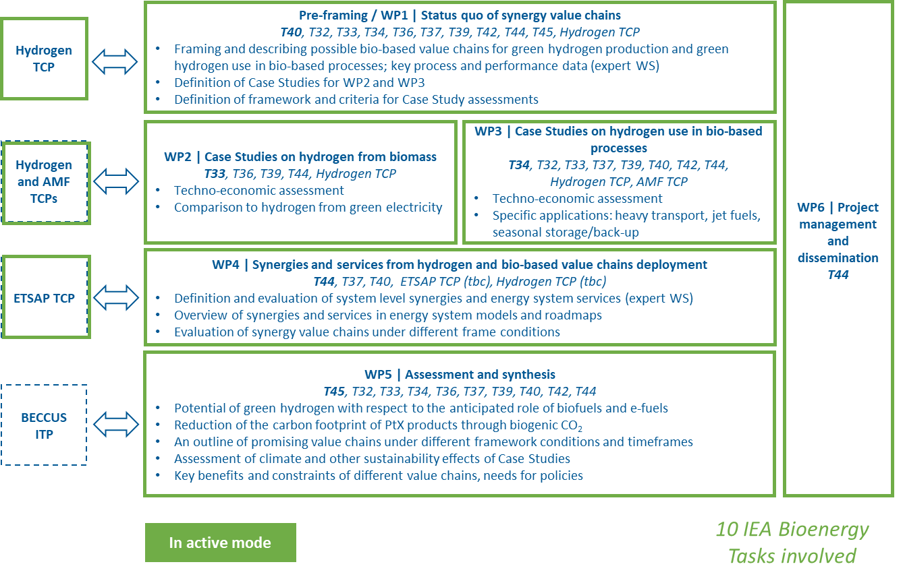
Work Packages
T39
T39
Franziska Müller-Langer (DE), Glaucia Souza (BR) with support from Dina Bacovsky (AT), Tomas Ekbom (SE), Luiz Augusto Horta Nogueira (BR), Rubens Maciel (BR), Nicolaus Dahmen (DE); Marco Buffi (EC), Paul Benett (NZ)
T39
T39

Slide 4
Timeline
ExCo 92 Workshopin Lyon
Expert workshop with IEA ETSAP (WP4)
From June 2022 to December 2024
Meeting and workshop in Vienna (ExCo 90)
First expert workshop (WP1)
Kick-off meeting
Work package / Project month | 2 | 4 | 6 | 8 | 10 | 12 | 14 | 16 | 18 | 20 | 22 | 24 | 26 | 28 | 30
WP 1 | Status quo of synergy value chains |  |  | X |  |  |  |  |  |  | R1
WP 2 | Case Studies on hydrogen from biomass |  |  |  |  |  |  |  |  |  |  | R2 | W1
WP 3 | Case Studies on hydrogen use in bio-based processes |  |  |  |  |  |  |  |  |  |  | R2 | W1
WP 4 | Synergies and services from hydrogen and bio-based value chains deployment |  |  |  |  | X |  |  |  |  |  |  |  |  | R3 | W2
WP 5 | Assessment and Synthesis |  |  |  |  |  |  |  |  |  |  |  |  |  | R3 | W2
WP 6 | Project management and dissemination |  |  | PS |  |  | PS |  |  | PS |  |  | PS |  |  | PS
X is workshop (either internal or with externals) R is report W is webinar PS is project status to ExCo

Slide 5
News
Elina Mäki has left the ITP Synergies as co-lead
Christiane Hennig continues leading the ITP Synergies
Tiia Kanto from VTT joins the ITP Synergies management team
Role of Tiia Kanto:
  Supporting the project management (WP6)
  Contributing to WP4, especially joining energy system modelling (activity 1) and working on the modelling (activity 3)

Slide 6
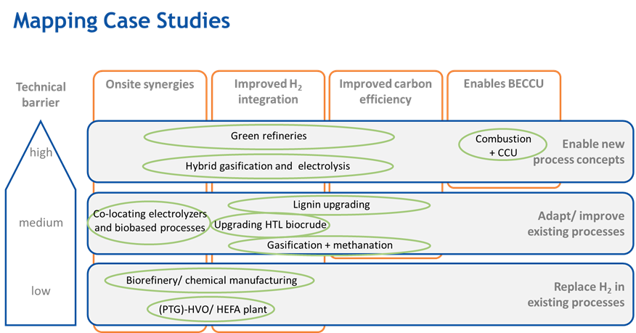
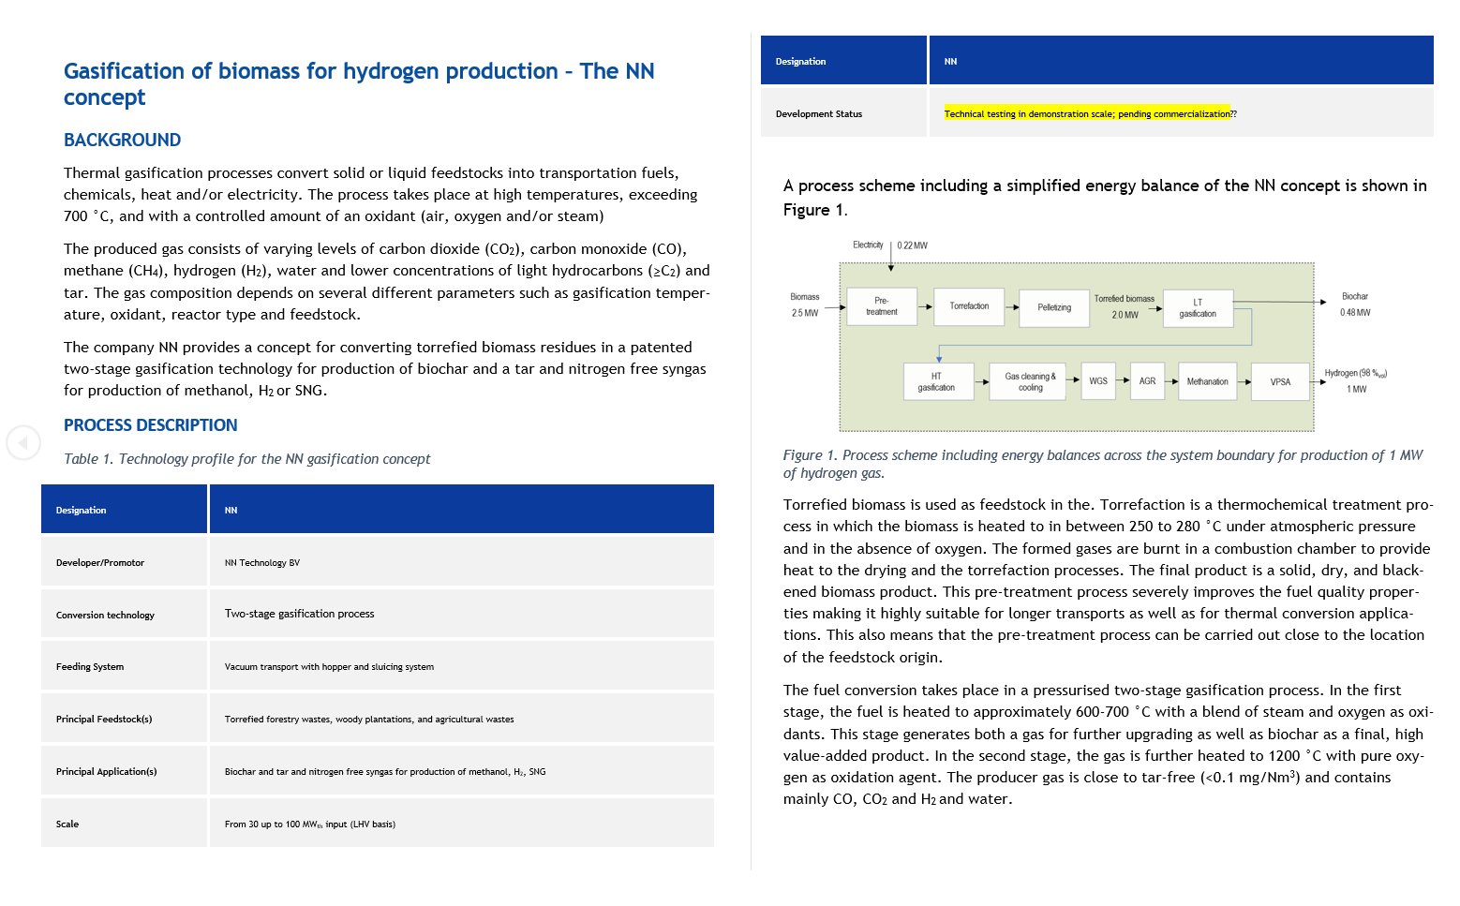
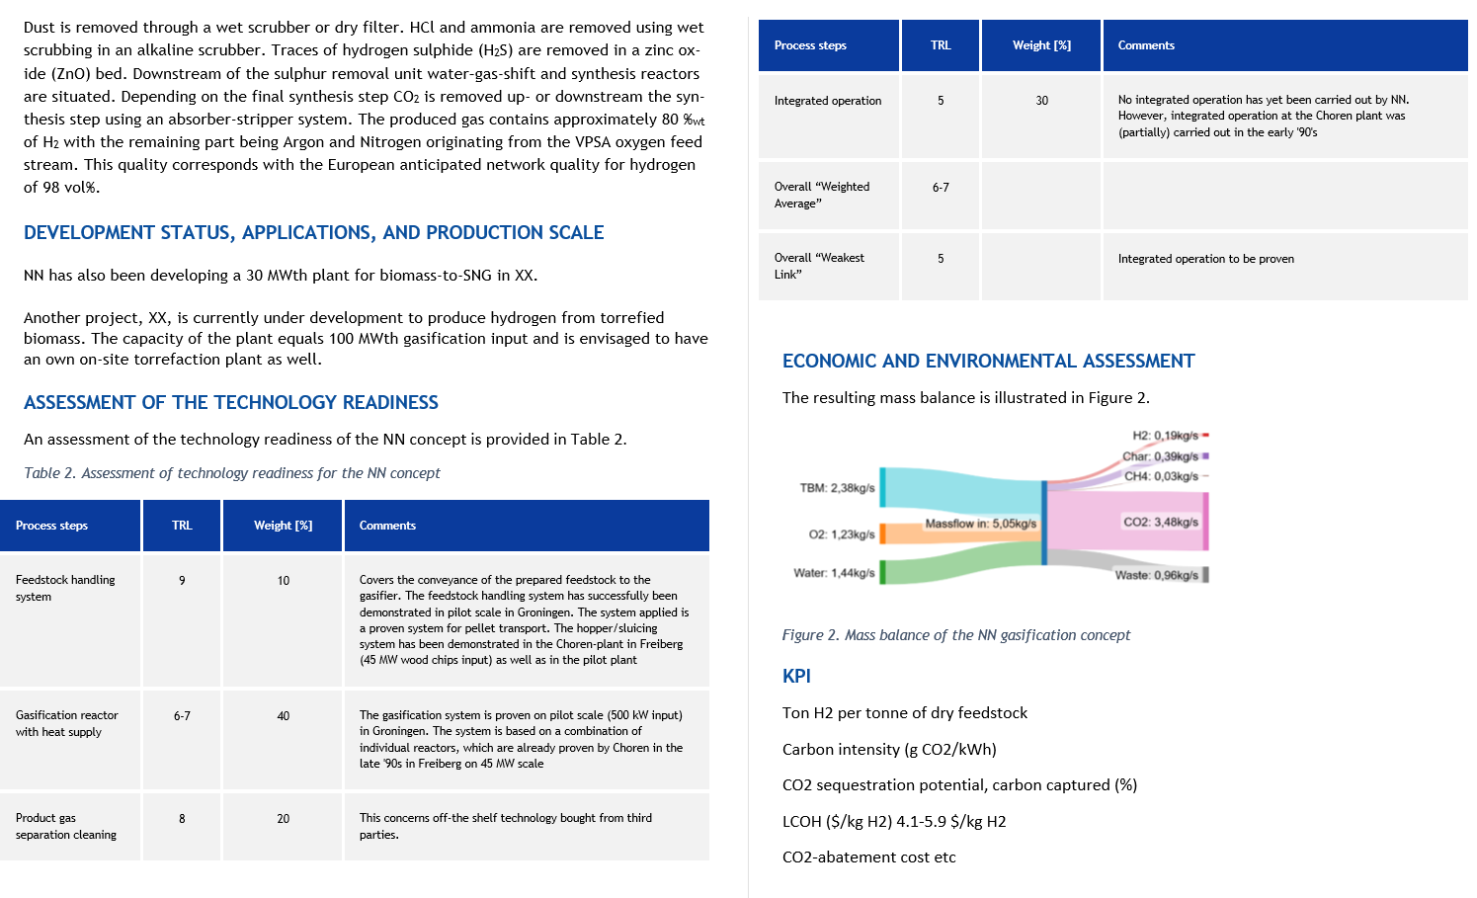
Achievements
Case study template developed (WP2 and WP3)
Case study templates to be completed by the different Tasks
Case studies for assessing climate effects selected (WP5)
Collaboration with IEA ETSAP TCP
  Preparation joint energy system modelling workshop (WP4)
  Torino, November 17
  Advancements in modelling hydrogen deployment
  Representatives from IEA Hydrogen invited
Participation in IEA Hydrogen TCP ExCo meeting
  Intensify collaboration on renewable hydrogen production project (WP6)
  Exchange with Alberto Giaconia and Eric Trably from IEA Hydrogen
  IEAB Task 33 in touch with subtask on gasification to support case studies

Slide 7
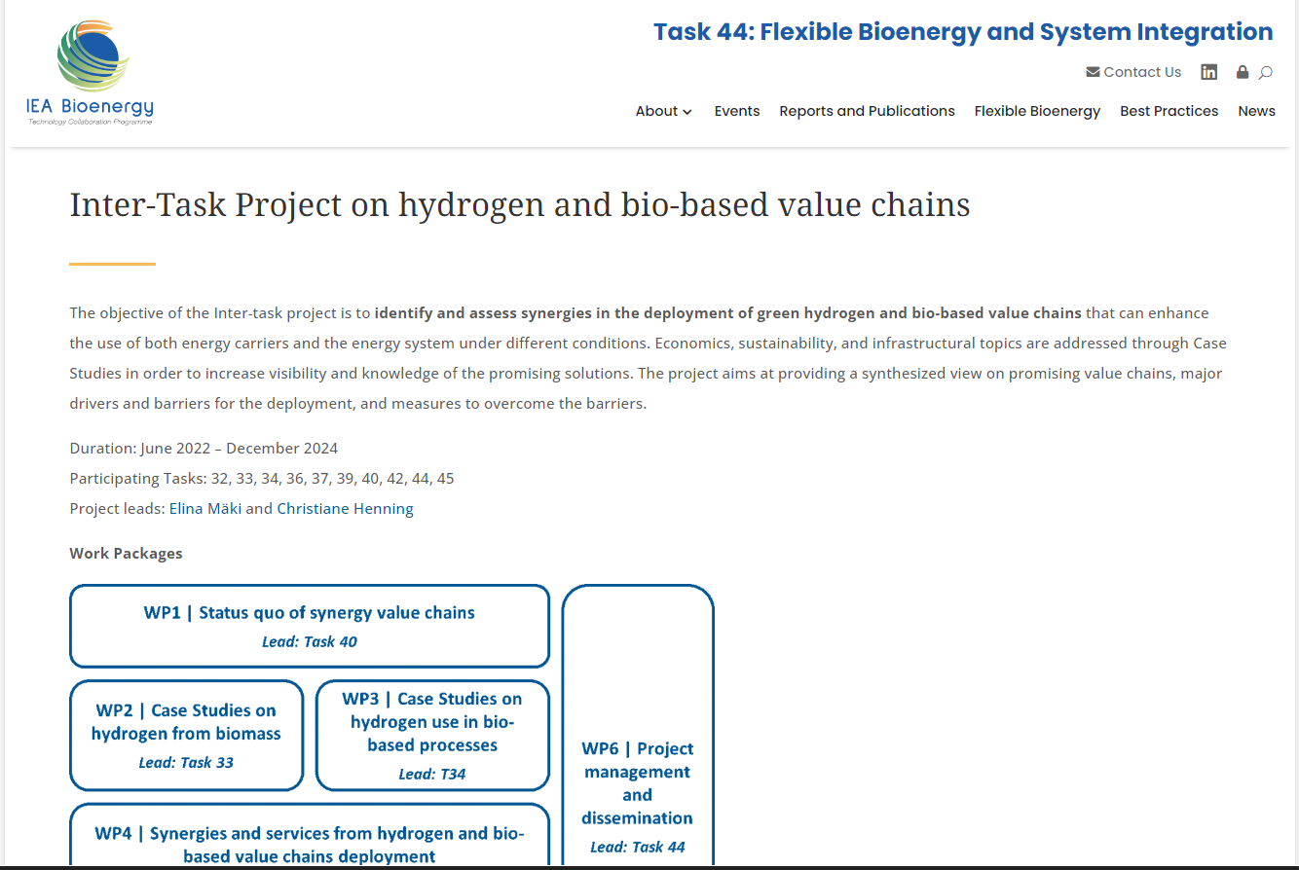
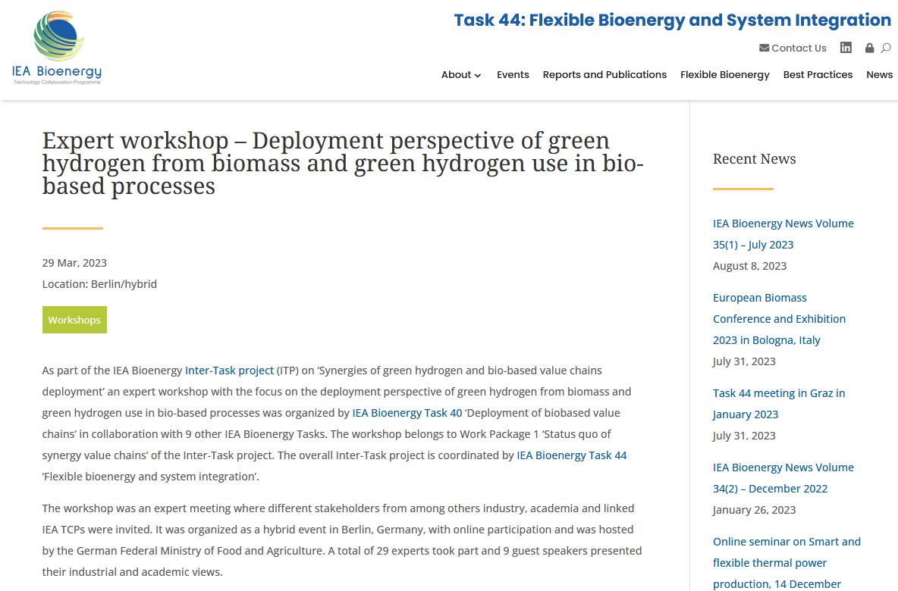
Additional activities
ITP Synergies and WP1 workshop webpage established via Task 44 website
WP1 workshop webpage >> all the ppts from the Berlin workshop available
https://task44.ieabioenergy.com/inter-task-project-on-hydrogen-and-bio-based-value-chains/
https://task44.ieabioenergy.com/ieaevent/expert-workshop-deployment-perspective-of-green-hydrogen-from-biomass-and-green-hydrogen-use-in-bio-based-processes/

Slide 8
Forthcoming activities
Activities / expected deliverables for the period to the next ExCo meeting
  WP leaders meetings to monitor the status of the project (WP6) >> next meeting December
  Participation in the ExCo92 workshop in Lyon (WP6)
  Case study templates to be completed by the different Tasks (WP2 and WP3)
  Finalizing Key Performance Indicator list (WP1, WP2 and WP3)
  Organizing expert workshop on energy system modelling in Torino, 17 November (WP4)
  Overview on the energy system modelling of renewable hydrogen (WP4)
  Getting settled with conducting the LCAs (WP5)
  Continuing collaboration with the Hydrogen and ETSAP TCPs (WP6)

Slide 9
Budget
T39
 |  | Participating Task: Cost/Budget (USD)
WP | Activity | 32 | 33 | 34 | 36 | 37 | 39 ^{*)} | 40 | 42 | 44 | 45 | Sub-total
1 | Status quo of synergy value chains | 2500 | 2500 | 2500 | 2500 | 5000 | 2500 | 15000 | 1000 | 2500 | 2500 | 38500
2 | Case Studies on hydrogen from biomass | - | 15250 | - | 17250 | - | 8000 | - | - | 5000 | 2500 | 48000
3 | Case Studies on hydrogen use in bio-based processes | 11000 | 3000 | 21000 | - | 13500 | 12000 | 3000 | 13000 | 5000 | 2500 | 84000
4 | Synergies and services from hydrogen and bio-based value chains deployment | - | - | - | - | 16000 | - | 15000 | - | 16000 | - | 47000
5 | Assessment and Synthesis | 1500 | 1500 | 1500 | 1500 | 4375 | 2500 | 5875 | 1000 | 3375 | 31375 | 54500
6 | Project management and dissemination | - | - | - | - | - | - | - | - | 30000 | - | 30000
Total Cost/Budget |  | 15000 | 22250 | 25000 | 21250 | 38875 | 25000 | 38875 | 15000 | 61875 | 38875 | 302000
From Task budget |  | 12000 | 18000 | 20000 | 17000 | 30000 | 20000 | 30000 | 12000 | 43000 | 30000 | 232000
From ExCo Strategic Fund |  | 3000 | 4250 | 5000 | 4250 | 8875 | 5000 | 8875 | 3000 | 18875 | 8875 | 70000
^{*)} estimated budget; confirmation later
After ExCo88 in 04/2022
Task contribution 232.000 USD
ExCo funding 70.000 USD
Total budget 302.000 USD
Pending confirmation of budget allocation from T39 25.000 USD
T39 internal
Budget allocation within T39 contributors
DE: T39 coordinator, WP1,2,3,5: 14.500 USD
BR: WP1,2,5: 10.500 USD
Further contribution inkind
Notes:
10 participating Tasks

Slide 10
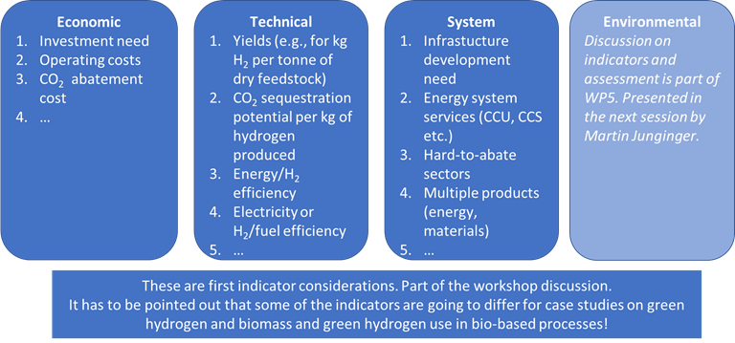
WPs T39 contribution
WP 2 & 3 | Work in progress
Report “Renewable hydrogen and bioenergy: prospects in Brazil” (Glaucia, Rubens, Luiz, Heitor):
Work on initial list of case studies for WP 3 (Franziska with Glaucia, Marco, Nico):
Workshop march 29, 2023 Berlin
(T39 participants Franziska, Nicolaus, Marco)
Results here https://task44.ieabioenergy.com/inter-task-project-on-hydrogen-and-bio-based-value-chains/

Slide 11
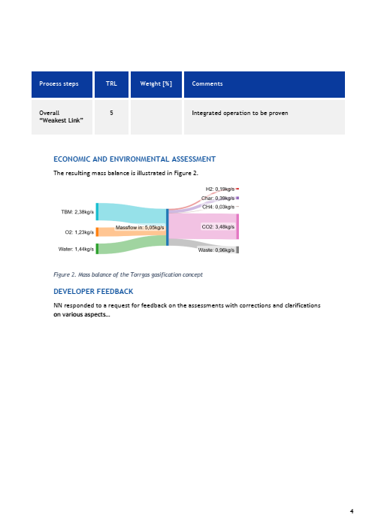
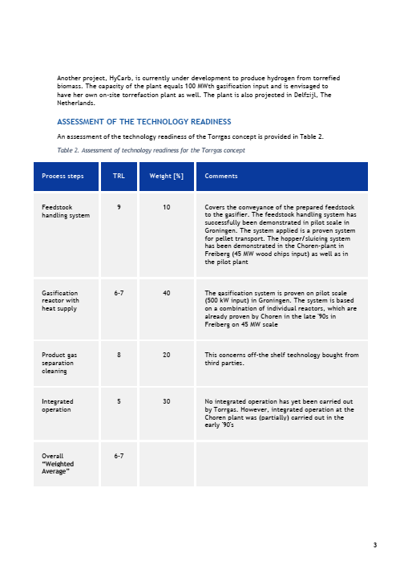
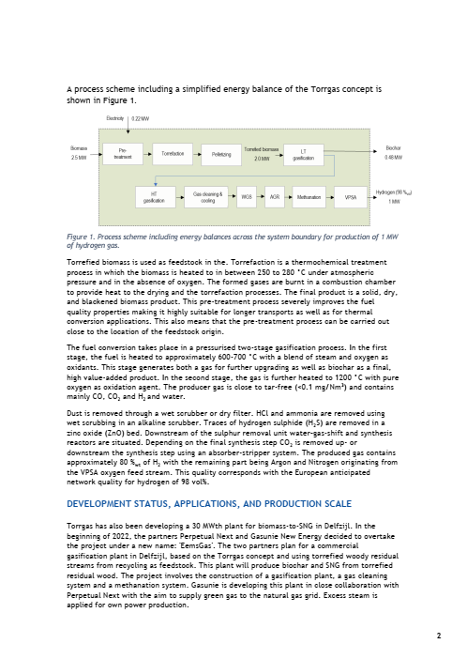
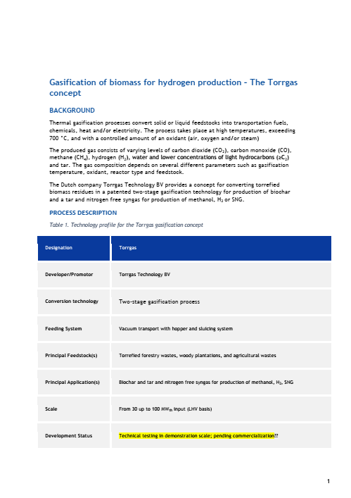
WPs T39 contribution
WP 2 & 3 | Work in progress
Template for cases studies WP 2 & 3
Background
Project description incl. profile
Development status, applications, and production scale
Assessment of the technology readiness
Economic and environmental assessment
Developer feedback
Example Torrgas
To be filled by Nov 17, 2023 for WP 3 examples Pilot-SBG, PTG-HEFA, ReFuels, Omega Green Plant, draft submitted already for WP 2

Slide 12
https://task44.ieabioenergy.com/inter-task-project-on-hydrogen-and-bio-based-value-chains/
ITP Synergies project coordinators
Christiane Hennig
christiane.hennig@dbfz.de
Tiia Kanto
tiia.kanto@vtt.fi
T39 contact
Franziska Müller-Langer
franziska.mueller-langer@dbfz.de | +49 341 2434 423

