Slide 1
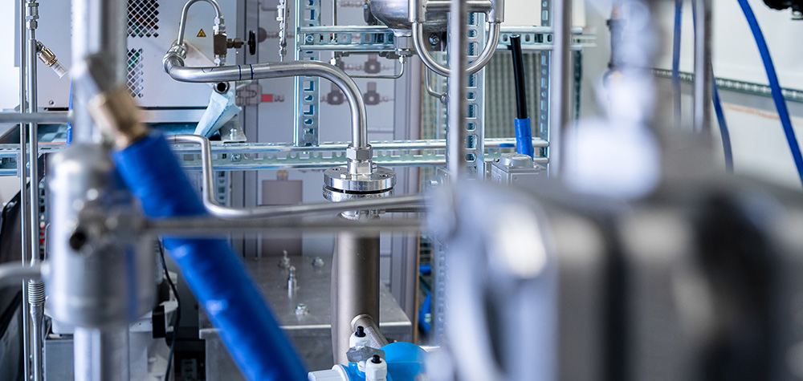
Task 64 E-fuels and end-use perspectives
Joint meeting
Thursday, 26 October 2023
Zoe Stadler
Task manager AMF task 64
Switzerland

Slide 2

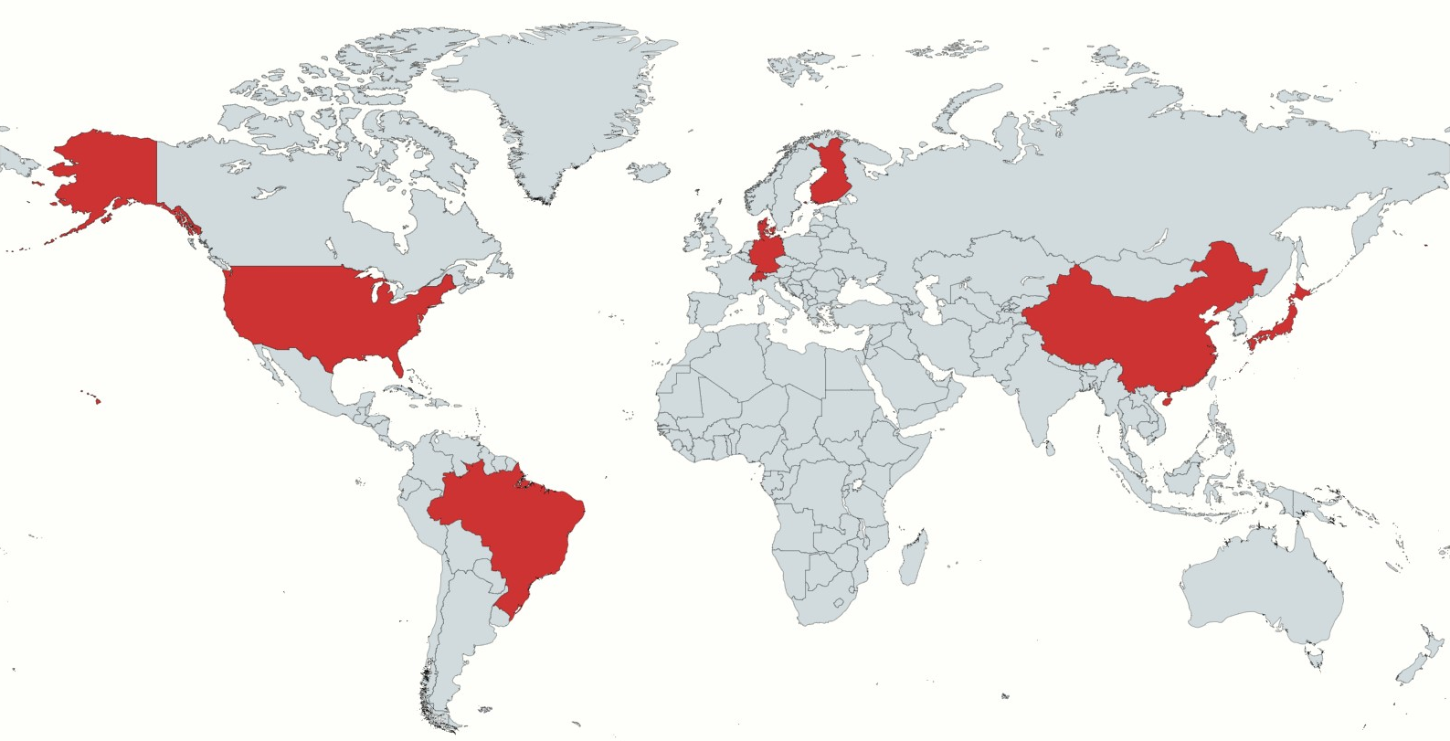
Task 64: E-Fuels and end-use perspectives
Goal
International exchange on the current status of e-fuels in different countries - from production to application, incl. consideration of regulations, costs, etc.
Countries
Brazil, China, Denmark, Finland, Germany, Japan, Switzerland, USA
Collaboration with
  Bioenergy TCP Task 40
  HEV (Hybrid Electric Vehicles) TCP Task 46
  Hydrogen TCP
  IEAGHG
  International Transport Forum
Source: https://www.mapchart.net/world.html

Slide 3
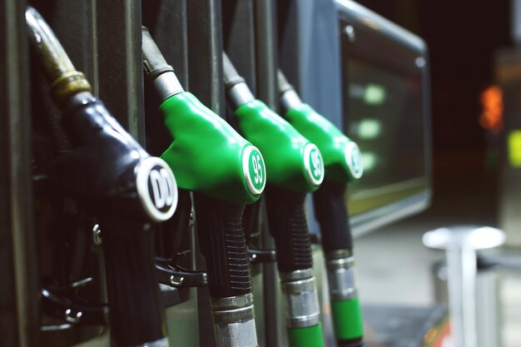
Definition of E-fuels
Electro fuels (e-fuels) are synthetic fuels manufactured using captured carbon dioxide, carbon monoxide or nitrogen together with low-carbon hydrogen. They are termed electro- or e-fuels because the hydrogen is obtained from sustainable electricity sources e.g. hydro, wind, solar and nuclear power.
Renewable fuel of non-biological origin (RFNBO), definition from RED II: ‘renewable liquid and gaseous transport fuels of non-biological origin’ means liquid or gaseous fuels which are used in the transport sector other than biofuels or biogas, the energy content of which is derived from renewable sources other than biomass. In practice this means the use of renewable power from geothermal, solar or wind power, where a local excess production can result during shorter or longer periods, thereby giving access to such energy at low costs.
Note: CO2 from processing of biomass or biogas can be used in the synthesis of e-fuels if the energy content is derived from non-biological sources.
Note: Hydrogen from sources other than renewable electricity is not considered for e-fuel production.
Sources of definitions: Policy briefing: Sustainable synthetic carbon based fuels (royalsociety.org); Renewable fuels of non-biological origin (RFNBO) (etipbioenergy.eu)
Image by fxquadro on Freepik

Slide 4
Topics
Demo sites / Pilot programs in the different countries
Resources: Availability of CO₂ and water resources and electricity sources
Application side: Experiences and challenges in the application of e-fuels, especially with regard to the use of e-fuels in aviation, maritime and road transport.
Regulations and standards: Norms, standards and/or regulations for the use of e-fuels. Incentives, regulations that promote the production and use of e-fuels.
Life-cycle assessments (LCA): Methods for LCA in the different countries/regions. Typical and expected net GHG effects of e-fuel production and use.
Techno-economic assessments (TEA): Costs of the different e-fuel production value chains in the different countries, and methodology for economic calculation.
Stakeholders: Actors from research, industry and administration along the value chain, as well as bioenergy research centres, academic institutions.
Task 64
Demo sites / pilot programmes
Resources: CO2 and hydrogen
Application
Regulations and standards
Life cycle assessments (LCA) / Well-to-wheel
Techno-economic evaluations
Stakeholders

Slide 5
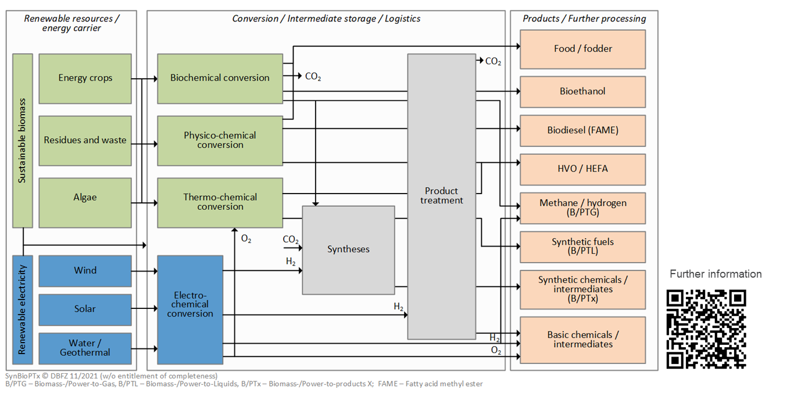
E-Fuel Production Pathways
E-fuels are an important complement to biofuels. It is important to combine the synergies and benefits of e-fuels and biofuels.
Some electro-fuels, such as FT fuels, or methanol, can be produced from high TRL or mature technologies.
Some single technologies might have a high TRL, in the combination in an overall plant, however, the TRL can be lower.
Presentation by Franziska Müller-Langer, DBFZ

Slide 6
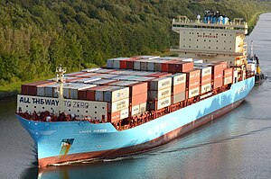
Application of e-fuels
The driver of a fast implementation of e-methanol in the shipping industry stems from a strong customer pull.
Of the e-fuels, e-methanol, e-ammonia and e-methane are interesting for use in shipping. Regulations for onboard use of methanol exist today and thus gives the broad implementation of methanol an advantage over the implementation of ammonia or hydrogen.
There are difficulties with the transportation of H2, it is therefore recommended to transport hydrogen in another energy carrier (e.g., ammonia) or in a liquefied form.
Source: Laura Maersk (2023) - Wikipedia

Slide 7
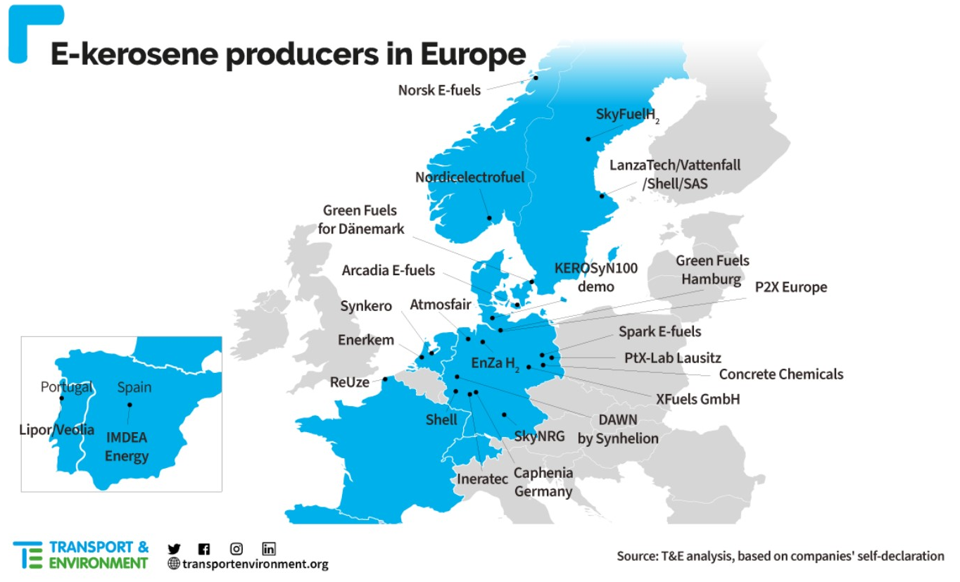
E-Fuels in Aviation
In the short term, biofuels will be used to cover the demand. They are cheaper in production than e-fuels. However, it is a limited resource. Therefore, sub-targets for e-fuels are set to build-up the infrastructure in due time.
In Germany e.g., fuel suppliers must ensure a minimum share of sustainable aviation fuel produced via electrolysis: 0.5 % (2026), 1 % (2028) and 2 % (2030), due to the national implementation of RED II. Also, ReFuelEU Aviation proposes a blending mandate for hydrogen-based aviation fuels of 1.2 % (2030).
In the U.S., the inflation reduction act supports the production of SAF with $0.35 to $1.75 per gallon, based on CO2 reduction potential.
Presentation by Karl Hauptmeier, Norsk e-Fuel
E-kerosene producers in Europe. Source: Transport & Environment: Analysis of green jet fuel production in Europe, November 2022 (updated study)

Slide 8
Techno-economic assessments
E-Fuels are generally more expensive than biofuels. The costs to produce e-kerosene is about 10 times higher than to produce fossil jet fuels.
The key cost driver of e-fuel production is hydrogen, of which the production cost mainly depends on electricity prices and capital cost.
To achieve low-cost hydrogen for economical e-fuels production, both electricity cost and electrolyser capital cost needs to decrease greatly. There are ambitious learning curves assumed and high operating capacities are needed (and a challenge).
Appropriate carbon pricing and low renewable power cost are critical to enhance the economic competitiveness of e-fuels.

Slide 9
Life-cycle assessments
LCA results show that using renewable electricity and hydrogen is key to having low-carbon e-fuels.
Usually, using electricity grid mix for producing e-fuels does not provide greenhouse gas (GHG) emission reduction benefits compared to the fossil baseline fuels.
The analysis shows that e-FT fuels and e-methanol present significant GHG reduction benefit coupled with renewable electricity and/or H2 compared to their fossil counterparts.
Zang, G., Sun, P., Elgowainy, A., Bafana, A., & Wang, M. (2021). Life Cycle Analysis of Electrofuels: Fischer–Tropsch Fuel
Production from Hydrogen and Corn Ethanol Byproduct CO2. Environmental Science & Technology, 55(6), 3888-3897.

Slide 10
Outlook
In general, there will be a large scale-up of hydrogen and e-fuel production.
Here two examples from the EU:
  RED III: In the industrial sector, a new binding target is set for the use of hydrogen and other electricity-based fuels (RFNBO). 42 percent of the hydrogen consumed in industry in 2030 must come from renewable energy sources of non-biological origin, and in 2035 this figure should already be 60 percent. A new indicative target is that the share of renewable energies in total energy consumption in industry should increase by 1.6 percent each year.
  ReFuelEU Aviation: The EU is introducing a quota for the market ramp-up of e-fuels ("RFNBOs") in the aviation sector, from 1.2% e-fuels in 2030 to 35% e-fuels in 2050. Overall, 70% of aviation fuels must then be renewable in 2050.
Sources: https://equota.de/red-iii/ and https://www.bmwk.de/Redaktion/DE/Pressemitteilungen/2023/06/20230616-neue-eu-richtlinie-fuer-erneuerbare-energien-angenommen.html

Slide 11
Current status of task
Task is ongoing – final report is expected in spring 2024
A public webinar with the key-messages will also be hold in spring 2024

Slide 12
Thank you!

