Slide 1

Task 28: Sub-task Advanced Motor Fuel Information (AMFI)
AMF and Bioenergy Task 39 joint meeting
26 October 2023
Dina Bacovsky
Kim Winther
Päivi Aakko-Saksa
BEST – Bioenergy and Sustainable Technologies
DTI
VTT

Slide 2
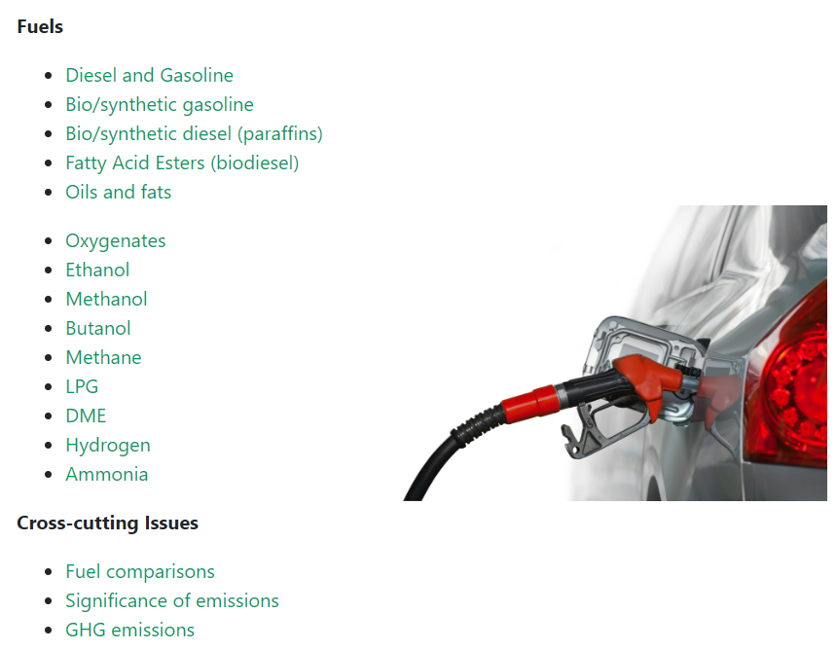
Fuel information system
Fuel information system is an effort to collate relevant information on advanced fuels and their use for transport.
Focus is on the end-use aspects of advanced motor fuels: performance of vehicles, effect on emissions and compatibility with infrastructure.

Slide 3
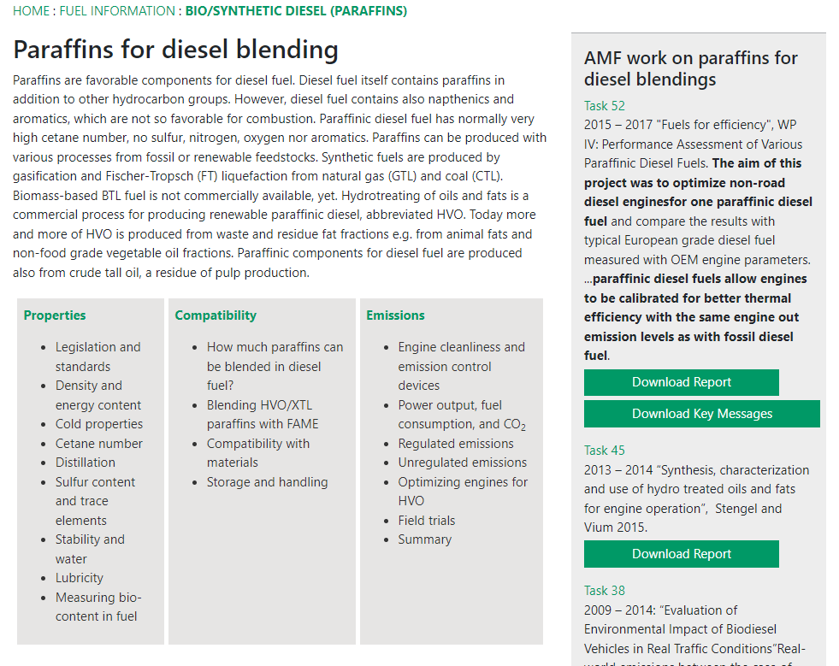
Example:
Paraffinic fuels
Properties (including standards), compatibility, exhaust emissions.
On the right-hand side, AMF work on each fuel category.

Slide 4
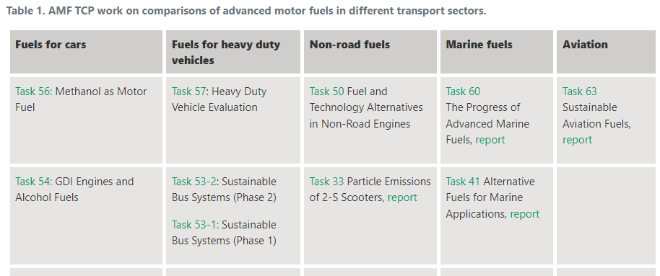
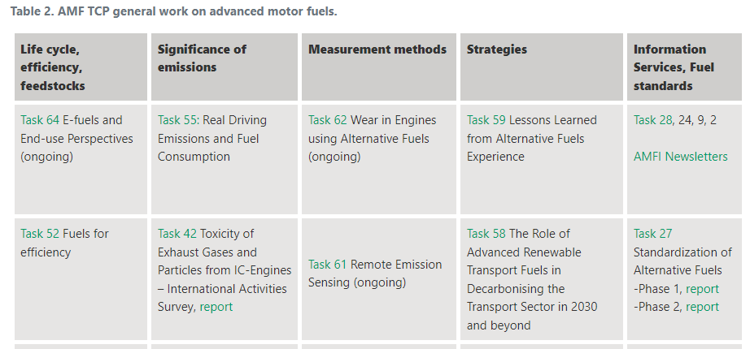
Fuel information system: continuation
AMF work develops along with the global changes, and so does the AMFI fuel information system.
Recent AMF Tasks have reported on marine fuels and sustainable aviation fuels. Consequently, these fuel categories will be adopted in the AMFI.

Slide 5
Information exchange is an important element in IEA TCPs

