Slide 1



Brazil –
Country Report
FAPESP Bioenergy Research Program BIOEN
Brazilian Energy Office
Glaucia Mendes Souza, Heitor Cantarella, Luiz Horta Nogueira, Raffella Rossetto, Rubens Maciel Filho, and Jean Felipe Leal Silva
Angela Oliveira da Costa, Juliana Rangel do Nascimento, Paula Isabel da Costa Barbosa and Rachel Martins Henriques
October 2023

Slide 2
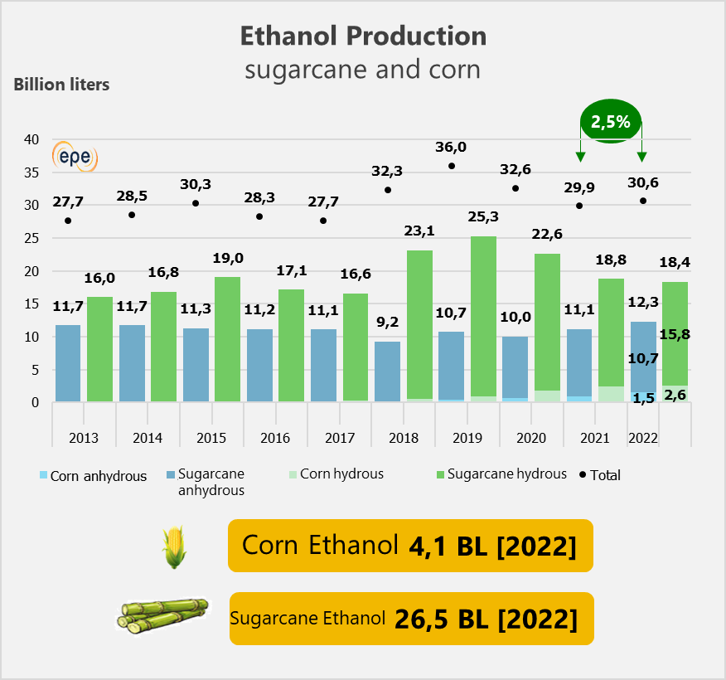
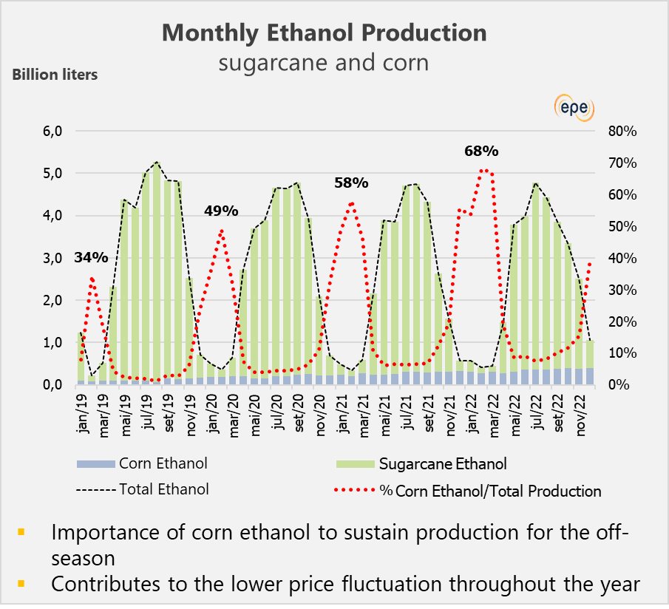
ETHANOL PRODUCTION
Source: EPE(2023) from MAPA

Slide 3
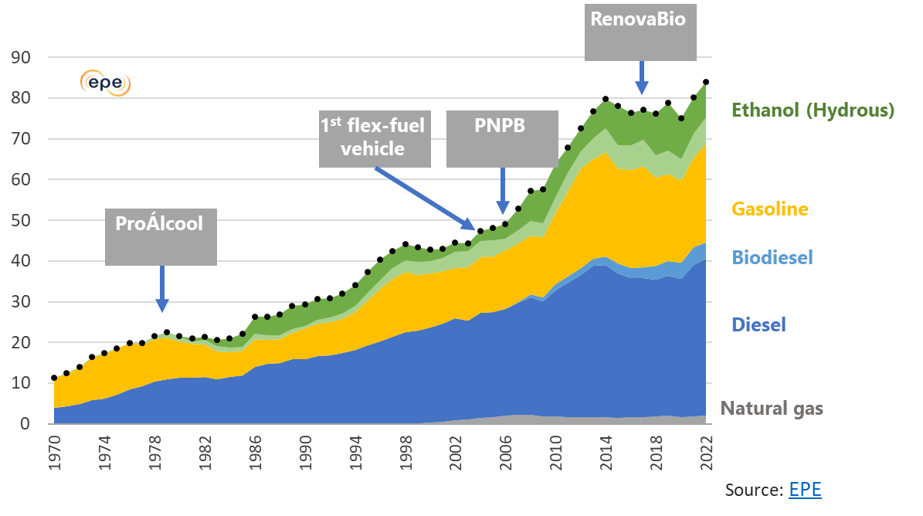
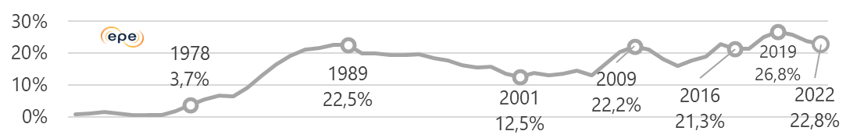
BIOFUELS HELPED DECARBONIZE ROAD TRANSPORT
Road energy consumption (Million toe; %renewables)
Disseminated flex-fuel technology allows Brazil to expand ethanol use.
Availability of sugarcane crops and
installed capacity of mills allows for an expedited increase in renewables.
Ethanol (Anhydrous)
Shared infrastructure minimizes costs of increasing ethanol use.
The existence of a domestic automotive industry with the capacity to develop local technologies reduces the impulse to electrify.
Country can better manage the pace of decarbonization while reducing emissions, and without needing to commit to a specific route.

Slide 4
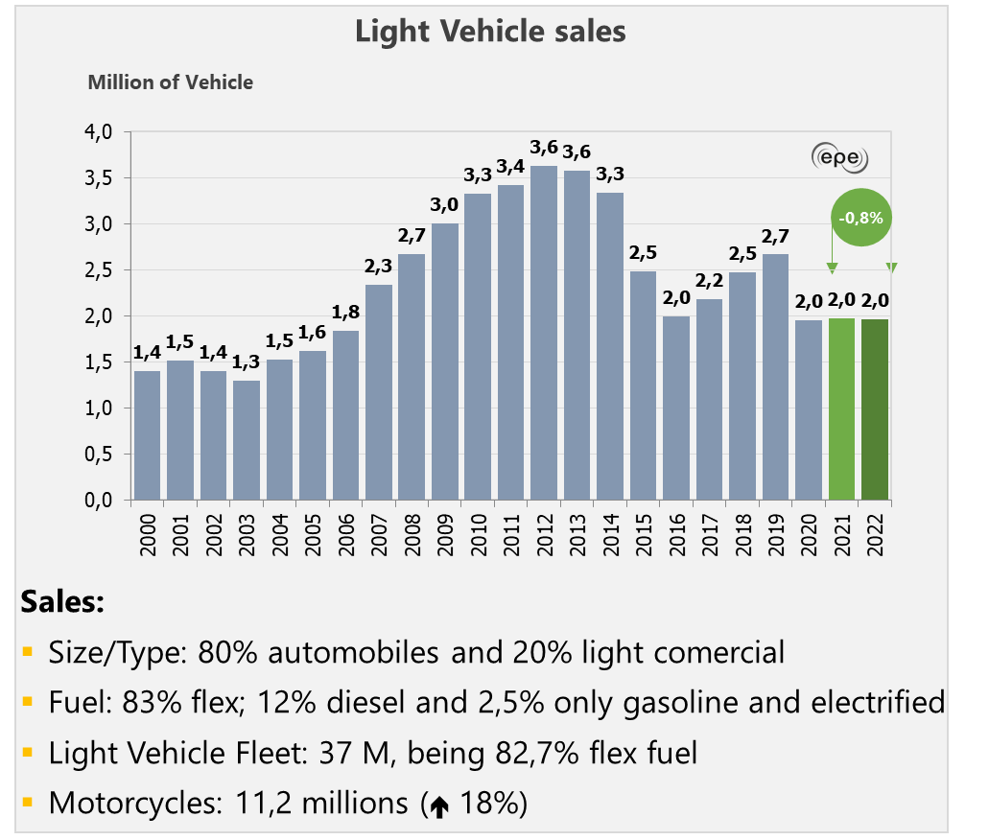
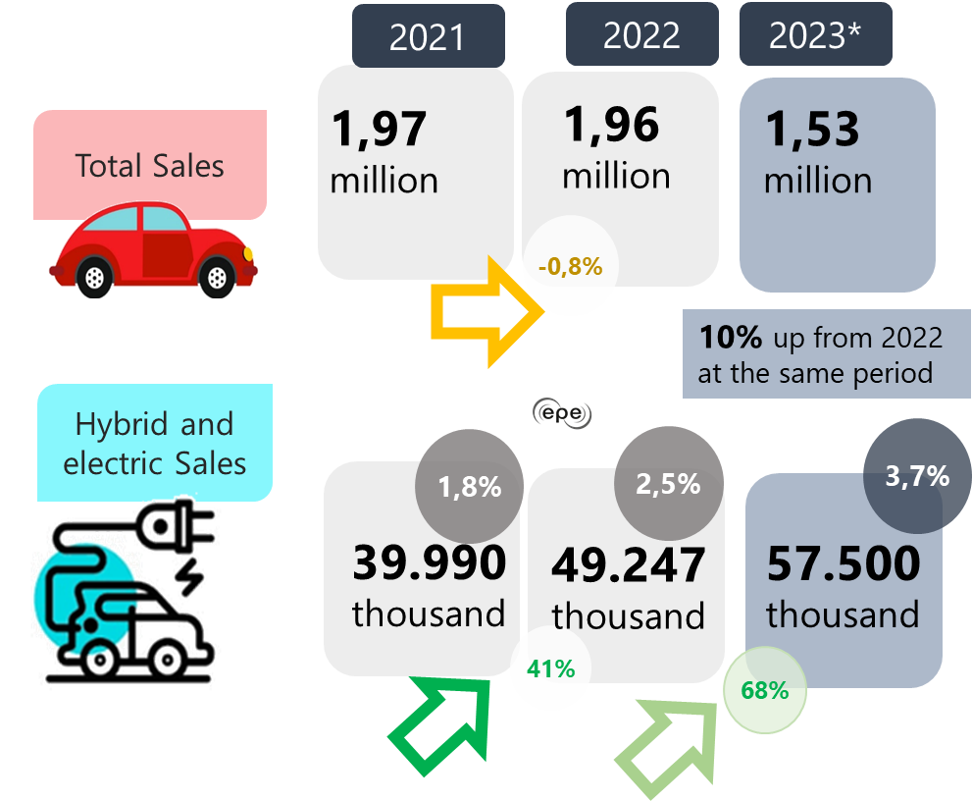
LIGHT VEHICLE SALES AND OTTO CYCLE DEMAND
Source: EPE from ANFAVEA and EPE

Slide 5
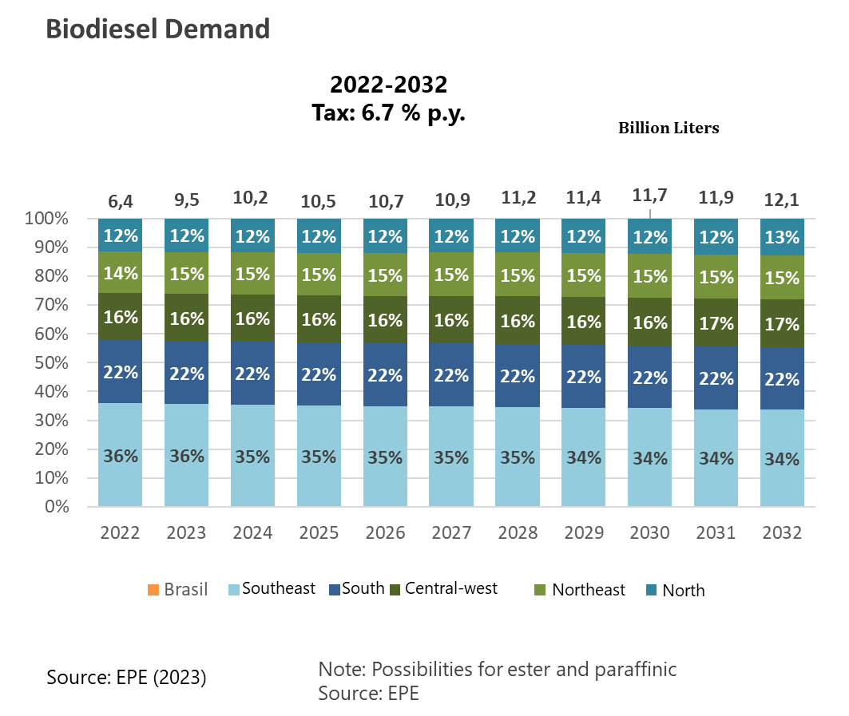
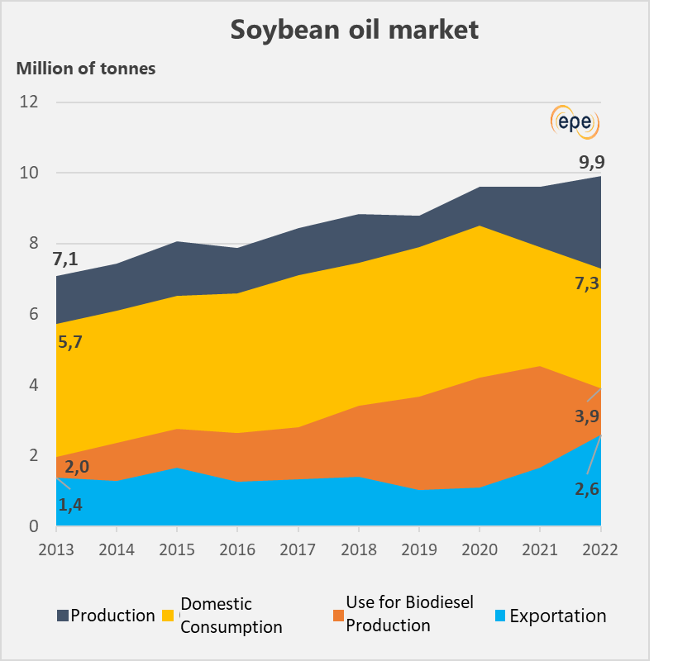
INSTALLED CAPACITY AND BIODIESEL CONSUMPTION
Source: EPE (2023)
Notes:
Participação de insumos:
72,1% - soja; 7,7% - gordura bovina; 11,6% - materiais graxos; 8,6% - outros

Slide 6


NEW BIOFUELS
Ethanol from lignocellulose
HVO
  Petrobras: Biorefinery Program - expansion of Diesel R production at REPAR (PR) and start of co-processing for biofuel production at RPBC (SP), REPLAN (SP) and REDUC (RJ).
  SAF
  Petrobras (2022): project to be installed RPBC (Cubatão/SP), with cap. of 350 thousand m³ p.y. of SAF and 100% renewable diesel, from the processing of up to 790 thousand tons p.y. of raw material.
  In the same year, BBF project for a SAF and HVO biorefinery, using palm oil, in Manaus, with cap. of 500 thousand m³ p.y., to be operational in 2025.
  H2V
  Jan/23: announcement of the start of H2V production, in the pilot project at the Pecém Thermoelectric Complex - UTE Pecém (CE), an investment of R$42 million. The unit is the first in Latin America on a scale over 1 MW.
Units and projects from E2G
Plant Annex | Companies | Cities | UF | Status | Annual Cap. (millions l) | Start of Opperation
Costa Pinto | Raízen | Piracicaba | SP | operating | 42 | 2015
Bonfim | Raízen | Guariba | SP | In construction | 82 | 2023*
Barra | Raízen | Barra Bonita | SP | In construction | 82 | 2024
Univalem | Raízen | Valparaíso | SP | In construction | 82 | 2024
Gasa | Raízen | Andradina | SP | In construction | 82 | 2025
Vale do Rosário | Raízen | Morro Agudo | SP | In construction | 82 | 2025
Planta independ. | Granbio | São Miguel dos Campos | AL | operating | 30 | 2014
* Conclusion planned to 2º semester of 2023
Notes:
E2G:
Bioflex-I (Granbio): em oper. desde 2017. A empresa anunciou planos de ampliar a sua capacidade de produção para 60 milhões l até 2025. Também obteve a validação de patente de produção por países europeus, o direito de licenciamento da tecnologia e o desenvolvimento e projeto de plantas.
Abril de 2021, Certificação Roundtable of Sustainable Materials - RSM, para as diretrizes da diretiva europeia RED II e, com isso, já está autorizada a exportar etanol 2G para a União Europeia.
SAF:
A tendência é que, no Brasil, tal como nos demais países, as unidades pioneiras deste produto, sejam oriundas da conversão de refinarias convencionais em biorrefinarias processando óleo vegetal.

Slide 7
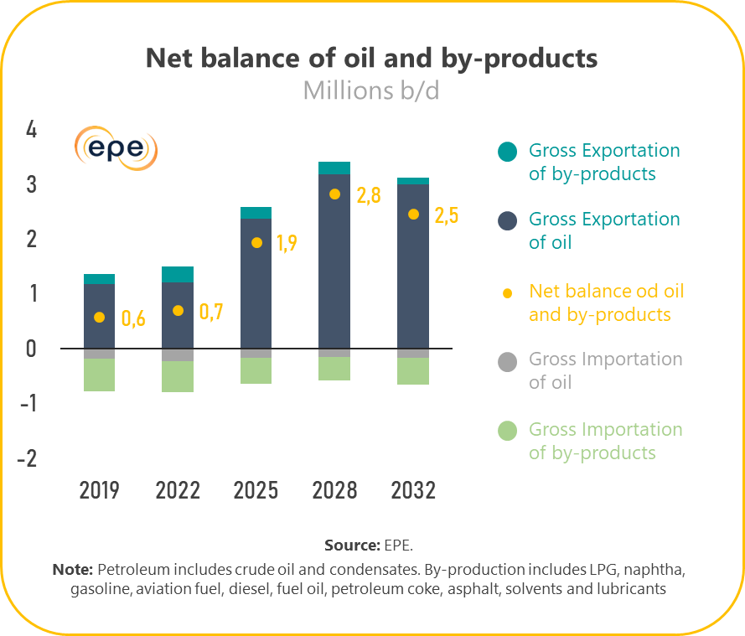
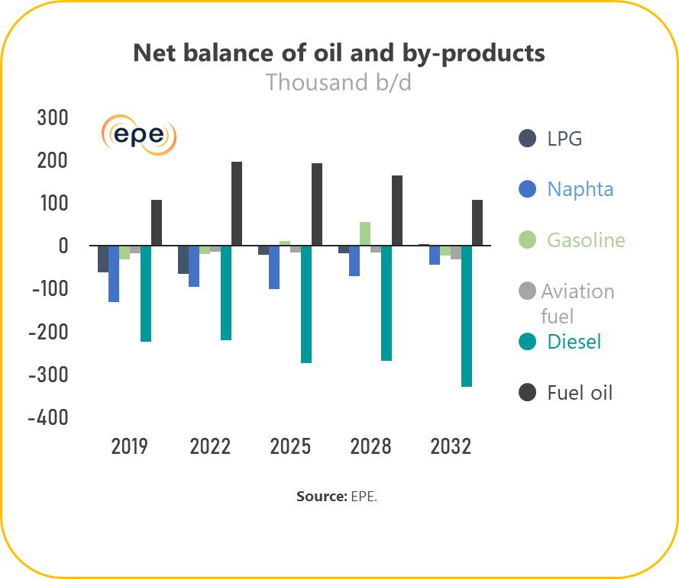
NET BALANCE OF OIL AND BY-PRODUCTS IN BRAZIL

Slide 8
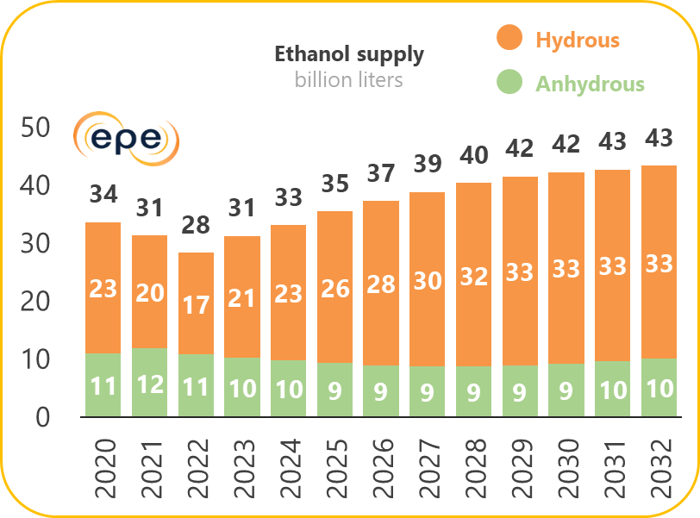
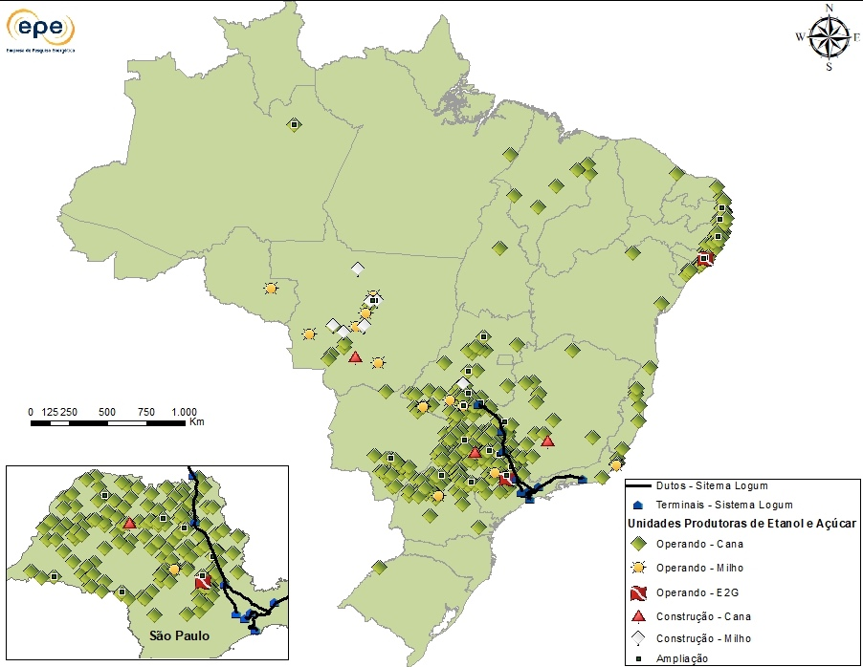
ETHANOL PRODUCTION SET TO EXPAND
Ethanol and Sugar production plants
Investments in sugarcane crops and in 2nd generation ethanol are picking up, especially given RenovaBio.
34 new corn ethanol plants, 7 sugarcane ethanol and 8 second generation ethanol plants are being considered until 2032.
Source: EPE; EPE
8

Slide 9



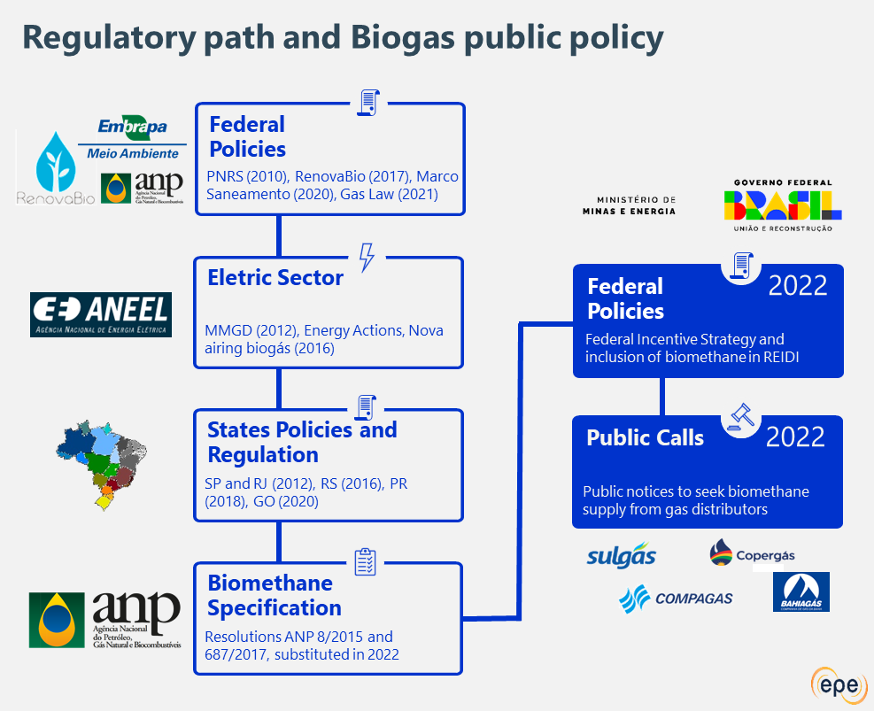

BRAZILIAN MAIN PROGRAMS AND INTERNATIONAL INITIATIVES
Brazil’s Biodiesel Program (PNPB)
To implement biodiesel sustainable production and use with a focus on productive inclusion and sustainable rural development through employment and income generation.
To increase the use of sustainable fuels and low carbon intensity, as well as the application of national vehicle technology, with biofuels.
2021
2005
To reduce the carbon intensity of Brazilian transportation matrix by expanding the use of biofuels and creating a carbon credit market to offset emissions of greenhouse gases by fossil fuels.
2023
2017
Institutional advances reflected in the creation of regulatory frameworks and public policies, helped biogas get to where it is and support future expectations for the source
Conceptual and fundamental aspects for the construction of the Brazilian hydrogen strategy was laid out by EPE in June 2021. Besides, Brazil considers the green hydrogen routes.
2021

Slide 10
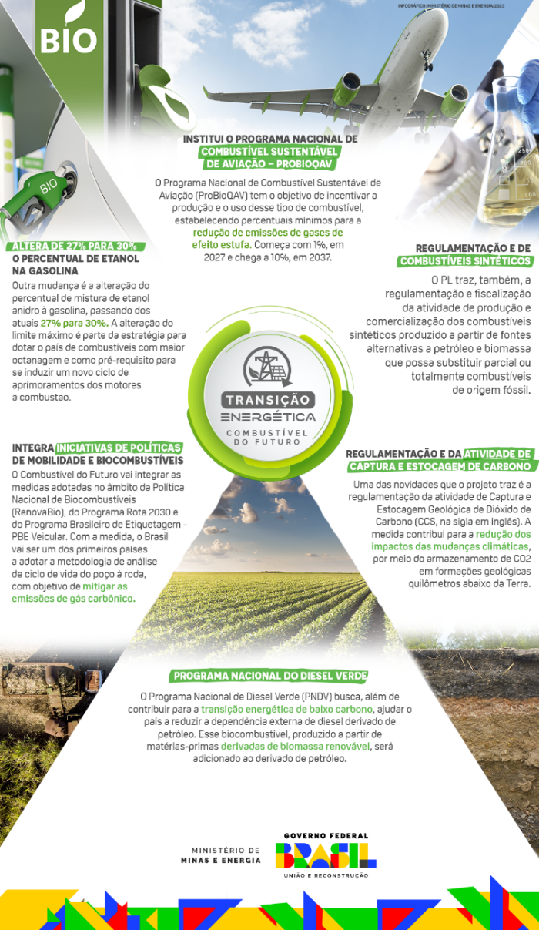
POLICIES APPLIED WITH INFLUENCE ON THE TRANSPORT SECTOR
FUELS OF FUTURE PROGRAM
Fuels
Strategic Guidelines
PNPB
Mandate for Addition of Biodiesel to Diesel Oil
Integration of public policies related to the Program
Promotion of the average carbon intensity reduction of the fuel matrix, reducing emissions in all modes of transport and increasing energy efficiency
Environmental–energetic efficiency Assessment through complete life cycle analysis (from well to wheel) at different transports’ mode
Stimulating technological development and innovation
National Sustainable Aviation Fuel Program (PROBIOQAV)
National Green Diesel Program (PNDV)
RenovaBio
Carbon credits paid by fossil fuels to stimulate ethanol
Rota 2030
Tax incentives to stimulate R&D and energy efficiency
PNH2
Development of the Hydrogen market and industry
Project Law

Slide 11
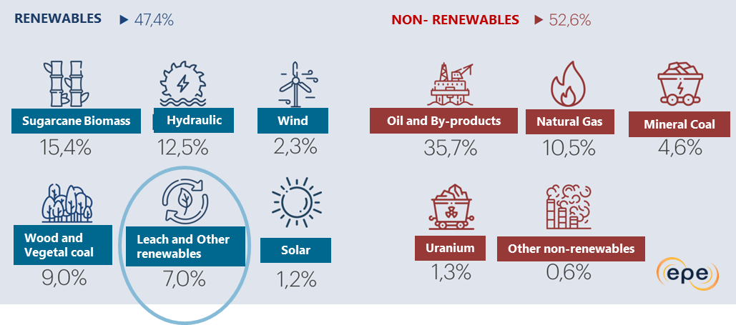
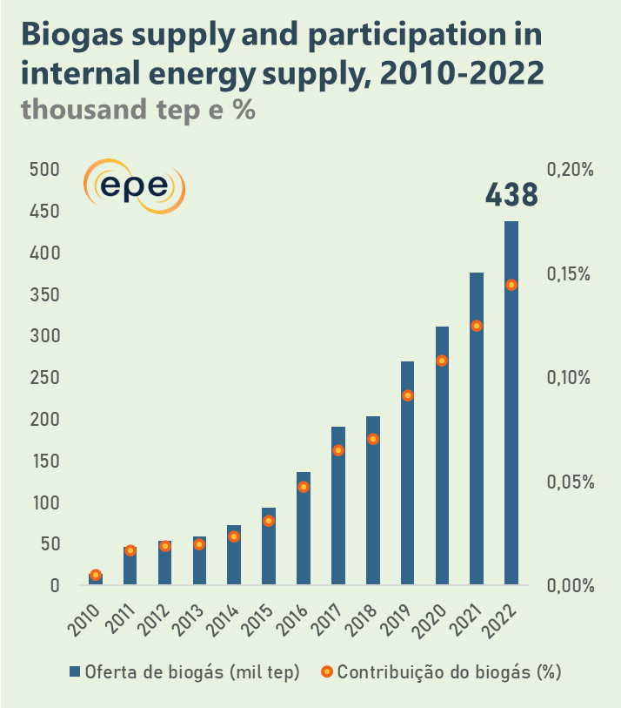
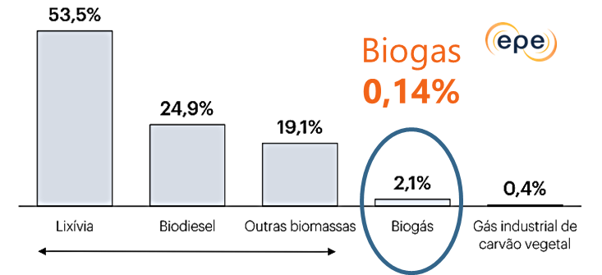

BIOGAS IN THE NATIONAL ENERGY BALANCE
Leach
Other Biomass
Biogas
Industrial Gas of vegetal coal
Biogas Supply
(thousand tep)
Biogas Contribuition (%)
Source: EPE (2023)

Slide 12
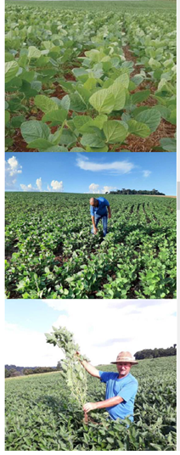
FAMILY FARMING AND ITS BENEFITS FOR GREEN DIESEL AND BIOJET
Family Farming as a feedstock supplier
Family farming produced 9.5 million tonnes, representanting 9% of the national production.
In the South, agricultural farming represented 22% of national production.
There are 164,710 unities of family farming that work with soy cultivation (69.7% of soy mills).
In 2020, 3.4 millions of tonnes were traded under the Social Fuel Seal with R$ 5.5 billion (or around US$ 1.0 billion) involving approximately 70 thousand agricultural families.
Benefits of Family Farming for Green Diesel and BioJet
Setting up a new market for family farming (FF).
Increase in the number of benefited family farmers.
Greater volume and marketed value of raw materials from FF.
Increased employment and income generation.
Provide technical assistance, access to other public policies and technological innovation to new FF.
Strengthening Family Farming.
Regional market development.
Compliance with international agreements (reduction of CO₂ emissions).
Source: Agricultural Census Data (Soy)

Slide 13
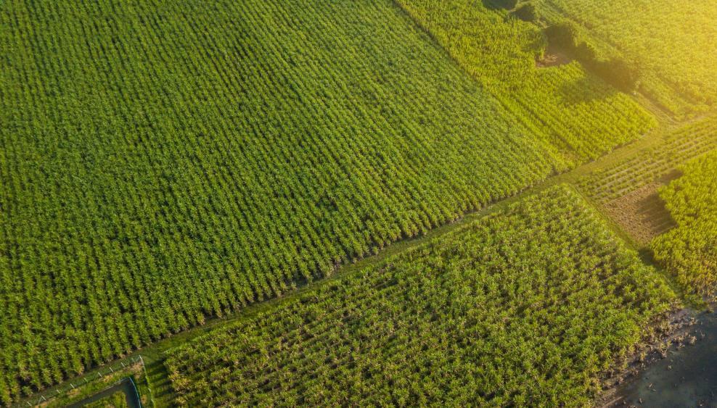
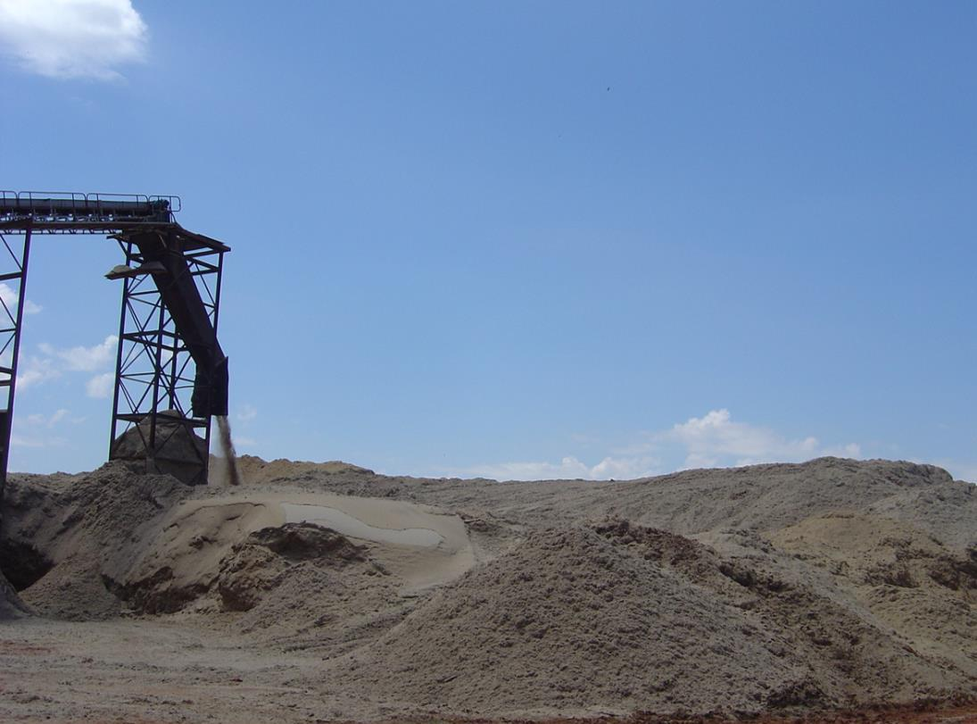
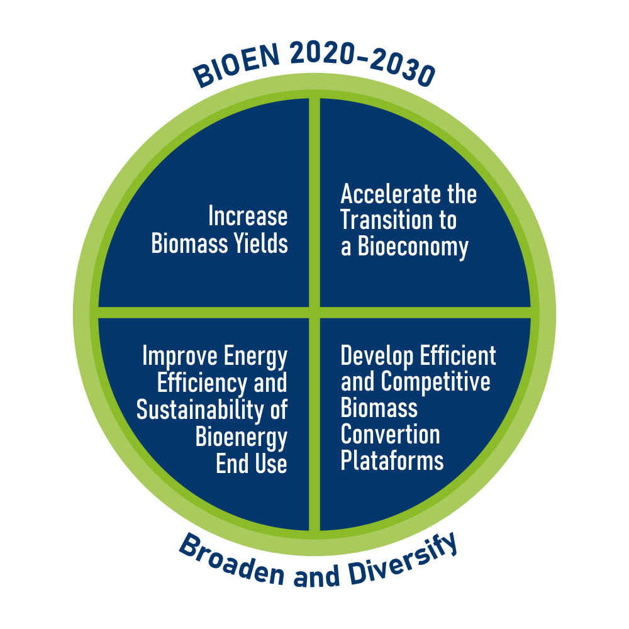
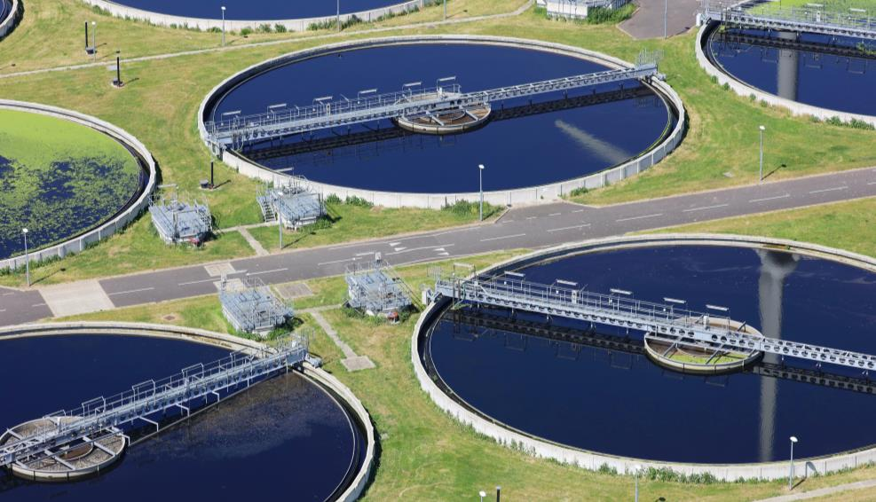
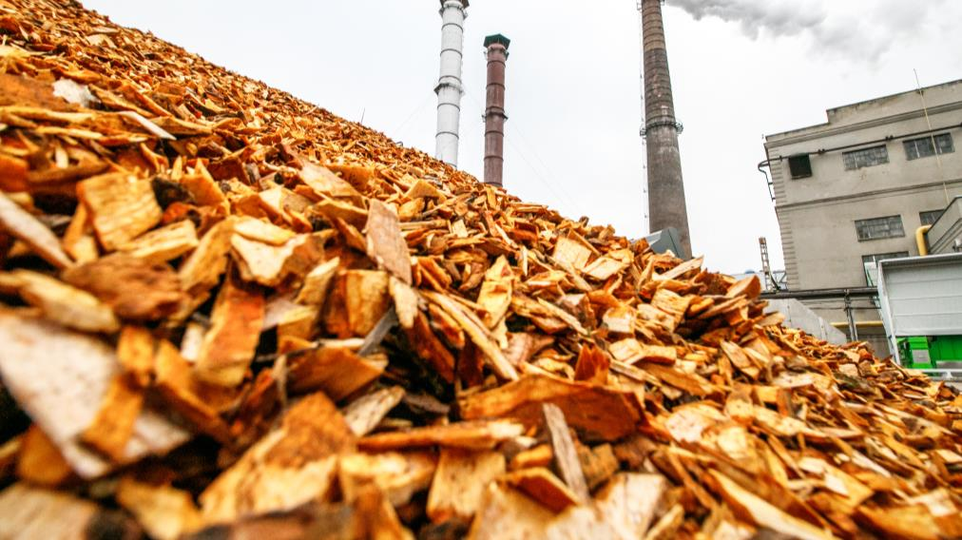

Slide 14

FAPESP supports the State of São Paulo Science, Technology and Innovation System
Higher education 54
Companies 2831
Governmental 40
Non-governmental 17
300+
Since 2009
700+
Research Projects
Fellowships in São Paulo and abroad
2200+
400+
Papers
200+
Researchers
Start-ups

Slide 15
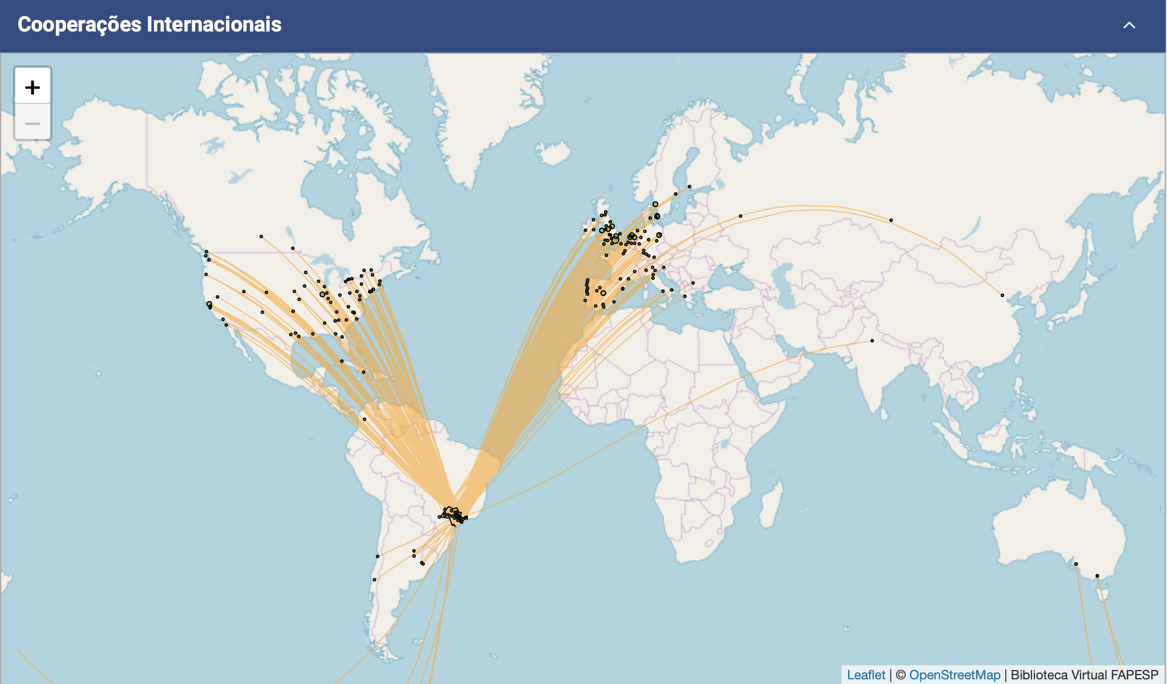
International cooperation

Slide 16

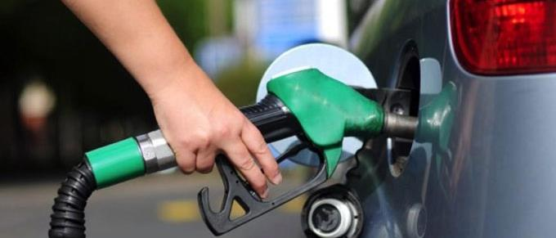

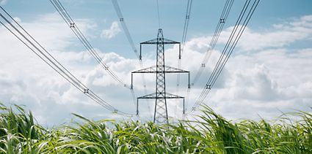
CALL FOR PROJECTS – ongoing 2023
Improve Efficiency and Sustainability of Bioenergy End Use
Contribute to the global effort towards a low carbon economy
Give subside to BIOEN activities within IEA Bioenergy, GBEP, and Biofuture Plataform
Biofuels for internal combustion engines
Ethanol application in Electric Vehicles (EV)
Sustainable Aviation Fuels (SAF) based on biomass
Marine and stationary applications of biofuels
Electricity generation from biomass
Biohydrogen

Slide 17

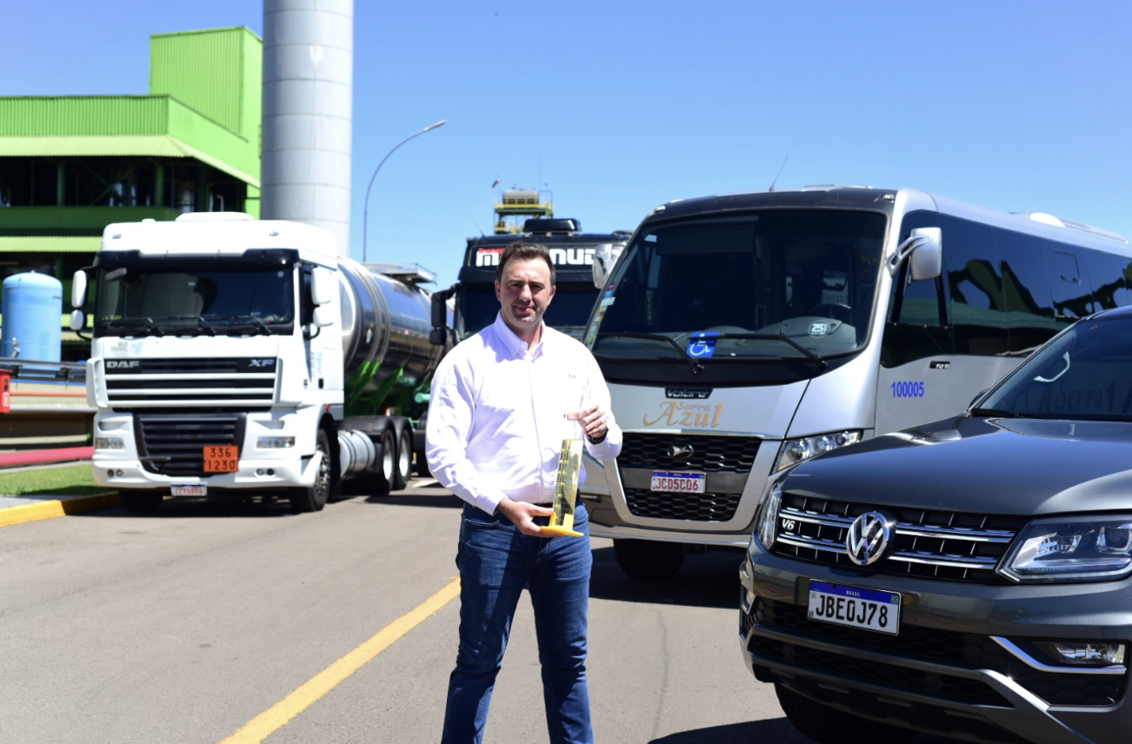
BeVant biofuel
Can replace diesel up to 100% no changes in engines.
Biodiesel as a raw material, but drop-in characteristic of HVO
More competitive than HVO (~ 50% lower price)
Production to start in 12 months
Investments of R$ 80 million for a capacity of 150 million liters/year.
Passed the testing phase and is cleared for use in any diesel cycle engine
The tests carried out on Euro V engines and meet Euro VI requirements
Higher ester contente reduces CO emissions by up to 50%
Particulate matter emissions by up to 85%
Black smoke by up to 90%
CO₂ emissions by up to 50% compared to fossil diesel
Biodiesel producer Be8 (formerly BSBIOS)
Notes:
Battistella explains that the biofuel is aimed at the Brazilian market and aims to serve companies that consume large volumes of traditional diesel oil and are looking for solutions to reduce their carbon emissions in the short term.
It can be used in power generators, heavy construction machinery, agribusiness and earthmoving, in addition to being an alternative for logistics, public transport and cargo sectors in road, sea and rail modes.
"We are talking about an immediate solution, which does not depend on investment in infrastructure or engine replacement compared to other technological routes such as hydrogen, biomethane and electric vehicles, with a high impact on the depollution of large urban centers in the short term," says Battistella.

Slide 18
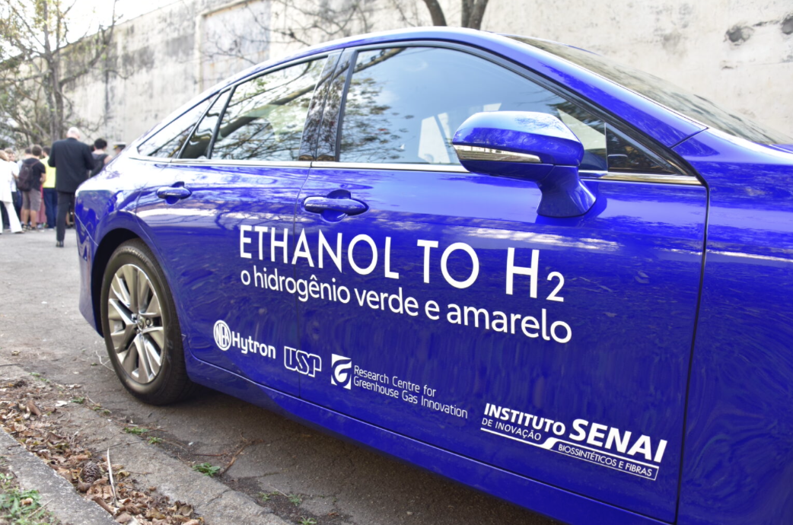
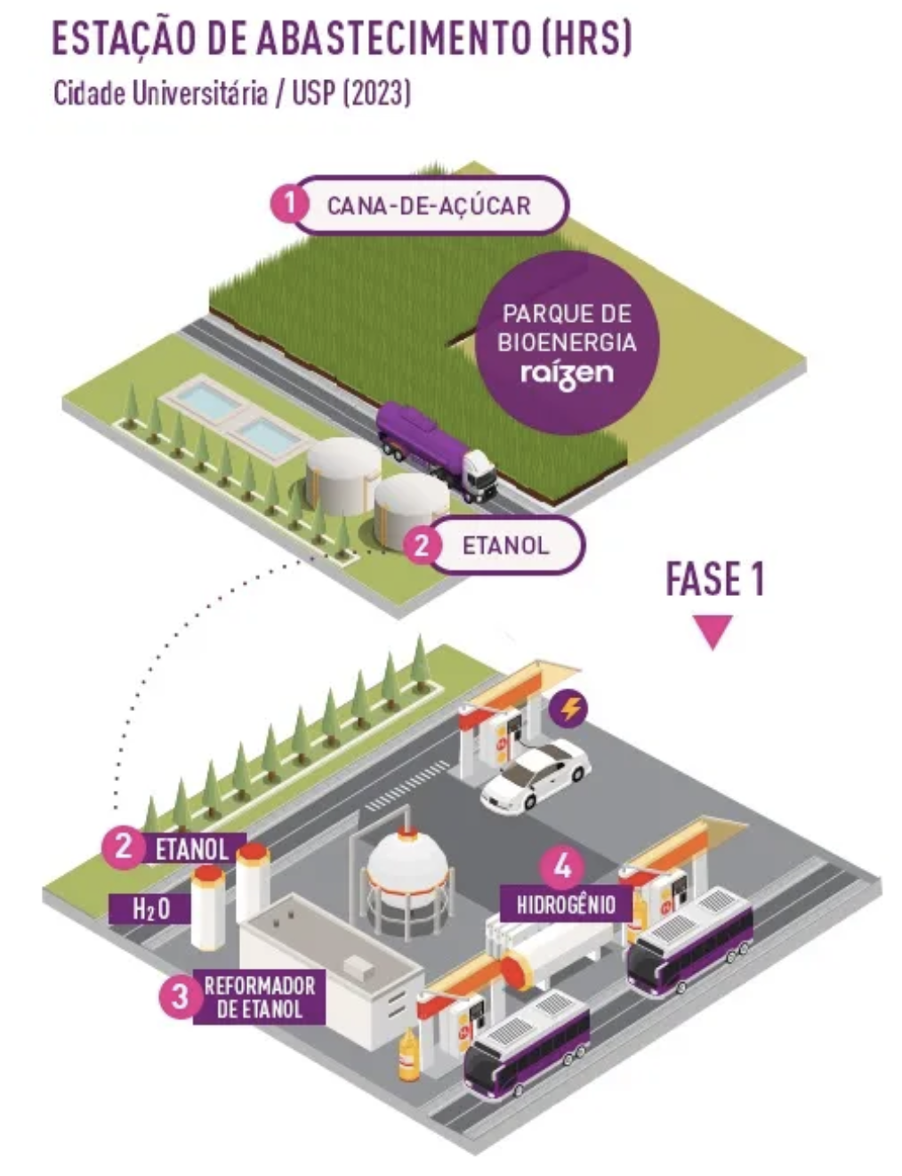
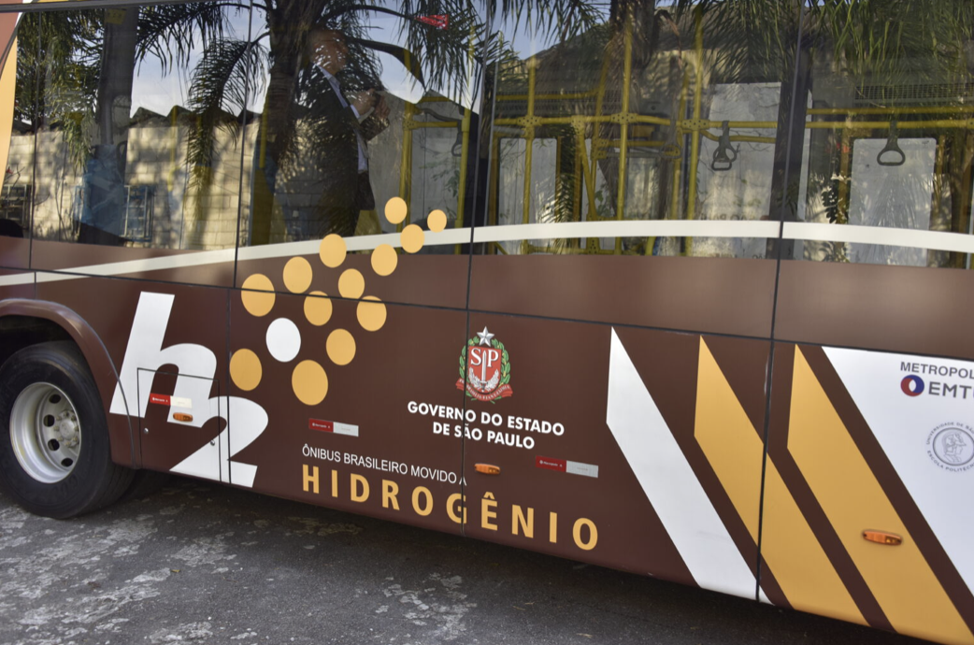
Renewable hydrogen from ethanol
Cooperation agreement for the development of two renewable hydrogen production plants from ethanol (capacities of 5 kg/h and 44.5 kg/h)
Vehicle supply station for fuel cell buses and cars that circulate through the main campus of the University of São Paulo
R$ 50 million investment from Shell Brasil, obtained via ANP. Technology for ethanol reform developed by Hytron through a FAPESP PIPE grant
Partnerships with Raízen, SENAI CETIQT, a Universidade de São Paulo, Marcopolo
E. Yamamoto, Jornal da USP, 2023, https://jornal.usp.br/?p=559072

Slide 19
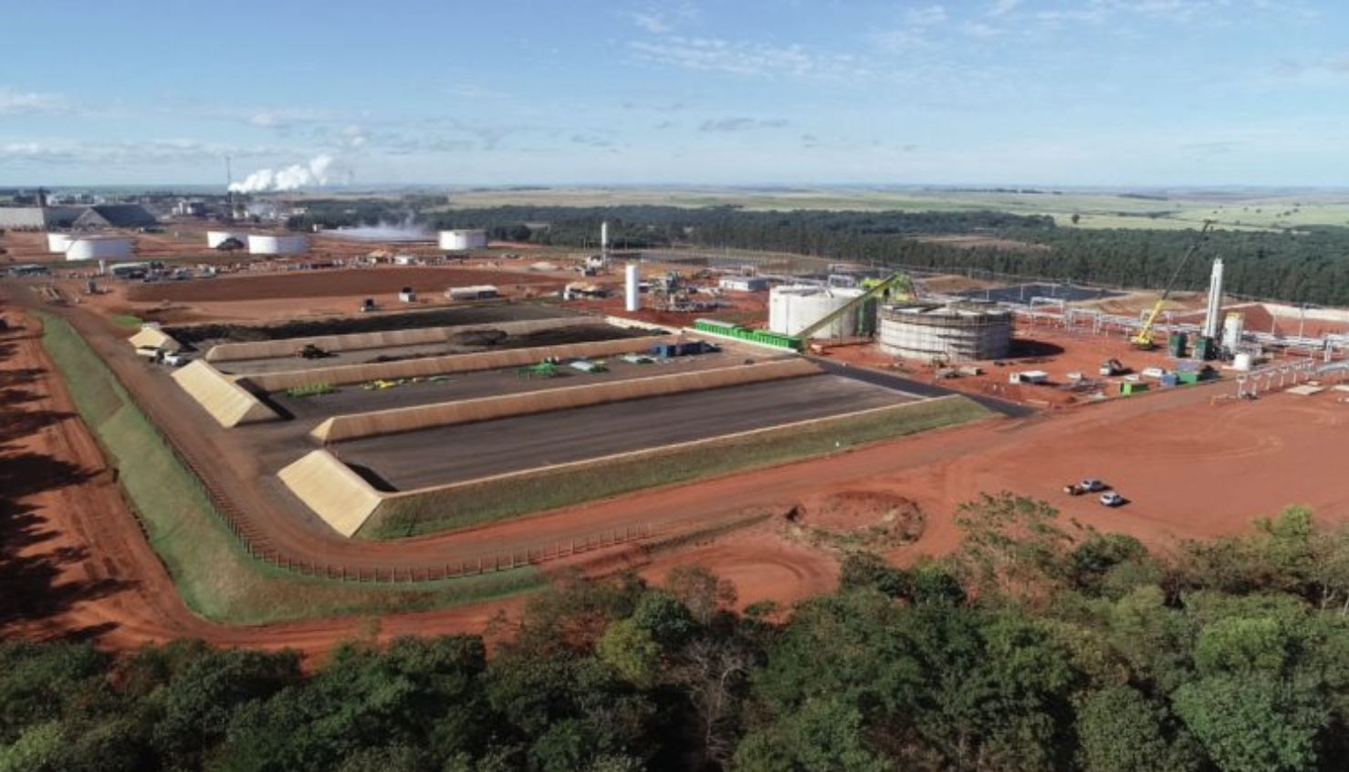
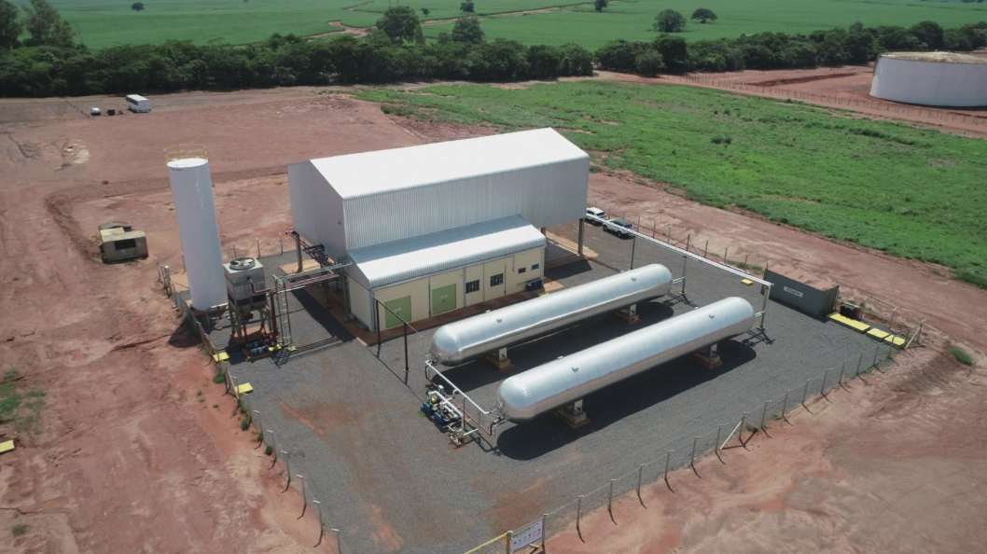
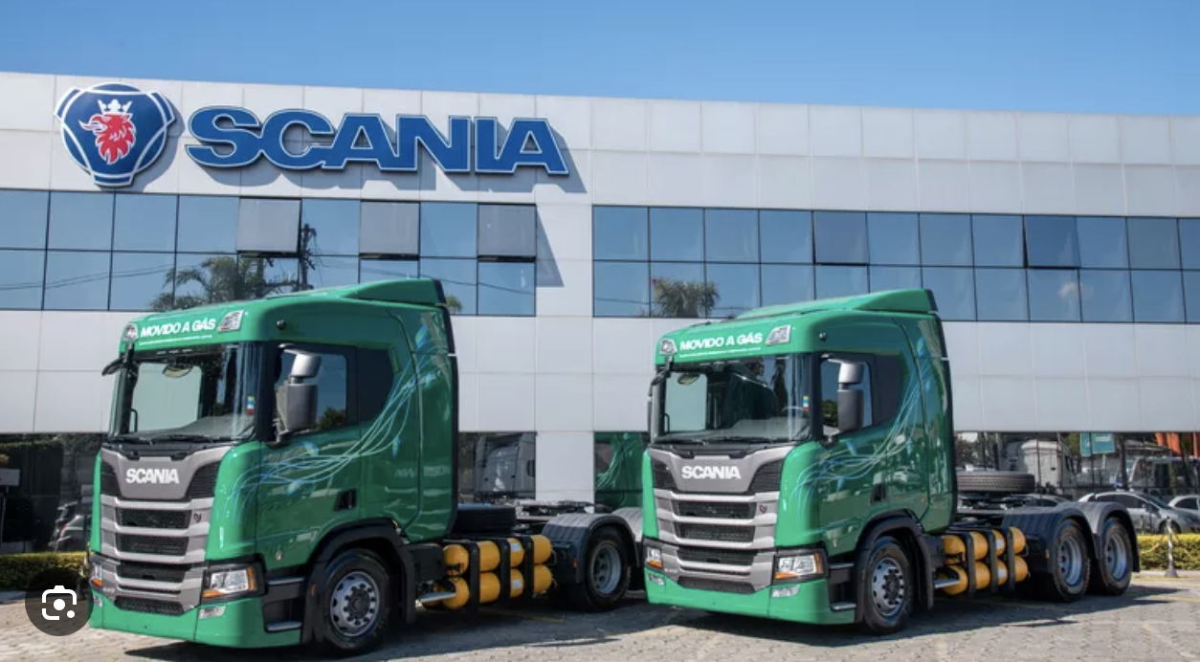
Vinasse + filter cake > biogas + biomethane + bioelectricity + food grade CO₂ + biofertilizer
15,000 m³/day of sugarcane biomethane for three municipalities
National production potential can zero the Brazilian goal of the Global Methane Agreement
Total investment of R$ 150 million from Cocal, financed by BNDES in the Climate Fund program, and R$ 30 million from GasBrasiliano
51 km of first dedicated pipeline from Cocal Plant to three cities
14.5 km of piping for the connection to the industrial, commercial, residential and vehicular market in the urban areas of these municipalities
Biomethane 30% cheaper than diesel oil for consumers
The national potential estimated at 121 million m³/day, the entire Brazilian goal of the Global Methane Agreement (8 million tons of methane avoided emissions (ABIOGAS).
25 new plants by 2030 (2.3 million m³/day, 2 million tons of methane avoided emissions)
Parallel production of 35 thousand MWh/year (660 consumer units) (Cocal consortium with Raízen)+ electricity from the burning of sugarcane bagasse and other biomass (470,000 MWh/year)
CO² food grade for ovens and ovens/dryers of the food industry
R$ 25 million investment (Cocal) for 16,000 tons of CO² food grade per year
Residual materials return to the field as biofertilizers
~90% of Cocal's 150,000 hectares of production use biofertilizer from sugarcane by-products, environmental and financial advantages when compared chemical fertilizer.

Slide 20
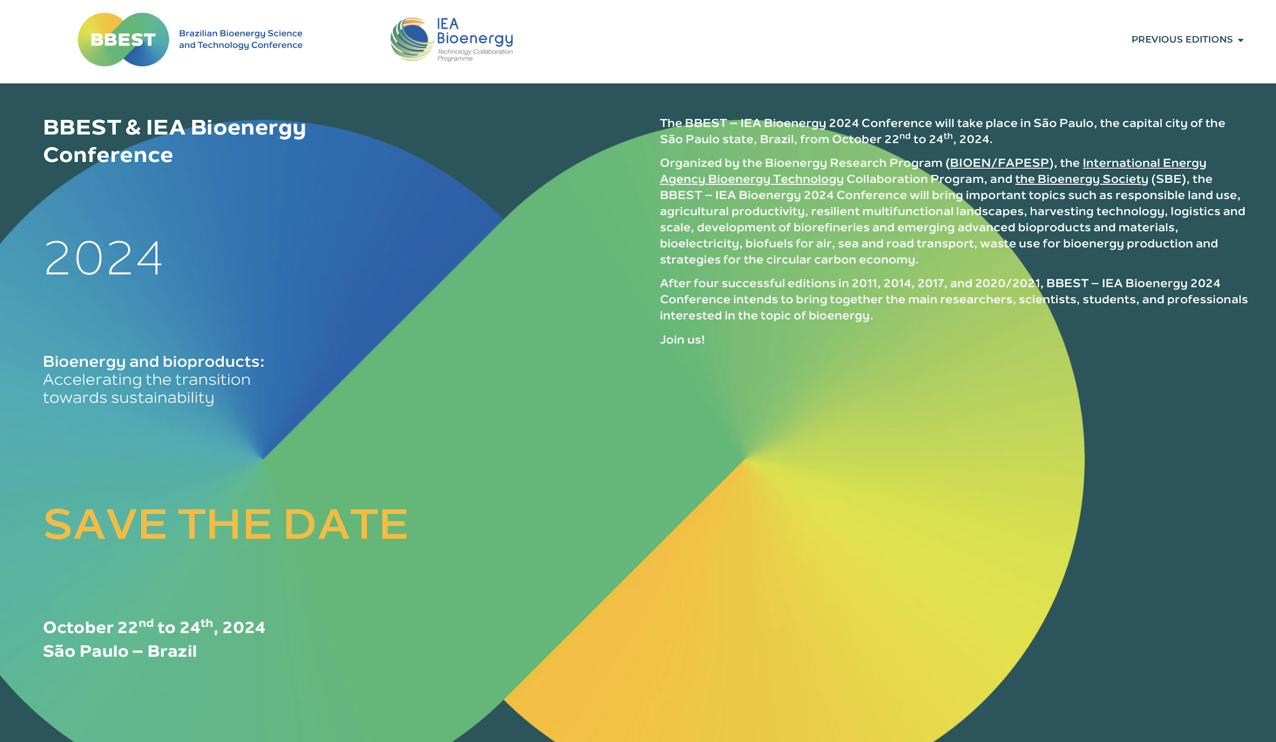

http://bbest-ieabioenergy.org

Slide 21


http://bioenfapesp.org
Glaucia Mendes Souza
University of São Paulo
glmsouza@iq.usp.br

