Slide 1
BioTheRoS Project – International Collaboration
Andrea Sonnleitner, BEST
October 25, 2023
Leipzig, Germany

Slide 2
Contents
BioTheRoS Concept Description
Project Objectives
Project Methodology
Consortium: Partners and Roles
Work Plan
WP 7 International cooperation and network development
Collaboration with IEA Bioenergy and others

Slide 3
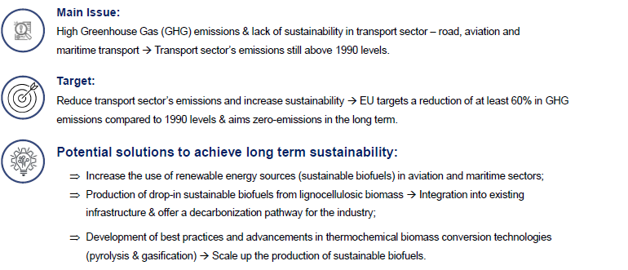
Concept Description

Slide 4
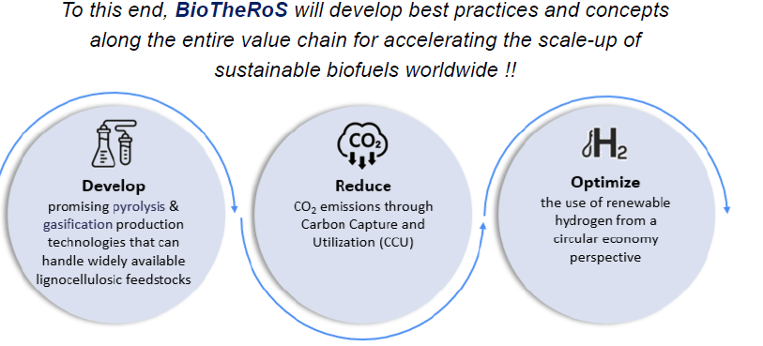
Concept Description

Slide 5
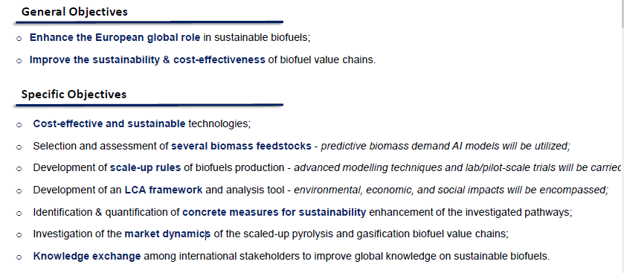
Project Objectives

Slide 6
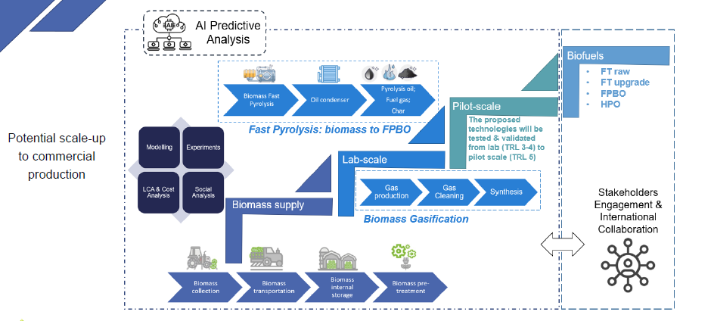
Project Methodology

Slide 7
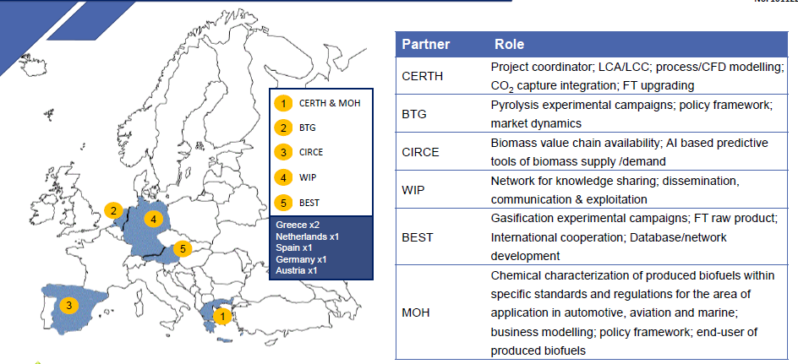
Consortium: Partners Roles & Responsibilities

Slide 8






Work plan
WP1 Project Management and Coordination
WP2 New value chains for biomass valorization to aviation & maritime biofuels
WP3 Pyrolysis value chain pilot validation
WP4 Gasification value chain pilot validation
WP5 Impact assessment and replication
WP6 Market dynamics & techno-economic feasibility
WP7 International cooperation and network development
WP8 Dissemination and communication

Slide 9
WP 7 International cooperation and network development
Objectives
Map and use synergies with European and international research groups working on relevant research questions for scaling-up sustainable biofuels
Exchange information with European and international groups and networks on topics related to sustainable biofuels value chains
Develop a network for knowledge sharing and information exchange through international collaboration

Slide 10
Collaboration with IEA Bioenergy and others
Task 33 - gasification
Task 34 – Fast pyrolysis
Task 39 – Biofuels
ETIP Bioenergy
Task 40 – hydrogen and CCU
Project from 10/23-09/26
Workshops for information exchange and discussion, sharing results
Link to technical WP (pyrolysis, gasification)
Joint workshop on market dynamics for all transport sectors (shipping, aviation, road transport)
Notes:
International and European networks will be contacted to collaborate for information exchange regarding the
different technological WPs (WP3/WP4). A meeting will be held with the IEA Bioenergy Task Leaders at an IEA
Bioenergy ExCo Meeting to identify common elements between the BioTheRoS and the IEA Tasks research
agendas. Workshops with the networks for information exchange and discussion on the identified topics and
common elements linked to the technological work packages will be carried out. For each network there will be at
least one workshop for information exchange and sharing of results. One highlight within this cooperation will be
a joint workshop on market dynamics for all transport sectors (shipping, aviation, road transport) with all above
mentioned networks. In Task 33 the collaboration will be done on the subtask biofuels from gasification. Another
important aspect will be the information exchange with the Task 34 project on transportation fuels from fast
pyrolysis led by the member country India. Within Task 39 there is a strong representation of the member country
Brazil and the possibility for information exchange. With Task 40 the intertask projects on biohydrogen and carbon
capture and utilization will be the main points for information exchange.

Slide 11
Andrea Sonnleitner, BEST Bioenergy and Sustainable Technologies GmbH, andrea.sonnleitner@best-research.eu

