Slide 1


New Zealand Low Carbon Transport
Paul Bennett
October 2023

Slide 2

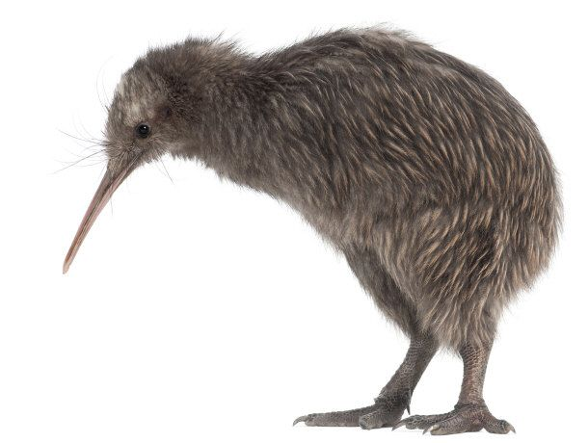
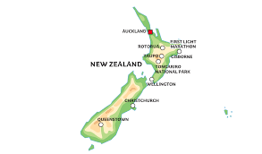
New Zealand Overview
268,000 km2 – 75% size of Germany
5.2 Million people – 6% of Germany
  (and 25 million sheep and 4 million cattle)
Very dispersed population
No national passenger rail, some freight
  Local rail services in two cities
Car fleet
  4.5 million
  Average age 14 years – large number of second hand imports from Japan
Large domestic aviation network

Slide 3
EVs in New Zealand
2016 Gov’t EV programme introduced
2019 NZ$8,000 clean car discount
2022 12.5% of new car sales
Targets
  2025 - 33,000 new EVs
  2030 - 100% of new car sales

Slide 4
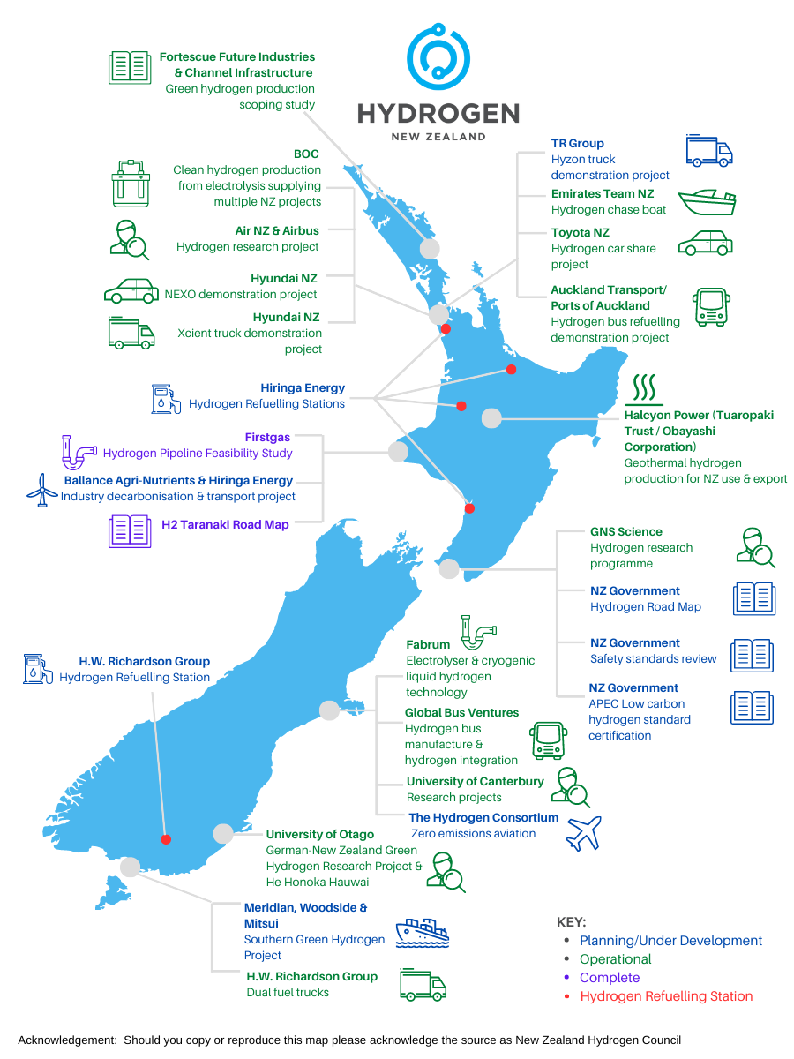
Hydrogen Projects
$50 million of Government investment
- NZ has 84% renewable power
- Anticipation of closure of aluminium smelter (15 GWh per day)
Support for demonstration projects
- Production
- Supply chain
- Refuelling
- Trucks/Buses/Boats/Planes

Slide 5

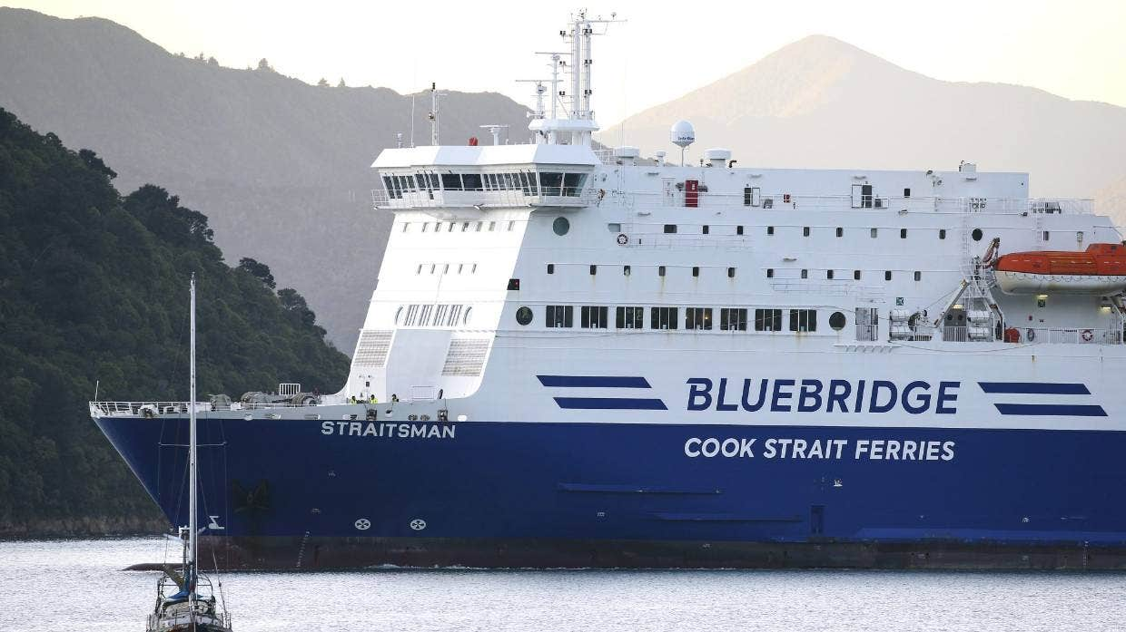
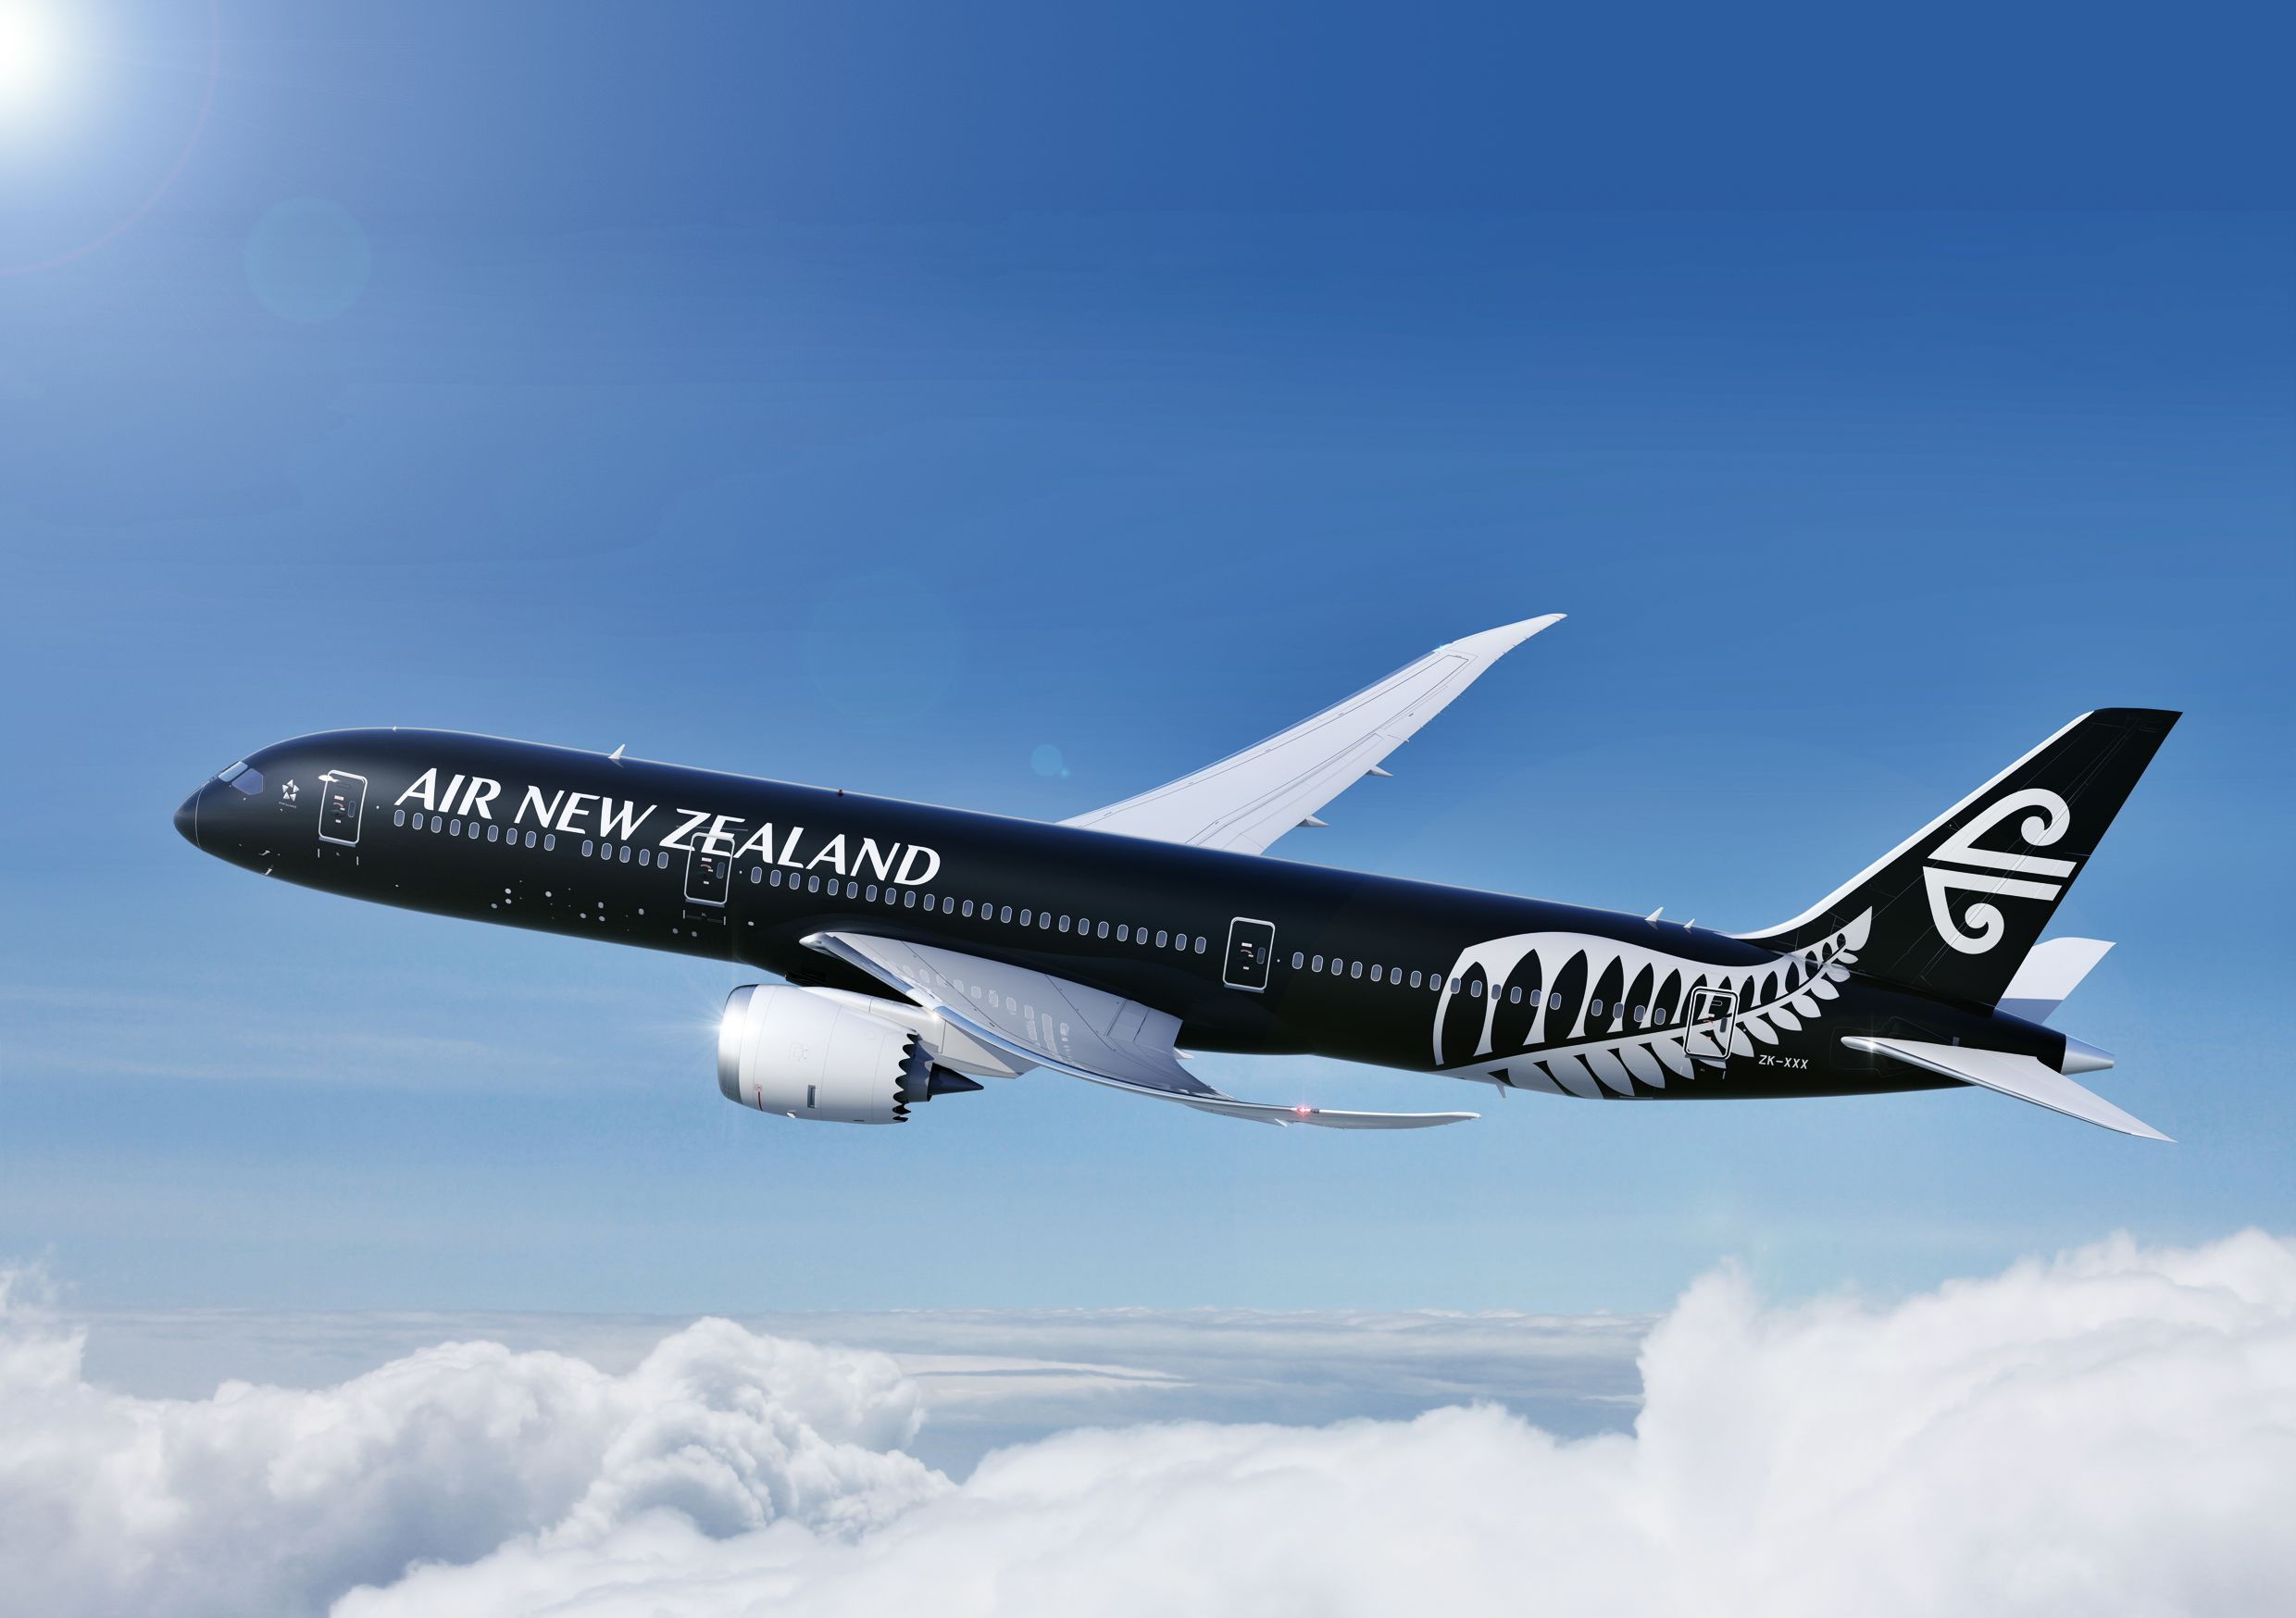

Liquid Biofuel Activities
2023 - Liquid Biofuels Obligation was withdrawn before implementation!!
But certain sector is starting to demand biofuels and are leading the way
Export focused economy: Nearly 50% GDP reliant on international travel, and 99% exports by ship
24% Used Cooking Oil Methyl Ester (UCOME) biofuel blended with very low sulphur fuel oil (VLSFO)
World’s 3rd SAF flight
2022 1 million litres SAF from Singapore delivered
2023Air NZ funding two detailed feasibility studies;
Lanzatech from Wood
Fulcrum from MSW

