Slide 1

CANADA - TASK 39 IMPLEMENTATION AGENDA
Hana Mohammadi & Jack Saddler (University of British Columbia)
Naheda Sahtout, Oriana Vanderfleet, Sara Eskandarifar, Ellen Handyside, Allison Simmonds & Oshada Mendis (Natural Resources Canada)
Xiong Mai (Environment and Climate Change Canada)
October 25, 2023

Slide 2
Canada’s Greenhouse Gas Emissions
In 2021, domestic GHG emissions totalled 670 Mt CO₂ eq.
This is a decrease from 2005 levels (732 Mt CO₂ eq).
The transportation sector GHG emissions have generally been consistent from 2005-2021, fluctuating between a high of 170 Mt CO₂ eq (2019) and a low of 143 Mt CO₂ eq (2020).
  Transportation sector was the second largest source of GHG emissions.
Environment and Climate Change Canada (2023) Canadian Environmental Sustainability Indicators: Greenhouse gas emissions. Available at: www.canada.ca/en/environment-climate-change/services/environmental-indicators/greenhouse-gas-emissions.html.

Slide 3
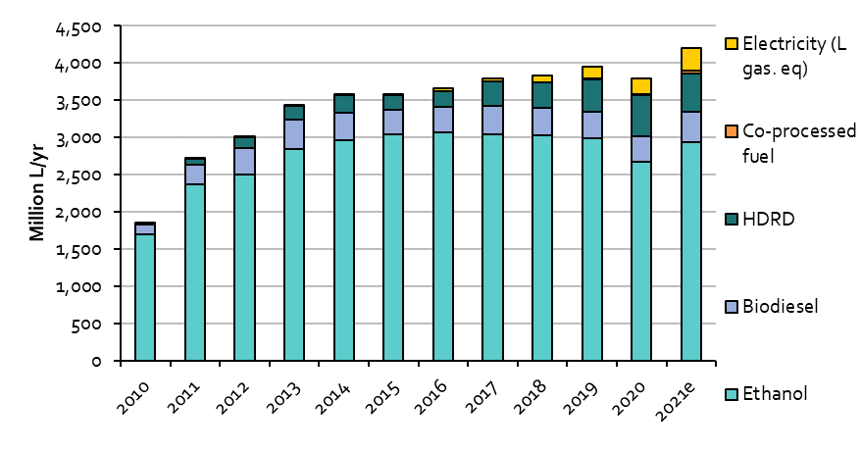
Biofuels Consumption
Biofuel consumption declined in 2020 due to overall lower fuel demand during the pandemic but rebounded in 2021.
Ethanol consumption increased from roughly 1,700 Million L/yr in 2010 to ~3,000 Million L/yr in 2014-2021.
Biomass-based diesel consumption reached almost 900 Million L/yr in 2020, driven by increased HDRD consumption.
Consumption of co-processed fuels grew to 20 Million L/yr in 2020 (and estimated 44 Million L/yr in 2021), all occurring in the province of British Columbia.
NOTE: Canadian fossil fuel consumption (2020) includes 35,432 Million L/yr of gasoline and 24,106 Million L/yr of diesel.
Navius, 2022. Biofuels in Canada 2022: Tracking biofuel consumption, feedstocks and avoided greenhouse gas emissions.

Slide 4
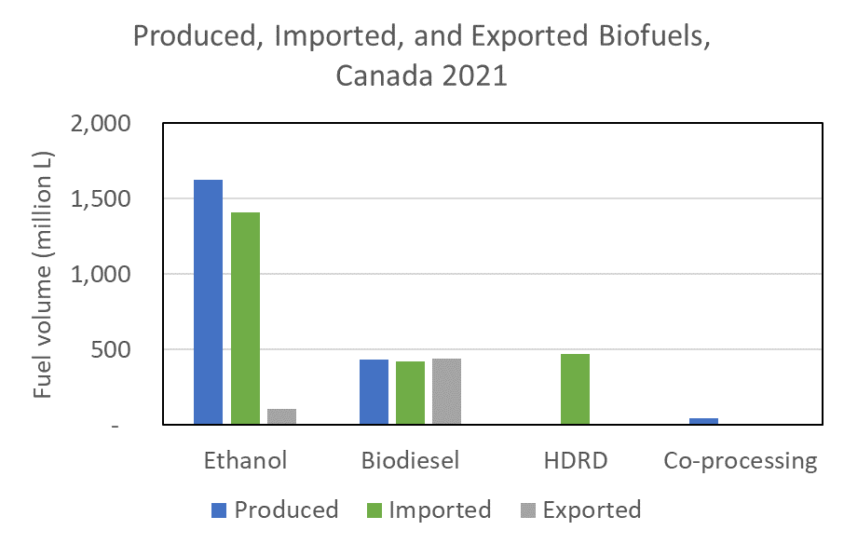
Biofuels Production & Import
Canada currently imports a significant fraction of biofuels used domestically, but this may change with new policies.
Biodiesel imports/exports are nearly equal; Canada could theoretically sustain its biodiesel market with domestic production.
All HDRD is imported as Canada currently has no domestic production capacity.
Canada began co-processing in 2019; this is a potential growth opportunity for domestic biofuels production.
Production & import data from: ECCC, 2022. Data collected under the Renewable Fuels Regulations.
Export data from: USDA Foreign Agriculture Service, 2022. Biofuels Annual Canada.

Slide 5
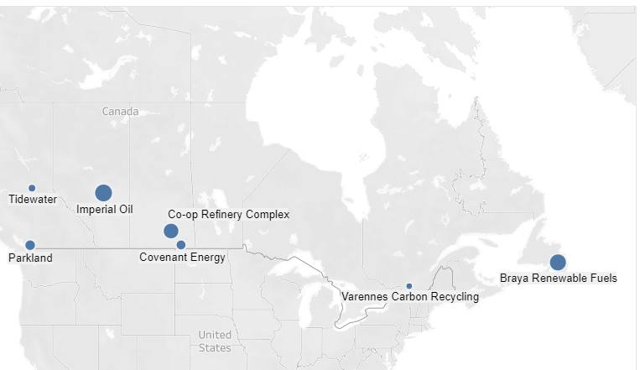
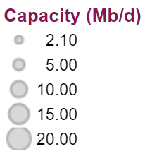
Domestic Renewable Diesel Production
Renewable diesel capacity is being established in Canada, with approx. 5,000 Million L/yr expected to come online between 2023 and 2027.
  Note current diesel consumption (2020) in Canada is 24,106 Million L/yr.
New production facilities require significant capital investments and are reliant on policy signals.
Co-processing is an alternative route that leverages existing infrastructure.
  Favored by some producers, e.g., Parkland.
  Significant potential in Canada: 17 refineries with a total capacity of 120,000 Million L/yr as of 2020.
Construction underway; production to begin in 2025
Production to begin late 2023
Planned operation by 2027
Planned operation late 2023
Cancelled early 2023
Construction planned in 2024; operation by 2026
Construction underway; commissioning in 2025
Canada Energy Regulator, 2023. Market Snapshot: New Renewable Diesel Facilities Will Help Reduce Carbon Intensity of Fuels in Canada
Notes:
Tidewater: 3000 bpd
Imperial Oil: 20,000 bpd or 3M L/d
Co-op: 15,000 bpd
Covenant: 430 ML/year
Varennes: 125 ML/year
Braya: 24,000 bpd

Slide 6
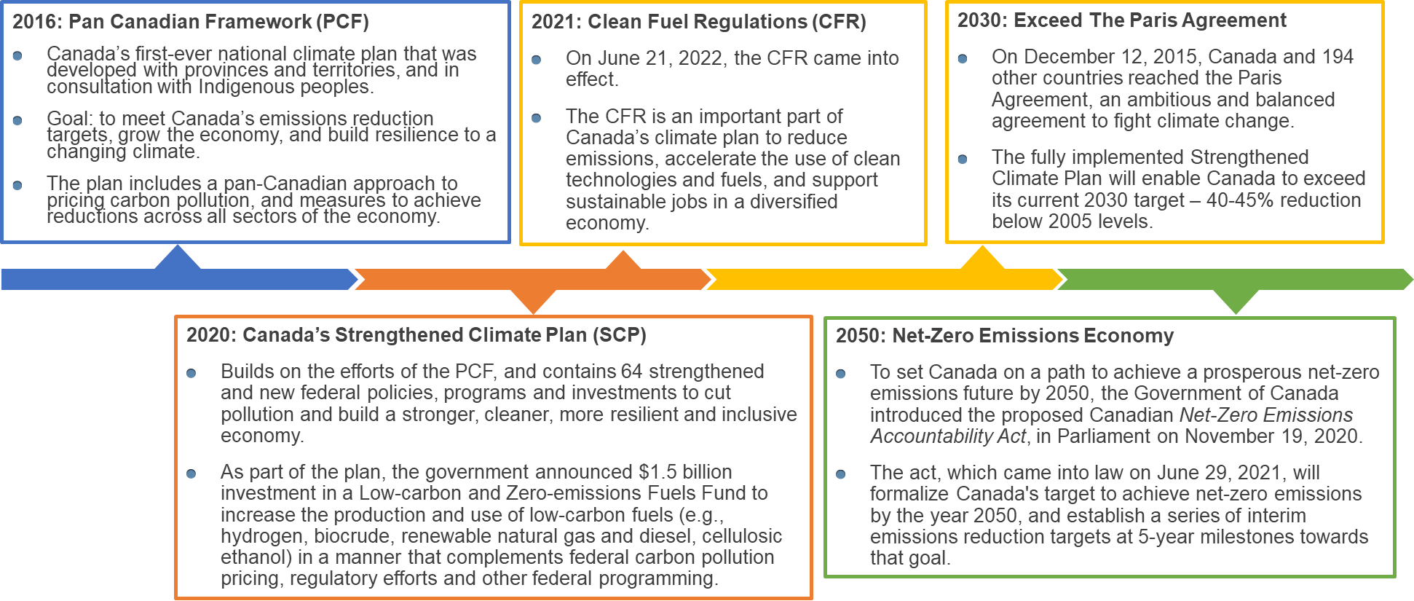
Moving Forward: A Snapshot to Net-Zero
To achieve targets, Canada is making use of:
Policy design and implementation to create market-pull.
Fiscal investments to create technology-push.
Notes:
-PCF: first climate plan, Clean Fuels Standard announced (now CFR)
-SCP: a more ambitious version of the PCF with 64 measures (policies, programs and investments), including the $1.5B CFF
-2022: CFR came into effect
-Ambitious targets: to exceed the Paris Agreement reduction targets by 2030 (40-45% below 2005 levels), net zero by 2050
-Legally binding "Net-Zero Emissions Accountability Act" with interim reduction targets
Editable version is in this presentation: https://gcdocs.gc.ca/nrcan-rncan/llisapi.dll?func=ll&objaction=overview&objid=81179282

Slide 7
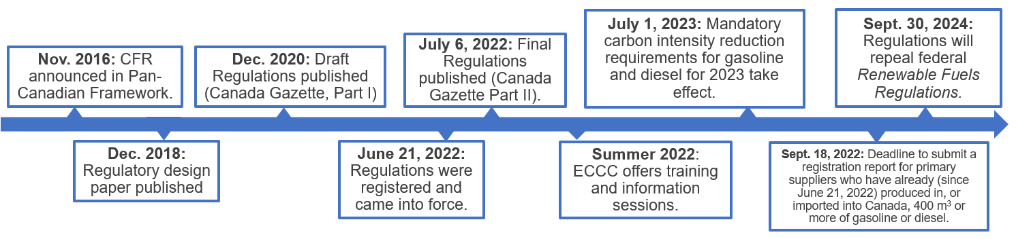
Clean Fuel Regulations (CFR)
Focuses on reducing the CI of liquid transportation fuels.
Looks to deliver up to 26 Mt CO₂ eq. of GHG emissions reductions in 2030 (decreasing the carbon intensity of gasoline and diesel used in Canada by approx. 15% by 2030).

Slide 8
Clean Fuel Regulations (CFR) Emissions Reductions
Primary liquid fossil fuel suppliers (i.e., producers and importers) required to gradually reduce the CI of the gasoline and diesel
2016 "baseline" CI levels (95 gCO2e/MJ for gasoline and 93 gCO2e/MJ for diesel) used for reference
Clean Fuel Regulations Carbon Intensity Limits for Different Fuel Classes (gCO₂e/MJ) (Canada Gazette, 2022).1
Fuel | 2016 Baseline | 2023 | 2024 | 2025 | 2026 | 2027 | 2028 | 2029 | 2030 and after
Diesel | 93 | 89.5 | 88 | 86.5 | 85 | 83.5 | 82 | 80.5 | 79
Gasoline | 95 | 91.5 | 90 | 88.5 | 87 | 85.5 | 84 | 82.5 | 81

Slide 9
Clean Fuel Regulations (CFR)
Establishes a credit market - regulated parties (producers and importers of gasoline and diesel) must create or buy credits generated in one of three categories:
CC1
Actions that reduce the CI of the fossil fuel throughout its lifecycle.
CC2
Supplying low-carbon fuels.
CC3
End-use fuel switching.
The CFR will use the Fuel LCA Model, an OpenLCA software-based model developed by Environment and Climate Change Canada (ECCC), to calculate the CI of fuels and determine compliance and credit creation.
  Distinct from GHGenius model used for British Columbia Low Carbon Fuel Standard (BC LCFS), which is privately owned.
While aviation and non-diesel marine fuels are not obligated under the CFR, supplying low-carbon liquid transportation fuels for aviation applications (e.g., sustainable aviation fuel), is eligible for credit generation.
Notes:
CC1: CCUS, low-CI power integration
CC2: Production and import of clean fuels, e.g., RD, ethanol, SAF
CC3: Delivering transportation fuel using advanced vehicle technologies, including hydrogen and power for EVs

Slide 10
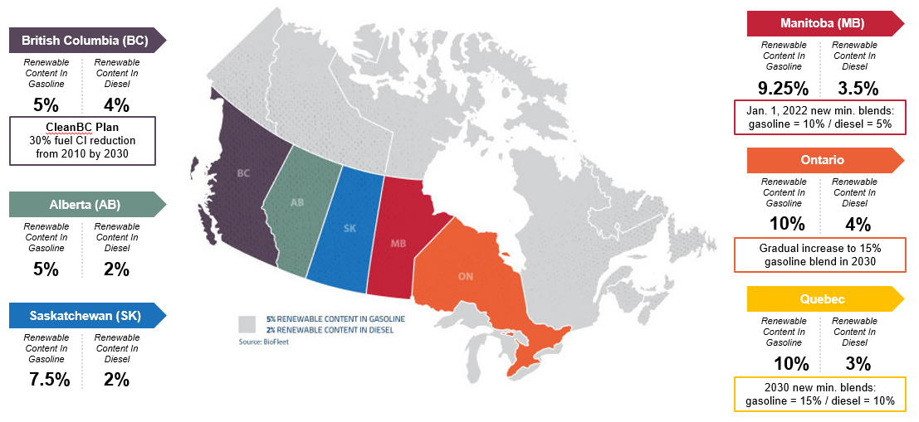
Provincial Level Policies
Some provinces have low carbon fuel policies that complement the CFR.
British Columbia has the Low Carbon Fuel Standard.
Alberta has the Renewable Fuel Standard.
Ontario has the Cleaner Transportation Fuels Regulation.
Notes:
Summarized below are some examples of Canadian jurisdictions that have low carbon fuel policies (such as renewable fuel mandates or a fuel standard).
British Columbia’s Low Carbon Fuel Standard (BC-LCFS): Bruce Ralston, Minister of Energy, Mines and Low Carbon Innovation for British Columbia highlighted that the BC-LCFS is an incredibly successful program and is the single largest contributor to reducing GHG emissions in the province (BC Gov News, 2022a). The BC-LCFS mandates a minimum 5% annual average renewable fuel content in gasoline and 4% renewable fuel content in diesel (Government of British Columbia, 2022). Further, the BC-LCFS aims to achieve a 30% CI reduction target for the diesel and gasoline fuel pools by 2030, following a reductions schedule that came into effect January 1, 2023 (Government of British Columbia, 2022). A fuel supplier can generate credits for fuels supplied in British Columbia with a CI below the target, and accrue debits for fuels having a CI over the target. Each credit or debit is equivalent to 1 tonne of CO2eq and a supplier’s balance must either be zero or carry a credit to avoid non-compliance penalties of $600/debit (Government of British Columbia, 2022). British Columbia’s fuel suppliers can comply with the LCFS by either supplying low-CI fuels, buying credits from other fuel suppliers, or earning credits through Part 3 agreements, i.e., agreements between a fuel supplier and the Ministry of Energy, Mines and Low Carbon Innovation, (Government of British Columbia, 2022). From 2010 to 2021, actions taken to comply with the LCFS have resulted in a reduction of more than 15.7 Mt of GHG emissions (BC Gov News, 2022b). The BC-LCFS has proven to be an effective “market-based mechanism”. The LCFS is important as it targets the transportation sector, which contributed 36% of British Columbia’s GHG emissions in 2020 (BC Gov news, 2022b).The BC-LCFS is the largest contributor to CleanBC goals and is expected to lead to a reduction of 5 Mt of GHG emissions by 2030, 31% of the amount required to meet CleanBC Roadmap climate targets (BC Gov News, 2022a). The modified BC LCFS, termed the Low Carbon Fuels Act and which came into effect Spring 2022, defines a jet fuel category and introduces “fossil-derived jet fuel” as a base fuel. The Low Carbon Fuels Act also enables the creation of regulations regarding the use of jet fuel and its characteristics. The Ministry of Energy, Mines and Low Carbon Innovation is developing regulations that are intended to bring the Act into force on January 1, 2024.
Alberta: The Renewable Fuels Standard requires a minimum annual average of 5% renewable alcohol in gasoline and 2% renewable content in diesel fuel sold in Alberta by fuel suppliers. To meet the Renewable Fuels Standard, renewable fuels must demonstrate at least 25% fewer GHG emissions than the equivalent petroleum fuel (Government of Alberta, 2023).
Manitoba: Since their introduction, the Manitoba Ethanol Mandate and the Biodiesel Mandate have ensured that renewable energy is used in transportation fuels sold for use within the province. The annual compliance with these mandates has required fuel suppliers to replace at least on average 9.3% of gasoline blended with ethanol, and 2.4% renewable content in both on- and off-road diesel fuel, although there is flexibility in both blending season and renewable fuel types to meet the Biodiesel Mandate. (Government of Manitoba, 2020). Effective January 1, 2021, the province required 9.25% ethanol content in gasoline. The requirement grew to 10% on January 1, 2022. The biodiesel requirement increased to 3.5% on January. 1, 2021 and 5% on January 1, 2022 (Biodiesel Magazine, 2020).
Ontario: The Cleaner Transportation Fuels regulation requires that fuel suppliers blend 10% of renewable content in gasoline from 2020 to 2024. The renewable content requirement will increase to 11% in 2025, 13% in 2028, and 15% in 2030 and onwards. The renewable content must emit fewer GHG emissions than fossil gasoline on a lifecycle basis by 45% before 2030 and 50% from 2030 onward. The regulation also requires fuel suppliers to continue to blend 4% renewable content in diesel. This renewable content must emit 70% fewer GHG emissions than fossil diesel on a lifecycle basis (Government of Ontario, 2021).
Saskatchewan: The Renewable Diesel Act requires fuel distributors to include 2% renewable content in diesel fuel sold in Saskatchewan on an annual average basis (Government of Saskatchewan, 2012). The province also has an Ethanol Fuel Regulation that requires distributors in the province to blend ethanol with unleaded gasoline fuel at 7.5% annually as of January 1, 2008 (Government of Saskatchewan, 2002).
Quebec: Effective January 1, 2023, Quebec requires 10% low-CI fuel content in gasoline and 3% in diesel. These requirements will increase to 15% for gasoline and 10% for diesel by 2030. In both fuel pools, the percentages by volume of low-CI fuel content are established on the basis of the reduction in CI over the period of one calendar year (Légis Québec, 2022).
Nova Scotia: The Environmental Goals and Climate Change Reduction Act highlights the Government's targets in relation to GHG emissions reductions and that GHG emissions in the province must be, by 2030, at least 53% below the levels that were emitted in 2005; and by 2050, at net-zero, accomplished by balancing GHG emissions with GHG removals and other offsetting measures (Nova Scotia Legislature, 2021).
Prince Edward Island (PEI): The PEI government is encouraging business and community organizations across the province to install electric vehicle (EV) charging stations targeted for business and public use through its PEI EV Charging Funding Program (Government of PEI, 2023a). The PEI government has phased out fossil fuel rebates as of December 31, 2022 (Government of PEI, 2023b). The province offers a wide variety of rebates and financial incentives to help reduce energy use through its Net-Zero Navigator. The Path to Net-Zero serves to highlight PEI’s goals of achieving net-zero emissions by 2040.
Yukon: Although not officially established, the territory of Yukon has had extensive consultations to the creation of a Clean Energy Act by 2023 to legislate GHG commitments, provide the Government of Yukon with the regulatory tools needed to meet those GHG commitments, and ensure long-term climate change accountability through public reporting. The Government of Yukon is committed to reducing the Yukon’s GHG emissions, with the exception of mining emissions, by 45% by 2030, reaching net-zero emissions across the Yukon’s entire economy by 2050 as part of its Clean Future.

Slide 11
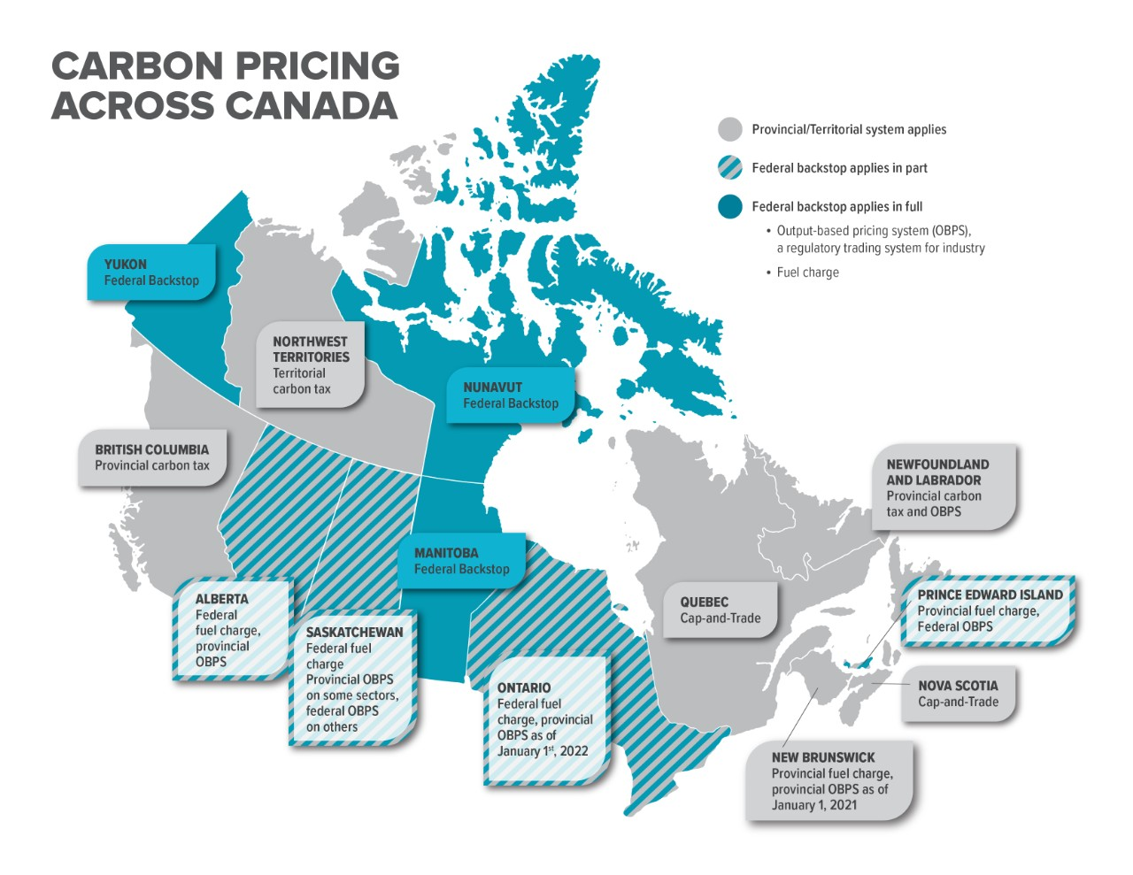
Carbon Pricing Regulations
Carbon Intensity benchmarks require all provinces and territories to have a carbon pricing plan.
Each jurisdiction must at a minimum follow the Federal Benchmark, which currently enforces a carbon price of $65/tonne CO₂eq, set to increase to $170/tonne CO₂eq by 2030.
National standards include:
  A regulatory charge on fossil fuels (Fuel Charge).
  A performance-based system for industries (Output-Based Pricing System).
Government of Canada. Carbon pollution pricing systems across Canada. 2023. Available at: https://www.canada.ca/en/environment-climate-change/services/climate-change/pricing-pollution-how-it-will-work.html
Notes:
The Canadian federal government has introduced CI benchmarks that require all provinces and territories to have a carbon pricing plan. Putting a price on carbon pollution is recognized as an efficient way to reduce GHG emissions while also driving innovation. Since 2019, every jurisdiction in Canada has had a price on carbon pollution. Canada’s approach is flexible: any province or territory can design its own pricing system tailored to local needs, or can choose the federal pricing system. The federal government sets minimum national stringency standards (the federal ‘benchmark’), that all systems must meet to ensure they are comparable and effective in reducing GHG emissions. If a province or territory decides not to price pollution, or proposes a system that does not meet these standards, the federal system is put in place (Government of Canada, 2021b).
In order to accelerate the market adoption of the technologies and practices needed to reduce emissions and to build a prosperous low carbon economy, Canada proposed in a Healthy Environment and a Healthy Economy to increase the price on carbon pollution. Following engagement with provinces, territories and Indigenous leaders, the minimum price on carbon pollution (for direct pricing systems) will increase by $15 per tonne per year starting in 2023 through to 2030.
Drawing on engagement and review process of the carbon pricing system, in August 2021 the Government published strengthened minimum national standards (federal benchmark) for the 2023 to 2030 period to make sure they are fair, consistent and effective. The standards contain two components: (1) A regulatory charge on fossil fuels like gasoline and natural gas, known as the fuel charge, which as of fall 2022 applies in Ontario, Manitoba, Yukon, Alberta, Saskatchewan and Nunavut, and (2) A performance-based system for industries, known as the federal Output-Based Pricing System (OBPS) which as of fall 2022 applies in Manitoba, Prince Edward Island, Yukon, Nunavut, and partially in Saskatchewan.
Carbon pollution pricing systems in Quebec, Nova Scotia, Newfoundland and Labrador, the Northwest Territories, British Columbia and New Brunswick continue to meet the federal benchmark stringency requirements. Provincial systems in place in Prince Edward Island, Alberta, Saskatchewan and Ontario meet the federal benchmark stringency requirements for the emission sources they cover. The federal backstop applies in these provinces to emission sources not covered by the provincial systems. In Prince Edward Island, the federal OBPS applies alongside the provincial fuel charge. In Alberta, Saskatchewan and Ontario, as of January 1, 2022, provincial output-based performance standards systems apply alongside the federal fuel charge (Government of Canada, 2021b, Government of Canada, 2022d).
Figure ‎10.7 shows a snapshot of the various carbon pricing regimes across Canada. The provinces and territories are highlighted in three colors depending on whether the federal backstop applies in full, in part or not at all.
Canada’s minimum national price on carbon pollution for explicit price-based systems (i.e., systems that directly set a price on emissions) is $65 per tonne of GHG emissions (CO2eq) in 2023, and this is expected to increase by $15 per year to $170 per tonne CO2eq in 2030 (Table ‎10.2; Government of Canada, 2022d). Carbon prices on specific fuel or emission sources must be calculated based on recognized global warming potential factors, such as those used for reporting requirements under the United Nations Framework Convention on Climate Change. As cap-and-trade systems set maximum emission levels rather than minimum carbon prices, the minimum carbon pollution price is translated into an equivalent cap on emissions (Government of Canada, 2022d).
Fuel charge: https://www.canada.ca/en/revenue-agency/services/tax/excise-taxes-duties-levies/fuel-charge.html
The fuel charge varies depending on the carbon content of the fuel in question. Under the federal system in 2021-22, for example, gasoline is charged at 8.8 cents per litre, and natural gas at 7.8 cents per cubic metre.
Output-Based Pricing System: https://www.canada.ca/en/environment-climate-change/services/climate-change/pricing-pollution-how-it-will-work/output-based-pricing-system.html
The federal OBPS is designed to ensure there is a price incentive for industrial emitters to reduce their greenhouse gas emissions and spur innovation while maintaining competitiveness and protecting against “carbon leakage” (i.e. the risk of industrial facilities moving from one region to another to avoid paying a price on carbon pollution).

Slide 12

Incentives & Investment Opportunities
The Sky’s the Limit Challenge ($13M)
Clean Fuels Fund ($1.5B)
Net-Zero Accelerator Initiative ($8B)
Energy Innovation Program – Clean Fuels & Industrial Fuel Switching ($53M)
Canada Growth Fund ($15B)
Provincial-level Initiatives
Zero Emission Vehicle Incentives ($400M)
Canada Infrastructure Bank
Canada's Budget 2023 included a commitment to engage with the biofuels industry in Canada to explore opportunities to promote its growth in Canada.
Notes:
Bioenergy related research is being conducted across Canada, at universities/colleges, within federal and provincial laboratories as well as in industry. Research, Development and Demonstration (RD&D) has been supported at both the federal and provincial/territorial levels. There are various types of government supports, spanning all stages of the biorefining process. The types of support available include: RD&D , business planning, plant construction, production, price support (e.g., tariffs), distribution and consumption (e.g., tax-breaks for the purchase of biofuel-consuming vehicles).
In 2018, Canada launched The Sky's the Limit Challenge. This program expanded the SAF network in Canada and contributed to cross-sectoral consortia building. It also helped identify existing expertise and capacities to help further scale-up SAF production in Canada. In March 2022, it was announced that Enerkem, based in Montreal, was awarded the $5 million grand prize. Enerkem develops and uses advanced thermochemical processes to convert municipal solid waste (MSW), as well as forestry and agricultural biomass, into sustainable chemicals and advanced biofuels, including SAF .
Various other types of federal and provincial government initiatives have been developed to encourage the production and use of biofuels. These span all stages of the biorefining process including low-interest loans, grants for feasibility studies and market development, grants for storage and distribution infrastructure and tax-breaks and rebates for the purchase of biofuel-consuming vehicles. Government support aimed at growing the clean fuel market across Canada includes: the $1.5 billion Clean Fuels Fund over five years, $8 billion in funding for the Net-Zero Accelerator Initiative (under the Strategic Innovation Fund), $67.2 million to support the implementation of the CFR, government procurement of SAF and sustainable marine fuel (such as through initiatives like the Greening Government Initiative), and preferential tax treatment (Accelerated Investment Incentive) for low-carbon fuels used in energy generation applications.
Natural Resources Canada’s Office of Energy Research and Development (OERD) administers the Energy Innovation Program (EIP), advancing clean energy technologies that will help Canada meet its climate change targets and supporting the transition to a low-carbon economy. OERD funds research, development and demonstration projects, and other related scientific activities. The $53 million Clean Fuels and Industrial Fuel Switching (CFIFS) call for proposals was announced in 2021 under the EIP, and targets industrial fuel switching and production of clean fuels for use in hard-to-abate sectors. Selected projects are expected to be announced in the near future.
Budget 2022 recognized Canada will need between $125 billion and $140 billion of investment every year from now until 2050 to achieve net-zero emissions, and that today’s annual investment in the climate transition is only between $15 billion and $25 billion, through a multitude of initiatives. Budget 2022 proposed establishing the $15 billion Canada Growth Fund to attract substantial private sector investment to help meet important national economic and climate policy goals. The 2022 Fall Economic Statement clarified that the Canada Growth Fund would utilize a broad suite of project financing tools, including contracts for difference.
Budget 2023 proposes to provide $500 million over ten years to the Strategic Innovation Fund to support the development and application of clean technologies in Canada. The Strategic Innovation Fund will also direct up to $1.5 billion of its existing resources towards projects in sectors including clean technologies, critical minerals, and industrial transformation (Government of Canada, 2023b).
In addition to Federal programs, Canadian provinces have been providing financial supports to develop biofuels technologies and markets such as British Columbia’s Innovative Clean Energy Fund, Alberta Bioenergy Producer Program and Emissions Reduction Alberta.
Canada is also incentivizing Canadians to switch to EVs through additional funding of $400 million for zero-emission vehicles (ZEVs) charging stations, announced in Budget 2022. Complemented by $500 million that Canada’s Infrastructure Bank will invest in large-scale ZEV charging and refueling infrastructure that is revenue generating and in the public interest, the funding will support the Government’s targets of deploying 84,500 chargers and 25 hydrogen stations by 2029. Budget 2022 also provided $1.7 billion to extend the incentives for the ZEV program to March 2025. To accelerate the manufacturing and adoption of cleaner cars, the federal government, as announced in Budget 2022, will put in place a sales mandate to ensure at least 20% of new light-duty vehicle sales will be ZEVs by 2026, at least 60% by 2030 and 100% by 2035. To reduce emissions from medium- and heavy-duty vehicles (MHDVs), the federal government will aim to achieve 35% of total MHDV sales being ZEVs by 2030.
Although Canada’s production of advanced biofuels is currently limited, federal and provincial policy incentives that favour low-CI biofuels will increase feedstock demand, requiring biofuel producers to turn to more abundant feedstocks, such as lignocellulosic biomass, ultimately increasing the production of advanced biofuels in Canada.

Slide 13





International Collaboration & Coordination
International Energy Agency
Canada participates in several IEA TCPs, including Bioenergy TCP Tasks 32 (Biomass Combustion), 33 (Biomass Gasification), 34 (Direct Thermochemical Liquefaction, 37 (Energy from Biogas), 39 (Advanced Transport Biofuels), and 43 (Sustainable Biomass Supply Integration), and the Advanced Motor Fuels TCP.
Mission Innovation
Canada played a leadership role in the first phase of Mission Innovation and co-led the Sustainable Biofuels Innovation Challenge. Mission members are collaborating through the Integrated Biorefineries Mission., which launched an Integrated Biorefineries Mission Roadmap in September 2022.
Biofuture Platform
Canada is one of 20 countries participating in this platform. Canada co-leads the Clean Energy Ministerial Biofuture Campaign.
Global Bioenergy Partnership
Canada is one of 23 countries participating in GBEP.
International Renewable Energy Agency
Canada officially joined IRENA in 2019.
Notes:
Mission Innovation
Canada played a leadership role in the first phase of Mission Innovation (MI). From 2016-2020, Canada co-led the Sustainable Biofuels Innovation Challenge (‘IC4’). In this phase, 16 countries made progress towards implementing affordable advanced biofuels for transportation and industrial applications. Currently, Canada is exploring opportunities to contribute to the next phase of Mission Innovation (‘MI 2.0’).
Replacing fossil fuel-based fuels, chemicals and materials with sustainable bio-based alternatives from residues and wastes could reduce GHG emissions, providing a renewable alternative for hard-to-abate sectors and support rural jobs. To realize this potential and to make sustainable bio-based alternatives from residues and wastes cost-competitive, Mission members are collaborating through the Integrated Biorefineries Mission. In September 2022, the Integrated Biorefineries Mission launched an Integrated Biorefineries Mission Roadmap in which the gaps and challenges in current biorefining value chains have been identified and key actions to support the Mission have been prioritized.
Biofuture Platform
Canada is one of 20 countries participating in the Biofuture Platform, a government-led international effort to promote accelerated development of advanced low carbon fuels, biochemicals and biomaterials. Canada co-leads the Clean Energy Ministerial Biofuture Campaign, which formally launched the 11 Clean Energy Ministerial (CEM11). The intent of this platform is to accelerate the deployment of bio- and waste-based products and showcase how they can and will benefit society.
Global Bioenergy Partnership
Canada is one of 23 countries participating in the Global Bioenergy Partnership (GBEP). GBEP brings together public, private and civil society stakeholders in a joint commitment to promote bioenergy for sustainable development. GBEP provides a mechanism for Partners to organize, coordinate and implement targeted international research, development, demonstration and commercial activities related to production, delivery, conversion and use of biomass for energy, with a focus on developing countries.
International Renewable Energy Agency
In 2019, Canada officially joined the International Renewable Energy Agency (IRENA). IRENA is an intergovernmental organization that supports countries in their transition to a sustainable energy future, and serves as the principal platform for international cooperation, a center of excellence, and a repository of policy, technology, resource and financial knowledge on renewable energy.

Slide 14




Highlighting Canadian Innovation
Technology and project developer planning to produce “bright green” carbon-negative biohydrogen from gasification of forestry residues with carbon capture.
Canada’s largest ethanol producer with four facilities located in Ontario and Quebec, producing ethanol, animal feed, corn oil, and specialty chemicals. Greenfield is investing in novel technologies in ethanol, RNG, and renewable diesel production.
Vyterra employs a proprietary fast pyrolysis technology to produce biochemicals and low carbon fuel products from forestry residues. Energy projects focus initially on the production of Low Carbon Fuel Oil for institutional heating and industrial processes, to be followed by production of biocrude for refinery co-processing and marine fuels.
Varennes Carbon Recycling, a biofuels facility under construction in Varennes, Quebec, will use Enerkem's gasification technology to produce biofuels and renewable chemicals out of landfill waste and wood waste. The plant will also incorporate one of the world’s largest electrolyzers to produce green hydrogen for use onsite.

Slide 15
Conclusions
Biofuels are expected to play an integral role in reducing transportation sector emissions and helping Canada achieve its goal of net-zero emissions by 2050.
Legislation, funding and informed policy changes have supported the development and deployment of transportation biofuels to date.
Funding, through programs like the Energy Innovation Program, support research, development and demonstration and encourage investments in the Canadian biofuels industry.
Canada is well positioned to achieve improved production capacity, commercial scale facilities, and regulatory compliance in the coming decades.

Slide 16
Thank you!
Allison Simmonds, P.Eng.
Office of Energy R&D, NRCan
Allison.simmonds@nrcan-rncan.gc.ca

Slide 17
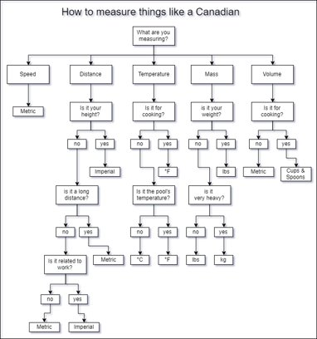
Thank you!
Allison Simmonds, P.Eng.
Office of Energy R&D, NRCan
Allison.simmonds@nrcan-rncan.gc.ca
https://www.reddit.com/r/HelloInternet/comments/czcf7u/canadian_measurement_flowchart/?utm_source=share&utm_medium=web3x&utm_name=web3xcss&utm_term=1&utm_content=share_button

Slide 18
Phasing out coal by 2030
Net-zero emissions by 2050
40-45% emissions reduction by 2030
A decrease of approximately 14% (below 2016 levels) in the CI of liquid fuels used in Canada by 2030.
Regulations and policies in place for international aviation and marine transport fuels.
Canada’s Greenhouse Gas Emissions Targets
Notes:
Phasing out coal by 2030: the Pan Canadian Framework on Clean Growth and Climate Change was amended in 2018 to phase out conventional coal-fired electricity by 2030.
Net-zero emissions by 2050: Canada’s Net-Zero Emissions Accountability Act, which became law on June 29, 2021, formalizes Canada’s target to achieve net-zero emissions by the year 2050.
40-45% emissions reduction by 2030: Canada’s 2030 Emissions Reductions Plan, published in 2022, builds on the actions in Canada’s Strengthened Climate Plan and the Pan-Canadian Framework and provides a roadmap for how Canada will meet its enhanced Paris Agreement target.
Publication and enforcement of Canada’s Clean Fuels Regulations (CFR). The CFR will require liquid fuel (gasoline and diesel) suppliers to gradually reduce the carbon intensity (CI) of the fuels they produce and sell for use in Canada over time, leading to a decrease of approximately 14% (below 2016 levels) in the CI of liquid fuels used in Canada by 2030.
Canada is also expected to be subject to regulations and policies in place for international aviation and marine transport fuels.
The Carbon Offsetting and Reduction Scheme for International Aviation (CORSIA) aims to stabilize international civil aviation net-carbon dioxide (CO₂) emissions at 2019 levels but is voluntary for International Civil Aviation Organization (ICAO) member states, which includes Canada, until 2027, when it becomes binding.
Development of legislation to regulate emissions from marine shipping fuels has been moving at an even slower pace than in the aviation sector; the International Maritime Organization (IMO) has a goal of reducing CO₂ emissions from international shipping by 40% by 2030, but the only binding emissions regulation thus far is a limit on marine fuel sulfur content.
https://gazette.gc.ca/rp-pr/p1/2020/2020-12-19/html/reg2-eng.html
https://www.imo.org/en/MediaCentre/HotTopics/Pages/Cutting-GHG-emissions.aspx

Slide 19
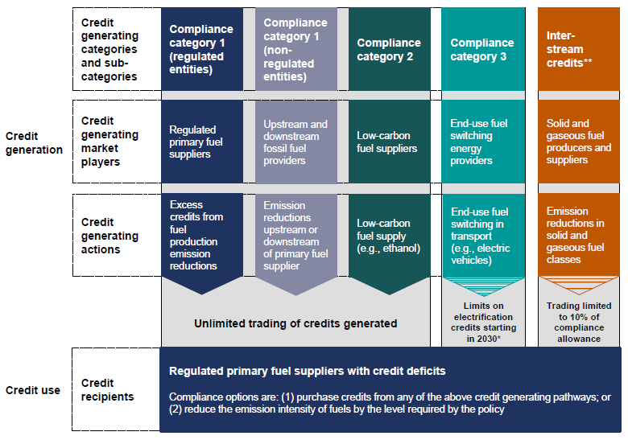
Credit Creation Categories
Navius Research, 2021. Canada’s Clean Fuel Regulations: Summary of Policy Designs and Insights. https://www.naviusresearch.com/publications/cfr-gazette-part-one/
Notes:
To comply, primary liquid fuel suppliers can generate credits by improving their processes or purchasing credits from other regulated entities that have a surplus of credits as well as from the following non-mandatory market participants:
Fossil fuel firms upstream or downstream from primary fuel suppliers. Upstream firms can generate credits by reducing emissions from fossil fuel production (e.g., methane leak control). Downstream firms generate credits by reducing emissions from fossil fuel distribution (e.g., using more efficient diesel tube trailers for liquid fuel transport).
Low-carbon fuel supply. Producers or importers can generate credits by supplying liquid low-carbon fuels, which include biomass-based or synthetic fuels.
End-use fuel switching in transportation. Firms can generate credits by selling fuels consumed by alternative fuel vehicles like electric, fuel cell, and natural gas vehicles (both fossil-based and renewable natural gas are eligible for credits).
Emission reductions in gaseous and solid fuel classes. Firms that reduce the carbon intensity of gaseous and solid fuels used in Canada can generate credits that can meet up to 10% of a regulated entities’ compliance obligation.

