Slide 1


Country Report Sweden
25 October 2023
Magnus Lindgren
Tomas Ekbom
IEA AMF
IEA Bioenergy Task 39

Slide 2
Energy use
Sweden
738 TWh total energy use
  Export
    37 TWh electricity
    159 TWh refined fossil fuels
    111 TWh losses (nuclear power)
Bioenergy: 141 TWh
  Industry
  Residential and services
  Transportation
Bioenergy

Slide 3
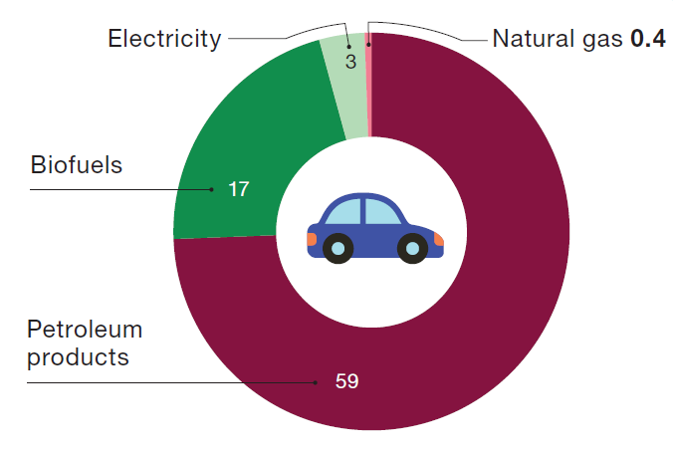
Biofuels in transport
Fossil and biogas
21% of total energy demand
  Increase from 5% in 2010
Types of fuel
  84% Biodiesel (FAME and HVO)
  8% Biogas
  5% Bioethanol
  3% Other (e.g. green naphtha)

Slide 4
Promising Swedish biorefineries development
Larger plants in operation
SunPine in Piteå
150 000 m³ Raw Tall Diesel
Agroetanol in Norrköping
230 000 m³ ethanol
Adesso in Stenungsund
120 000 ton RME
Preemraff Lysekil
175 000 m³ HVO-products
Preemraff Gothenburg
370 000 m³ HVO
Energifabriken in Karlshamn
55 000 ton RME
Södra in Mönsterås
5000 ton biomethanol
Pyrocell in Gävle
25 000 ton biocrude for HVO
Started 7 Dec 2021
Plants in development
St1 Refinery in Gothenburg
200 000 ton HVO + SAF biofuels Q4 2023
Preemraff Lysekil
900 000 m³ HVO-products 2024
Liquid Wind with Övik Energi
50 000 m³ biomethanol 2025
Project AIR Perstorp at Stenungsund
200 000 m³ biomethanol 2025?
SCA in Östrand w St1
300 000 ton HVO biofuels 2025?
Vattenfall+Shell+LanzaTech in Forsmark
50 000 ton SAF for SAS 2026
SkyFuelH2 Uniper+Sasol in Långsele
100 000 ton SAF 2028
St1 Refinery in Gothenburg
200 000 ton HVO + SAF biofuels 2028?
Selected projects or plants, e.g. biogas plants not shown
Biofor in Stockholm with 6 million Nm3 bio-CNG
Colabit, Swedish Biofuels, RenFuel, OrganoFuels, Votion Biorefineries, Plagazi, TreePower…

Slide 5

Policy: Transport
Reduced reduction quota -> 6% Jan 2024
Reduced tax on petrol and diesel
Incentives
  Charging and hydrogen refuelling stations
  Electric light-commercial vehicles, Environmental heavy-duty vehicles and non-road mobile machinery
Fossil-free, not renewable, energy
The 70% CO2 reduction target for transport by 2030 will likely not be met
Elisabeth Svantesson, Minister of finance
Budget bill 2024

Slide 6
Stability and sudden changes in policies,
mixed signals for investors and actors
Road transport emission reduction 70% until 2030, net zero emissions 2045. Electrification is underway.
Fuel | Comment | Taxes and policy
Petrol | E10, 10% vol ethanol | Reduction quota mandate 7.8% until 1 Jan 2024
Diesel | B7, 7% vol FAME + 30-35% vol HVO | Reduction quota mandate 30.5% until 1 Jan 2024
E85 | Summer: 85% vol ethanol Winter: 75% vol ethanol | Full tax exemption for biofuel share to 31 Dec 2026
B100 | 100% RME | Full tax exemption to 31 Dec 2026
HVO100 | Approved for new cars and most buses and trucks | Full tax exemption to 31 Dec 2026
ED95 | 95% ethanol for buses and trucks | Full tax exemption to 31 Dec 2026
Bio-CNG | >90% of CNG is biogas-based | Full tax exemption to 31 Dec 2030

Slide 7
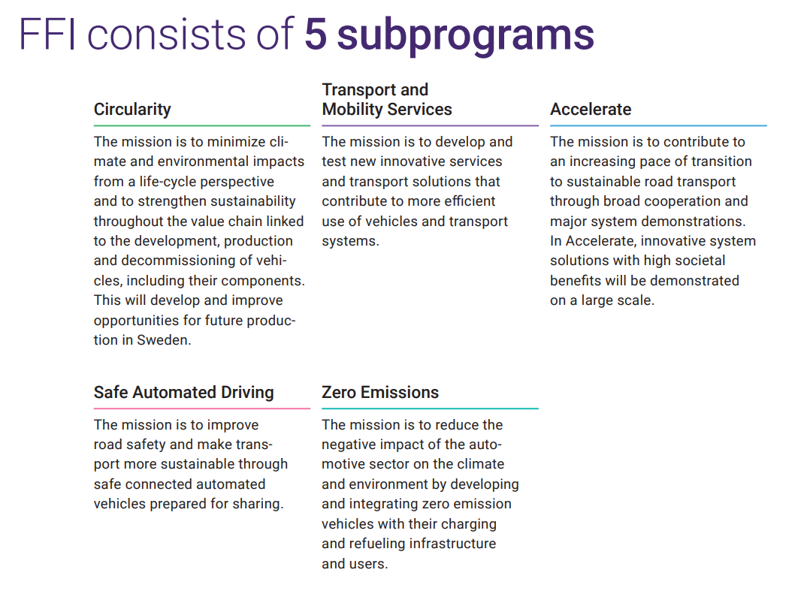
Research areas
Accelerate
  System demonstration
  Demand driven
  Fossil free
Zero emission
  Vehicles and their associated infrastructure
  Electrification including fuel cells
    also smaller investments in other driveline alternatives for zero-emission vehicles
Advanced motor fuels
  Aviation
  Maritime

Slide 8

New developments
Renewable → Fossil free
  Nuclear power
Landwärme
  Tax exemption for biogas removed
European focus
  Fit-for-55
  Less focus on national goals for transport
Public acceptance
  Fuel cost
Notes:
New developments in the country
Förnyat intresse I kärnkraft
Landwärme dom kopplat till biogas?
Något om att Sverige inte längre går före EU? Eller är det för pessimistiskt….Men i alla fall nämna att det finns en stor problematik i att dyrare drivmedelspriser har gjort att politiker backar i sina klimatambitioner och att det kanske är en indikation på att ”säkerställa acceptans” måste få en större roll i omställningen. (man kan nog uttrycka det bättre men ni förstår kanske vad jag menar….)

