Slide 1
Country Report
-Japan-
Yuta SHIBAHARA (NEDO)
Masayuki KOBAYASHI (LEVO)
Noritsune KAWAHARADA (NTSEL)
Mitsuharu OGUMA (AIST)

Slide 2
Contents
1. Japan's strategy for decarbonizing/defossilizing the transport sector
- Green Growth Strategy towards 2050 Carbon Neutrality
- Basic Policy for the Realization of Green Transformation (GX)
2. Examples of priority research areas on fuels and vehicles and new developments
Notes:
The contents of my presentation are as follows.
1. Japan's new policy, "carbon-neutral"
2. Key points as fuels/energy for mobility
3. Summary - Sustainability of mobility energy -

Slide 3
Contents
1. Japan's strategy for decarbonizing/defossilizing the transport sector
- Green Growth Strategy towards 2050 Carbon Neutrality
- Basic Policy for the Realization of Green Transformation (GX)
2. Examples of priority research areas on fuels and vehicles and new developments
Notes:
The contents of my presentation are as follows.
1. Japan's new policy, "carbon-neutral"
2. Key points as fuels/energy for mobility
3. Summary - Sustainability of mobility energy -

Slide 4

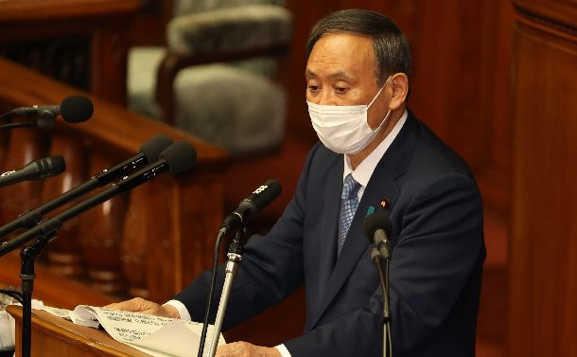
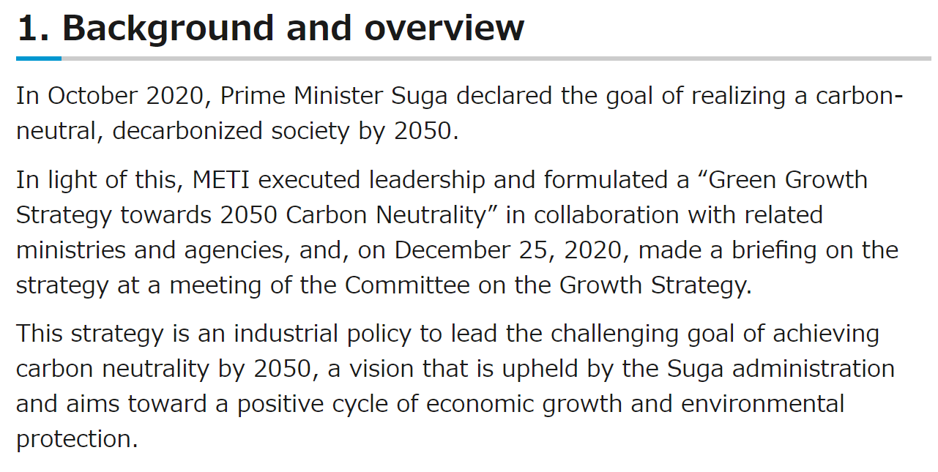
“Green Growth Strategy towards 2050 Carbon Neutrality”
1. Background and overview
In October 2020, Prime Minister Suga declared
the goal of realizing a carbon-neutral,
decarbonized society by 2050.
In light of this, METI executed leadership and
formulated a “Green Growth Strategy towards 2050 Carbon Neutrality” in collaboration with related ministries and agencies, and, on December 25, 2020, made a briefing on the strategy at a meeting of the Committee on the Growth Strategy.
This strategy is an industrial policy to lead the challenging goal of achieving carbon neutrality by 2050, a vision that is upheld by the Suga administration and aims toward a positive cycle of economic growth and environmental protection.
Source : Japanese METI homepage
Notes:
In October 2020, Prime Minister Suga, at that time, declared the goal of realizing a carbon-neutral, decarbonized society by 2050.
In light of this, The Ministry of Economy, Trade and Industry (METI) executed leadership and formulated a “Green Growth Strategy towards 2050 Carbon Neutrality” in collaboration with related ministries and agencies, and, on December 25, 2020, made a briefing on the strategy at a meeting of the Committee on the Growth Strategy.

Slide 5
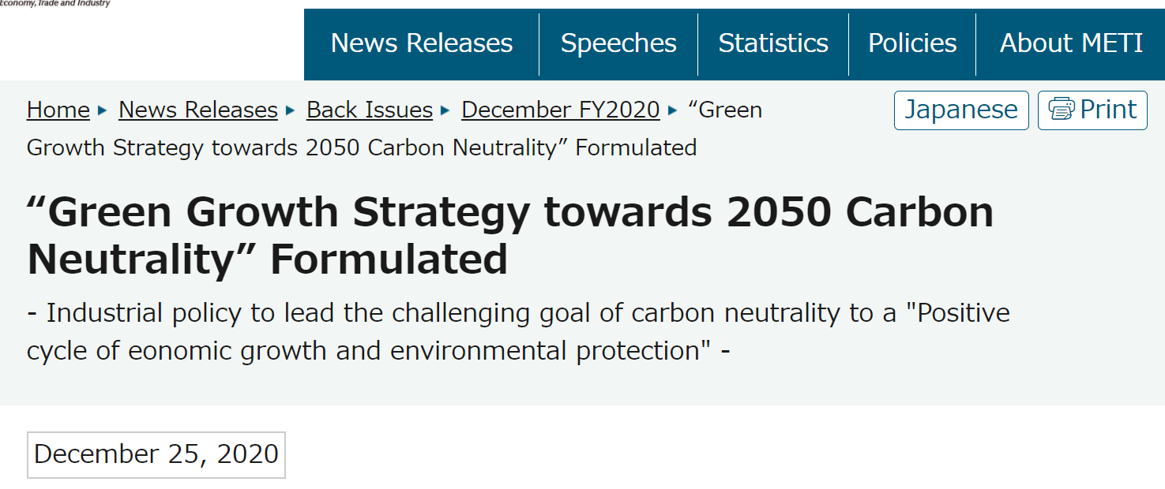
“Green Growth Strategy towards 2050 Carbon Neutrality” Formulated
- Industrial policy to lead the challenging goal of carbon neutrality to a "Positive cycle of economic growth and environmental protection" -
December 25, 2020
The Ministry of Economy, Trade and Industry (METI) formulated a “Green Growth Strategy towards 2050 Carbon Neutrality” in collaboration with related ministries and agencies. This strategy is an industrial policy to lead the challenging goal of achieving carbon neutrality by 2050, a vision that is upheld by the Suga administration and aims toward a positive cycle of economic growth and the environmental protection.
Source : Japanese METI homepage
Notes:
This strategy is an industrial policy to lead the challenging goal of achieving carbon neutrality by 2050, a vision that is upheld by the Suga administration and aims toward a positive cycle of economic growth and the environmental protection.

Slide 6
14 priority fields for Green Growth Strategy
Energy related
industry
Transportation・Manufacturing
related industry
Home・Office related
industry
① Offshore
wind/solar/
geothermal power
⑥ Semiconductor/
information and
communication
⑫ Housing and
building/ nextgenera-
tion power management
⑤Automobile/
battery
② Hydrogen/fuel
ammonia
⑧ Logistics, people
flow, and civil engi-neering infrastructure
⑦ Shipping
⑬ Resource
circulation-related
➈ Food, agriculture,
forestry and fisheries
③ Next-generation
heat energy
⑩ Aircraft
⑭ Lifestyle-related
④ Nuclear
⑪ Carbon
recycling/material
Growth fields will be expanded toward 2030 and 2050
Source : Japanese METI material and translate in English
Notes:
This slide shows the 14 priority fields for Green Growth Strategy.
For energy related industry, there are four priority fields such as "Offshore wind/solar/geothermal power", "Hydrogen/fuel ammonia", "Next-generation heat energy" and "Nuclear".
For transportation-manufacturing related industry, "Automobile/Battery", "Semiconductor/Information communication", "Shipping", "Logistics, people flow, civil engineering infrastructure", "Food, agriculture, forestry and fisheries", "Aircraft" and "Carbon recycling/material".
For Home-office related industry, "Housing and building/next-generation power management", "Resource circulation-related" and "Lifestyle-related".

Slide 7
⑤ Automobile・Battery
Aiming for carbon neutralization of whole automobile life cycle in 2050 and competitiveness strengthening for battery industry
 | Current status and issues | Future initiatives
Promotion of electrification ・innovation of automobile usage | Low pricing of EV etc. ・Infrastructure development (the rest is omitted) | Accelerated spread of EV etc. ➔Growth realize with strengthening of battery etc. and EV related technologies (the rest is omitted)
Carbon neutralization of fuel | Low pricing, manufacturing technology and establishment for synthetic fuel*¹ - Unfinished of Integrated manufacturing process for commercialization | Scale up and technology development support for synthetic fuel - Aiming for no more than current gasoline price in 2050 - Development of Innovative new technology and process・applied research for integrated manufacturing process for commercialization
Battery | Struggling to scale up even leading R&D ➔Issue of mass production and performance improvement (the rest is omitted) | Scale up・R&D support and creation of battery business ➔Capture growth markets about twice until 2030, five times for vehicle use (the rest is omitted)
*1 Liquid fuel can be used for combustion engines produced by green hydrogen and captured CO2
Source : Japanese METI material and translate in English
Notes:
This slide shows the "current status and issues" and "Future initiatives" of automobile and battery industries.
Regarding the carbon neutralization of fuel, the current status and issues are shown such as low pricing, manufacturing technology and establishment for synthetic fuel, because of unfinished of integrated manufacturing process for commercialization.
Therefore, the future initiatives of the carbon neutralization of fuel are explained that "Scale up and technology development support for synthetic fuel", such as
- Aiming for no more than current gasoline price in 2050
- Development of Innovative new technology and process・applied research for integrated manufacturing process for commercialization

Slide 8
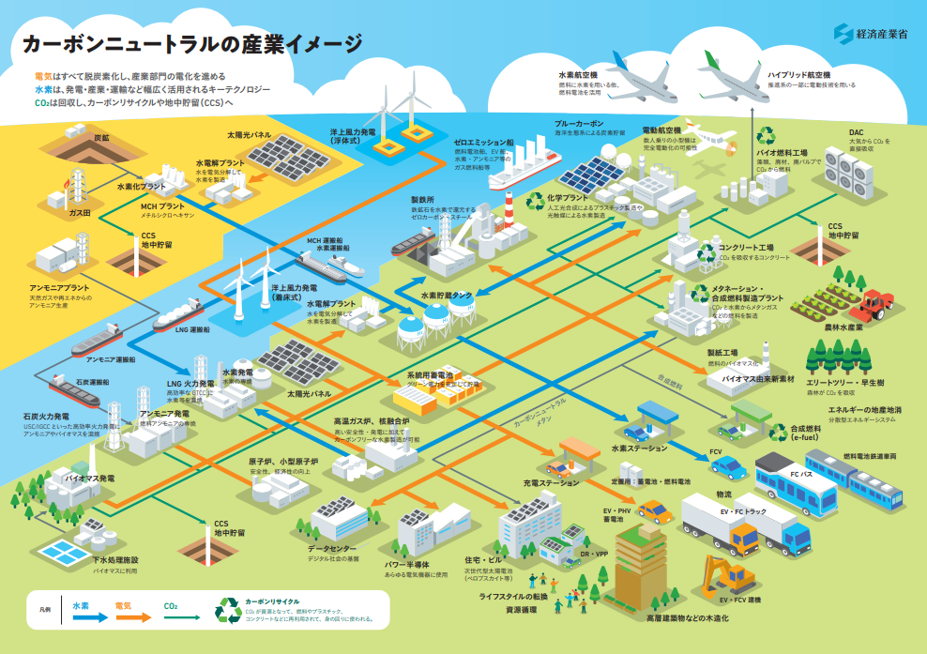
Future view of carbon neutral
CO2
Hydrogen
Synthetic fuel
Electricity
Source : Japanese METI homepage
Notes:
This slide shows the future view of carbon neutral.
Sorry for this image explained by only in Japanese.
You can see the infrastructure not only electricity and hydrogen but also synthetic fuel.
It is important to use the right power sources and energy, in the right place, I think.

Slide 9
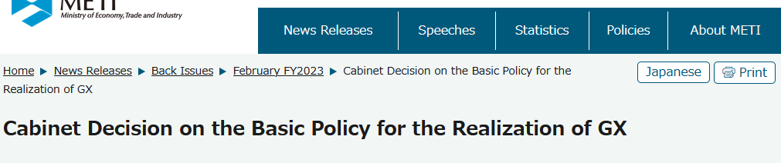
Cabinet Decision on the Basic Policy for the Realization of Green Transformation (GX)
February 10, 2023
Since Russia's aggression against Ukraine last February, securing a stable supply of energy has become a major issue around the world. In order to simultaneously achieve the three goals of decarbonization, a stable energy supply, and economic growth through GX (green transformation), the Basic Policy for the Realization of GX was compiled at the end of last year based on discussions by the GX Implementation Council and committees from various ministries.
Today, a Cabinet decision was made on the Basic Policy after conducting a public call and other processes.
Source : Japanese METI homepage
Notes:
This strategy is an industrial policy to lead the challenging goal of achieving carbon neutrality by 2050, a vision that is upheld by the Suga administration and aims toward a positive cycle of economic growth and the environmental protection.

Slide 10
The Basic Policy for the Realization of Green Transformation (GX)
Following the Russian Federation's aggression against Ukraine, we will promote primarily the following two initiatives in addition to responses to the issue of climate change in order to simultaneously ensure stable supply of energy-the foundation of people's livelihoods and economic activities-and achieve economic growth.
1. In order to ensure stable supply of energy, in addition to thorough energy efficiency improvement, we will promote decarbonization initiatives toward GX, such as switching to decarbonized power sources that contribute to improving the self-sufficiency rates of energy, like renewable energy and nuclear power.
2. To achieve GX, we will realize and implement the Pro-Growth Carbon Pricing Concept, which includes bold advance investment support using GX Economy Transition Bonds, incentives for GX investment through carbon pricing, and utilization of new financial instruments.

Slide 11
The Basic Policy for the Realization of Green Transformation (GX)
(1) GX initiatives based on the premise of ensuring a stable energy supply
1)Promotion of thorough energy efficiency improvement
2) Making renewable energy a mainstay power source
3) Utilization of nuclear power
4) Other important matters
• In order to develop hydrogen and ammonia production and supply chains, we aim to implement a support scheme that focuses on their price differences with existing fuels. We will design comprehensive policy measures and update the national strategy with a view to leading the world in the hydrogen field.
• In order to secure supply capacity in the electricity market, we will steadily operate the capacity market and promote systematic investment into decarbonized energy sources by implementing Reserve Power Plants system and Long Term Decarbonized Power Resource Auction.
• Interests in Sakhalin 1 and 2, and other international projects will be preserved for the time being, as they are important for energy security.
• In light of the growing uncertainty in the LNG market, we will build a mechanism to strategically secure buffer LNG and support the development of technologies such as those related to methane hydrate.
• In addition, we will promote research and development, capital investment, demand creation, and other GX efforts in the areas of carbon recycled fuels (e.g., Methanation, SAF, fuels), batteries, resource circulation , next generation automobiles, next generation aircraft, zero emission ships, investment into digital technology for decarbonization, housing and buildings, ports and other infrastructure, food and agriculture, forestry, and fishery industries, and regions and livelihoods.

Slide 12
The Basic Policy for the Realization of Green Transformation (GX)
(2) Realization and implementation of the “Pro Growth Carbon Pricing Concept” and other initiatives
1) Upfront investment support utilizing GX Economy Transition Bonds
2) GX investment incentives through P ro Growth Carbon Pricing Concept”
3) Utilization of new financial instruments
4) International strategy, Just Transitions, and GX of small and medium enterprises and other businesses

Slide 13
Contents
1. Japan's strategy for decarbonizing/defossilizing the transport sector
- Green Growth Strategy towards 2050 Carbon Neutrality
- Basic Policy for the Realization of Green Transformation (GX)
2. Examples of priority research areas on fuels and vehicles and new developments
Notes:
The contents of my presentation are as follows.
1. Japan's new policy, "carbon-neutral"
2. Key points as fuels/energy for mobility
3. Summary - Sustainability of mobility energy -

Slide 14
Japanese national research projects related fuel synthetic
production from CO2
1. NEDO Project
Liquid fuel production technology from CO2
2. Green Innovation Fund Projects
2.1 High efficient liquid fuel production technology using synthetic reaction from CO2
(1) Improvement of liquid fuel production yield technology
(2) Improvement of fuel usage technology
2.2 Sustainable Aviation Fuel (SAF) production technology
2.3 Innovative synthetic Methane production technology
(1) Innovative SOEC Methanation technology
(2) Innovative Methane production technology by low temperature process
2.4 Green LP gas synthetic technology
14
Notes:
The contents of the second topic as shown.

Slide 15
2. Green Innovation Fund Project
2.1 High efficient liquid fuel production technology using synthetic reaction from CO2
(2) Improvement of fuel usage technology
Purpose and Overview
Improvement of synthetic fuel utilization efficiency for passenger car and heavy duty vehicle, and solution of exclusive event of synthetic fuel usage.
50% or more reduction of TtW CO2 from passenger HEV while running
Over 55% of maximum thermal efficiency and 25% or more TtW CO2 reduction from heavy duty commercial vehicle
Implementation Structure
Project Scale
AICE
Total Budget : Approx. 45 M-Euro
(Research Association of Automotive
Internal Combustion Engines)
(Subject to change depending on the situation
from now on)
Project Period
2022～2027 (6 Years)
SOURCE：METI HP, Translated into English
15

Slide 16
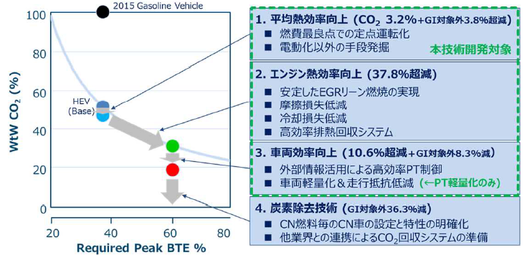
2. Green Innovation Fund Project
2.1 High efficient liquid fuel production technology using synthetic reaction from CO2
(2) Improvement of fuel usage technology
Project Image (Passenger car)
Coverage of this project
1.Improvement of Averaged Thermal Efficiency
- Fixed operation condition at best point
- Finding of except electrification device
2.Improvement of Engine Thermal Efficiency
- Stabled lean EGR combustion
- Friction loss reduction
- Cooling loss reduction
- Exhaust heat recovery system
3.Improvement of vehicle running efficiency
- High efficient PT control using external information
- Reduction of Vehicle weight & running resistance
4.Carbon removal
- Vehicle application for carbon neutral fuels
- Preparation of CO2 capture system
SOURCE：METI HP, Translated into English
16

Slide 17
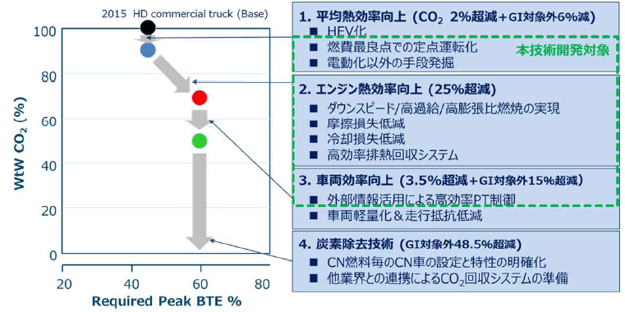
2. Green Innovation Fund Project
2.1 High efficient liquid fuel production technology using synthetic reaction from CO2
(2) Improvement of fuel usage technology
Project Image (Heavy duty vehicle)
1.Improvement of Averaged Thermal Efficiency
- HEV
Coverage of this project
- Fixed operation condition at best point
- Finding of except electrification device
2.Improvement of Engine Thermal Efficiency
- Down speed / Supercharging / High expansion ratio
- Friction loss reduction
- Cooling loss reduction
- Exhaust heat recovery system
3.Improvement of vehicle running efficiency
- High efficient PT control using external information
- Reduction of Vehicle weight & running resistance
4.Carbon removal
- Vehicle application for carbon neutral fuels
- Preparation of CO2 capture system
SOURCE：METI HP, Translated into English
17

Slide 18
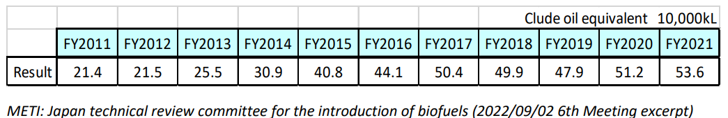
Number of EV,HEV,PHEV,and FCV owned in Japan
End of the FY |  | 2016 | 2017 | 2018 | 2019 | 2020 | 2021
EV | Passenger v. | 73,378 | 91,357 | 105,919 | 117,315 | 123,706 | 138,325
 | Others | 1,640 | 1,514 | 1,512 | 1,563 | 1,871 | 1,877
 | Light motor v. | 18,555 | 18,808 | 18,858 | 19,242 | 20,186 | 21,161
PHV | Passenger v. | 70,323 | 103,211 | 122,008 | 136,208 | 151,241 | 174,231
FCV | Passenger v. | 1,807 | 2,440 | 3,009 | 3,695 | 5,170 | 6,981
HEV | Passenger v. | 6,473,943 | 7,409,635 | 8,331,443 | 9,145,172 | 9,862,987 | 10,630,750
 | Others | 24,687 | 26,244 | 31,493 | 45,190 | 58,115 | 73,211
 | Light motor v. | 476,433 | 775,507 | 1,106,347 | 1,498,064 | 1,954,926 | 2,322,201
＊ EV : Electric vehicle PHV : Plug in hybrid vehicle FCV : Fuel cell vehicle HEV : Hybrid vehicle
o The above data are Next Generation Vehicle Promotion Center estimates as of April of each fiscal year to March of the following year, calculated based on data from the Japan Vehicle Inspection and Registration Information Association, Light motor vehicle inspection Association, etc.
o Others is the total of freight vehicles, passenger vehicles, and special-class vehicles.
o The latest year will be posted around November of the following year due to the timing of data availability.
(note) Total sales of HEV light motor vehicles for the last 10 years including the relevant fiscal year are shown because there is no publicly available information on the number of HEVs owned
Source : Next Generation Vehicle Promotion Center https://www.cev-pc.or.jp/tokei/hoyuudaisu.html
Usage Result of Bioethanol
Crude
Source Task 39 Newsletter – December 2022

Slide 19
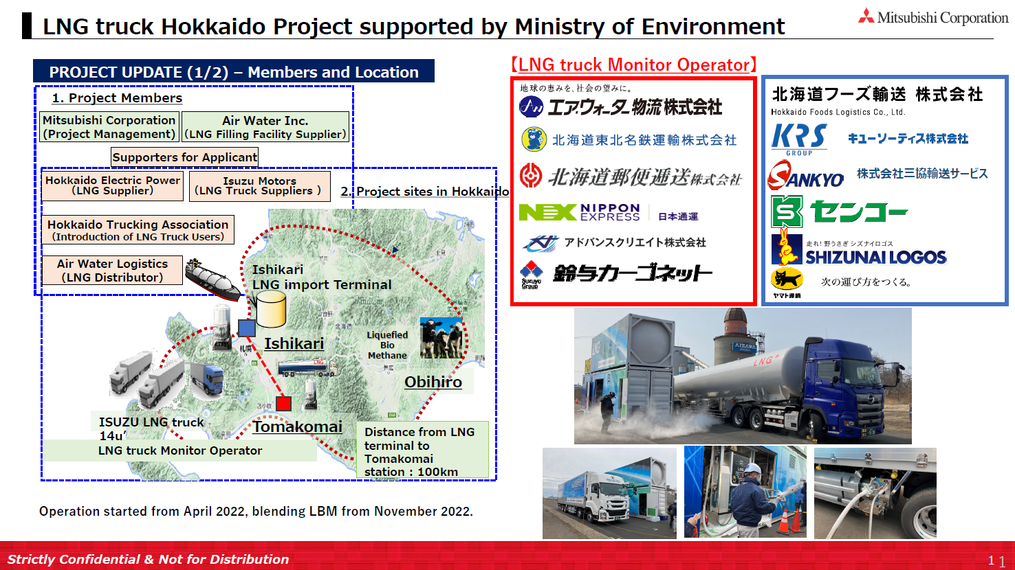
Example of biogas truck initiatives

Slide 20
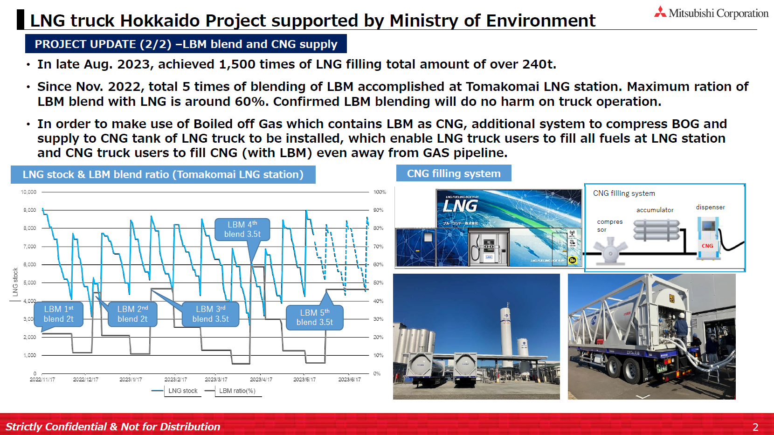
Example of biogas truck initiatives

Slide 21
Appendix
- Information of NEDO
- Information of AICE
21

Slide 22

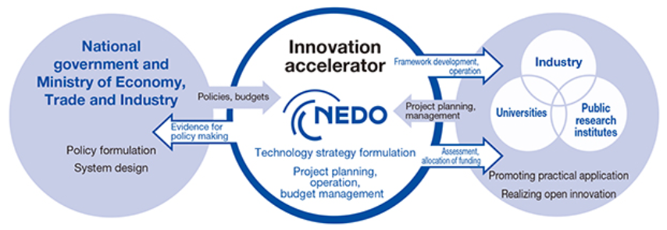
About NEDO
NEDO is a national research and development agency that creates innovation by promoting technological
development necessary for realization of a sustainable society.
NEDO acts as an innovation accelerator to contribute to the resolution of social issues by developing and
demonstrating high-risk innovative technologies having practical application.
Addressing energy and global environmental problems
NEDO actively undertakes the development of new energy and energy conservation technologies. It also conducts research to verify technical results. Through these efforts, NEDO promotes greater utilization of new energy and improved energy conservation. NEDO also contributes to a stable energy supply and the resolution of global environmental problems by promoting the demonstration of new energy, energy conservation, and environmental technologies abroad based on knowledge obtained from domestic projects.
Positioning of NEDO as an Innovation Accelerator
In order to contribute to the resolution of social issues, NEDO formulates technology strategies and project plans and, as part of its project management, establishes project implementation frameworks by combining the capabilities of industry, academia, and government. NEDO also promotes technology development by carrying out, evaluating, and allocating funding to promising projects to accelerate the practical application of project results.
22

Slide 23
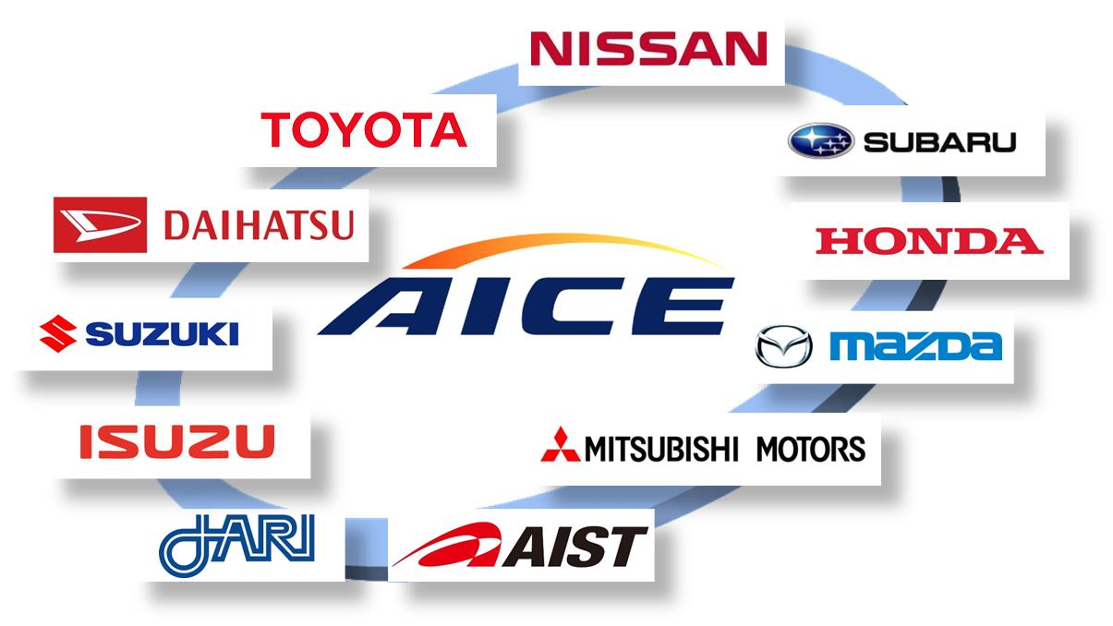
About AICE
(Research Association of Automotive Internal Combustion Engines)
Date of establishment : April 1st, 2014
Associates : 9 automakers and 2 organizations
Joint research member :
Project outline : Basic and applied research of performance improvement technology
for internal combustion engines
AICE principles
AICE brings together the knowledge and expertise of industry, academia and the government to strengthen the fundamental technologies of internal combustion engines - which will remain one of most promising power sources in the future -- and contribute to the enduring enhancement of the world-leading industrial strength of Japan.
Promoting research conducted through mutual enlightenment among industry, academia and the government, AICE strives to improve Japan’s collective expertise in the area of internal combustion engines and to nurture engineers and leaders who will continue promoting collaboration among industry, academia and the government.
23

Slide 24







Scheme of AICE
Automakers
Saving R&D cost and resources
Benefitting from technologies amassed in academia
Concentrating resources on core technologies
Core technologies
of each automaker
Automaker
A
Automaker
B
Automaker
C
Common issues
automakers face
Challenges in creating new values
Technology research association AICE
Universities and research institutes
Enhancing technological strengths
Collecting information regarding business needs
Great opportunity for nurturing human resources
24

Slide 25
③ Hydrogen/fuel ammonia (Hydrogen)
Hydrogen is a key carbon-neutral technology that is widely used in power generation, industry, and transportation. Positioning it as a new resource, it involves a wide range of players, not just automotive applications.
 | Current status and issues | Future initiatives
Use | (1) Hydrogen power generation turbine: Demonstration with actual equipment has not yet been completed, and commercialization is an issue (2) Stationary fuel cells: The key is the spread and expansion of commercialized fuel cells, including pure hydrogen fuel cells. (3) FC trucks: During demonstration, commercialization is an issue (4) Hydrogen-reduced steelmaking: Technology not yet established, procurement of large amounts of inexpensive hydrogen is a challenge | (1) Hydrogen power generation turbines: Launch the market ahead of others and export to Asia, etc. (2) Stationary fuel cells: Promotion of social implementation by digging deeper into value and supporting investment in production equipment (3) FC trucks: launching the domestic market at the same time as the world, and exporting to various countries (4) Hydrogen-reduced steelmaking: Establishing technology ahead of the rest of the world
Source : Japanese METI material and translate in English
Notes:
This slide shows the "current status and issues" and "Future initiatives" of hydrogen.
◆Hydrogen is a key carbon-neutral technology that is widely used in power generation, industry, and transportation. Positioning it as a new resource, it involves a wide range of players, not just automotive applications.

Slide 26
③ Hydrogen/fuel ammonia (Hydrogen)
Hydrogen is a key carbon-neutral technology that is widely used in power generation, industry, and transportation. Positioning it as a new resource, it involves a wide range of players, not just automotive applications.
 | Current status and issues | Future initiatives
Transportation, etc. | (5) Hydrogen carriers, etc.: Upsizing through technological development and demonstration is a challenge | (5) Hydrogen carriers, etc.: Commercialization ahead of the world, exporting equipment, technology, etc.
Manufacturing | (6) Water electrolyzer: European companies take the lead in large-scale technology, etc. | (6) Water electrolysis equipment: Export to overseas markets where renewable energy is cheap, then introduce domestically
Source : Japanese METI material and translate in English
Notes:
This slide shows the "current status and issues" and "Future initiatives" of hydrogen.
◆Hydrogen is a key carbon-neutral technology that is widely used in power generation, industry, and transportation. Positioning it as a new resource, it involves a wide range of players, not just automotive applications.

Slide 27
③ Hydrogen/fuel ammonia (fuel ammonia )
Ammonia, which does not emit CO2 when burned, is an effective decarbonized fuel for co-firing in coal-fired power plants. Establish co-firing technology at an early stage and expand it to Southeast Asia, etc., build an international supply chain as soon as possible, and take the initiative in the world's ammonia supply and utilization industry.
 | Current status and issues | Future initiatives
Use (Thermal power generation by mixed fuel combustion) | Increasing NOx emission when ammonia is burning using burner for coal - Necessity of NOx reduction burner technology | Spread of coal-ammonia mixed combustion thermal power generation, increasing mixed ammonia ratio and 100 % of ammonia combustion thermal power generation - Supporting overseas expansion by leading the international standardization of fuel ammonia specifications and NOx emissions from combustion equipment. etc.
Supply (Ammonia plant, etc.) | Necessity of additional production of ammonia due to expanded use - Annual production of ammonia is 200 million tons. Most of it is locally produced and consumed as fertilizer. - 500,000 tons of ammonia per year is required for a 20% mixed combustion of one coal-fired power plant. | Stable ammonia supply - In 2030, we aim to supply natural gas in the upper 10 JPY range per Nm³-H₂, which is lower than the current price of natural gas. Domestic demand is expected to be 3 million tons per year (approximately 500,000 tons in terms of hydrogen). - In 2050, annual domestic demand is expected to reach 30 million tons (approximately 5 million tons in terms of hydrogen).
Source : Japanese METI material and translate in English
Notes:
This slide shows the "current status and issues" and "Future initiatives" of fuel ammonia.
◆Ammonia is an effective decarbonized fuel for co-firing in coal-fired power plants. Establish co-firing technology at an early stage and expand it to Southeast Asia, etc., build an international supply chain as soon as possible, and take the initiative in the world's ammonia supply and utilization industry.

Slide 28
⑦ Shipping
Acquire technical capabilities related to the development of gas-fueled vessels such as LNG, hydrogen, and ammonia, which are essential for achieving zero emissions, and establish a production base. Lead the development of international standards, strengthen the international competitiveness of Japan's shipbuilding and shipping industries, and work toward carbon neutrality in marine transportation.
 | Current status and issues | Future initiatives
Switching to carbon-free alternative fuels | Engine that can directly burn hydrogen and fuel ammonia is required | Technology development and practical application for long-distance and large ships
Higher efficiency of LNG-fueled ships | It is necessary to improve the space efficiency of fuel tanks, etc. | Developing innovative space-efficient technology
Development of a framework to promote the introduction and popularization of energy-saving and CO2 emission-saving ships | Countermeasures for existing ocean-going vessels are a challenge | Prompt implementation of the development of a framework for low-carbon and decarbonization
Source : Japanese METI material and translate in English
Notes:
This slide shows the "current status and issues" and "Future initiatives" of shipping.
Regarding the higher efficiency of LNG-fueled ships, the current status and issues are shown such as necessity to improve the space efficiency of fuel tanks, etc..
Therefore, the future initiatives are developing innovative space-efficient technology.

Slide 29
⑩ Aircraft
ICAO (International Civil Aviation Organization) institutionalized the baseline from 2024 onwards, defined as 85% of CO2 emissions in 2019. It aims to establish technological superiority in multiple elements such as composite materials, electrification, hydrogen and alternative fuels.
 | Current status and issues | Future initiatives
Electrification | Equipment and propulsion systems have technical issues - Batteries (including fuel cells), motors, generators, and inverters for aircraft, which are indispensable for electrification, have potential, but performance needs to be improved for aircraft. etc. | Response to hybrid electrification and full electrification.
Hydrogen aircraft | Although development has started worldwide, there are many technical development elements. | Established core technology for fuel conversion to hydrogen.
Source : Japanese METI material and translate in English
Notes:
This slide shows the "current status and issues" and "Future initiatives" of aircraft.
You can see the current status and issues, and the future initiatives for electrification, hydrogen aircraft and jet fuel including SAF and liquid synthetic hydrocarbon fuels as follows.

Slide 30
⑩ Carbon recycling/material
ICAO (International Civil Aviation Organization) the baseline from 2024 onwards, defined as 85% of CO2 emissions in 2019. It aims to establish technological superiority in multiple elements such as composite materials, electrification, hydrogen and alternative fuels.
 | Current status and issues | Future initiatives
Jet fuel | Enlarging the scale for stable supply and overcoming high costs is a challenge. | Cost reduction and supply expansion through large-scale demonstration.
 | Challenges for commercialization are cost and establishment of manufacturing technology. | Support for large-scale and technological development of synthetic fuels. - Higher efficiency of existing technology (reverse shift reaction + FT synthesis process) and design and development of manufacturing equipment. - Development of innovative new technologies and processes (co-electrolysis, Direct-FT, etc.). - Establish high-efficiency, large-scale manufacturing technology by 2030. The aim is to expand the introduction and reduce costs in the 2030s, and to achieve self-sufficient commercialization by 2040.
SAF
(Sustainable
Aviation Fuel)
Liquid synthetic fuel*
*Liquid fuel made by synthesizing CO2 and hydrogen collected from power plants and factories.
Source : Japanese METI material and translate in English
Notes:
This slide shows the "current status and issues" and "Future initiatives" of aircraft.
You can see the current status and issues, and the future initiatives for electrification, hydrogen aircraft and jet fuel including SAF and liquid synthetic hydrocarbon fuels as follows.

Slide 31
1. NEDO Project
1.1 Liquid fuel production technology from CO2
Project Name : Liquid fuel Production technology from CO2
Project Period : 2020 to 2024 (5 years)
Total Budget : Approx. 32 M-Euro
Research Theme
Contractors
R&D of Carbon Recycle Synthetic liquid Fuel Production Technology from CO2
Next Generation FT Reaction
(2) Synthetic Liquid Fuel Production
Process Using Renewable Power
- Seikei University
- ENEOS Corporation
- Nagoya University
- Yokohama National University
- Idemitsu Kosan Co., Ltd.
- AIST (National Institute of Advanced Industrial Science and Technology)
- JPEC (Japan Petroleum Energy Center)
SOURCE：NEDO HP, Translated into English
31

Slide 32
1. NEDO Project
1.1 Liquid fuel production technology from CO2
Schematic Diagram of Liquid Fuel Production Technology from CO2
Next Generation FT Reaction R&D
Factories,
etc.
Direct FT
Selectivity Control
of FT Product
CO2
CO
Integrated Production
Process
Liquid
Synthetic
Fuel
Renewable Power
(Co)-Electrolysis
FT Synthesis
H2O
Fuel Utilization
Technology
Electrolysis Utilization
Technology
H2
Overseas
Green
Hydrogen,
etc,
(Direct FT)
MCH
Production Process R&D of Liquid Synthesis Fuel Using Renewable Power
SOURCE：NEDO HP, Translated into English
32

Slide 33
2. Green Innovation Fund Project
2.1 High efficient liquid fuel production technology using synthetic reaction from CO2
(1) Improvement of liquid fuel production yield technology
Purpose and Overview
Synthetic fuel production technology development from CO2 and Green Hydrogen
towards carbon neutral of aviation, ship and ground mobility. FT synthetic reaction
is utilized for this project and variety of liquid fuel production process will become
possible for gasoline, jet fuel and diesel fuel.
High performance individual process and recycle technology to realize significant improvement of production yield are studied and reduce raw material costs which make up the majority of synthetic liquid fuel cost. And, connect to social implementation of synthetic fuel by establish of scale up technology through technical verification of pilot plant.
Implementation Structure
Project Scale
ENEOS Corporation
Total Budget : Approx. 380 M-Euro
(Subject to change depending on the situation
from now on)
Project Period
2022～2028 (7 Years)
SOURCE：METI HP, Translated into English
33

Slide 34
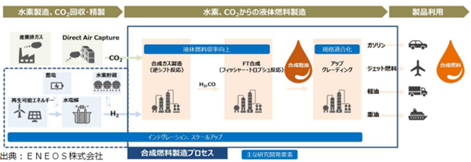

2. Green Innovation Fund Project
2.1 High efficient liquid fuel production technology using synthetic reaction from CO2
(1) Improvement of liquid fuel production yield technology
Synthetic Fuel Production Process and Main R&D Elements
Hydrogen Production,
CO2 Capture & Refining
Liquid Fuel Production from Hydrogen and CO2
Product Usage
Industrial
Exhaust Gas
Direct Air Capture
Yield Improvement of
Liquid Fuel Production
Standard
Conformity
Gasoline
Syngas
Production
(Revers Shift)
FT Synthesis
(Fischer-Tropsch)
Synthetic
Raw Oil
Up
Grading
H2 Storage
Jet Fuel
Power Storage
Synthetic
Fuel
Renewable Power
Water Electrolysis
Light Oil
Heavy Oil
Integration, Scale-Up
Source : ENEOS Corporation
Synthetic Fuel
Production Process
Main R&D Elements
SOURCE：METI HP, Translated into English
34

Slide 35
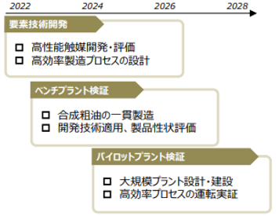
2. Green Innovation Fund Project
2.1 High efficient liquid fuel production technology using synthetic reaction from CO2
(1) Improvement of liquid fuel production yield technology
Development Schedule of Synthetic Fuel Production Process
2022 2024 2026 2028
Elemental technology Development
High Performance Catalyst (Design & Evaluation)
High Efficiency Production Process Design
Bench plant verification
Integrated Production of Synthetic Raw Oil
Developed Technology Application and Product Properties Evaluation
Pilot plant verification
Large Scale Plant Design & Construction
High Efficiency Process Operation & Demonstration
SOURCE：METI HP, Translated into English
35

