Slide 1

National SAF Developments and Strategies
Findings from AMF Task 63
24 October 2023
Dina Bacovsky
AMF Sekretary
BEST – Bioenergy and Sustainable Technologies GmbH, Austria

Slide 2
AMF Task 63
Project overview
November 2021 – April 2023
Task member countries: Austria (lead), Brazil, China, Denmark, Germany, Switzerland, USA
Activities of the Task include:
  Identify major challenges for SAF market uptake
  Showcase examples of successful deployment
  Organization of workshops and online seminars
Further information and publications are available here:
https://iea-amf.org/content/projects/map_projects/63

Slide 3
National SAF Developments and Strategies
Europe

Slide 4
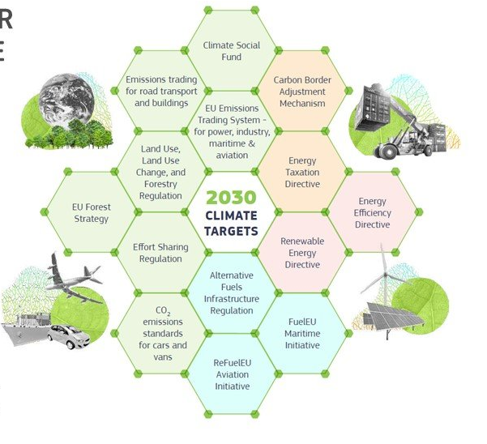
Legal Framework
European Union
Green Deal (Fit-for-55 Package)
  Reducing GHG emissions by at least 55% by 2030 compared with 1990 levels
RED II (RED III under negotiation)
  1.2 multiplier for SAF (non-food/feed)
EU-ETS
  Incentives for biobased SAF in compliance with RED II sustainability criteria „zero emission“
CORSIA (ICAO international)
  Use SAF that comply with dedicated sustainability criteria instead of purchasing emission offsets
https://ses.jrc.ec.europa.eu/eirie/en/news-and-events/news/fit-55-major-step-towards-decarbonized-eu-2050

Slide 5
ReFuelEU Aviation Initiative
Proposal by the Commission
EU proposed regulation 2021/0205 (COD) on ensuring a level playing field for sustainable air transport
  SAF are defined as drop-in fuels, either synthetic aviation fuels or advanced biofuels - Feed and food crop-based fuels are excluded due to limited scalability potential and sustainability concerns
  Fuelling obligation for aircraft operators who have to ensure that 90% of the annually required aviation fuel is uplifted at a given EU airport
  Reporting obligation for aircraft operators and fuel suppliers with financial penalties for non-compliance
https://eur-lex.europa.eu/legal-content/EN/TXT/?uri=CELEX%3A52021PC0561

Slide 6
ReFuelEU Aviation Initiative
(under negotiation)
EU proposed regulation 2021/0205 (COD) on ensuring a level playing field for sustainable air transport
  On all commercial flights carrying passengers (including business travel), cargo or mail traveling within the EU and departing from the EU
  Gradual increase of the volumetric share of SAF in the fuel supplied to operators at EU airports with a sub-target on synthetic aviation fuels
[%] | 2025 | 2030 | 2035 | 2040 | 2045 | 2050
SAF | 2 | 6 | 20 | 34 | 42 | 70
Synt. SAF | 0 | 0.7 | 5 | 8 | 11 | 28
https://www.europarl.europa.eu/RegData/etudes/BRIE/2022/698900/EPRS_BRI(2022)698900_EN.pdf
Notes:
Die Beimischungsziele wurden in der Zwischenzeit überarbeitet – 70% in 2050

Slide 7
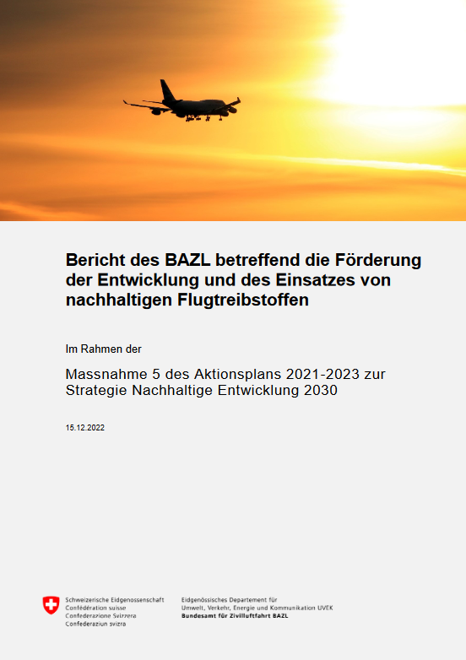
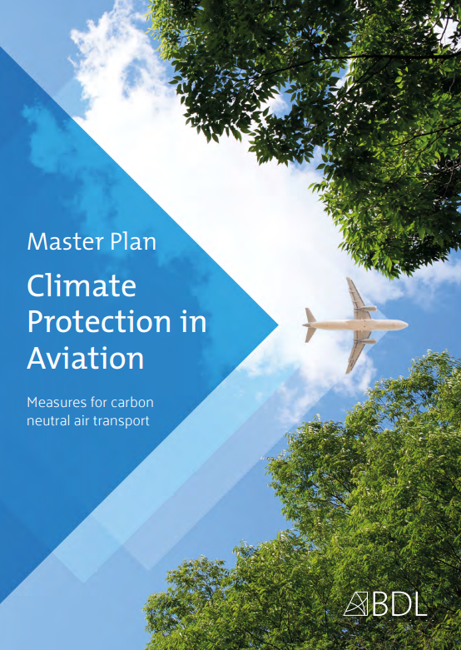
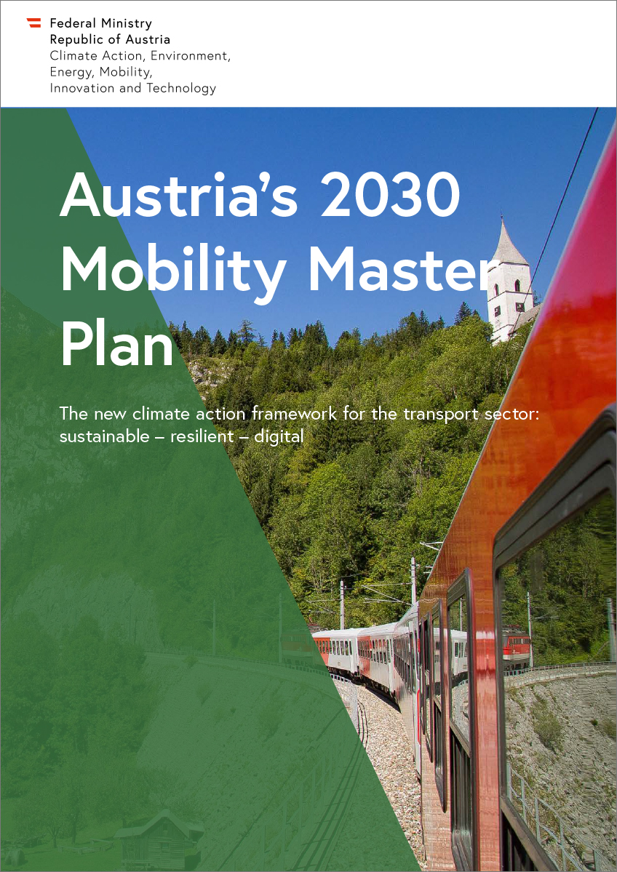
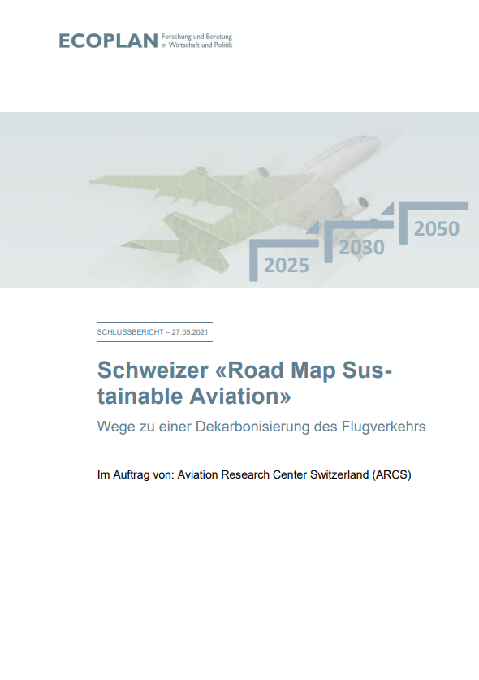
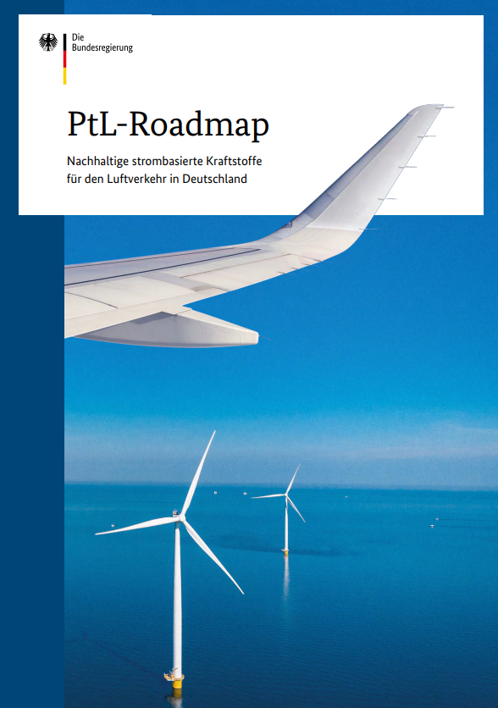
National strategies
Several countries already commissioned or published strategies or roadmaps on SAF market uptake

Slide 8
Austria
Targets | Climate neutrality by 2040 For industries, energy systems and transport (except aviation)
Strategies | Hydrogen strategy & Renewable gas strategy H₂ for industries which are hard to decarbonize (incl. aviation) Green gas only for sectors with no substitution option (excl. aviation) Mobility master plan Promotion of e-fuels, hydrogen and battery for aviation Advanced biofuels for aviation if there is no other more efficient application SAF roadmap (under development)
Projects/ Initiatives | SAF action plan Joint position of leading companies in the mobility & energy sector TAKE OFF program (Austrian Research Promotion Agency) Implementation of the research strategy for the Austrian aviation sector
Strengths | Agreement on the importance of SAF of politics and industry Know-how, there are several related research institutes and technology providers

Slide 9
Denmark
Targets | One green domestic flight route in 2025 All domestic aviation must be green by 2030
Strategies | Aviation plan announced Transition will be financed by imposing a flat passenger fee of €1.70 (domestic and international flights – excl. transit)
Projects/ Initiatives | Bornholm Energy Island Huge investment in off-shore production of electricity in the north sea together with Germany, The Netherlands and Belgium Electricity from the energy island shall be converted into e-fuels for the marine and aviation sectors ALIGHT project Copenhagen Airport as example for a sustainable airport of the future GreenLab project First and largest commercial PtX facility
Strengths | A strong political willingness to foster investments and research

Slide 10
Germany
Targets | PtL SAF capacity of at least 200,000 t/a by 2030
Strategies | PtL SAF roadmap (linked with National hydrogen strategy) & BDL master plan Clear focus on PtL SAF by industry and government Aimed market ramp up in Germany of at least 200,000 t/a by 2030 GHG quota with the compliance option PtL in aviation: 0.5% by 2026 (about 50,000 t/a), 1% by 2028 (about 100,000 t/a), 2% by 2030 (about 200,000 t/a); amounts can be double-counted
Projects/ Initiatives | Several projects and demonstration plants for SAF production are ongoing, e.g.: BP is co-processing UCO in an existing refinery A first PtL plant in Germany with a capacity of 360 t/a Project Amelia for a ATJ plant with a capacitiy of 60,000 t/a Different SAF related projects on DE/EU level (e.g. KEROSyN100, HyKero, TULIPS, HyFlexFuel and ALIGHT)
Strengths | Well developed fuel infrastructure (especially important for importing SAF) There are leading technology providers and users as well as R&D institutions Accompanying funding for PtL SAF projects

Slide 11
Switzerland
Targets | Reduction of fossil CO₂ emissions from aviation with SAF by at least 60% by 2050 Compared to a development without measures
Strategies | Following the ReFuelEU Aviation proposal by the EC Without any notable differences in quota or sustainability criteria Swiss Emission Trading System (linked to EU-ETS) Allows crediting of SAF use on flights starting in Switzerland Biogenic fuels are tax exempted when complying with sustainability criteria Dedicated cultivation of biogenic resources for the purpose of SAF production is not supported (residues only) Swiss Roadmap for Sustainable Aviation (RMSA) was elaborated SAF (biogenic and synthetic) seen as central and most important measure
Projects/ Initiatives | Funding of pilot and demonstration plants Helvoil – production of biofuels (incl. SAF) from UCO and waste animal fats Multiple projects (biogenic and synthetic SAF production) are currently in the concept phase, but have not yet been publicly announced
Strengths | Excellent network of universities and notable technology providers Highly motivated actors to contribute to a quick upscaling of SAF

Slide 12
Summary of European Strategies
European strategy is mainly driven by the ReFuelEU Aviation proposal
  Main focus is ensuring a level playing field for sustainable air transport
Although legal framework is set on European level, strategies of Member States vary
  Several Member States already published SAF roadmaps
  Denmark and Germany have a strong focus on PtL
In all four countries SAF is considered as important measure to decarbonize aviation by politics and industry
There are notable technology providers and university networks

Slide 13
National SAF Developments and Strategies
Brazil

Slide 14
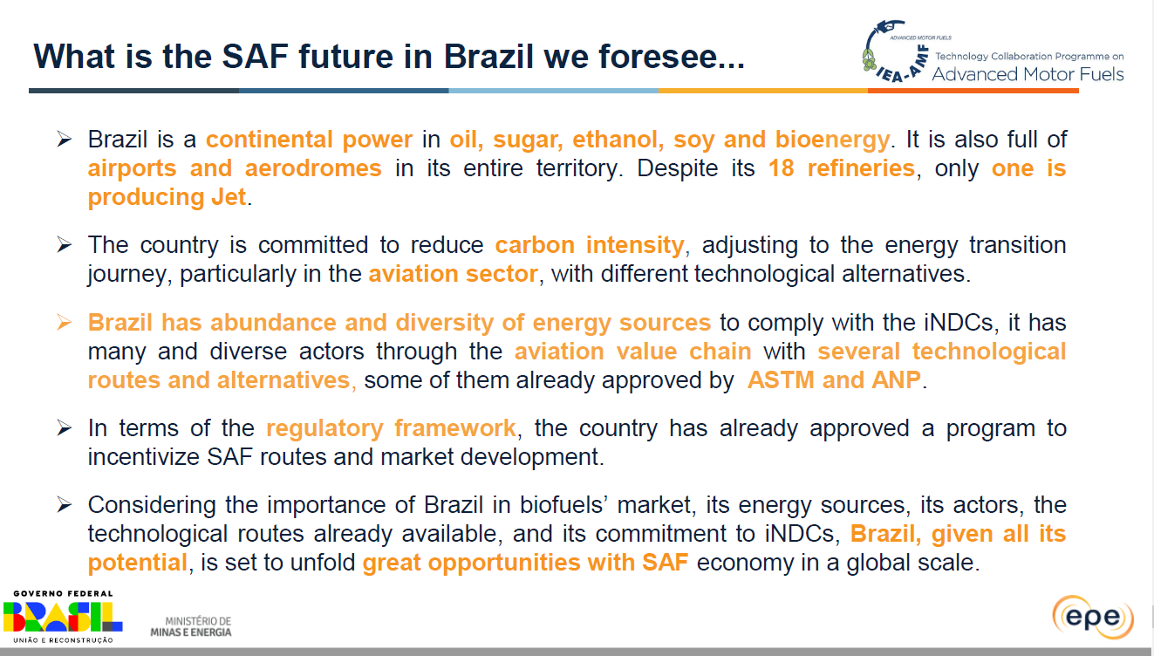

Slide 15
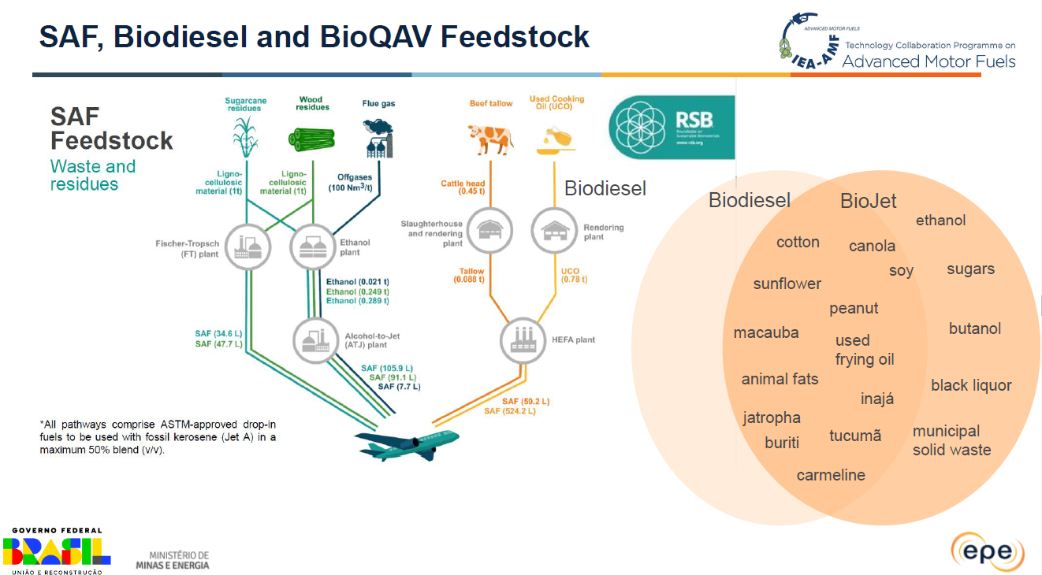

Slide 16
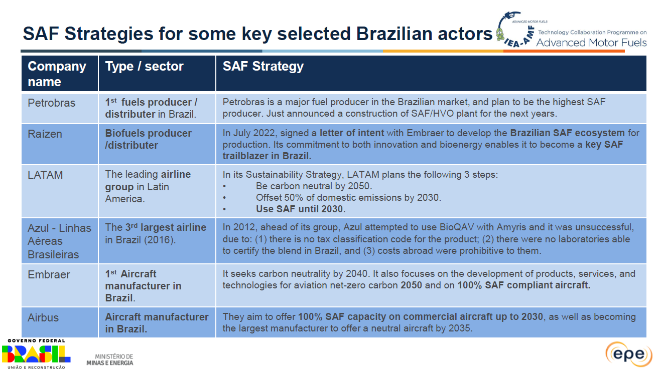

Slide 17
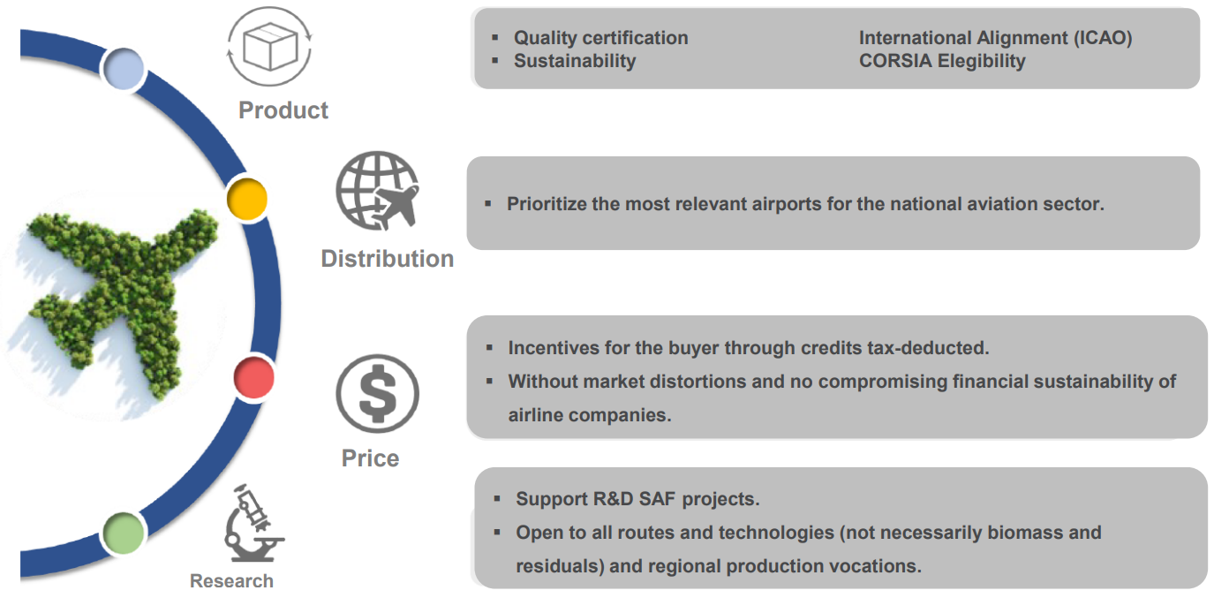
Principles for the application of the SAF Policy in Brazil
Notes:
Folie von Paula!!

Slide 18
National SAF Developments and Strategies
USA

Slide 19
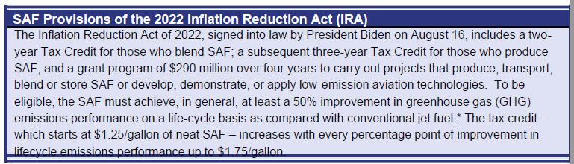
SAF policies at the federal and state level
Section 13203: Sustainable Aviation Fuel Credit
  Incentive for SAF (40B tax credit)
  Incentive amount is based on LCA GHG results
  LCA is based on CORSIA or RFS
  Applies to SAF sold or used after December 31, 2022
Section 13704: Clean Fuel Production Credit
  Incentive for clean transportation fuels, including SAF (45Z tax credit)
  Incentive amount is based on LCA GHG results
  LCA is based on GREET (or as above for SAF)
  Applies to fuels sold or used after December 31, 2024
Section 13204: Clean Hydrogen
  Incentive for clean hydrogen (45V tax credit)
  Incentive amount is based on LCA GHG results
  LCA is based on GREET
  Need regulation/guidance by Aug. 16, 2023 (one year from enactment)
  State of Illinois
  $1.5/gallon tax incentive, based on GREET LCA results
State of California
  Will consider jet fuels in CA as regulated fuel under its LCFS regulation
Notes:
Folie von Michael!
(taking off AND landing flights; or taking off OR landing flights?)

Slide 20
SAF R&D investment
USA
FAA FAST-SAF and FAST-Tech program
  To advance SAF and low emissions aviation technologies to reduce emissions from aviation and aid in addressing climate change
  $297 million will be available
US Department of Energy
  SAF production technologies
  Optimized combustion of new jet fuels
USDA, NASA, and other agencies
Private sector investment fund
  United Airlines, Boeing, JP Morgan
  $100 million will be available
Notes:
Folie von Michael!

Slide 21
Conclusions

Slide 22
Key differences EU/USA/Brazil
Carrot or stick:
  EU volume-based blending obligation
  USA carbon intensity-based tax credits
  Brazil tax credits
Eligible feedstocks
  EU SAF only based on residues and wastes or synthetic (PtL), some countries PtL only
  USA all feedstocks
  Brazil all feedstocks, incentives for Family Farming
Notes:
EU – focus on waste and residues – UCO limited
e.g. CORSIA and EU-ETS
How much FT/ATJ – depending on framework conditions

Slide 23
Thank you

Slide 24
Key findings
Main barriers for implementing SAF were confirmed within the Task:
  High production costs of SAF compared to conventional jet fuel
  Mobilization of sufficient sustainable feedstocks (biomass, waste) for some regions
  Lack of clear international regulations and alignment between them
Biogenic SAF is essential for decarbonizing the aviation sector, especially in the short-term.
  HEFA is currently the main pathway, but by 2030 also Gasification-FT and ATJ are expected to contribute.
  PtL will take longer to be fully commercial.
  However, all SAF technology pathways are needed to achieve the targets of the sector.
Notes:
EU – focus on waste and residues – UCO limited
e.g. CORSIA and EU-ETS
How much FT/ATJ – depending on framework conditions

Slide 25
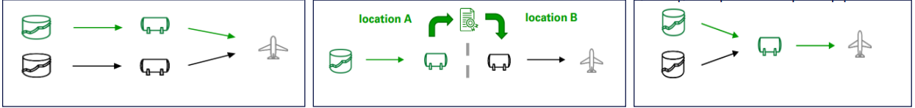
Key findings II
Even though the EU share a common (proposed) framework, strategies among Member States vary (e.g. strong focus on e-fuels in Germany and Denmark)
SAF blending is mainly an economical and an administrative issue, not a technological one (even in case of multi-blending)
There are three ways for accounting for SAF delivery – segregated delivery, mass balance and book & claim. Only a physical delivery allows for reducing regional non-CO2 effects.
Segregation
Book & Claim
Mass balance

Slide 26
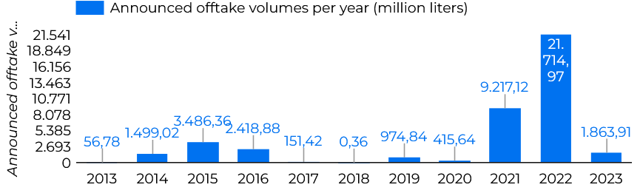
Key findings III
Scaling-up SAF capacities require huge investments and risk sharing among stakeholders.
  Offtake agreements are one possibility for airlines to support SAF producers while securing their SAF supply.
SAF availability is very limited at the moment, but e.g. the EU and USA have very ambitious plans for capacity increase (ReFuelEU Aviation, US Aviation Climate Goal).
  Worldwide there are only a few production facilities in operation, with Neste as market leader. In the USA the production forecast for 2027 is about 60 times higher compared to 2022.

Slide 27
Major conclusion Task 63
Although SAF production technologies other than through hydrotreatment still have to be further developed and deployed, neither production technology nor technical issues when operating aircrafts on SAF are seen as main challenges. The implementation of SAF is, first and foremost, an economic problem, not a technical one.

Slide 28
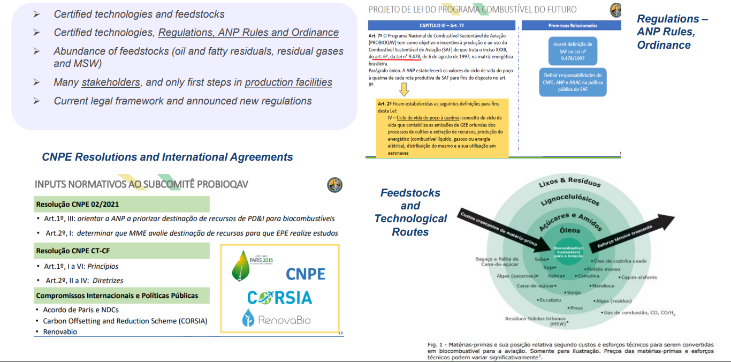
Overview of the status quo
Notes:
Folie von Paula!!
Brazil is a huge country, with 18 refineries but only one of them producing kerosene, and thousands of airports
Jet fuel demand is on the rise and the need for imports is increasing

Slide 29
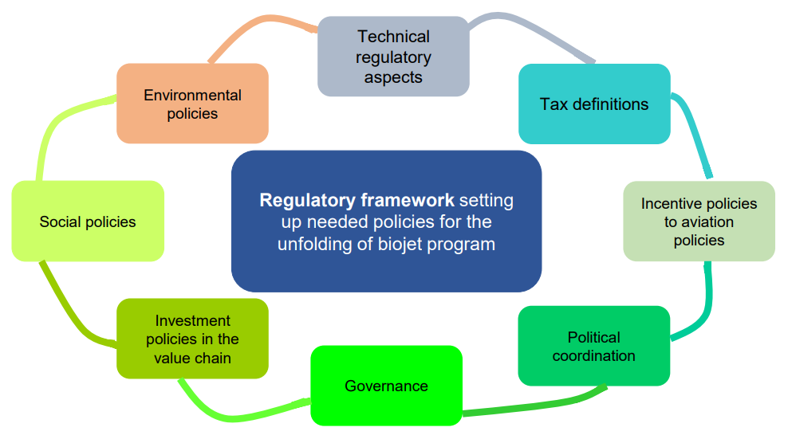
Challenges for SAF market
Notes:
Folie von Paula!!

Slide 30
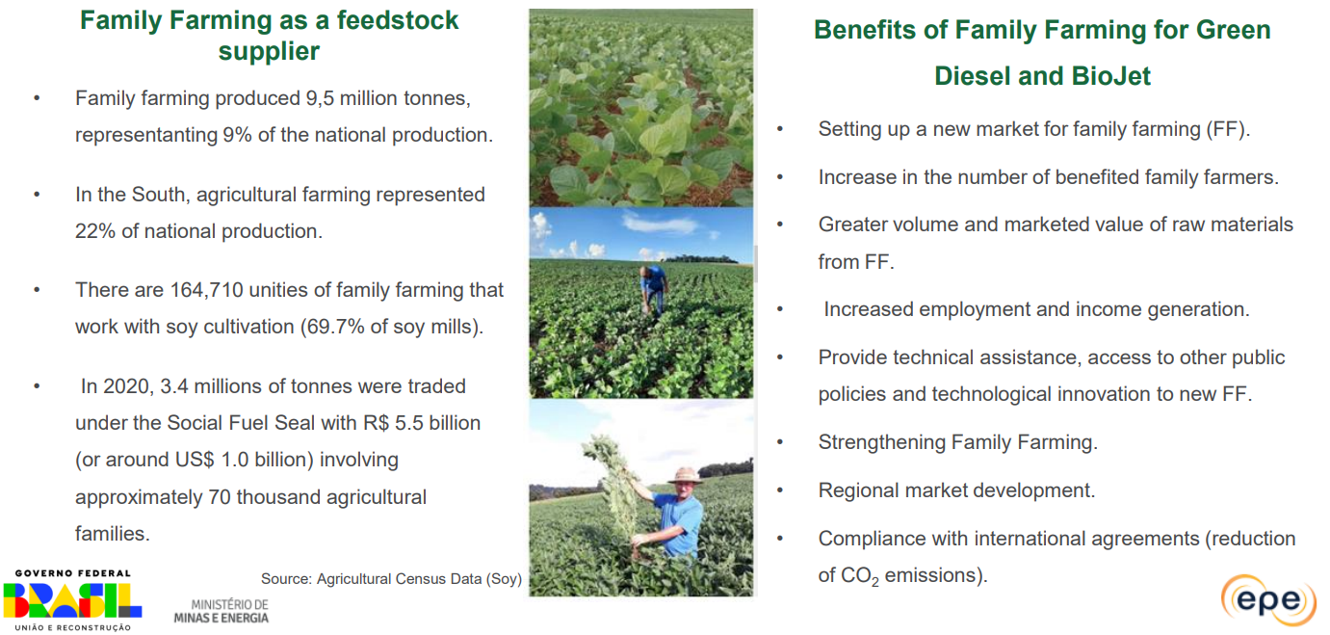
Strengths and strategies
Example Family Farming
Notes:
Folie von Paula!!

Slide 31
Decarbonize aviation and meet green deal target
RED II and EU-ETS have not led to a sufficient market uptake of SAF
CORSIA on its own did not provide sufficient economic incentives
The aim of the EU is a clear regulatory roadmap for decarbonizing the aviation sector and reinforcing a level playing field, by
  Increasing the share of SAF with blending requirements
  Tackling fuel tankering practices
  Strengthening EU-ETS and CORSIA
SAF are considered to have the most potential to reduce GHG emissions of the aviation sector in the short-term
  Since alternative propulsion technologies will not be commercially available in the next decade
https://www.europarl.europa.eu/RegData/etudes/BRIE/2022/698900/EPRS_BRI(2022)698900_EN.pdf

