Slide 1
IETS TCP and Task XI on Industry-Based Biorefineries
Exploring the Potential to Collaborate
Thore Berntsson (IEA-IETS TCP) - SWEDEN
Marzouk Benali (NRCan) and Paul Stuart (Polytechnique) - CANADA
Bettina Muster-Slawitsch and Sarah Meitz (AEE INTEC) – AUSTRIA
Jorge Costa and Isabel Cabrita (Instituto Superior de Educação e Ciências) - PORTUGAL
Presentation to IEA Bioenergy TCP Task 39 (and AMF TCP)
Leipzig, Germany - 26 October 2023

Slide 2

IETS: Industrial Energy-Related Technologies and Systems
Objective of this Presentation
To disseminate overview information on current IETS activities, with an emphasis on Task XI on Industry-Based Biorefineries
To catalyze a discussion to explore the potential for collaboration between (1) IEA Bioenergy and IETS (broadly), and (2) IEA Bioenergy Task 39 and Task XI of IETS (specifically)

Slide 3
IETS: Industrial Energy-Related Technologies and Systems
Roll-Out of this Presentation
IETS
  Quick overview
  Some Words from Thore on IETS collaborations
IETS Task XI on Industry-Based Biorefineries
  Overview
  Sub-Tasks
    Decision Support Systems and Ex-ante Research
    Technology Pathways for Negative and/or Net-Zero Emission Biorefineries
    Circular Bioeconomy and Biomass-Oriented Industrial Symbiosis
Potential context for collaboration with IEA Bioenergy Task 39
  Catalyzing a discussion on collaboration

Slide 4
IETS: Industrial Energy-Related Technologies and Systems
Roll-Out of this Presentation
IETS
  Quick overview of IETS today
  Some Words from Thore on IETS collaborations
IETS Task XI on Industry-Based Biorefineries
  Overview
  Sub-Tasks
    Decision Support Systems and Ex-ante Research
    Technology Pathways for Negative and/or Net-Zero Emission Biorefineries
    Circular Bioeconomy and Biomass-Oriented Industrial Symbiosis
Potential context for collaboration with IEA Bioenergy Task 39
  Catalyzing a discussion on collaboration

Slide 5
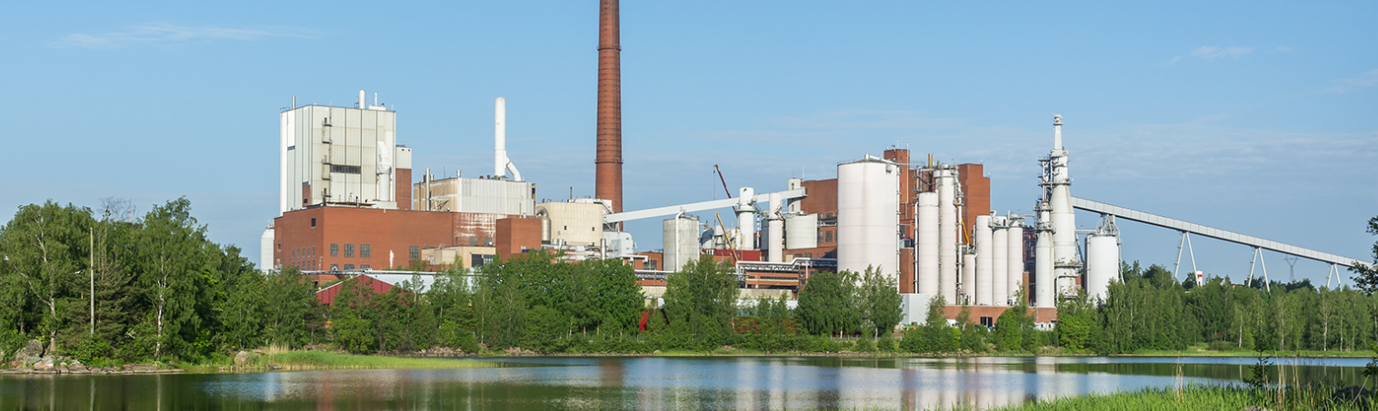
IETS: Industrial Energy-Related Technologies and Systems
Overview of IETS
The objective of IETS is to foster international co-operation for accelerated research and technology development of industrial energy-related technologies and systems with a focus on end-use technologies.

Slide 6
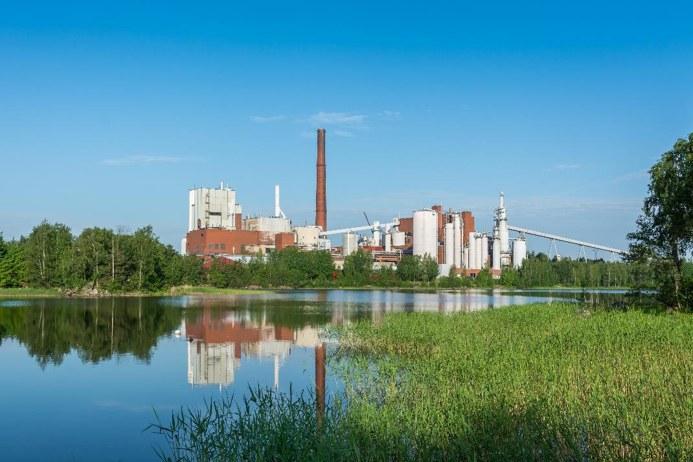
IETS: Industrial Energy-Related Technologies and Systems
Overview of IETS Tasks
Task
XI
Industry-based Biorefineries:
Decision Support Systems and Ex-ante Research
Task
XIV
Energy efficiency in the iron and steel industry
Task
XV
Industrial Excess Heat Recovery
Task
XVI
Energy Efficiency in SMEs
Task
XVII
Membrane Processes in Biorefineries
Task
XVIII
Digitalization, Artificial Intelligence and Related Technologies for Energy Efficiency and GHG Emissions Reduction in Industry
Task
XIX
Electrification in Industry
Task
XX
Task
XXI
Development of Industry Transition Roadmaps
Decarbonizing industrial systems in a circular economy framework

Slide 7
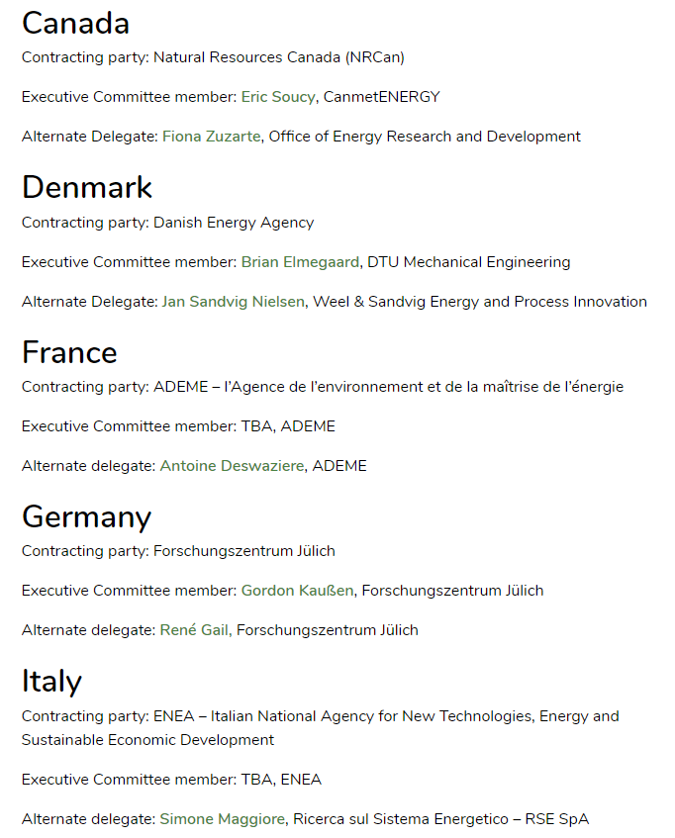
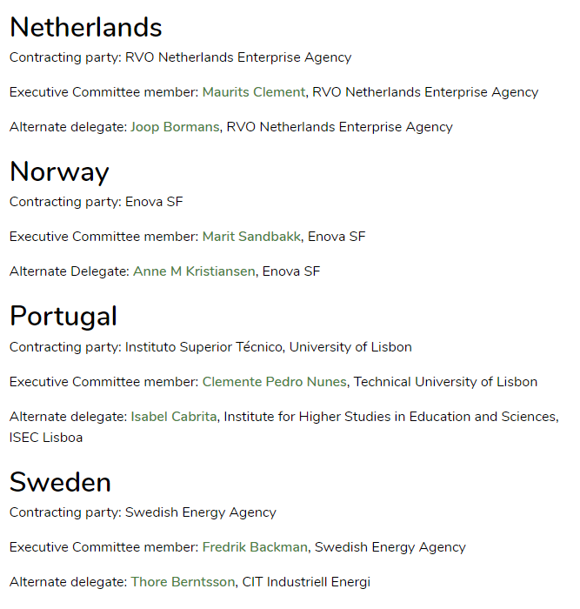
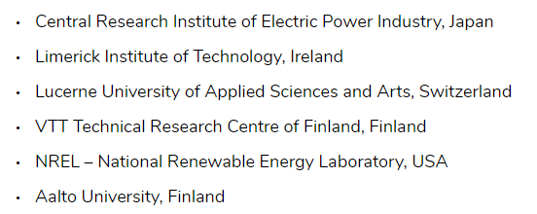
IETS: Industrial Energy-Related Technologies and Systems
Overview of IETS
9 Country members
6 sponsors

Slide 8

IETS: Industrial Energy-Related Technologies and Systems
Recent IETS Seminal Moment

Slide 9

A Few Words from Thore about Inter-TCP Collaboration
IETS Contacts with other TCPs
Main TCP contacts – seeking collaboration
IEA Bioenergy
IEAGHG (consequences in industry sectors from CCUS)
Hydrogen (and indirect electrification)
Hear Pumping (industrial excess heat and electrification)
Energy Technology Systems Analysis Program (ETSAP)
Ongoing contacts
International Smart Grid Action Network (ISGAN)
Energy Storage Technology Collaboration Programme (ES TCP)
Solar Heating and Cooling Programme (SHC)
Users TCP
Gas and Oil (GOTCP)

Slide 10
A Few Words from Thore about Inter-TCP Collaboration
Examples of IETS Cooperation with other TCPs
IEA Bioenergy
Joint workshop, and back-to-back ExCo meetings, May 2017, Gothenburg – very successful, but not Task-to-Task
Heat Pumping (industrial excess heat and electrification)
Starting with a workshop, leading to Joint Task-to-Task cooperation on industrial heat pumps; shared Task Manager work
IEAGHG
Joint online workshop on CCUS integration in industry now planning a direct cooperation
ETSAP
Planned close cooperation on industry modelling in system analyses

Slide 11
A Few Words from Thore about Inter-TCP Collaboration
Discussion Points…
Collaboration between TCPs:
Sometimes a timing problem, the two Tasks in different TCPs are at different stage in the process
Different approaches to cooperation within the TCP, eg networking on existing projects or funded projects
An alternative could be two different Tasks but with close cooperation, eg discuss early to create collaboration opportunity
Check and discuss with other relevant TCPs when defining and initiating a new Task, to ensure complementarity and maximize synergy

Slide 12
A Few Words from Thore about Inter-TCP Collaboration
The Need for Communication and Knowledge Transfer
Communication/information transfer between the TCP secretariats
  Regular short meetings sharing news across several Tasks
Invite other TCPs/Tasks to workshops and other activities of common interest
At each ExCo meeting, inform about relevant new activities in other TCPs
Arrange joint workshops on the TCP Task level
Seek longer-term sustained activities, eg white papers
Make references to each other’s reports
Joint work especially with regards to training activities...

Slide 13
IETS: Industrial Energy-Related Technologies and Systems
Roll-Out of this Presentation
IETS
  Quick overview
  Some Words from Thore on IETS collaborations
IETS Task XI on Industry-Based Biorefineries
  Overview
  Sub-Tasks
    Decision Support Systems and Ex-ante Research
    Technology Pathways for Negative and/or Net-Zero Emission Biorefineries
    Circular Bioeconomy and Biomass-Oriented Industrial Symbiosis
Potential context for collaboration with IEA Bioenergy Task 39
  Catalyzing a discussion on collaboration

Slide 14
Task XI on Industry-based Biorefineries
Overview
Task XI addresses the concept of biorefineries integrated and not-integrated into industrial complexes, aiming at the optimization of energy efficiency and reduction of GHG emissions in global terms.
Our approach is based on the systems analysis of industry needs and applications, combining the knowledge of industrial technologies with energy efficiency and biomass conversion processes.
Different industrial sectors are considered, including the integration of bio and pre-existing industrial processes, together with CCUS, exploring technology and systems aspects for a better use of energy.

Slide 15
Task XI on Industry-based Biorefineries
Sub-Tasks Recently Initiated
3
IETS Task XXI
2
4
IETS Task XVIII
1

Slide 16
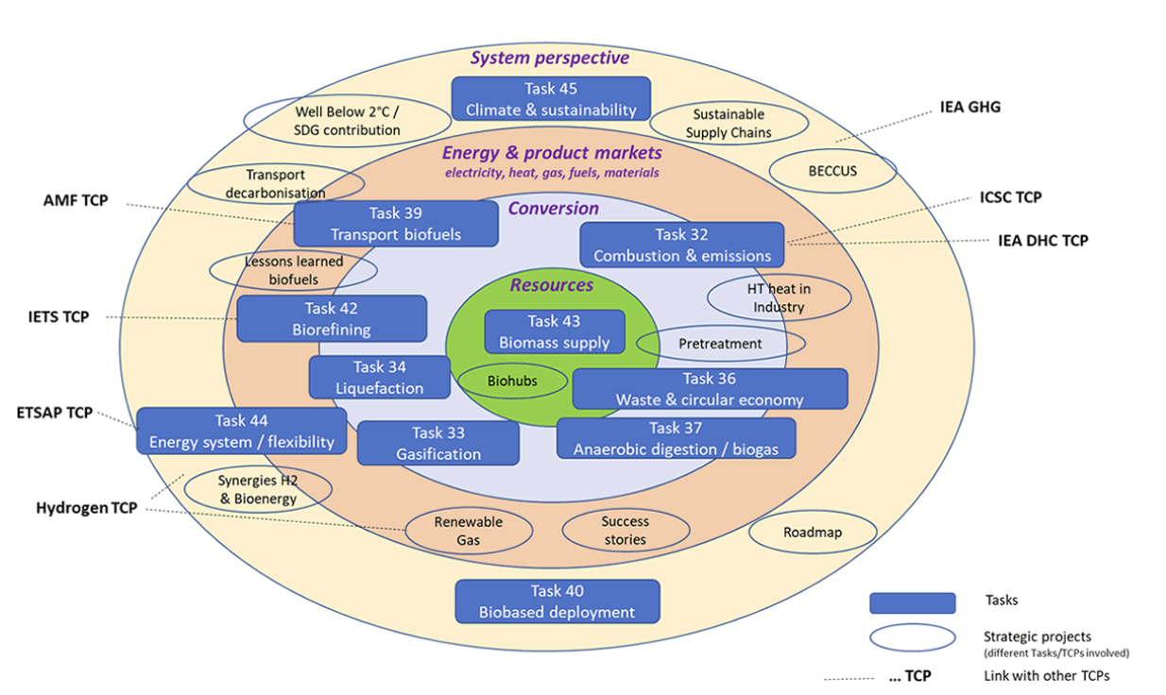
Task XI on Industry-based Biorefineries
Impressive IEA Bioenergy Structure and Linkages

Slide 17
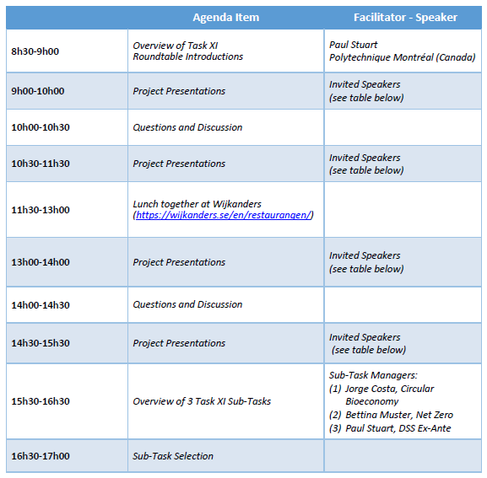

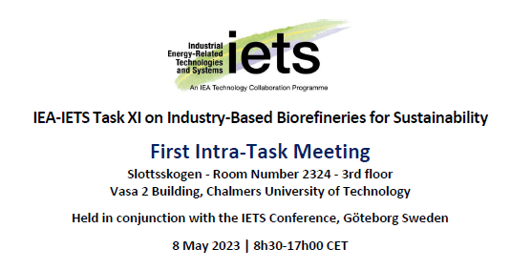
Task XI on Industry-based Biorefineries
Recent IETS Task XI Seminal Moment

Slide 18
IETS TCP and Task XI on Industry-Based Biorefineries
Exploring the Potential to Collaborate
Sub-Task on DSS and Ex Ante Research
Marzouk Benali (NRCan) and Paul Stuart (Polytechnique) - CANADA

Slide 19
Sub-Task on DSS and Ex Ante Research
Sub-Task Context: Useful Decision-Making Tools are Under-Exploited
Biorefinery systems researchers/analysts and industry-based biorefinery implementers/decision-makers may be more or less connected…
There is a need to better appreciate:
  The systems engineering and decision-making techniques being used with regards to the biorefinery and bioeconomy, in industry and government
  The role or potential role of ex-ante research in biorefinery decision-making
Various decision support software has been developed, but not employed in decision-making
  Synthesis of software complementarities and synergies
  Frameworks

Slide 20
Sub-Task on DSS and Ex Ante Research
Sub-Task Objectives
Objectives
  Advance and share knowledge on decision support approaches and tools.
  Better understand the complex decision-making needs, of industry and government, related to setting bioeconomy strategies.
  Demonstrate the pertinence of DSS coupled with Ex Ante research relative to complex bioeconomy decisions critical to industry.
  Establish and disseminate best practices and guidelines with respect to decision support tools and ex-ante scenario analysis methods.
  Strengthen networking among IETS and IEA Bioenergy TCP.
Key Activities
  Present industrial case studies and related specific projects.
  Review decision making methodologies and decision support tools, and establish harmonized DSS and Ex-ante approaches/methods.
  Organize a series of working meetings and workshops.

Slide 21
Sub-Task on DSS and Ex Ante Research
Overview of Sub-Task Methodology: Critical Analysis
Policy Scenarios
Biorefinery Systems Researcher
What We Seek
What We Have
Other Scenarios
Research Needs
BioEconomy Stakeholders
Visualization (interpretation)
Dash Board (results)
Application Software

Slide 22

Sub-Task on DSS and Ex Ante Research
Selected Projects in this Sub-Task
Development of systems dynamics model for the representation of biomass value chains and their use in various biorefinery conversion pathways
Emily Newes, National Renewable Energy Laboratory (USA)
Competitiveness of pulp companies in producing gasification-based biofuels: TEA and MCDM analysis
Adriano Pinto Mariano,UNICAMP (Brazil)
Creating Alignment and Evaluating Biorefinery Strategies Through MultiCriteria Analysis
Virginie Chambost, EnVertis Consulting (Canada)
Green hydrogen production
Patrice Mangin, H2V Énergies (France)
System perspectives on biofuel production in Sweden
Ingrid Nohlgren, Chalmers University of Technology (Sweden)
Multi-Scale Challenge: CO2ER
Andrea Ramirez Ramirez, Delft University of Technology (Netherlands)
Ex-ante LCA using artificial intelligence methods
Antonis Kokossis, NTUA (Greece)

Slide 23
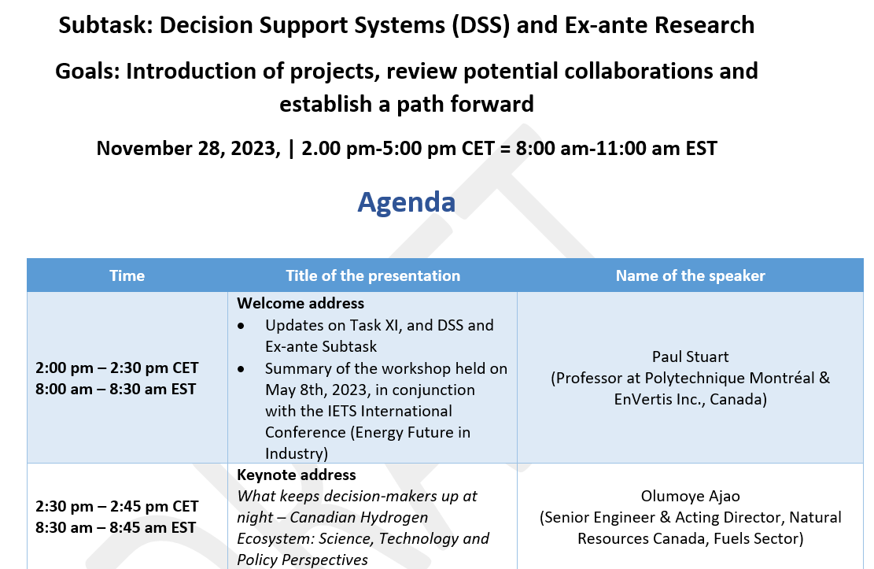
Sub-Task on DSS and Ex Ante Research
Sub-Task Status
3 working meetings have taken place to explore concepts and possible projects for the Sub-Task
4th meeting: Tuesday November 28, 2023
2.00 pm-5:00 pm CET = 8:00 am-11:00 am EST (at-distance)
Please consider this an invitation to join us!

Slide 24
IETS TCP and Task XI on Industry-Based Biorefineries
Exploring the Potential to Collaborate
Sub-Task on Technology Pathways for Negative and/or Net-Zero Emission Biorefineries
Bettina Muster-Slawitsch and Sarah Meitz (AEE INTEC) – AUSTRIA

Slide 25
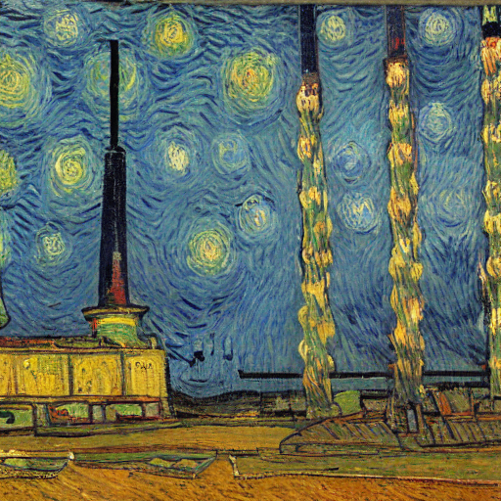
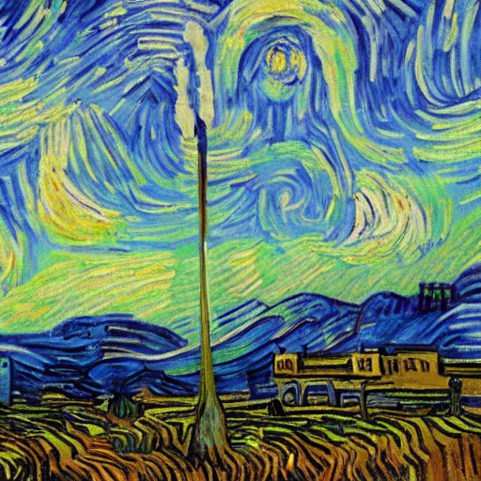
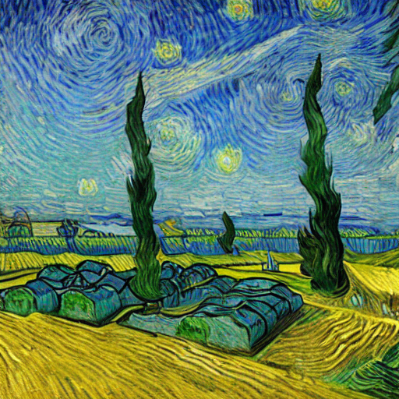
Sub-Task on Technology Pathways for Negative and/or Net-Zero Emission Biorefineries
Sub-Task Context: Negative Emissions for Biorefineries
pictures
Biorefinery concepts leading to net zero / negative emissions
Industry and GHG emissions
Energy and resource efficient biorefineries – new products, new pathways, possibly integrated to industrial complexes
Pictures: KI based image creation, https://huggingface.co/spaces/stabilityai/stable-diffusion

Slide 26
Sub-Task on Technology Pathways for Negative and/or Net-Zero Emission Biorefineries
Sub-Task Objectives
Technology Pathways embrace any technical attribute (new processing technology; new product pathway; new CCU/CCS strategy or implementation of renewable energy) and novel concepts that lead to overall net-zero/negative emissions in integrated biorefineries.
Specific Objective 1
Specific Objective 2
Specific Objective 3
Focus on creating an expert network on technical solutions for integrated biorefineries to reach negative or net-zero GHG emissions, including a variety of efficient processing and/or CCU/CCS technologies.
Available methods and approaches to increase energy efficiency and enhance the integration of renewable energy in industry will be applied and re-framed for biorefineries, aiming for close collaboration of industry and science.
Specific case studies of biorefinery pathways towards negative or net-zero GHG emissions shall be highlighted via projects in participating countries, advancing knowledge and reinforcing international collaboration.

Slide 27
Sub-Task on Technology Pathways for Negative and/or Net-Zero Emission Biorefineries
Sub-Task Status
Sub-Task Activities
Austrian National Networking
Identified potential projects for the Sub-Task
Austria, Canada, Netherlands, Sweden
Cooperation within the scope of international projects Other IETS Tasks, TCP Bioenergy Task 40/42
Academia: Energy Institute (JKU Linz), TU Vienna, Montan-University
Industry: Agrana, BrauUnion
Last WORKSHOP Jan 2023
Which methodological approach is being used?
Which are the main attributes that enable net-zero ?
Which system boundaries are to be defined for evaluating „net zero“?
Path Forward and Next Activities
Organise workshop on system boundary definition
Confirmation of commitments to IETS for implementation
Organise periodic workshops with project presentations every 6 months
Develop compendium on technology pathways as living document and international publication
Focus on system boundary definition in next workshop 7/11 2023 2-4pm

Slide 28
IETS TCP and Task XI on Industry-Based Biorefineries
Exploring the Potential to Collaborate
Sub-Task on Circular Bioeconomy and Biomass-Related Industrial Symbiosis
Jorge Costa and Isabel Cabrita
(Instituto Superior de Educação e Ciências) - PORTUGAL

Slide 29
Sub-Task on Circular Bioeconomy and Biomass-Related Industrial Symbiosis
Sub-Task Context
  The Sub-Task is focused on carbon circularity approaches to strengthen the sustainability of a bioeconomy strategy and decarbonization of industry, through the integration of diverse biorefinery technology pathways and analytics related to industrial symbiosis.
  The implementation of this sub-task will be based on ongoing projects, as a first approach to establish an open platform of knowledge and experiences exchange, with the aim to form networks to identify new R&I areas that could lead to networking and projects’ implementation influencing future trends towards negative carbon emissions.

Slide 30
Sub-Task on Circular Bioeconomy and Biomass-related Industrial Symbiosis
Sub-Task Objectives
Specific Objective 1
Specific Objective 2
Specific Objective 3
To create a platform to enhance collaboration among countries and create a network to share knowledge and experiences within its scope, in the context of circular bioeconomy.
To share best practices, experiences and lessons learned in process analysis methodologies, emphasizing industrial symbiosis, that promote the decarbonization of various industry sectors through the integration of biorefineries.
To share case studies and ongoing projects, and synthesize the project results to identify priorities and new systems analysis research areas.

Slide 31

Sub-Task on Circular Bioeconomy and Biomass-related Industrial Symbiosis
Sub-Task Activities
  Information sharing on policy and best practices to design strategies for circularity.
  Enabling a shared view on the state-of-the-art of integrated systems using biorefineries, including industrial symbiosis case studies.
  Creating new system loops in the context of circular bioeconomy and biomass-oriented Industrial Symbiosis to support the deployment of circular bioeconomy.
  Networking with other Tasks and TCPs.
  Management and knowledge dissemination.

Slide 32
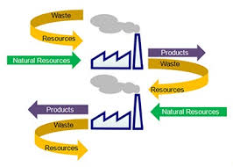
Sub-Task on Circular Bioeconomy and Biomass-related Industrial Symbiosis
Selected Projects in this Sub-Task
Design and Planning of Biomass Supply Chains
Helena Paulo, ISEL (Portugal)
SAF – A roadmap for site production selection based on overall system analysis
Isabel Cabrita, ISEC Lisboa (Portugal)
Calcium-rich algae incorporation into the cement industry
Paula Teixeira, IST (Portugal)
PyroCO2
Jawad Elomari, Sintef (Norway)
H2VEnergie circular bioeconomy – best practices and methodologies
Patrice Mangin, UQTR (Canada)
Green H2 and circular bio-coal from biowaste for cost-competitive steel
Andrea Lanzini, Politecnico di Torino (Italy)
AI4B
Antonis Kokossis, NTUA (Greece)

Slide 33

Sub-Task on DSS and Ex Ante Research
Sub-Task Status
For more information and contact, please visit:
1st Workshop on Circular Bioeconomy and Biomass-Oriented Industrial Symbiosis, in February 2022 (at-distance)
1st Activities’ Leaders meeting in October 2023
2nd Workshop on Circular Bioeconomy and Biomass-Oriented Industrial Symbiosis and Projects’ Leaders meeting – to be held the week before Christmas (at-distance)
Please consider this an invitation to join us!

Slide 34
IETS: Industrial Energy-Related Technologies and Systems
Roll-Out of this Presentation
IETS
  Quick overview
  Some Words from Thore on IETS collaborations
IETS Task XI on Industry-Based Biorefineries
  Overview
  Sub-Tasks
    Decision Support Systems and Ex-ante Research
    Technology Pathways for Negative and/or Net-Zero Emission Biorefineries
    Circular Bioeconomy and Biomass-Oriented Industrial Symbiosis
Potential context for collaboration with IEA Bioenergy Task 39
  Catalyzing a discussion on collaboration

Slide 35
Task XI on Industry-based Biorefineries
Next IETS Task XI Seminal Moment

Slide 36

Sub-Task on DSS and Ex Ante Research
Potential IETS Task XI and Bioenergy Task 39 Linkages
Collaboration mode: Joint Workshops leading to white papers, or similar?
Decision Support Systems and Ex-ante Research
  Impact of policy on the economics of biofuels production
  Decision-making criteria for triage/design approach for biofuel plants
Technology Pathways for Negative and/or Net-Zero Emission Biorefineries
  Strategies for coupling biofuel plants with CCUS for negative emissions
  Strategies for combining CO2 and H2 value chains to produce synthetic renewable and sustainable fuels
Circular Bioeconomy and Biomass-Oriented Industrial Symbiosis
  Quantification of opportunities related to industrial symbiosis to improve the economics of biofuel production processes and the carbon footprint

Slide 37

Merci - Thank You!
Please don’t hesitate to contact us…
Paul Stuart
Professor
Product and Process Design Laboratory
Department of Chemical Engineering
Polytechnique Montréal, Quebec, Canada
Telephone : +1(514) 891-3506
Email: paul.stuart@polymtl.ca
https://www.polymtl.ca/en/
Marzouk Benali
Senior Research Scientist
Industrial Systems Optimization
Natural Resources Canada/CanmetENERGY
Telephone : +1 (514) 241-5915
Email: marzouk.benali@nrcan-rncan.gc.ca
www.nrcan.gc.ca

