Slide 1

Inter-Task project ‘Synergies of green hydrogen and bio-based value chains deployment’ (T39 T6)
Task 39 Business Meeting
Franziska Müller-Langer, DBFZ
Online| May 31, 2023

Slide 2
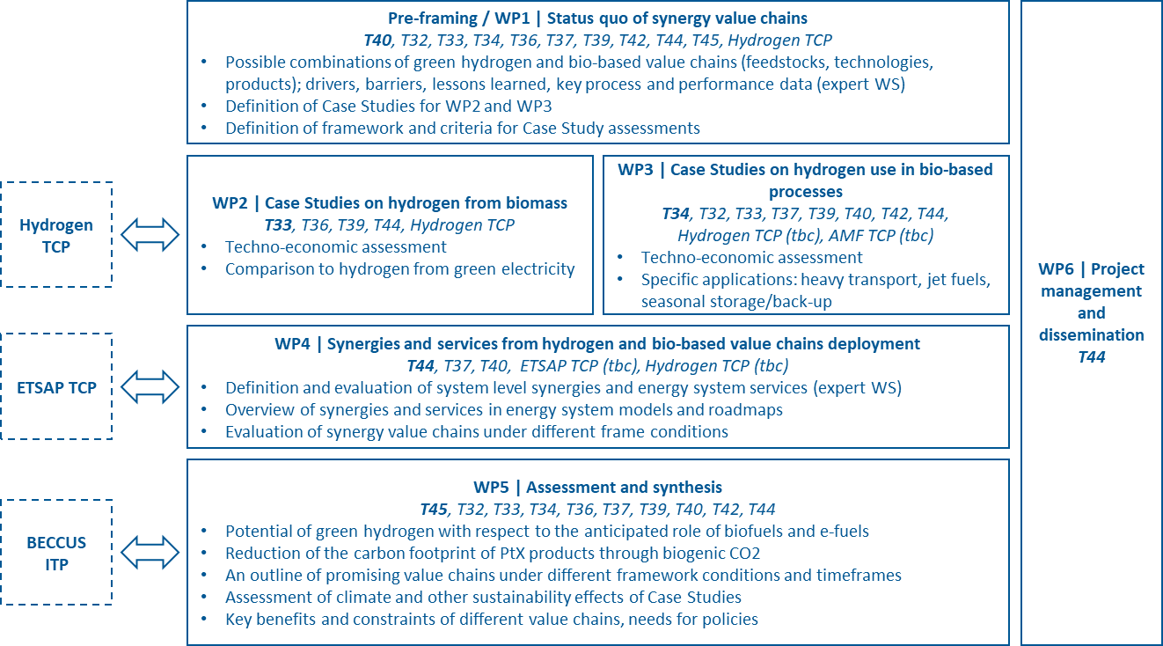
Work Packages
T39
T39 project team
Franziska Müller-Langer (DE), Glaucia Souza (BR), Dina Bacovsky (AT), Tomas Ekbom (SE), Luiz Augusto Horta Nogueira (BR), Rubens Maciel (BR), Nicolaus Dahmen (DE); Marco Buffi (EC), Paul Benett (NZ)
T39
T39

Slide 3
Timeline
From June 2022 to November 2024 (30 months)
Initial plan: From Jan 2022 to June 2024 (30 months)
Kick-off meeting
06/2022
First expert
workshop in 10/2022
Workshop March 29, 2023 in Berlin
Next WPL meeting end of 06/2023
Work package / Project month | 2 | 4 | 6 | 8 | 10 | 12 | 14 | 16 | 18 | 20 | 22 | 24 | 26 | 28 | 30
WP 1 | Status quo of synergy value chains |  |  | X |  | R1
WP 2 | Case Studies on hydrogen from biomass |  |  |  |  |  |  |  |  |  |  | R2 | W1
WP 3 | Case Studies on hydrogen use in bio-based processes |  |  |  |  |  |  |  |  |  |  | R2 | W1
WP 4 | Synergies and services from hydrogen and bio-based value chains deployment |  |  |  |  | X |  |  |  |  |  |  |  |  | R3 | W2
WP 5 | Assessment and Synthesis |  |  |  |  |  |  |  |  |  |  |  |  |  | R3 | W2
WP 6 | Project management and dissemination |  |  | PS |  |  | PS |  |  | PS |  |  | PS |  |  | PS
x is workshop (either internal or with externals) R is report W is webinar PS is project status to ExCo

Slide 4
Budget
T39
 |  | Participating Task: Cost/Budget (USD)
WP | Activity | 32 | 33 | 34 | 36 | 37 | 39 ^{*)} | 40 | 42 | 44 | 45 | Sub-total
1 | Status quo of synergy value chains | 2500 | 2500 | 2500 | 2500 | 5000 | 2500 | 15000 | 1000 | 2500 | 2500 | 38500
2 | Case Studies on hydrogen from biomass | - | 15250 | - | 17250 | - | 8000 | - | - | 5000 | 2500 | 48000
3 | Case Studies on hydrogen use in bio-based processes | 11000 | 3000 | 21000 | - | 13500 | 12000 | 3000 | 13000 | 5000 | 2500 | 84000
4 | Synergies and services from hydrogen and bio-based value chains deployment | - | - | - | - | 16000 | - | 15000 | - | 16000 | - | 47000
5 | Assessment and Synthesis | 1500 | 1500 | 1500 | 1500 | 4375 | 2500 | 5875 | 1000 | 3375 | 31375 | 54500
6 | Project management and dissemination | - | - | - | - | - | - | - | - | 30000 | - | 30000
Total Cost/Budget |  | 15000 | 22250 | 25000 | 21250 | 38875 | 25000 | 38875 | 15000 | 61875 | 38875 | 302000
From Task budget |  | 12000 | 18000 | 20000 | 17000 | 30000 | 20000 | 30000 | 12000 | 43000 | 30000 | 232000
From ExCo Strategic Fund |  | 3000 | 4250 | 5000 | 4250 | 8875 | 5000 | 8875 | 3000 | 18875 | 8875 | 70000
^{*)} estimated budget; confirmation later
After ExCo88 in 04/2022
Task contribution 232.000 USD
ExCo funding 70.000 USD
Total budget 302.000 USD
Pending confirmation of budget allocation from T39 25.000 USD
T39 internal
Budget allocation within T39 contributors
DE: T39 coordinator, WP1,2,3,5: 14.500 USD
BR: WP1,2,5: 10.500 USD
Further contribution inkind
Notes:
10 participating Tasks

Slide 5
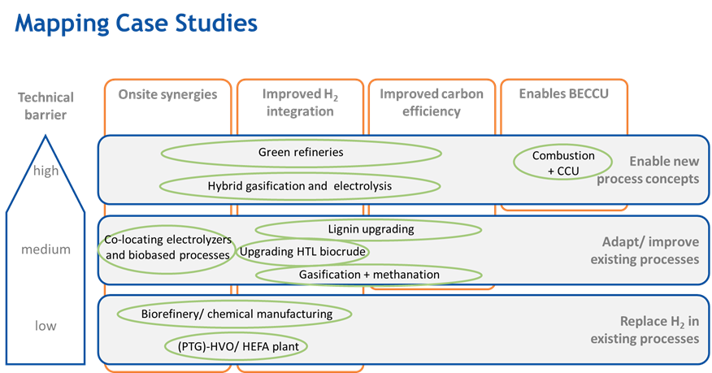
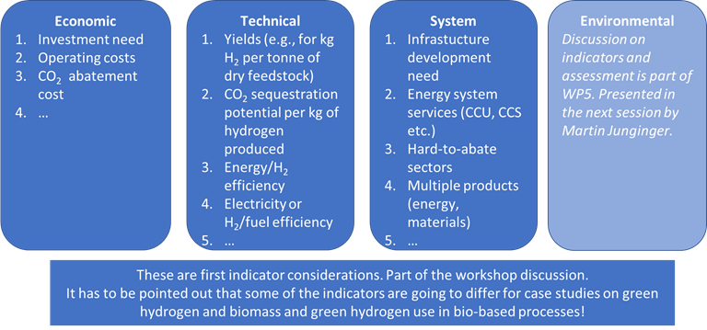
WPs T39 contribution
WP 2 & 3 | Work in progress
Report “Renewable hydrogen and bioenergy: prospects in Brazil” (Glaucia, Rubens, Luiz, Heitor):
Work on initial list of case studies for WP 3 (Franziska with Glaucia, Marco, Nico):
Workshop march 29, 2023 Berlin (T39 participants Franziska, Nicolaus, Marco) >> Results to be shared soon
Many participants from Bioenergy TCP, Hydrogen TCP, AMF TCP and HQ
Presentations by IEA TCPs and IEA headquarters
Presentation of case studies on green hydrogen from biomass and on green hydrogen use in bio-based processes
Presentation of an assessment framework for evaluating the deployment of green hydrogen from biomass and green hydrogen use in bio-based processes
Presentation of carbon footprint assessment for evaluating the deployment of green hydrogen from biomass and green hydrogen use in bio-based processes
Moderated open discussion
working forward with the case study selection of WP2 and WP3, development of a case study template, assessment framework in respect to the indicators overview.

Slide 6
Contact
Dr.-Ing. Franziska Müller-Langer
Head of Department Biorefineries
franziska.mueller-langer@dbfz.de | +49 341 2434 423

