Slide 1
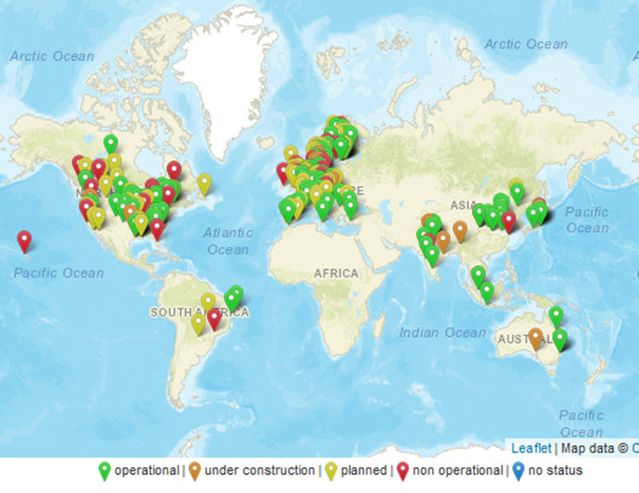
T39-T4 Assess and map demonstration plants and commercialization progress
Andrea Sonnleitner, BEST Austria
Business Meeting, online, 31.05.2023

Slide 2
Commerzialisation progress
Many plants (> 50) announced for 2023 and following years
  See https://demoplants.best-research.eu
Not all become operational – often investment decision pending, construction is postponed- Slow Commerzialisation progress
Negative Example: Red Rock Biofuels
built but not completed, planned startup date 2017, aviation biofuels refinery, southern Oregon, foreclosure, acquired by Lakeview RNG, a wholly owned subsidiary of NEXT Renewable Fuels → Lakeview RNG facility producing RNG and hydrogen from forest waste
Example Startup 2023: NESTE renewable fuels expansion project in Singapore
trial runs and inauguration of the 1.3 million tonne-per-year (tpy, operations started in April 2023

Slide 3
Outreach of database
Further interest in database and requests
  Internal interest from IEA, different groups
  European project “Study on development of outlook for the necessary means to build industrial capacity for drop-in advanced biofuels”
  Experts, journalists
Increasing visibility of Task 39 database - Presentation at conferences
  Next presentation at the EUBCE with focus on „Sustainable Aviation Fuel (SAF) production and challenges for market uptake”

Slide 4
Next steps – Systematic Update
with Task 39 participants, ETIP Bioenergy and IEA AMF
BEST will create XLS file and update database with available information from last months
XLS file is sent to NTLs, ETIP Bioenergy and IEA AMF members for feedback and additions
Finalisation before Task meeting in October
→ Ask each T39 member country to verify and update the respective country file – WILL BE SENT PER EMAIL
Thank you for your help and expertise!

Slide 5
Thank you!
Feedback and new information is welcome!
Andrea Sonnleitner
andrea.sonnleitner@best-research.eu
https://demoplants.best-research.eu

