Slide 1
Brazil – Country updates
1) Corn ethanol production in Brazil is soaring: 2% in 2018/2019 to 17% 2023/24 (forecast). Sugarcane ethanol is expected to remain at the same level of the last 3 years (27.5 million m³). Brazilian government has resumed the goal of increasing biodiesel use in the country. Blending mandate was increased from 10% to 12% in April, with a commitment to increase 1 p.p. each year until 15% in 2026.
2) 50% of the energy consumed in Brazil came from renewable resources (world average: 14%) in 2022. Sugarcane products alone accounted for about 20% of the energy consumed in Brasil in 2022, with an ethanol share of 6%. Recently the linking of biomethane into the distribution system o CNG has been approved.
3) Many developments are being observed for green diesel in Brazil. Brazil's domestic production of diesel and jet fuel were about 23% and 18% less than their domestic demand in 2022, and hydroprocesing has potential to grow in Brazil to reduce diesel and jet fuel imports. In April, the government of the state of Bahia has signed a project with the company Acelen valued at 2.44 billion dolars to develop an HVO facility with a capacity of 1 billion liters of biofuels per year. Bills are under discussion in the national congress to include green diesel inside or outside the biodiesel blending mandate. Petrobras, the state oil company, has been producing since 2022 a blend with 5% of vegetable oil in fossil diesel via co-processing in one of its refineries. The project is set to reach a capacity of 4 million m³ per year this year. Vibra Energia signed a contract com BBF to commercialize advanced biofuels from palm produced in Manaus and Roraima starting 2025.

Slide 2

Biofuels in Emerging Markets:
Potential for sustainable production and consumption
Environmental and economic assessment of biofuels production in countries of Latin America, Africa and Asia
Brazilian Team:
Glaucia Mendes Souza, Heitor Cantarella, Luis Fernando Cassinelli, Luiz Horta Nogueira, Raffaella Rossetto, and Rubens Maciel Filho
Collaborators:
Jean Felipe Leal Silva, Pablo Ortiz, Nicholas Canabarro
May 2023
Notes:
Thank you. Good morning to all from Brazil. So, I will try to give you an overview of the work of the brazilian team from the FAPESP Bioenergy research program BIOEN on Biofuels in Emerging Markets conducted in IEA Bioenergy Task 39.

Slide 3
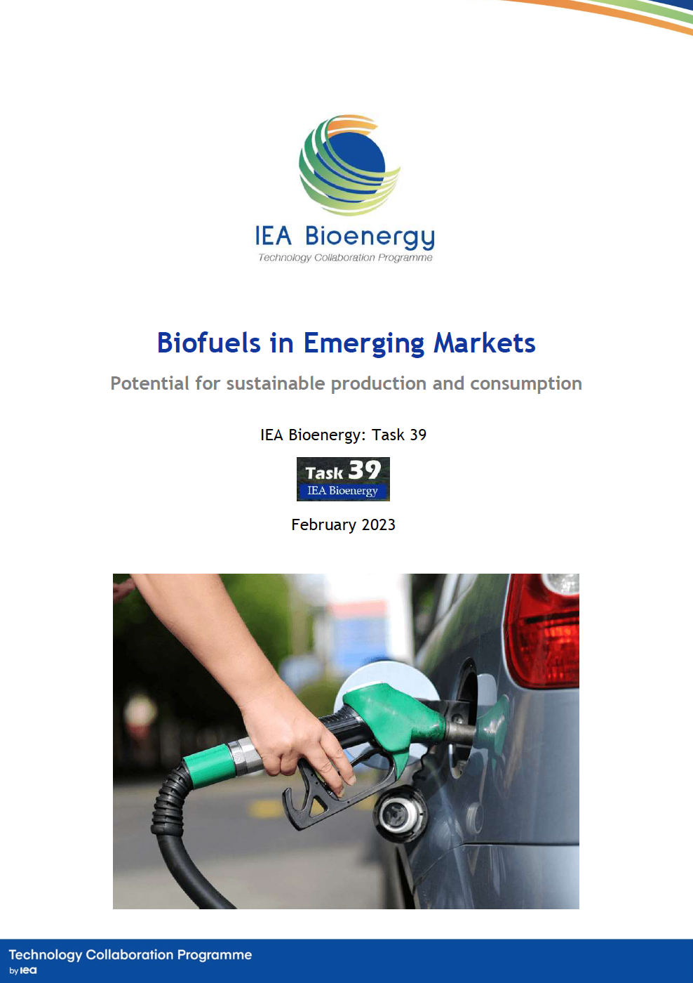
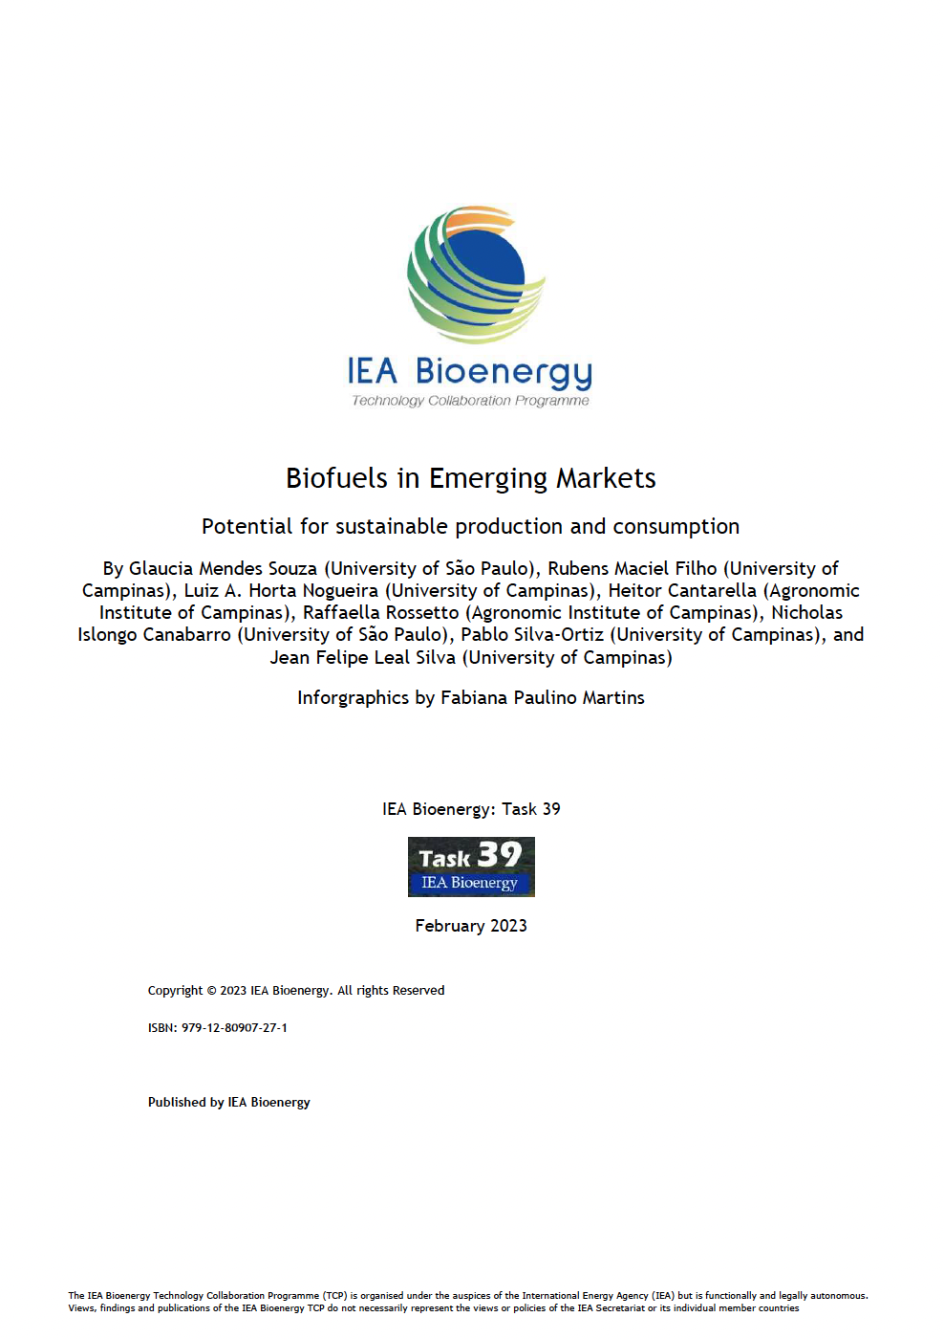


Presentation at the ExCo workshop
May 23
https://task39.ieabioenergy.com/wp-content/uploads/sites/37/2023/03/Biofuels-in-Emerging-Markets.pdf
Notes:
This work has been recently summarized in a policy brief and presented at the ExCo Workshop this month.

Slide 4
Developing countries with large populations, high energy demand, biofuels policies
Cradle-to-grave, attributional LCA
Inventory: based on literature data and ecoinvent 3.8
Emissions allocated among products based on energy content
Distribution: same as current fueling infrastructure
Life cycle assessment (LCA)
emissions in agricultural phase
emissions in industrial phase
Techno-economic analysis (TEA)
crop yield
emissions in distribution phase
conversion process data
MARKET ANALYSIS:
Determine economic and environmental feasibility of replacing gasoline and diesel
feedstock cost
price of co-products
Key expected results:
GHG savings
Required land to produce biofuels
Fuel cost (blending mandate)
market conditions
Notes:
To continue we chose developing countries with large populations, high energy demand and biofuels policies in place to conduct a life cycle assessment and a techno-economic analysis based on data we’ve been gathering on crop yields, conversion processes, emissions in all phases, feedstock costs, price of co-products and market conditions. Based on the results of LCA and TEA, we can look into different scenarios of blending mandates, determine economic and environmental feasibility, estimate the GHG savings, the required land to produce biofuels, and the fuel costs.

Slide 5
CASES EVALUATED
 | Ethanol |  | Biodiesel
 | Corn | Sugarcane | Soybean | Palm | Rapeseed
Argentina | ✓ | ✓ | ✓
Brazil |  | ✓ | ✓
Colombia |  | ✓ |  | ✓
Guatemala |  | ✓
China | ✓ | ✓ | ✓ |  | ✓
Ethiopia |  | ✓ | ✓
India |  | ✓ |  | ✓
Indonesia | ✓ |  |  | ✓
Malaysia | ✓ |  |  | ✓
South Africa |  | ✓ |  |  | ✓
Thailand |  | ✓ |  | ✓
Fully deployed, high TRL
Positive energy balance
Competitive with fossil fuel prices
Significant reduction of GHG emissions (63 MtCO2eq/yr)
Potential to double production with ~5% of pasturelant conversion into energy cropland
Other countries: next round of studies
Notes:
In the first phase of the Project we evaluated Argentina, Brazil, Colombia and Guatemala, where biofuels are fully deployed and Technologies have reached high TRL. We concluded that in all cases, for both ethanol and biodiesel, from corn, sugarcane, soybean and palm, processes presented a positive energy balance, they are competitive with fóssil fuel prices, they contribute with significant reductions in GHG emissions, and we verified a potential to double production using very little pastureland. We are now in the second phase of this Project evaluating China, Ethiopia, India, Indonesia, Malaysia, South Africa and Thailand. Let me show you through some of the new data.

Slide 6
IN PROGRESS: LCA - countries of Africa and Asia
* Corn ethanol is imported from the US
† Sugarcane ethanol is imported from BR
Notes:
We finished the LCA analysis for China, Ethiopia, India, Indonesia, Malaysia, South Africa and Thailand. We are looking into the following impact categories: human toxicity, terrestrial acidification, fossil resource scarcity, and global warming potential (action: point at the purple, yellow, orange, and green graphs as you mention the categories).
You can see here that in the case of the first three impact categories, we have problems regarding some biofuel routes in specific countries, such as in the case of South Africa. The global warming potential is less than that of the equivalent fossil fuel for South Africa. However, we’ve seen that some of their biofuel production processes use coal as energy source for the chemical processing of the biomass. Therefore, improvements can be made.
However, we have an overall positive figure in terms of greenhouse gas savings for all biofuels considered here, and these are the key results that we are carrying over to the next phase of our study.

Slide 7


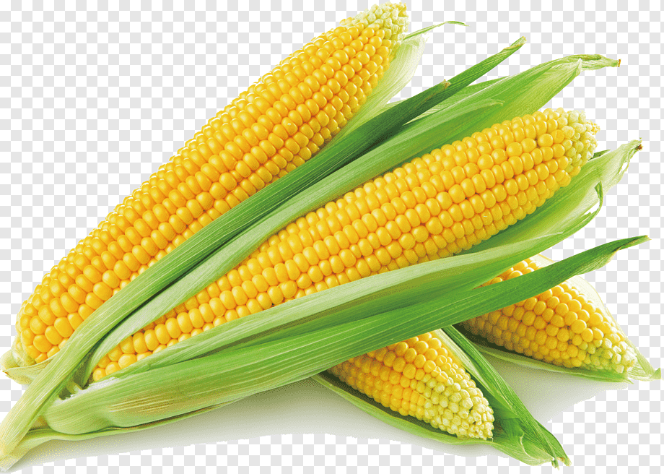

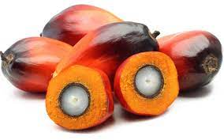

IN PROGRESS: MARKET ANALYSIS - countries of Africa and Asia
Biodiesel
Ethanol
3 scenarios for blending mandates
  5% ➔ ET-SC01
  10% ➔ ET-SC02
  25% ➔ ET-SC03
  Exceptions: IDN, MYS, and THA (blending already established)
Country area required for biodiesel:
3 scenarios for blending mandates
  5% ➔ BD-SC01
  10% ➔ BD-SC02
  25% ➔ BD-SC03
  Exceptions: IND and THA (blending already established)
Country area required for ethanol:
Notes:
In our market analysis, for each biofuel, we area considering three blending mandates: two of them are more feasible, and one of them will represent a hypothetical case in which biofuels represent at least ¼ of the fuel markets (in terms of energy content, not volume). You can see here in these graphs that the land required to produce the biofuel required in each of these scenarios in generally small. In fact, a great part of the land required can be covered by pasture and meadows or through the recovery of degraded areas. We are deepening our analyses in these aspects of land use and deforestation because we know that this can be a subject of discussion.
The biofuel demand in each scenario will be used, combined with the previous LCA results, to determine the potential greenhouse gas savings of each of these scenarios. This way, we hope that we can shed light on the impact of developing stronger biofuel markets in these developing countries to demonstrate their potential contributions to the decarbonization of the fuel sector.

Slide 8
Thank you for your attention!
Glaucia Mendes Souza
✉ glmsouza@iq.usp.br

Slide 9
T39-P2
Extend assessment of the Sustainability of Biofuels Pathways (LCA) (US/Canada/EC/Brazil/NZ)
Extend assessment of the sustainability of biofuels pathways, including review and evaluation of how much existing biofuels policies incorporate social and environmental aspects of sustainability, the specific impact of various proposed “new/advanced” feedstocks on the CI of biofuels, and also further compare and harmonize leading LCA models being used to support biofuels categorization and regulation (i.e., GREET, GHGenius, BioGrace, etc.). (Possibly joint with Task 45, or multi-Task). Report

Slide 10
1. Define the carbon intensity of transport biofuels, particularly those to be used for decarbonizing hard-to-electrify sectors (long-distance aviation, marine, rail, and trucking). | Submitted (Susan Van Dike, Glaucia Souza, Jack Saddler, Hana Mohammadi, Canada, Brazil)
2. Assess the potential to further reduce the carbon intensity of conventional biofuels. | Underway, Emerging Markets project (Glaucia Souza, Brazil)
3. Improve the understanding and confidence in the accuracy of the leading LCA models being used to assess the sustainability of biofuels.
4. Clarify overall sustainability measures and evaluate best ways to assess and include sustainability metrics beyond GHG reduction. | Submitted (Susan Van Dike, Glaucia Souza, Jack Saddler, Hana Mohammadi, Canada, Brazil)
1. Develop high-quality regional data for LCA models and making this data available to model developers/users to incorporate into their assessments. | Under way in Task 45, Land Use in Brazil project (Marcelo Moreira, Glaucia Souza, Brazil; Goran Berndes, Sweden; Floor Van Der Hilst, The Netherlands)
2. Continue development of the LCA’s used to assess the effectiveness of co-processing. | Underway, Drop-in Biofuels project (Jack Saddler, Canada)
3. Assessing land use change impacts in collaboration with other sustainability assessment stakeholders such as Task 45, USDA and FAO. | Underway in Task 45, Land Use in Brazil project (Marcelo Moreira, Glaucia Souza, Brazil; Goran Berndes, Sweden; Floor Van Der Hilst, The Netherlands)
4. Define the role of specific feedstocks in achieving lower cost low carbon intensity biofuels. | Underway, Emerging Markets project (Glaucia Souza, Brazil)
5. Develop “briefing notes” for policy makers summarizing the key factors that influence LCA results such as allocation issues, emissions variability, and possible soil carbon changes, and the unintended consequences of their decisions.
6. Assess conversion pathways to various biofuels (oleochemical, lignocellulosic biomass and other processing “wastes” feedstocks) with other IEA Bioenergy Tasks (Tasks 33, 34, 36, 37, 40, 42, 43, 44 and 45).
7. Evaluate the potential development of high integrity certification schemes across all the “waste”, oleochemical and lignocellulosic supply chains (from feedstock production through delivery of final products (e.g., biojet and renewable diesel) to end users). | Submitted with a focus on SAF (Jose Muisers, Paul Sinnige, The Netherlands; Joaquim Seabra, Glaucia Souza, Brazil; Austria
8. Clarify commonalities and the main differences in the methodological structures, calculation procedures and assumptions used by the leading LCA models (i.e., EU’s BIOGRACE, Canada’s GHGENIUS, USA’s GREET and Brazil’s VSB, etc.).
9. Investigate potential improvements in GREET, identify points of improvement in emission factors.
10. Investigate LUC and the concept of low-Indirect Land Use Change (iLUC)-biofuels (sugarcane, corn, new photosynthetic plant-based biofuels) (in collaboration with Tasks 40, 43 and 45). | Under way in Task 45, Land Use in Brazil project (Marcelo Moreira, Glaucia Souza, Brazil; Goran Berndes, Sweden; Floor Van Der Hilst, The Netherlands)

