Slide 1
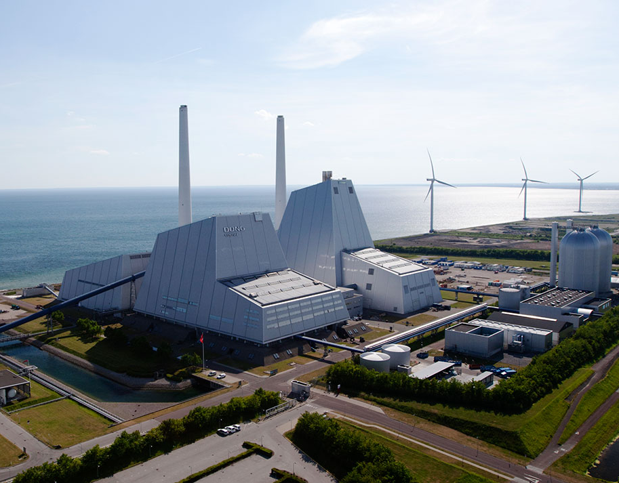

Country update – Denmark
Three relevant cases (fast)
May 2023
Sune Tjalfe Thomsen

Slide 2

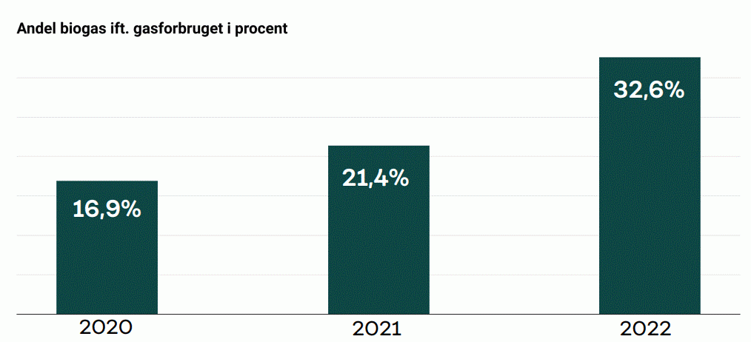
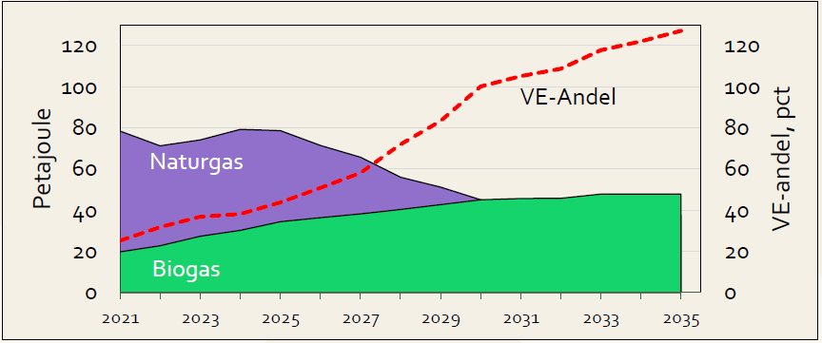


Biogas sector in significant development
Production of biogas increasing
  And has been further pushed as a consequence of the war in Ukraine
Danish leading biogas company, Nature Energy, were successfully acquired by Shell.
  Activities in several countries including USA and Germany
  Nature Energy operates 26 biogas plants.
  The company also has a pipeline of around 30 new plant projects in Europe and North America. More than a third of these projects are in medium to late development stage in Denmark, the Netherlands and France
  Reported price: 1.9 billion €
Share of biogas in the mix
Source: https://ing.dk/artikel/taettere-paa-uafhaengighed-af-fossile-gasser-danmark-er-europamester-i-biogas
Ren.%
Share of renewability
Source: https://www.biogas.dk/biogas-outlook-2023/

Slide 3
Discussion – Sustainability of forest biomass
The European Parliament backed plans to exclude “primary woody biomass” from the EU’s renewable energy targets
  Arguing that Europe needs to regrow its carbon sinks in the fight against climate change.
Policy-wise the discussion and potential implementation of these plans have been prominent in 2023
  NGO’s and knowledge institutions are to a large extend disagreeing on the matter
Denmark has a high consumption of biomass, of which a large part is imported.
  The National Climate counsel argues that the high consumption is a consequence of the fact that the price of biomass does not reflect the climate impact of felling the biomass and burning it – argues for a high impact...
  The government work on EU level to support the current Danish energy infrastructure
Plans for increased production of liquid biofuels for road transport are/will be affected by this discussion.

Slide 4

Sune Tjalfe Thomsen, Associate Professor
University of Copenhagen
Department of Geosciences and Natural Resource Management
TEL +45 35 33 62 62
MOB +45 50 59 40 49
stt@ign.ku.dk
www.ign.ku.dk

