Slide 1
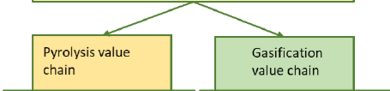
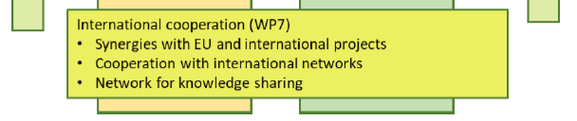
Project BioTheRoS –Grant Agreement Preparation Phase
Collaborative Actions to Bring Novel Biofuels Thermochemical Routes into Industrial Scale
Project Start October 2023
Duration 3 years
CERTH, BTG, CIRCE, WIP, BEST, Motor Oil Hellas
Cooperation with international networks in WP7 - IEA Bioenergy Task 33, 34, 39, 40 and ETIP Bioenergy
Contact via Task Leaders

