Slide 1
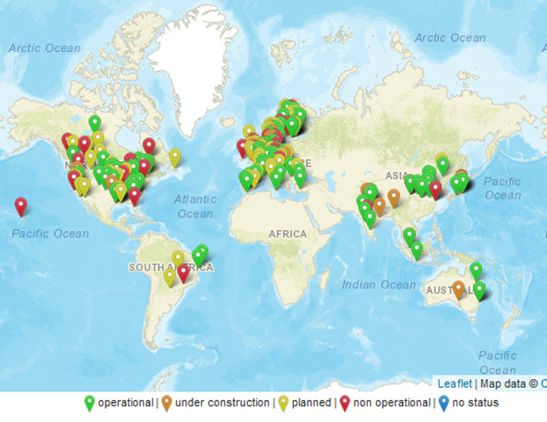
T39-T4 Assess and map demonstration plants and commercialization progress
Andrea Sonnleitner, BEST Austria
Business Meeting, online, 23.02.2023

Slide 2
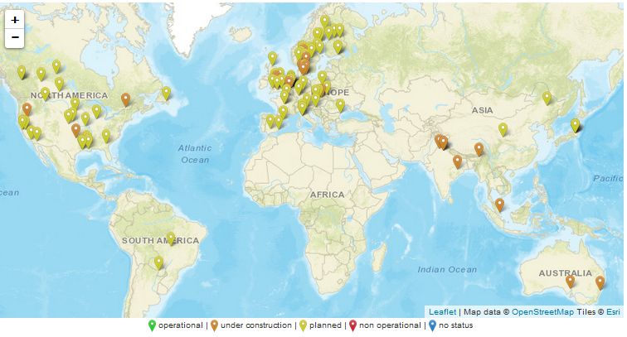
Planned facilities for advanced biofuel production
Planned facilities by f.e.
Velocys
Eni
Synkero
Vattenfall
Enerkem
Different Joint ventures
…
Notes:
What is happening in the biofuels sector – you see here a map with all planned facilites or facilities already under construction. So there is a lot going on , especially in the aviation sector.

Slide 3
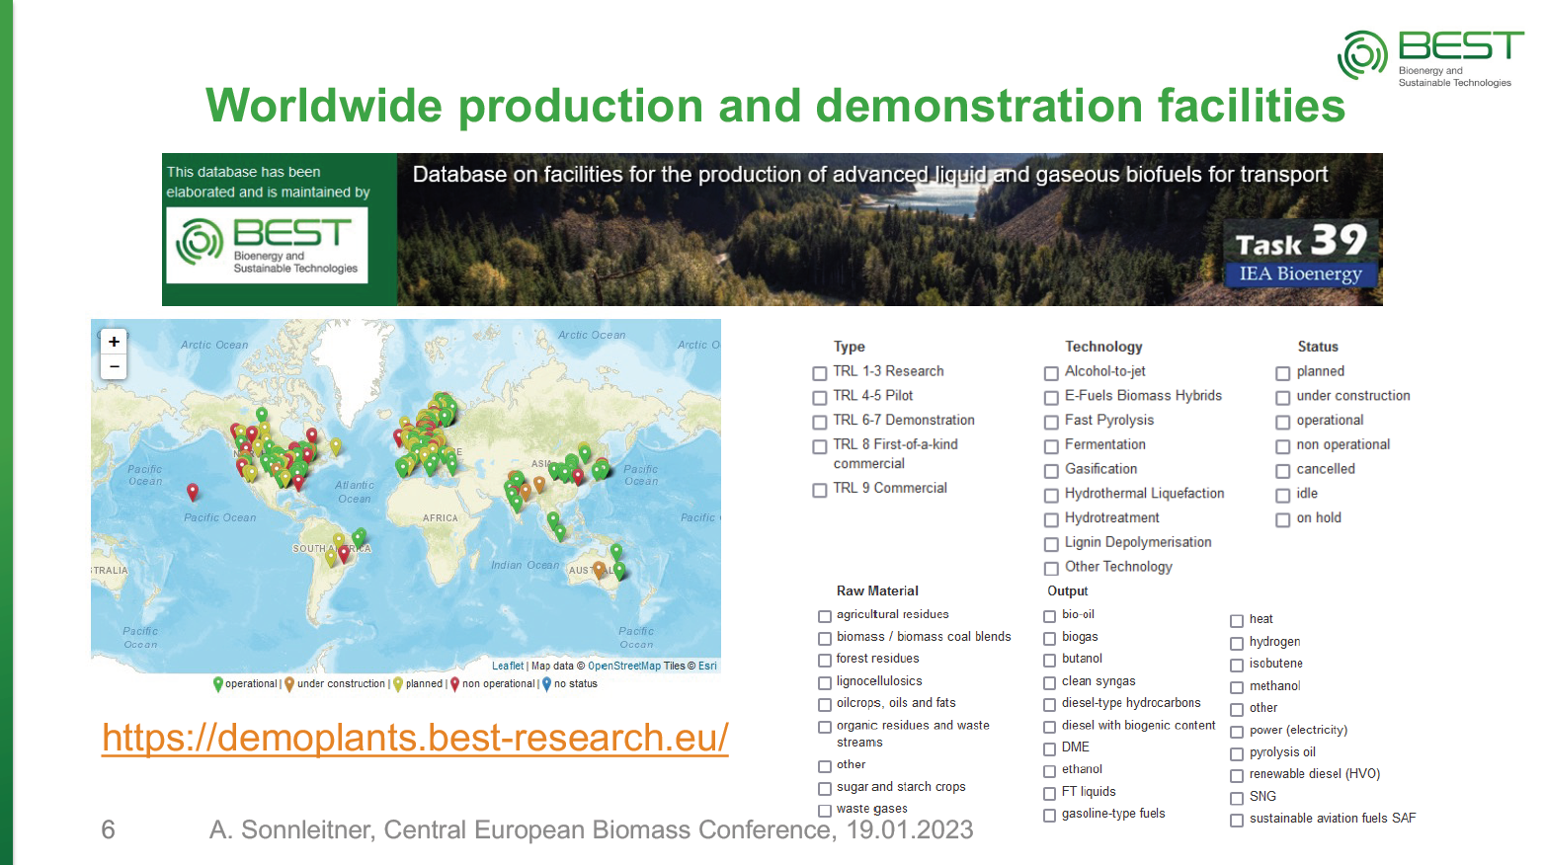
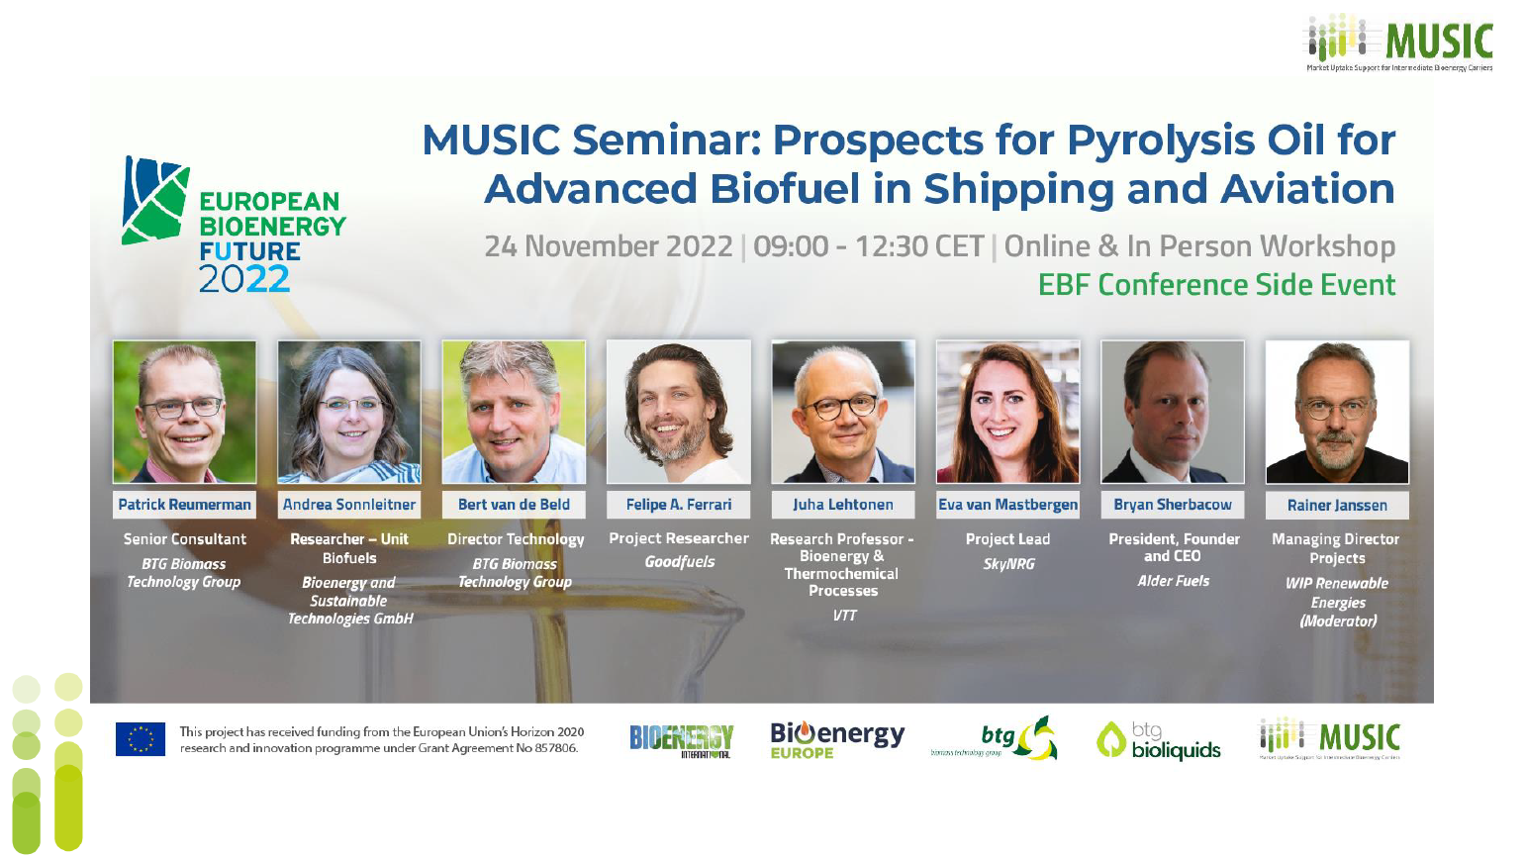
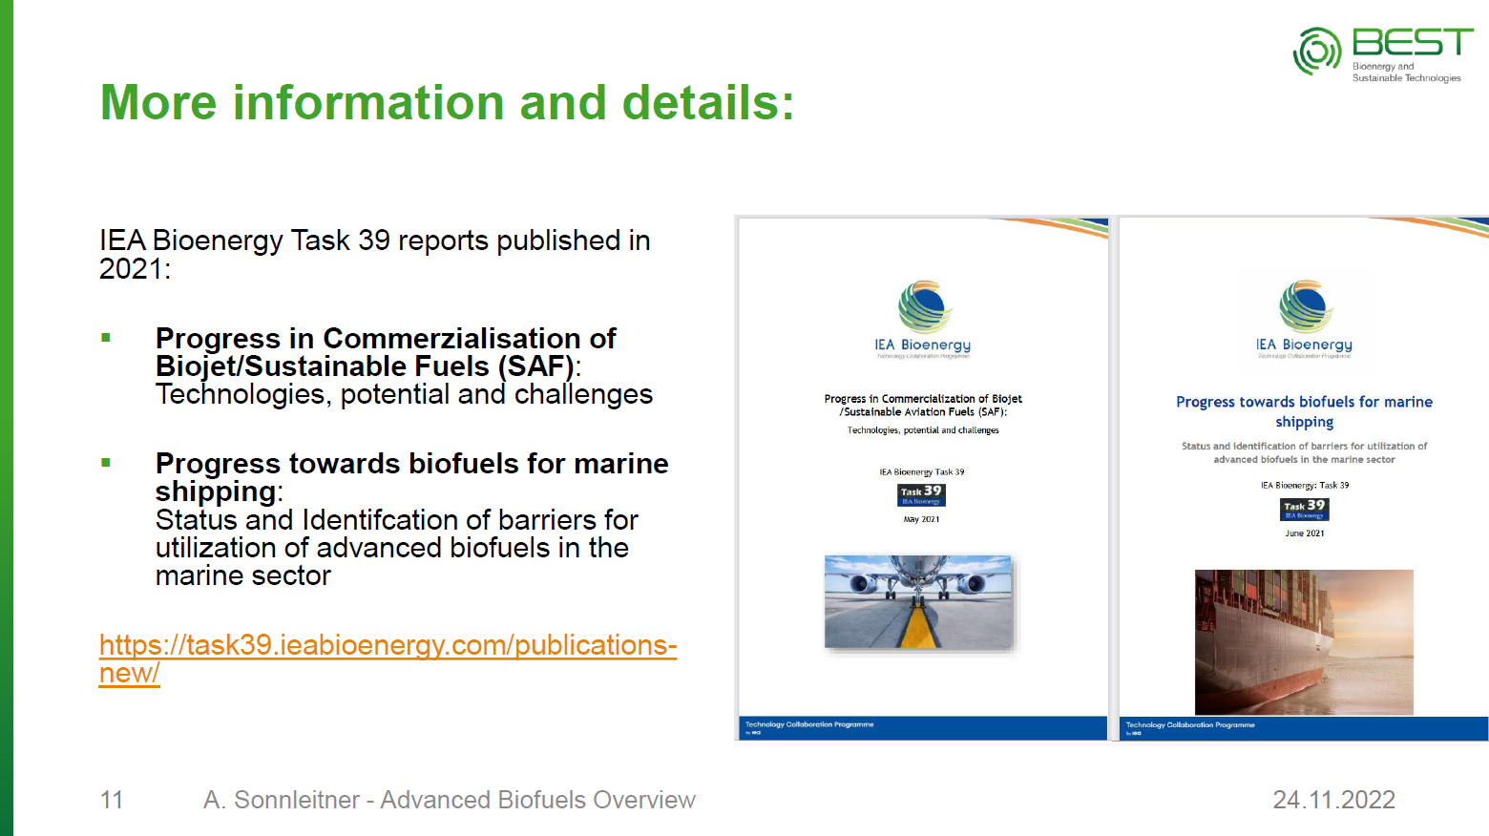
Increasing visibility of Task 39 database
- Presentation at conferences
Panel discussion - Advanced Biofuels Conference, September 2022, Stockholm, Sweden
Production technologies and facilities – national networking event on SAF in Austria, September 2022, Airport Vienna
Advanced Biofuels Overview - European Bioenergy Future 2022: Hybrid Seminar on Prospects for Pyrolysis Oil as Advanced Biofuel in Shipping and Aviation, November 2022, Brussels
Production capacity and outlook for advanced biofuels worldwide - Central European Biomass Conference, January 2023 Graz, Austria

Slide 4
Increased interest in database
- Many requests in 2022
Interest of research groups concerning the data collected for the Demoplants database
IEA - Jean-Baptiste Le Marois – IEA, Energy Technology Policy Division
student bibliographic project on the reality/viability of 2nd generation biorefineries today - Victor Pallares – AgroParisTech, France
conducting work to map out biofuel production facilities - Oyvind Sekkesaeter – DNV, Norway
Project ToZCA, focus SAF - Olivier Dessens - Researcher at the UCL Air Transportation Systems Lab, UK
BDC Biorenewable Deployment Consortium, Ben Thorp, Harry Seamans, and Masood Makhtar, BDC, USA

Slide 5
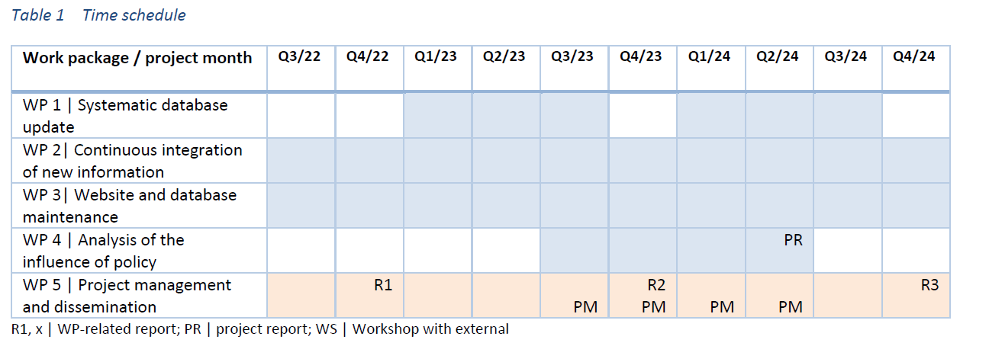
Progress in project
Next step:
SYSTEMATIC DATABASE UPDATE – until Q3/23
with Task 39 participants, ETIP Bioenergy and IEA AMF
Notes:
Systematic update – Update with T39 participants, ETIP Bioenergy, IEA AMF starting Q1/23
Adapt layout for database website in coordination with T39 Website
Annual progress report Q4/22 + information mail on trends and development

Slide 6
Systematic database update
The database will be systematically updated twice per triennium. This update comprises four different elements: collating information from Task 39 participants, collating information from other groups, own research for updating outdated information, and critical review of data and integration into the database.
Task 1.1 Update with Task 39 participants
Task 39 members will be asked to contribute to the update. The following steps will be taken by BEST:
• Creation of an XLS/CSV File with the existing database entries (one sheet per country) and editing for better readability
• A request to all Task 39 participants to verify and update information on facilities in their own countries
Task 1.2 Update with other groups
ETIP Bioenergy WG 2 and AMF TCP members will be asked to contribute to the update. Here BEST leverages on other financing sources and provides the following as in-kind contribution:
• Creation of an XLS/CSV File with the existing database entries (one sheet for European facilities, and one sheet per AMF country) and editing for better readability
• A request to all members of ETIP Bioenergy WG 2 and AMF TCP to verify and update information on facilities in their own area of expertise/own countries
→ Ask each T39 member country to verify and update the respective country file – WILL BE SENT PER EMAIL
Thank you for your help and expertise!

Slide 7
Thank you!
Feedback and new information is welcome!
Andrea Sonnleitner
andrea.sonnleitner@best-research.eu
https://demoplants.best-research.eu

