Slide 1

Project Proposal:
Update on developments in drop-in biofuel commercialization and co-processing (2022-2024 Update)
Susan van Dyk, Jianping Su, Jack Saddler- Canada NTLs
Notes:
What I would like to talk about is the progress made so far in the IA report.

Slide 2
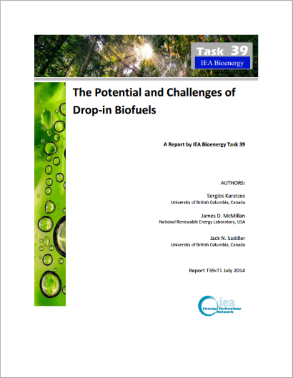

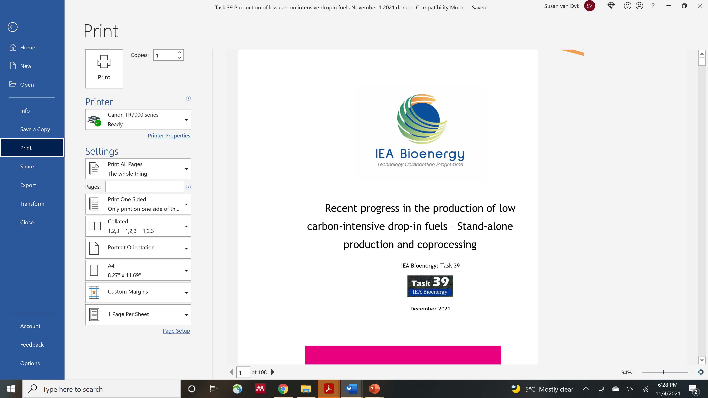
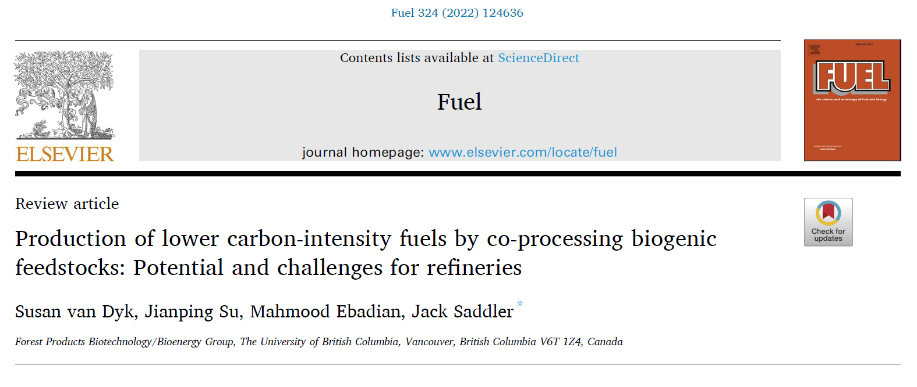
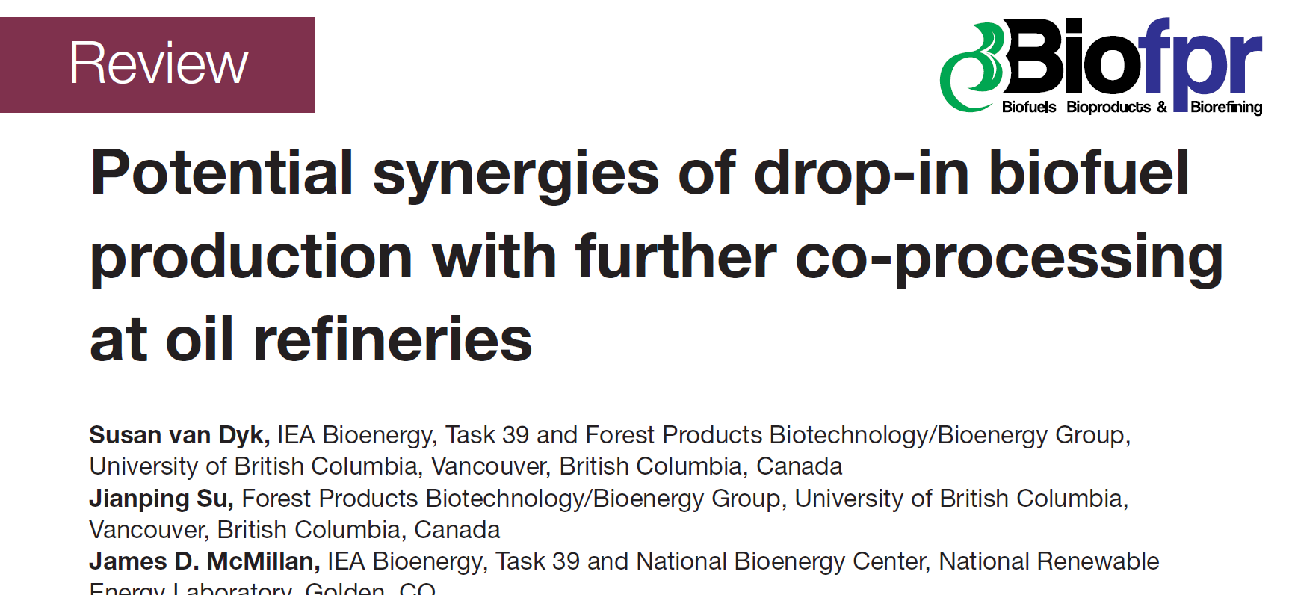
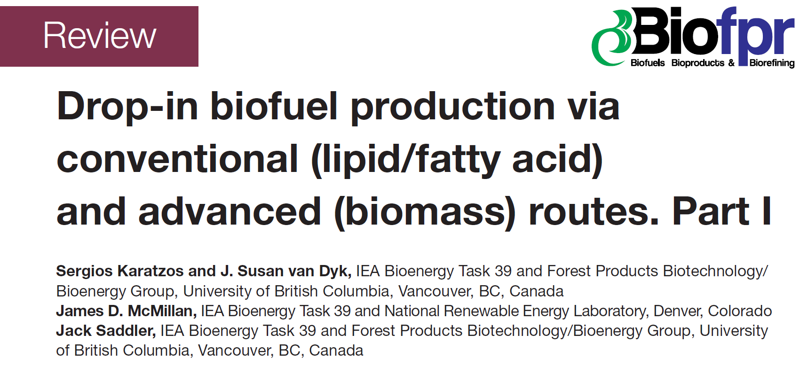
Drop-in biofuels reports (2014, 2019 & 2021)

Slide 3
Topics to be covered
Assess the expansion of commercial drop-in biofuel facilities and current volumes of production
  HVO technology and renewable diesel facilities
  Gasification and Fischer-Tropsch
  Thermochemical liquefaction – progress in HTL and pyrolysis
  efuels
  Assess co-processing activities world-wide and volumes
Update on technology pathways and new emerging technologies
  TRL levels, latest developments,
  Main companies and significant technology features
  An update on the latest research for drop-in biofuel production
Notes:
Before strat taling about the prograss I would like to review the scope of theIA report

Slide 4
Topics to be covered
Co-processing
  Lipid co-processing – key developments and trends
  Biocrude co-processing
    Developments in biocrude production and volumes available
    Co-processing by Preem (tall oil and pyrolysis bio-oil)
    Update on key research areas and progress (e.g. Renewell project)
  Tracking the green molecules in co-processing and determining the carbon intensity of co-processed fuels – assess the latest developments
Techno-economic evaluation of production costs based on literature and reports
Discussion on the sustainability and carbon intensity of drop-in fuels
  Modified agricultural practices, renewable energy, green hydrogen and CCS to reduce the carbon intensity of fuels

Slide 5
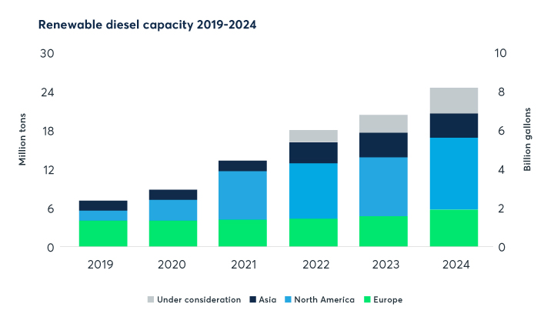
Expansion of HVO/renewable diesel capacity – this technology will deliver the majority of drop-in fuels by 2030
Source: BloombergNEF, company announcements (June 2021) https://www.reuters.com/article/sponsored/renewables-growth-feedstock

Slide 6
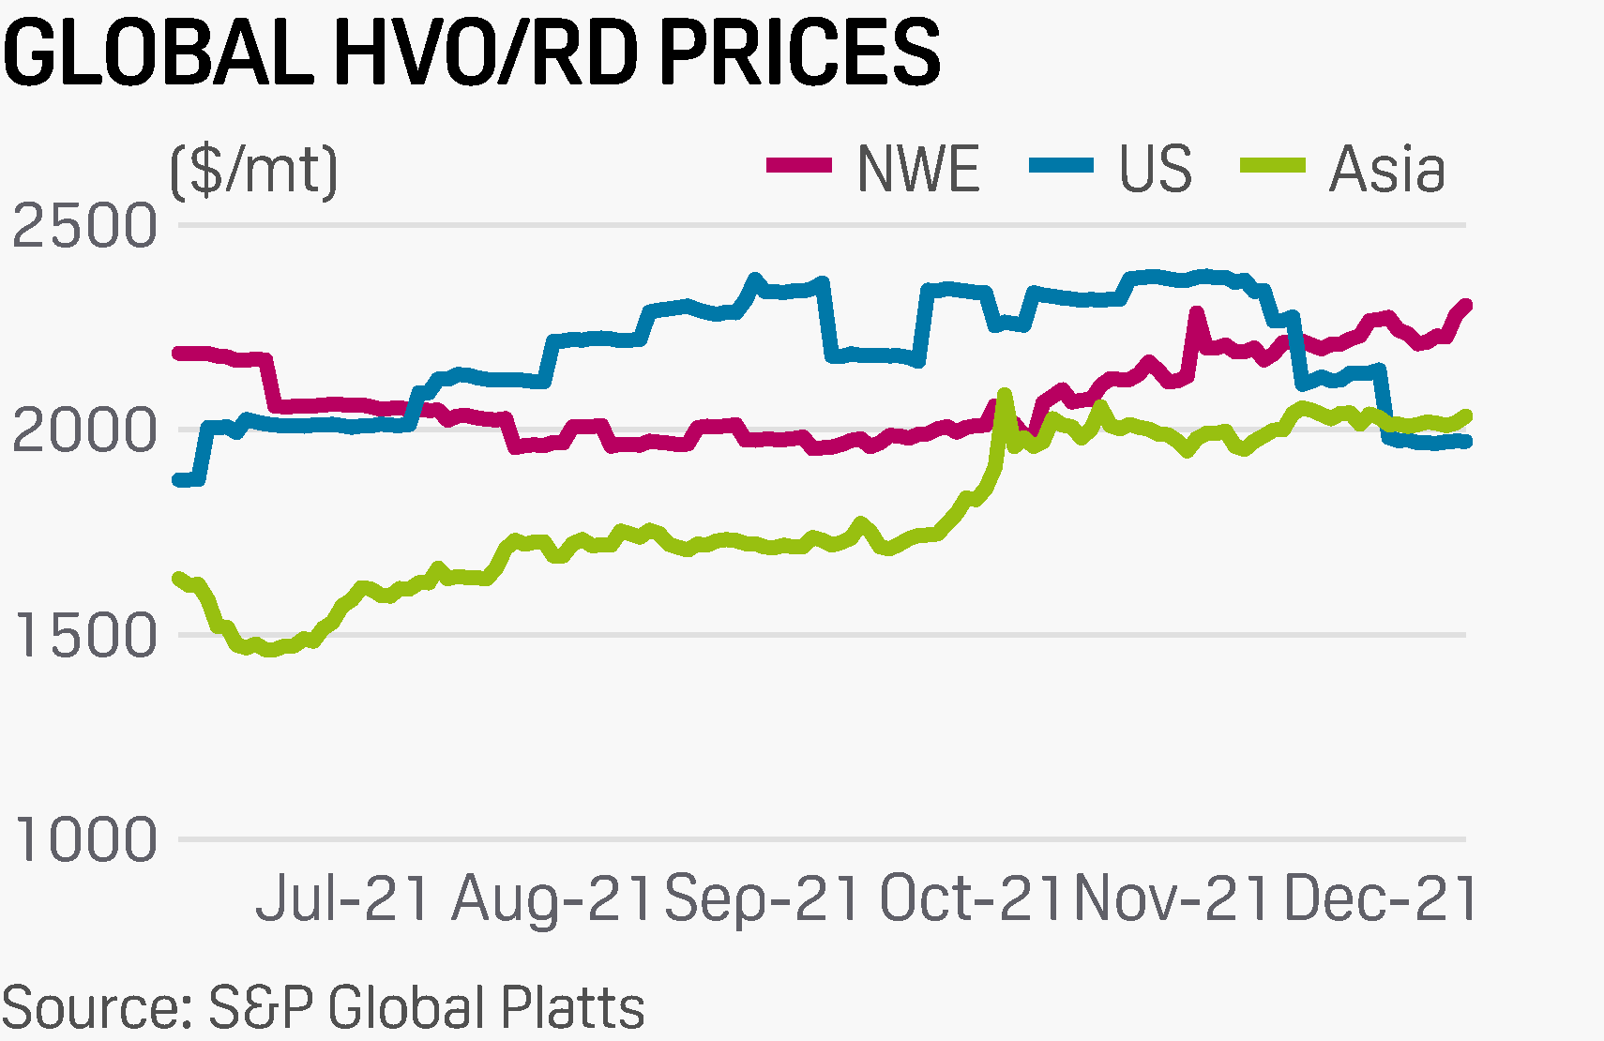
HVO/renewable diesel prices are still very high
https://www.spglobal.com/commodityinsights/es/oil/refined-products/jetfuel/122221-commodities-2022-saf-hvo-look-to-build-on-2021-success

Slide 7
Commercialisation update on drop-in biofuels (freestanding and coprocessing)
HEFA/HVO - Significant expansion of number of facilities
Gasification/FT - Fulcrum Bioenergy completed their gasification/FT facility based on MSW feedstock and produced their first syncrude. Further upgrading will be carried out at Marathon Petroleum (coprocessing)
  Red Rock Biofuels – defaulted on debt and face foreclosure – a setback for commercialisation of gasification from forest residues
Alcohol-to-jet - Lanzajet Freedom Pines facility - Construction will be completed in 2023 with commission and startup in 2024. Recently approved EPA pathway indicates sugarcane ethanol will be used (qualifies for D4 RINs) – 55-64% reduction in carbon intensity
Pyrolysis and HTL based drop-in fuels – Pyrocell commercial production and upgrading at Preem. Developments in freestanding upgrading and coprocessing of biocrudes
PtL developments and commercialisation status

Slide 8
Recent techno-economic publications
Comparison of minimum selling price for different technologies and feedstocks for pioneer and Nth facilities
(Source: Work done at FAA ASCENT lead by Kristin Brandt)
Total Capital Investment (TCI) per 100 million litre total product (not total SAF) for Pioneer and Nth facilities based on technology/feedstock combinations.
Link to open access models at Washington State University

Slide 9
Jack Saddler
jack.saddler@ubc.ca
Susan van Dyk
svandyk100@gmail.com

