Slide 1

Project Proposal:
Update on developments in SAF/biojet fuel commercialisation (2022-2024 Update)
Susan van Dyk, Jack Saddler- Canada NTLs
Notes:
What I would like to talk about is the progress made so far in the IA report.

Slide 2
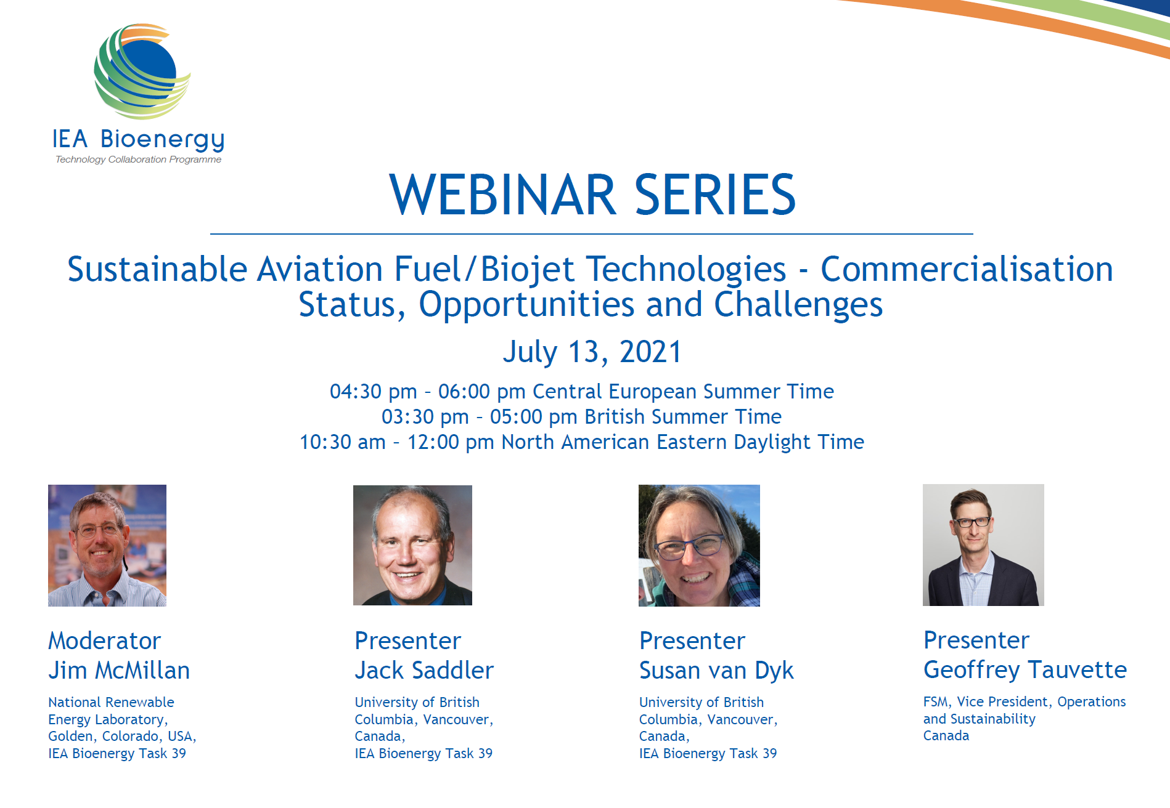
Previous Task 39 Biojet/SAF report
Link to the webinar video and the presentation slides:
https://www.ieabioenergy.com/blog/publications/iea-bioenergy-webinar-sustainable-aviation-fuel-biojet-technologies-commercialisation-status-opportunities-and-challenges/

Slide 3
Current status of SAF production
The International Air Transport Association (IATA) estimates 200% increase in SAF production for 2022
  30 billion litre target for 2030
  450 billion litre target for 2050
Total offtake agreements (14 Feb 2023) – 41 billion litres
ArgusMedia report on 27 January 2023 – Price of SAF
  Sustainable aviation fuel (HEFA-SPK) sells at a premium compared with conventional jet fuel
  The outright was set at $3,344.74/t, which equates to a premium of around $2,330/t to the 1-27 January jet fuel average.
YEAR | 2019 | 2020 | 2021 | 2022E
Estimated SAF Output (Million Liters) | 25 | 62.5 | 100 | 300-450

Slide 4
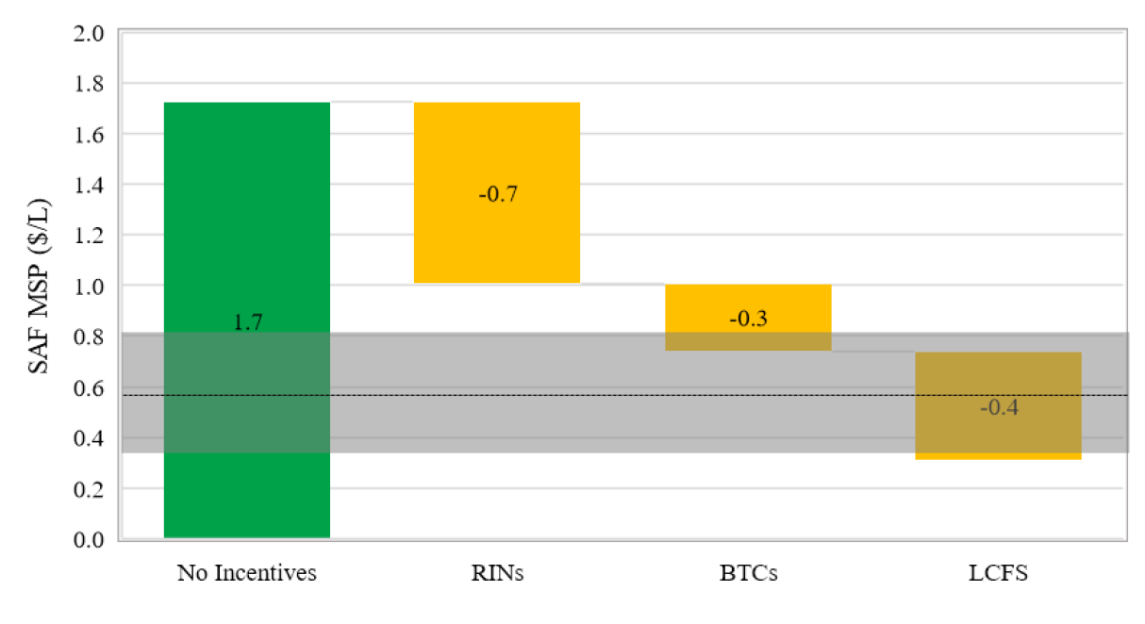
Policy in the US to promote SAF
Inflation Reduction Act
  SAF blenders tax credit - $1.25/gal with a minimum of 50% reduction in CI; increased by $0.01 for each additional % reduction in CI up to $1.75) – Duration 2023-2024
  SAF production credit – $0.35/gal if CI reductions are not met; $1.75/gal if CI reductions are met - Duration 2025-2027
Other incentives under the federal Renewable Fuel Standard (RFS) (RINs) and at state level are stackable
ICAO has published a guidance on potential policies for SAF development
Impact of policies on an nth facility based on gasification of forest residues and FT synthesis.
ICAO CAEP. (2022). Guidance on potential policies and coordinated approaches for the deployment of SAF

Slide 5
Additional SAF tax credits introduced in Illinois and Washington State
Illinois (approved) – tax credit for SAF bought and sold in Illinois
  $1.50/USG sustainable aviation fuel (SAF) tax credit that airlines can use to satisfy all or part of their state use tax liabilities
  For every gallon of SAF sold to or used by an air carrier in Illinois from 1 June 2023 to 1 June 2033
  will effectively lower the price airlines pay for SAF used at airports in the state
  caps the volume of soybean oil-derived SAF that airlines can claim credits for to 10mn USG/yr
  Starting in June 2028 the state tax credit will only apply to SAF derived from domestic feedstocks
Washington State (proposed bill)
  tax incentives to manufacture and purchase alternative jet fuel,
  From July 1, 2024, but only after a facility capable of producing at least 20 million gallons of alternative jet fuel is operating in Washington
  10 years

Slide 6
Update on policies in Europe
ReFuelEU – trilogue discussions still need to finalise policy
  Proposed targets remain the same but discussion around increased targets and sub-targets
  Mandates for SAF are set at 2% in 2025, 5% in 2030, 20% in 2035, 32% in 2040, 38% in 2045 and 63% in 2050.
  Sub-mandate for synthetic or e-fuels are 0.7% in 2030, 5% in 2035, 8% in 2040, 11% in 2045 and 28% in 2050.
  Legislators discussingincreasing the sub-targets for synthetic fuels to 1% in 2030, 2% in 2033 and 5% in 2035.
EU delegated acts on Renewable Hydrogen and Renewable Fuels of Non-biological origin
  When can hydrogen, hydrogen-based fuels or other energy carriers be considered as a renewable fuel of non-biological origin (RFNBO)? The rules ensure that these fuels can only be produced from “additional” renewable electricity generated at the same time and in the same area as where the fuels are produced.
  What methodology will be used to calculate GHG emissions savings from RFNBO’s and recycled carbon fuels?

Slide 7
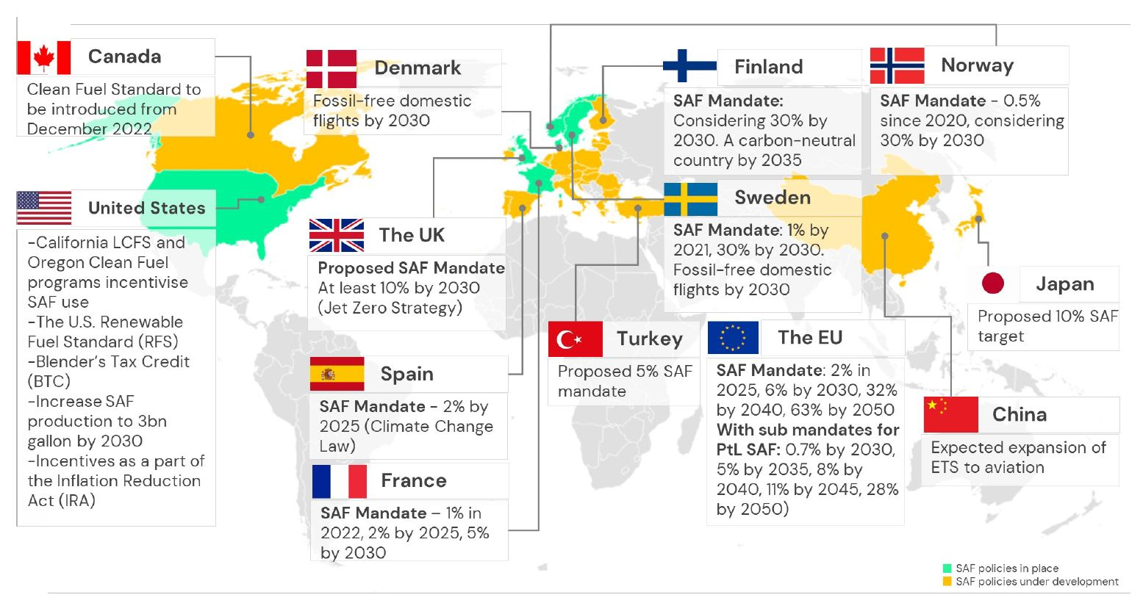
SAF policies in Europe & global
Source: https://airport-world.com/game-changer/

Slide 8
A range of topics will be covered in the report update
Sector goals to 2030/2050 – ICAO agreement on long term aspirational goals (LTAG)
Commercialisation status of technologies and a deep dive into “future” technologies such as PtL
Developments in ASTM certification of technologies, with a focus on the development of 100% SAF
Feedstocks
  Availability (e.g. low CI lipids (UCO, Tallow, etc.), higher CI lipids (e.g. vegetable oils), biocrudes (e.g. fast/catalytic pyrolysis, HTL)
  Debate around use of food feedstocks for SAF production (e.g. corn ethanol, vegetable oils, etc.)
Techno-economics – comparison of estimated production costs for different technologies and potential cost reductions by 2030/2050
6. Global policy developments used to promote production and use of SAF
7. Carbon intensity, LCA models, sustainability and certification

Slide 9
Jack Saddler
jack.saddler@ubc.ca
Susan van Dyk
svandyk100@gmail.com

