Slide 1
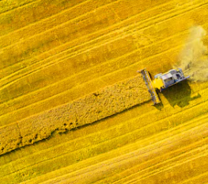
Biofuels in Emerging Markets
Potential for sustainable production and consumption
Environmental, economic, and exergetic assessment of biofuels production in countries of Africa and Asia
Brazilian Team:
Glaucia Mendes Souza, Heitor Cantarella, Luis Fernando Cassinelli, Luiz Horta Nogueira, Raffaella Rossetto, and Rubens Maciel Filho
Collaborator:
Jean Felipe Leal Silva
February 23rd, 2023

Slide 2
Last year achievements
Paper published (LCA):
  Sustainability assessment of ethanol and biodiesel production in Argentina, Brazil, Colombia, and Guatemala - Renewable and Sustainable Energy Reviews
Policy Brief summarizing LCA, TEA and EA results for biofuels in Latin America
Draft of another manuscript (TEA, EA):
  How far can we go with biofuel blending mandates? An economic and energetic outlook on ethanol and biodiesel in Latin American markets

Slide 3
Plans for this year
Carry out a similar analysis for other emerging markets in Africa and Asia
Selected countries: China, Ethiopia, India, Indonesia, Nigeria, Malaysia, South Africa, and Thailand
  45.5% world’s population
  23.3% world’s CO₂ emissions
CO₂ emissions in the transportation sector normalized by the GDP is lower than the average of OECD countries (44 gCO₂ $) ➔

Slide 4
Possible crops
Reasoning: potential energy crops currently being produced in the country or already produced in countries of similar climate with good results
 | Ethanol |  | Biodiesel
 | Corn | Sugarcane | Soybean | Palm oil | Rapeseed
China | ✓ | ✓ | ✓ |  | ✓
Ethiopia | ✓ | ✓ | ✓
India | ✓ | ✓ | ✓ | ✓
Indonesia | ✓ | ✓ | ✓ | ✓
Malaysia | ✓ | ✓ |  | ✓
Nigeria | ✓ | ✓ | ✓ | ✓
South Africa | ✓ | ✓ | ✓ |  | ✓
Thailand | ✓ | ✓ | ✓ | ✓

Slide 5
Method
Life cycle assessment ➔ determine emissions from biofuels in each country for each crop
Techno-economic analysis ➔ determine the cost to assess competitiveness with fossil fuel
Exergy analysis ➔ identify aspects of the production process that can be improved to enhance the energy conversion of crops to biofuels

Slide 6
Method
TEA and LCA results will be combined in a market analysis of different blending mandates (i.e., from B5 to B10 in China, or from B30 to B40 in Indonesia)
  What is the cost of this change? ⬅ TEA
  What is the required area for this change?
  What is the contribution in reduction of GHG? ⬅ LCA
Discussions on implications of extended biofuels use in specific countries will take special care regarding the food vs. fuel debate

Slide 7
Project timetable
 | 1 | 2 | 3 | 4 | 5 | 6 | 7 | 8 | 9 | 10 | 11 | 12
WP1
WP2
WP3
WP4 |  |  |  |  |  |  | P1 |  |  |  |  | P2
Webinar |  |  |  |  | WS
Reports |  |  |  |  |  |  |  |  |  |  |  | PB
WP1: TEA and LCA
WP2: EA
WP3: sustainability of biofuels
WP4: Results and dissemination of knowledge
  WS: Workshop in April 2023
  P1 & P2: papers
  PB: Policy Brief

Slide 8
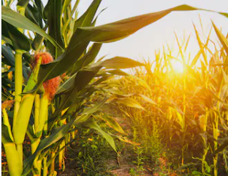
Thank you for your attention!
Brazilian Team:
Glaucia Mendes Souza, Heitor Cantarella, Luis Fernando Cassinelli, Luiz Horta Nogueira, Raffaella Rossetto, and Rubens Maciel Filho
✉ glmsouza@iq.usp.br
Collaborator:
Jean Felipe Leal Silva
✉ jefelipe@outlook.com

