Slide 1


Project Proposal:
Improvement opportunities for policies and certification schemes promoting sustainable biofuels with low GHG emissions
Part 2: Robustness of GHG emission certification and verification – a case study of selected biofuel supply chains and policies
José Muisers, Paul Sinnige RVO The Netherlands
23 February 2023 (virtual)
Notes:
What I would like to talk about is the progress made so far in the IA report.

Slide 2
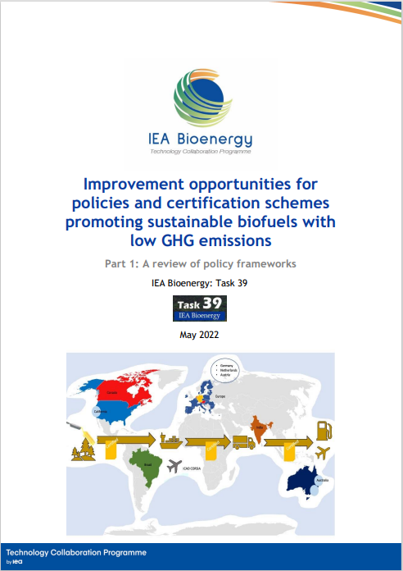
Main findings Task 39 Part 1 report (ISBN 979-12-80907-15-8)
Jinke van Dam Consulting and Sergio Ugarte (SQ Consult)
The global sustainability framework for biofuels is as strong as its weakest link, this may affect overall biofuel trade (flows), but more importantly also the overall robustness of the system.
Recommendations:
on strengthening the GHG emission reduction requirements and sustainability criteria (CH3)
on improving the categorization and correct identification of feedstocks (CH4)
to strengthen minimum level of robustness for certification or verification schemes (CH5)
on strengthening the Chain of Custody (CoC) and transfer of information (CH6)
to strengthen correctness and completeness of information at end of the supply chain (CH7)
to improve the public and private supervision to monitor compliance (CH8)

Slide 3
Background Part 2
Robustness of GHG emission certification and verification
Policies steer increasingly towards (further) reducing CO2 emissions. There are a range of differences between policies on how this is to be achieved. This leads to (1) different outcomes, as well as to (2) differences in the level of stringency and robustness of policy frameworks (and related certification schemes) on GHG emissions of biofuels
Based on the analyses of “Part 1” there are generally two categories of policy frameworks that aim to promote the use of low GHG emissions biofuels: (1) based on a carbon reduction target – often combined with a carbon trading mechanism (LCFS, Renovabio), (2) based on mandating defined volumes or blending levels (EU RED)
The structural differences in the governance set-up between these two categories of approaches (and some policy frameworks fall in between) rely on (1) GHG accounting approaches and (2) underlying (verification) rules, that might affect the robustness of sustainable biofuel supply chains

Slide 4
Objectives and scope of work
The project will develop a better understanding regarding:
  Similarities and differences in existing certification and verification approaches of policy frameworks to assess the GHG performance of biofuels
  How a combination of – even small – differences in GHG emission related policy requirements and allied certification and verification requirements may affect the overall robustness of policy frameworks on the sustainability of biofuels
  The implications of differences in existing certification and verification approaches related to GHG performance of biofuels for the quality of GHG assessment results in practice
The assessment will be based on a case study on a selection of SAF biofuel supply chain/policy combinations and will be more qualitative in nature
The project will be closely connected to a parallel T45 project activity focusing on methodological issues related to GHG calculation itself
Based on the outcomes improvement opportunities for policies and (co-regulating) certification schemes will be discussed.
A joint synthesis report on the findings and reflections of both the T39 and T45 activities is envisaged.

Slide 5
Topics to be covered
Inception phase - Setting the framework (WP1)
Inventory of policy frameworks and potential biofuel supply chains; Selection of case studies; Definition of
framework and criteria for case study assessment (AVIATION: HEFA, ATJ, FT-SPK, +CCU, feedstocks, etc)
Building blocks of different SAF biofuel pathways (WP2)
  How does the pathway look like, and where do the sensitivities lie within/between the selected policy frameworks (C-O-C, feedstock categorization, etc)
Robustness of the assurance system ‘on paper’ (WP3)
  The results from ‘Part 1’ of this project learn that the verification and assurance of the (GHG emission) data are key to ensure robustness of the system
Verification of data quality – ‘in theory’ vs ‘in practice’ (WP4)
Following available procedures and requirements, auditors and verifiers check the
GHG emission data in the supply chain – improvement should not only be on paper but
actual improvement of climate impact, overlapping claims (information to be collected through interviews
and information from standards)
  Benchmarking the potential of different biofuel pathways (WP5)
  How do the different pathways “score” depending on the targets and policy framework used (qualitative differences)
Project management and dissemination (WP6)
Optional: Synthesis (WP7) – T39 & T45

Slide 6
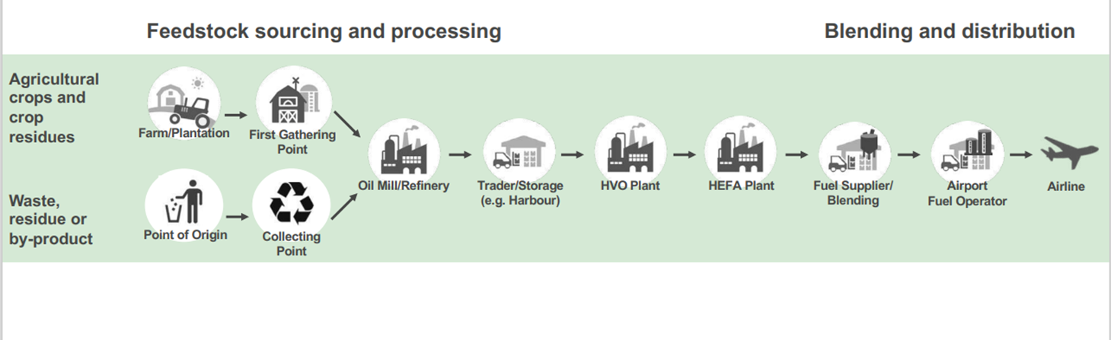
WP2 |”Building blocks” of different SAF biofuel pathways (case study)
Example (after ISCC):

Slide 7
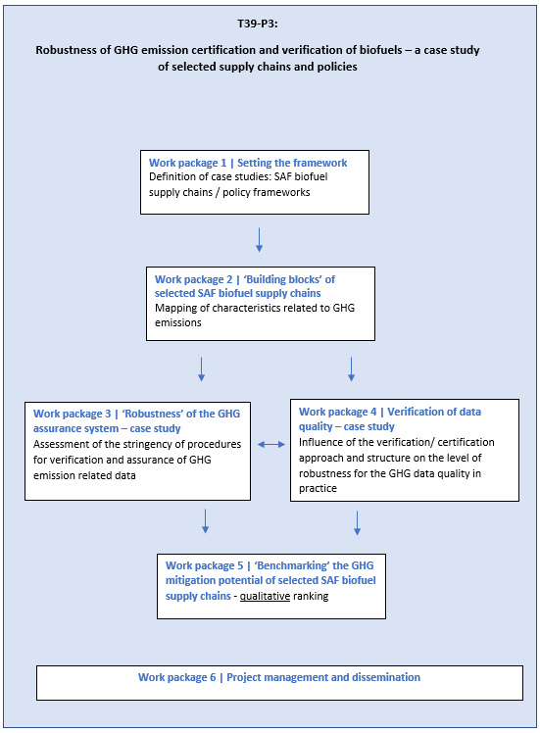
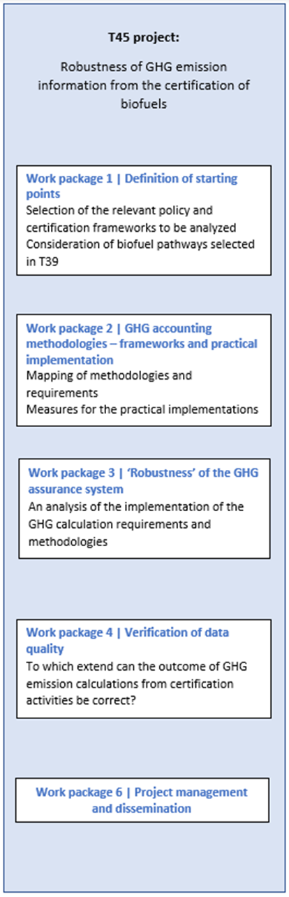

Slide 8
Budget and financing
Task 39:
Task 45:
expected budget for the T45 project of around ~20k
+ in kind contributions from the US and Germany
Work package / Task in USD | Budget | In-kind contribution | Other | Total
Netherlands | 1, 2, 3, 4, 5, 6 (7) | - | Agreed / amount tbd
Germany | 3, 4, (7?) |  | Agreed /amount tbd
Brazil | ?
US | ?
Canada | ?
EC | ?
Austria | ?
Country x | ?
Independent consultant| 2, 3, 4, 5, 6 (7)
Total in USD

Slide 9
José Muisers
Jose.Muisers@rvo.nl
Paul Sinnige
Paul.Sinnige@rvo.nl
Thank you!

