Slide 1

IEA Bioenergy Task 39
Biofuels to Decarbonize Transport
Fifth meeting @ Zoom
Tomas Ekbom, SVEBIO
Stockholm, 23 February 2023

Slide 2
Meeting agenda (local time 21:00 – 01:00)
General introduction with welcome 30 minutes
Breaking news in biofuels, quick update 1 minute per NTL.
General status update, Tomas and Glaucia 10 minutes
Task 39 budget status and project invoices, Tomas 10 minutes
Presentation: Qingdao Institute of Bioenergy and Bioprocess 20 minutes
Technology (QIBEBT) with China country update, Dr. Fuli Li
Coffee break 10 minutes
Presentation: Chonnam National University and South Korea 20 minutes
country update, Dr. Chang Hyun Ko
Presentation: National Renewable Energy Lab, USA, Dr. Ling Tao 10 minutes
Project updates. Brief status, 6 minutes each 45 minutes
Coffee break 10 minutes
Program of Work proposals. General discussion 30 minutes
Project BioTheRoS, EU Proposal, Andrea Sonnleitner 10 minutes
Project ICARUS, Franziska Müller-Langer 5 minutes
Discussion “Leadership of I-T Project BECCUS Phase 2” Tomas 10 minutes
Joint Business Meeting #7 with IEA AMF 10 minutes
Proposed additional meetings, visits, conferences, others 10 minutes
21:00
21:30
21:40
21:50
22:10
22:20
22:40
22:50
23:35
23:45
00:15
00:25
00:30
00:40
00:50

Slide 3
1. General introduction with welcome
Presentation of all attendees with name, affiliation and function.
All NTL:s to present three currently most important topics or “issues” being it projects, policies, events or others in their country right now – a quick biofuels update. Except for China and South Korea, they have later presentations.
Each NTL is given about one minute for this, no slides necessary.
Task 39 Members and respective persons:
Australia (Guest: Steve Rogers, Licella)
Austria
Belgium
Brazil
Canada
China
Denmark
European Commission
Germany
Ireland (Guest: Tom Walsh, Renetech)
Japan
New Zealand
South Korea
Sweden
The Netherlands
United States
USGC

Slide 4
2. General status update
Currently there is participation from 15 countries and 1 Limited Sponsor = 16 members. We are the second largest Task group with Task 37 being is the largest, 17 countries.
Estonia has given notice of withdrawal as of 2023 and a waiver of the fee is processed. Australia has opted to not participate and the Observer status is thus ended. Türkiye is awaiting process of rejoining IEA Bioenergy TCP. Some contacts with Finland.
Task 39 migrated its website with ETA Florence (hosting) and launched a new site in October. Ongoing work.
Website features Member-only section. Documents. OneDrive.
Task 39 plans for several webinars. Invitations made to Task 39 for presentations at conferences. Latest publications.
The newsletter is in process of getting ISSN. The layout will be changed (possibly to IEA Bioenergy). Coming editions 2023:
#62 European Commission by April,
#63 New Zealand for August,
#64 China for November.

Slide 5
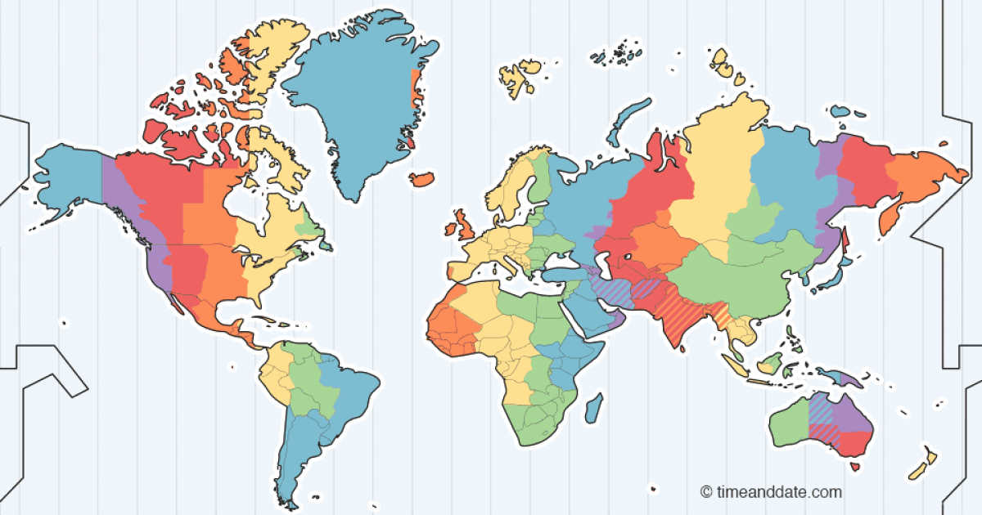
Members of IEA Bioenergy TCP Task 39
15 member countries 2022-2024
1 Limited Sponsor
http://task39.ieabioenergy.com/
Belgium
Ireland
Denmark
European Commission
The Netherlands
Germany
Sweden
Canada
Austria
South Korea
Japan
United States
US Grains Council
China
Awaiting completion of internal authorizations / procedures.
Participated as Observer, currently as Guest/Expert.
Discussions with Finland, France, India, Norway.
Turkey¹
Brazil
Australia²
New Zealand

Slide 6
Task 39’s Program of Work and activities
The task group organizes two-three Business meetings per year (one physical) and arranges webinars, seminars, workshops and conferences, not seldom with other task groups, and manages a Task 39 website.
Program of Work includes conducting task projects with own funding, and also inter-task projects for sustainable, low-carbon intensity transport biofuels to decarbonize the global economy.
Examples includes assess and help with market development, maintain demonstration plants database and website which shows advanced biofuels production facilities, an Implementation Agenda: compares and contrasts successful policies to assess applicability to global regions.
Publishing world class, state-of-the-art, reports, and three newsletters per year, featuring country reports, media stories and research (distributed to +2000 biofuels stakeholders).
Collaborate with other Tasks and allied international agencies (IEA HQ, IRENA, etc.) as well as other IEA TCPs (AMF, Hydrogen, etc.) and national programs.

Slide 7
3. Task 39 budget and status
A revised budget was sent to ExCo with the Progress report, which was approved. Main cause being changes with members entering, leaving, re-appearing.
In addition, the work-load and schedule became more clear giving need for change. Also, “Dissemination” and “Other expenditure” (task meetings, workshops) were corrected.
The budget has again changed in 2023 with Estonia leaving and the 10% less to the Strategic Fund which had to be corrected as 2022 was based on anticipated revenue for 17 members.
The total budget is now not calculated as $648,000 but with the changes $634,500 for the triennium. This can though change.
There are currently six projects on-going with total financing of $230,000. However, there is lack of invoices and expenditure is behind schedule. Still, there are uncommitted projects and large fund available.

Slide 8
Task 39 Financial statement
Total Task 39 Budget = 634,500 USD
Uncommitted projects = 173,500 USD
The income 2022 has been revised with additional income, but made in 2023.
The actual travel spending has not been updated for all of 2022.

Slide 9
4. Qingdao Institute of Bioenergy and Bioprocess Technology, Chinese Academy of Sciences (CAS)
Introduction presentation and country update on China
Dr. Fuli Li, new participant and new National Team Leader (20 minutes)

Slide 10
5. Chonnam National University and the School of Chemical Engineering
Introduction presentation and country update on South Korea
Dr. Chang Hyun Ko, new National Team Leader (20 minutes)

Slide 11
6. National Renewable Energy Laboratory (NREL)
Introduction presentation
Dr. Ling Tao, new National Team Leader (10 minutes)

Slide 12
7. Project updates
Brief status reports on ongoing projects (6 minutes presentation with 4 minutes Q&A and maximum 6 slides = 45 minutes).
a. T39-T1 by Jack Saddler, Canada
b. T39-T2 by Jack Saddler, Canada
c. T39-T4 by Andrea Sonnleitner, Austria
d. T39-T6 by Franziska Müller-Langer, Germany
e. T39-P1 by Jack Saddler, Canada
f. T39-P4 by Glaucia Mendes Souza, Brazil
g. T39 Intertask Lessons learned by Tomas, Sweden
The Task will continue to lead and coordinate activities in the three main program areas of: 1) technology and commercialization; 2) sustainability; and 3) policy
1) Technology and Commercialization (T-projects)
To address technical/commercial aspects of producing and using low carbon intensity (CI) liquid and gaseous biofuels for transport, including both “conventional” and “advanced” biofuels
2) Sustainability (P-projects)
Sustainability and carbon intensity metrics are playing an ever-increasing role in the policies used to develop and use biofuels, sustainability/LCA assessment is a priority for the Task
3) Policy (P-projects)
The “right” policies (such as LCFSs) significantly influence the rate and extent of development, deployment and use of biofuels (e.g., bioethanol, biodiesel, renewable diesel, drop-in biofuels, etc.)
Ideal for next meeting to present and discuss the other six projects for startup during 2023 and finalization during 2024 for even schedule of deliverables.

Slide 13
7. Program of Work, 2022-2024 Triennium
The Task will continue to lead and coordinate activities in the three main program areas of: 1) technology and commercialization; 2) sustainability; and 3) policy
1) Technology and Commercialization (T-projects)
To address technical/commercial aspects of producing and using low carbon intensity (CI) liquid and gaseous biofuels for transport, including both “conventional” and “advanced” biofuels
2) Sustainability (P-projects)
Sustainability and carbon intensity metrics are playing an ever-increasing role in the policies used to develop and use biofuels, sustainability/LCA assessment is a priority for the Task
3) Policy (P-projects)
The “right” policies (such as LCFSs) significantly influence the rate and extent of development, deployment and use of biofuels (e.g., bioethanol, biodiesel, renewable diesel, drop-in biofuels, etc.)
Ideal for next meeting to present and discuss the other six projects for startup during 2023 and finalization during 2024 for even schedule of deliverables.

Slide 14
7. Technology and Commercialization
Assess tech. and market development of drop-in and advanced biofuels
T39-T4 Assess and map demonstration plants and commercialization progress
Participants: Austria / USA / Brazil
Lead: Austria (presentation from Dina)
T39-T6 The potential to synergise “green” hydrogen and bioenergy deployment (Intertask by T44, with in-kind 25 kUSD from T39)
Participants: Austria / Brazil / Germany / The Netherlands / Sweden
Lead: Germany (presentation from Franziska)

Slide 15
7. Sustainability, Policy, Markets and Implemen.
Policy, Markets and Implementation
T39-P1 Update Implementation Agendas report - compare-and-contrast of each member country’s biofuels policies used to develop, deploy and expand biofuels production and use
Participants: All countries
Lead: Canada (presentation from Jack/Mahmood)
Sustainability
T39-P4 Extend analysis of status of biofuel production and use potentials in emerging countries/markets (e.g., South America China, India, South-East Asia, etc.)
Participants: Brazil / Germany / USGC? / (India?)
Lead: Brazil (presentation from Glaucia)

Slide 16
Inter-Task Project (T39, T40 and T45) update
The project “Successes and Lessons Learned for Biofuels Deployment” has been for considerable delay but is due for the final stage of completion.
WP1 and WP2 are finalized and need work in layout. WP3 is almost finished with completion of material in case studies. WP4 is finalized and with layout. WP5 is worked upon in parallel and soon to be finalized and then with layout.
The reports will be sent for review and then published. The estimate for completion of the WPs is end March. A webinar will then be held end of April.
The project was presented at ABC in Sept 2022. After approval of report and dissemination there is potential for Phase 2 project for start September 2023.

Slide 17
8. Program of Work proposals
Brief status reports on ongoing projects (6 minutes presentation with 4 minutes Q&A and maximum 6 slides = 45 minutes).
T39-T3 “Extend assessment of decarbonization of the marine transport sector” by Sune Thomsen, Denmark
T39-P2 “Assessment of the sustainability of biofuels pathways…, and also further compare and harmonize leading LCA models (possibly InterTask with T45)” by Glaucia Mendes Souza, Brazil
T39-P3 “Emerging/proposed certifications for oleochemical/lignocellulosic feedstock-to-biofuel supply chains” by Paul Sinnige / José Muisers, the Netherlands.
Six projects started 2022. Ideal is four projects startup 2023 and finalization of some in 2023 and remainder during 2024 for even schedule of deliverables.

Slide 18
9. Project BioTheRoS
Presentation of Project BioTheRoS (Collaborative Actions to Bring Novel Biofuels Thermo-chemical Routes Into Industrial Scale) a Horizon Europe Proposal (6-8 slides)
Dr. Andrea Sonnleitner (10 minutes)

Slide 19
10. Project ICARUS
Presentation of Project ICARUS (International cooperation for sustainable aviation biofuels) on technical option for oils, alcohols and syngas to SAF in about six work packages with about 14 partners (3-4 slides)
Dr. Franziska Müller-Langer (5 minutes)

Slide 20
11. Project BECCUS
Discussion of Action No 9 in ExCo90 regarding the “Leadership of I-T Project BECCUS Phase 2 and of Task 39 to coordinate to further explore opportunities for synergies”
Tomas Ekbom (10 minutes)

Slide 21
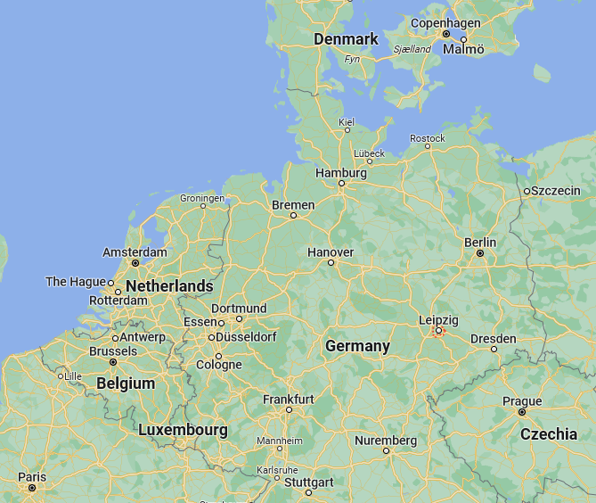
12. Business meeting #7 Leipzig 23-26 Oct
Joint meeting & workshop with IEA AMF
Monday 23 Oct
- Expert workshop
Tuesday 24 Oct
- Internal meeting
- Study visit
- Dinner
Wednesday 25 Oct
- Joint & int meeting
- Study visit
Thursday 26 Oct
- Joint workshop
- Study visit

Slide 22
13. Others, general
Proposed additional meetings and Intertask and additional task projects, conferences and visits.
Tomas Ekbom (10 minutes)

Slide 23
Biofuels to decarbonize transport –
the work we do improves the world
Tomas Ekbom, Task leader
tomas.ekbom@svebio.se

