Slide 1
Collaboration with Horizon Europe Proposal BioTheRoS
23.02.2023, online Task 39 Business meeting
Andrea Sonnleitner

Slide 2
Project Proposal BioTheRoS
BioTheRoS - Collaborative Actions to Bring Novel Biofuels Thermochemical Routes into Industrial Scale
Horizon Europe Call: TOPIC ID: HORIZON-CL5-2022-D3-03-02 Best international practice for scaling up sustainable biofuels
Submitted 10th of January 2023 – evaluation result maybe in summer?
Planned duration: 3 years
Notes:
10 eingereichte proposals – 9 Mio Euro zur Verfügung – 3 von 10 werden genehmigt. BioTheRoS Project aims at developing a holistic methodology that will boost the scale-up of sustainable biofuels via thermochemical
conversion technologies. These are pyrolysis upgrading through hydrodeoxygenation and Fischer-Tropsch synthesis from biomass
gasification. The project will bring together key actors at a both European and International level, such as technological and social
experts, renewable energy-oriented associations along with industrial experts that will bring and exchange their knowledge in order
to reach the project targets. Within the project, several non-food biomass feedstock will be analyzed and optimized across their entire
value chain. Barriers linked with the selected feedstocks supply and pretreatment will be identified. Furthermore, AI-based predictive
models will be developed, in order to be adapted to the scale-up cases. Then, the most promising biomass feedstock will be tested
experimentally in the studied thermochemical reactors. At this point of the project, technical constraints and opportunities for the
scale-up of the sustainable biofuels thermochemical processes will be identified. Possible synergies of blending pyrolysis oil and
gasification based advanced biofuels will be investigated by a potential end-user (petroleum company). The selected data will be
used as an input for advanced modelling tools, including process modelling, CFD tools and LCA/LCC/sLCA tools results of which will
feed a multi-criteria analysis to derive generalized up-scaling rules and guidelines of the produced biofuels. The engagement of
several stakeholders in the planning of the scaling-up of sustainable biofuels production will be crucial at this point, since they will
review the project results and assess if a biofuel production technology can be delivered from the lab/pilot to a larger-scale, by taking
into account operational difficulties, plant cost and plant capacity limitations (technological barriers).

Slide 3
BioTheRoS consortium
Coordinator: CERTH CENTRE FOR RESEARCH AND TECHNOLOGY HELLAS CERTH, Greece
B.T.G. BIOMASS TECHNOLOGY GROUP BV, Netherlands
CIRCE, FUNDACION CIRCE CENTRO DE INVESTIGACION DE RECURSOS Y CONSUMOS ENERGETICOS, Spain
WIP, WIRTSCHAFT UND INFRASTRUKTUR GMBH & CO PLANUNGS KG, Germany
BEST, BIOENERGY AND SUSTAINABLE TECHNOLOGIES GMBH, Austria
MOTOR OIL (HELLAS) CORINTHREFINERIES SA, Greece

Slide 4
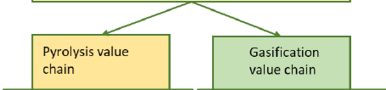
Target of the project
To upscale two highly relevant thermochemical advanced biofuel production pathways i.e. pyrolysis and gasification (biooil and FT fuels) with the aim to develop both value chains sustainably in a relevant international context
Combined with interdisciplinary research (on feedstock base, scaleup modeling, sustainability, market dynamics)
Experience from previous projects and continuous update with the international community
Notes:
In short, within BioTheRoS technical research on two highly relevant thermochemical advanced biofuel production pathways i.e. pyrolysis and gasification are combined with interdisciplinary research (e.g. on feedstock base, scaleup modelling, sustainability, impact assessment, market dynamics), with the aim to develop both value chains sustainably in a relevant international context

Slide 5
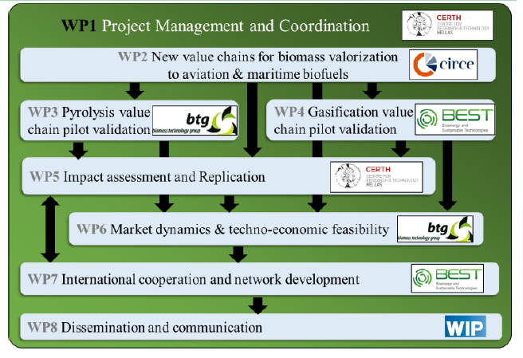
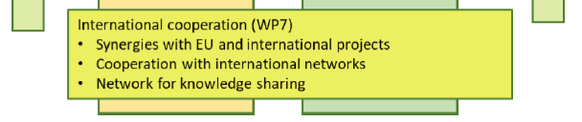
Proposed work plan
Notes:
In short, within BioTheRoS technical research on two highly relevant thermochemical advanced biofuel production pathways i.e. pyrolysis and gasification are combined with interdisciplinary research (e.g. on feedstock base, scaleup modelling, sustainability, impact assessment, market dynamics), with the aim to develop both value chains sustainably in a relevant international context.

Slide 6
Cooperation with international networks
LOIs from IEA Bioenergy Task 33, 34, 39, 40 and ETIP Bioenergy
Objective: Exchange information with European and international groups and networks on topics related to sustainable biofuels value chains
  Identification of common topics at IEA Bioenergy ExCo
  Common workshops for information exchange regarding the technological WPs and sharing results
  Highlight: Joint Workshop on market dynamics for all transport sectors (Shipping, aviation, road transport)
Contact: BEST (Andrea Sonnleitner, Dina Bacovsky)

