Slide 1

Biojet fuel (SAF) technologies and status of commercialisation.
Progress and initiatives in select countries
Susan van Dyk, Jack Saddler
June 2020

Slide 2
Introduction
Development and commercialization of biojet fuels (SAF) technologies has been slow
Some technical challenges remain. However, the main obstacle is economics
Biojet fuels cannot compete with conventional jet fuel at current oil prices
It is also more lucrative for a biorefinery to produce renewable diesel rather than biojet
ALL possible technologies should be pursued if the aviation sector is to meet its significant targets for emission reduction

Slide 3
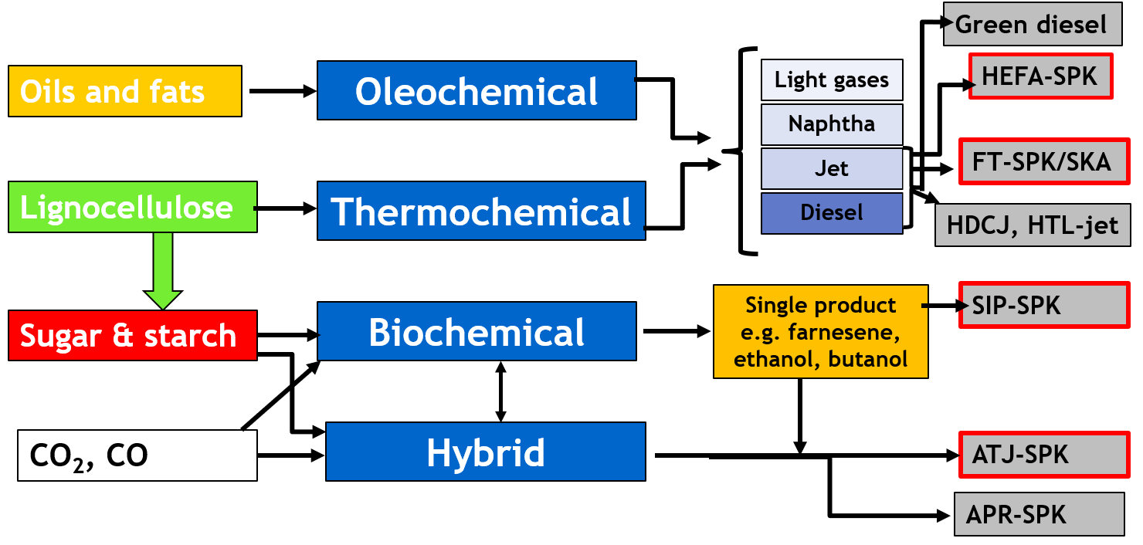
Categories of technology pathways for biojet fuel production
PtL will also be assessed

Slide 4
Current ASTM certification and pathways to commercial Biojet fuel production
APROVED PATHWAYS
Fischer-Tropsch SPK (50%) & Fischer-Tropsch SKA (2009)
HEFA SPK – 50% (2011)
Synthesized Iso-paraffins (SIP-SPK) – 10% (2014)
Alcohol to jet SPK 30% (isobutanol Gevo (2016), ethanol Lanzatech(2018))
Catalytic hydro-thermolysis of lipids to jet fuel – ARA (2020)
Co-processing of lipids (5%) (2019)
HEFA from microalgal lipids – 10% (2020) – (expedited certification)

Slide 5
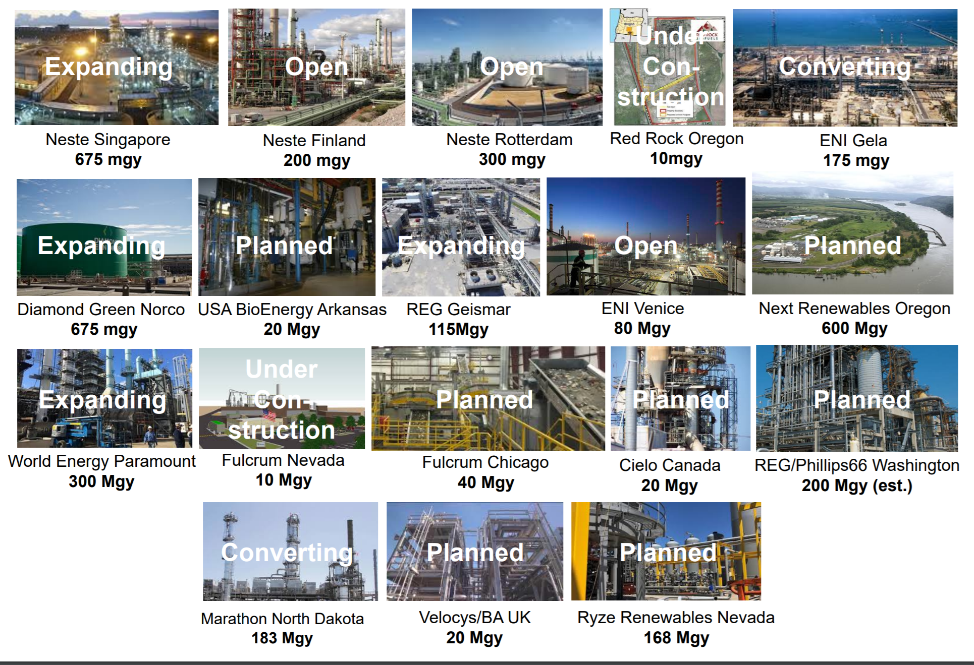
Current and planned facilities

Slide 6
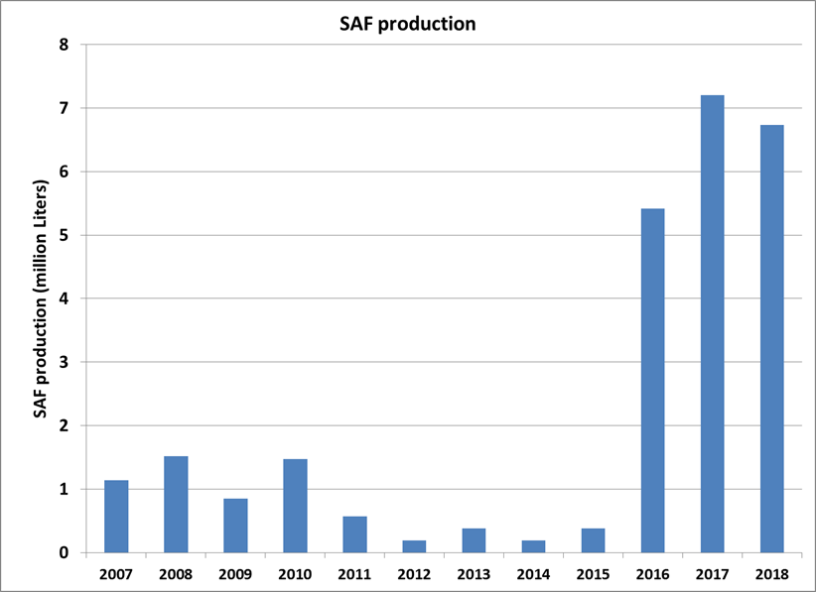
Current production volumes & future
Average of 0.29 million litres per year (2013-2015)
to 6.45 million litres per year (2016-2018).
In 2019 Neste produced 125 million litres
8 billion litres by 2032
Far short of volumes needed

Slide 7
Focus on Gasification and Fischer-Tropsch for biojet fuel production
Fully commercial based on coal and natural gas
ASTM certification in 2009 (but based on coal)
Why is it not yet commercial for biomass?
A key challenge is syngas cleanup
  complex and very expensive when starting with biomass
  Very clean syngas needed for Fischer-Tropsch (as opposed to using the gasification for heat/electricity)
  Tar formation, alkali metals, nitrogen
  Gasifiers that can produce very clean syngas (plasma) is very expensive (CAPEX and OPEX)

Slide 8
Focus on alcohol-to-jet
Biomass
sugars
Gevo – prop. yeast
FERMENTATION
Lanzatech – acetogenic bacterium
Isobutanol (GEVO)
Naphtha
-Dehydration
-Oligomerisation
-Hydrogenation
-Fractionation
Jet
Diesel
Ethanol (LANZATECH)
CO₂
_{- Waste gases (steelmaking)}
_{- Syngas from gasification}
Key challenges
High value of the isobutanol/ethanol intermediates
Sustainability (when using sugars from corn)

Slide 9
Summary
Expansion of biojet fuel production has been very slow and commercial fuel volumes still very small
The HEFA process still the main technology/route
  More companies now looking at dedicated biojet production as part of their renewable diesel production (e.g. Neste)
Alcohol-to-jet very high profile but not yet commercial
Gasification based facilities currently under construction, look promising, but challenges
Although co-processing of lipids is becoming more widespread, low-carbon intensity jet fraction not yet commercialized. However, considerable potential

Slide 10
Please send me information about biojet fuel initiatives in your country? (e.g. Japan)
svandyk100@gmail.com

