Slide 1

Certification chain of custody
Overview and lessons learnt
Timo Gerlagh/ Paul Sinnige
Webex 23 june 2020

Slide 2
Review existing/proposed certifications used for oleochemical- and lignocellulosic-based biofuels supply chains; identify certification scheme improvement opportunities
Previous meeting:
Non bio– chains (report Ted Knijn)
  Complexity and the use of energy balances

Slide 3
Topic is developing…
EU is revising Mass Balance for RED2.
EU-consultation is on-going process.
  Rules for mass balance to be defined . Assume to be more explicit than RED 1.
  NAVIGANT study on mass balance rule for certification systems for the EU market.
  Decision on final assessment format expected within months now.
  =? Certification schemes will have to implement this

Slide 4
Navigant
Discussion on (some examples):
Definition product groups / where is mixing allowed.
How to deal with mass balance and the sub-targets for advanced fuel / Annex B (mainly UCO) etc.
Tracebility
Use of grids / information through the chain.
=> Outcome will impact the topic as decribed.

Slide 5
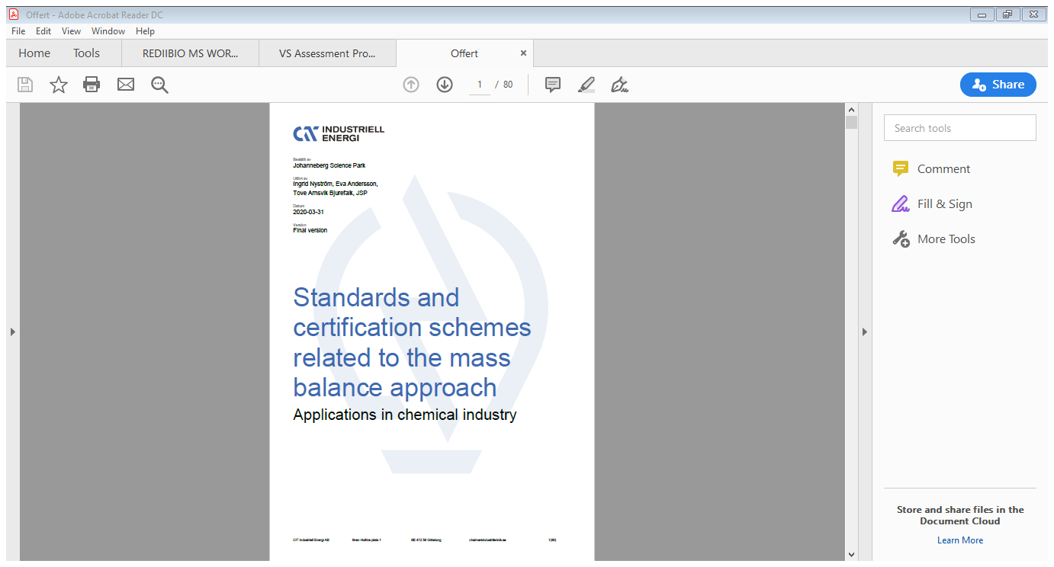

Slide 6
Proposal for further work
Small project building on existing work.
Investigate impact RED 2 on chain of custody in world market.
Define topic more specific after publication assessment protocol for voluntary schemes RED 2
  (autumn meeting)
Work : begin 2021, draft report available spring 2021 meeting.
(Intest for the work Utrecht University, Copernicus Insitute)

Slide 7
Thank you!
Questions / discussion
Paul Sinnige / Timo Gerlagh

