Slide 1
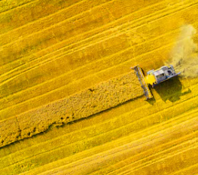
Analyze status of biofuels production and use in non-IEA countries/emerging economies
Brazilian Team: Glaucia Mendes Souza, Heitor Cantarella, Luis Fernando Cassinelli, Luiz Augusto Horta Nogueira, Rubens Maciel Filho
Collaborator: Pablo Silva Ortiz
Brazil - June 23, 2020

Slide 2
Specific objectives:
Selection of the countries that are considered as emerging economies with a large population and in average lower energy consumption compared to developed countries.
Identification of official data source for each country in terms of energy production, energy demand as well as the production of biofuels.
Database construction of relevant data (energy matrix, feedstock availability, the energy expenditure of production, net energy content, energy conversion efficiency, among others).
Identification of possible raw-materials and conversion technologies.
Evolve the analysis including sustainability (Energy and Exergy-based performance indicators).
Evaluate how incentives can alter sustainability and process (using Renovabio as a case study, sugarcane biorefinery concept).
Generation of periodic reports, and scientific papers.

Slide 3









Selected countries | Data sets
Key performance indicators (KPIs)
Latin America
 | Brazil
 | Argentine
 | Colombia
 | Mexico
Africa
 | South Africa
 | Nigeria
Asia
 | India
 | China
Europe
 | Russia
Total Energy Production (Mtoe)
Electricity domestic consumption (TWh)
Share of renewables in electricity production (%)
CO2 emissions from fuel combustion (MtCO2)
cNR: unit exergy cost of non-renewable (kJ/kJ)
cR: unit exergy cost of renewable (kJ/kJ)
cT: unit exergy cost total (kJ/kJ)
mCO2: CO2 emissions (gCO2/kWh)
Renewability exergy index
Global energy and exergy efficiency
Carbon Efficiency
Fuel selling price

Slide 4

CO₂ emissions from fuel combustion (MtCO₂)
Based on Enerdata, Global Energy Statistical Yearbook 2019

Slide 5
Electricity domestic consumption (TWh)
Based on Enerdata, Global Energy Statistical Yearbook 2019

Slide 6
Share of renewables in electricity production (%)
Based on Enerdata, Global Energy Statistical Yearbook 2019

Slide 7
Methodology
SCOPE: Developing Countries with large populations and high energy demand.
SYSTEM ANALYSIS
Key performance indicators
(KPIs)
Feedstocks and conversion process data
Techno-economic assessment (TEA), and Life-cycle(LCA),
Exergy Analysis
Integrated methodologies approach
Capital Costs
(CapEx)
Purchase cost
Installation cost
Engineering and construction costs
Financing
Operating Costs (OpEx)
Raw materials
Utilities
Labor
Waste treatment
Emission Inventory
(LCI)
Upstream
Logistics
Conversion process
Specific chemical exergy

Slide 8

Comparative Energy Balance to Crop Choice as Feedstock (e.g. Ethanol)
Methodology
PROCESS Feedstock | Corn¹ | Switchgrass¹ | Sugar cane²
Energy unit | (GJ/ha.yr) | (GJ/ha.yr) | (GJ/ha.yr)
Crop production energy consumption | 18.9 | 17.8 | 13.9
Biomass Energy | 149.5³ | 220.2 | 297.1⁴
Agricultural energy ratio | 7.9 | 12.3 | 21.3
Ethanol production energy consumption | 47.9 | 10.2 | 3.4
1- Source: ORNL, 2- Source: Copersucar/UNICAMP, 3-No credit for corn stover, 4- No credit for sugar cane leaves
How to evaluate if metabolic improvement is viable: Theoretical Photosynthesis Production
Capacity (TPPC) compared to observed production
For sugar cane TPPC= 386 ton/hay and the observed production capacity is 85 ton/hay
(Moore et. al, 2013, Souza Mendes et. al 2015)
For sugar cane ethanol - 9-14 liters renewable energy/liter fossil energy
Oil - Each unit of energy invested to produce oil in the 1940s yielded the equivalent of 110 energy
units (1 to 100) Nowasdays – depending upon the oil field 1-10
(Maciel Filho, 2014)

Slide 9
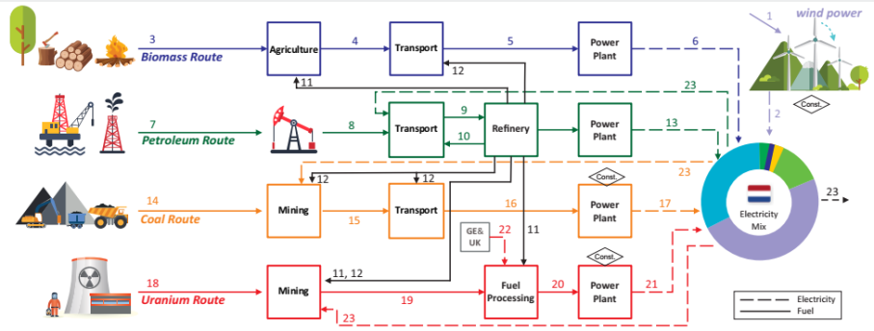
Methodology

Slide 10
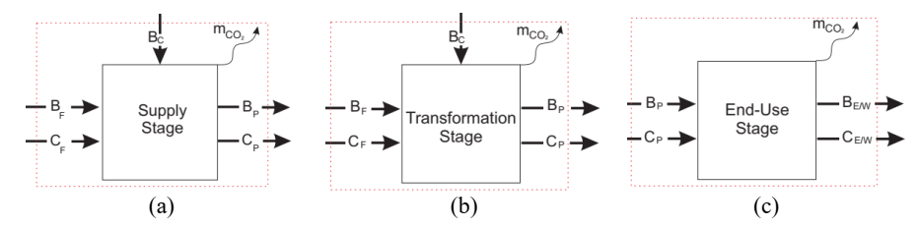
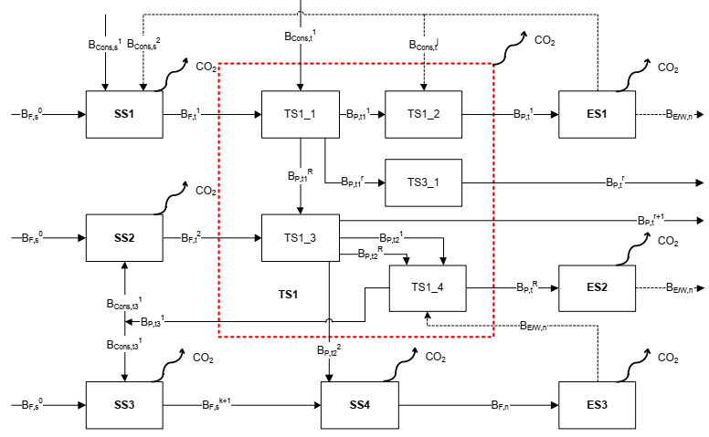

Slide 11
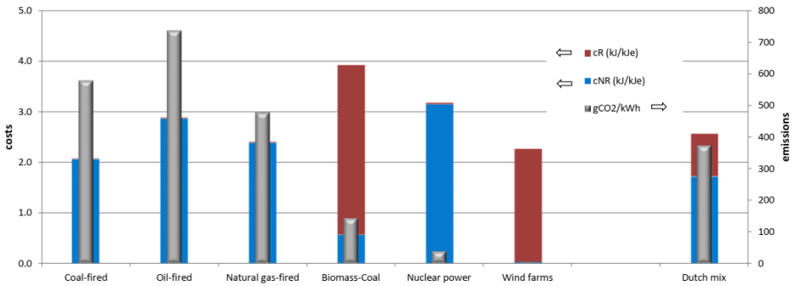
Results
Case Studies: Brazil and the Netherlands
Unit exergy cost and specific CO2 emissions of the electricity generation in the Netherlands
SILVA-ORTIZ et al. (2020)

Slide 12
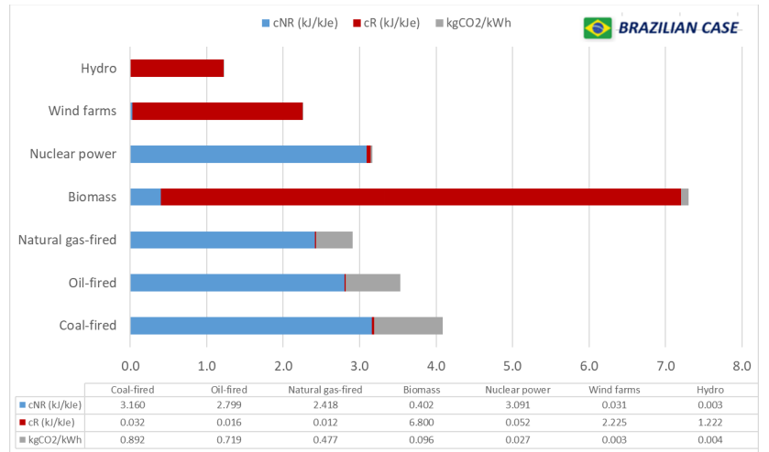
Unit exergy cost and specific CO2 emissions of the Brazilian electricity mix per route
Renewable and non-renewable exergy cost and specific CO2 emission of electricity generation: The Brazilian case
FLÓREZ-ORREGO et al. (2014)

Slide 13
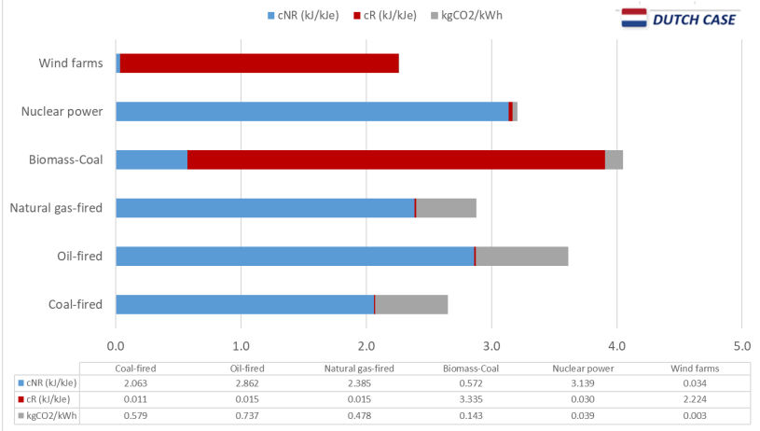
Unit exergy cost and specific CO2 emissions of the Dutch electricity mix per route
Unit exergy cost and specific CO2 emissions of the electricity generation in the Netherlands
SILVA-ORTIZ et al. (2020)

Slide 14
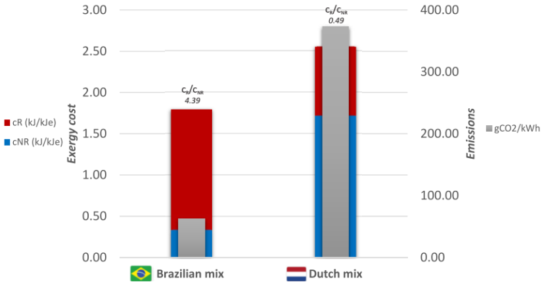
COMPARISON BETWEEN THE DUTCH AND BRAZILIAN ELECTRICITY MIX IN TERMS OF THE TOTAL, RENEWABLE, AND NON-RENEWABLE UNIT EXERGY COSTS AND SPECIFIC CO2 EMISSIONS.
Unit exergy cost and specific CO2 emissions of the electricity generation in the Netherlands
SILVA-ORTIZ et al. (2020)

Slide 15
Next Steps
Database development.
Update and expansion of the database of the energy matrix, including feedstock production and use for energy in each of the selected countries.
Identification of possible raw-materials and conversion technologies in each of the selected countries.
Evaluation of incentives using the Renovabio program as a case study.
Generation of periodic reports and scientific papers.

Slide 16
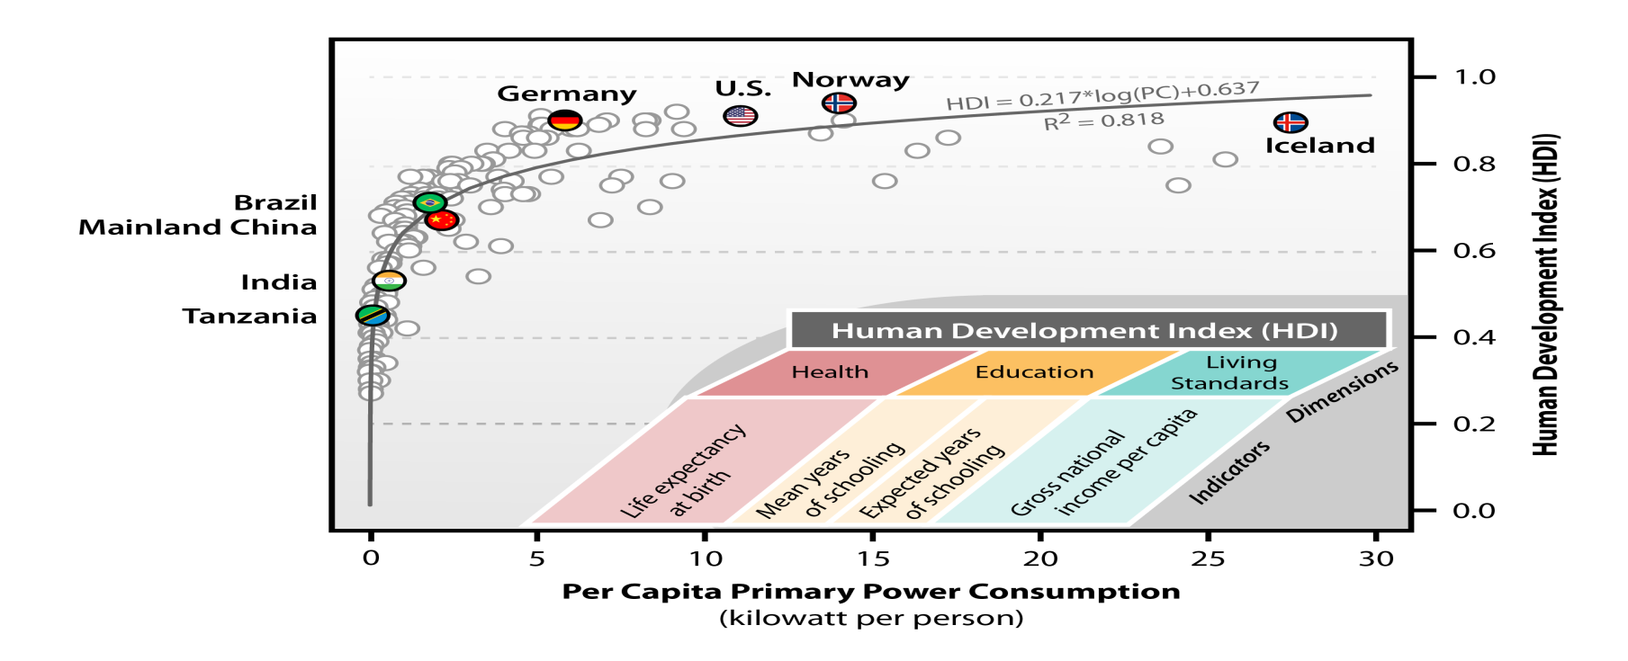
Final Comments
Emerging countries are increasing their need for energy but the fossil sources appears to be main source;
Bioenergy has potential to be signinficant part of the energy matrix, but it has to be in sustaintable way;
They need more energy for development.
Energy Consumption & Human Well Being are Linked
By Bruce Dale–Michigan State University/Maciel Filho Unicamp
Notes:
Relationship between 2008 per capita primary energy consumption and human development indices (HDI) for 170 countries. Qatar is not shown with a per capita primary energy consumption of greater than 30 kilowatts per person. Based on a figure by Martinez and Ebenhack, 2008; and the inset is based on a figure from the Human Development Report Office (HDRO) of the United Nations (UN): http://hdr.undp.org/en/statistics/hdi/ . Human development indices are also from the HDRO: http://hdr.undp.org/en/statistics/hdi/ . Per capita primary energy consumption data are from the U.S. Energy Information Administration (EIA): http://www.eia.gov/cfapps/ipdbproject/IEDIndex3.cfm .
All data were accessed on Nov. 17, 2011.

Slide 17
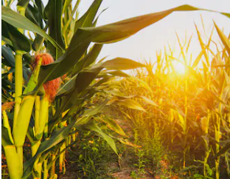
Thank you for your attention!
Brazilian Team: Glaucia Mendes Souza, Heitor Cantarella, Luis Fernando Cassinelli, Luiz Augusto Horta Nogueira, Rubens Maciel Filho
Collaborator: Pablo Silva Ortiz

