Slide 1
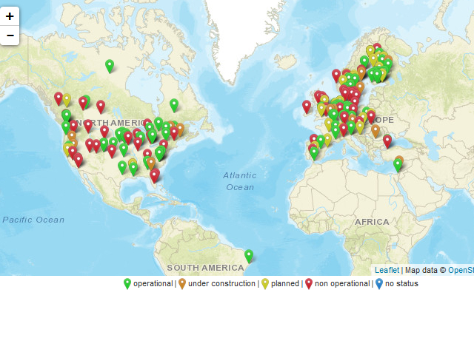
Update on Advanced Biofuels
Demonstration Plants website
Dina Bacovsky, BEST
Virtual Business Meeting, 23/06/2020

Slide 2
Objectives
To monitor the progress made in the commercialization of advanced biofuels by collecting information on the ongoing demonstration projects and by visualizing this in an online map
To include only validated information in the database
To be acknowledge as trustworthy source of information

Slide 3
Activities/Scope
Systematic annual update
Continuous integration of new information
Website and database maintenance
Reporting to IEA Bioenergy Task 39

Slide 4
Progress
Systematic annual update
  Information on all European facilities (121) verified and updated Feb-April 2020
  Update with Task 39 members planned for Aug-Nov 2020
Continuous integration of new information
  Ongoing
Website and database maintenance
  Programming updated in April 2020
Reporting to IEA Bioenergy Task 39
  Reporting done 02/04/2020

Slide 5
Status of Demoplants Database
226 entries currently active
Technologies covered:
  gasification
  fermentation
  hydrotreatment
  fast pyrolysis
  hydrothermal liquefaction
  lignin depolymerisation
2020 update with support of ETIP Bioenergy WG 2:
  ~100 entries checked
  55 entries updated
  21 newly created (most of them for hydrotreatment which was not covered before)

Slide 6

Thank you
Dina Bacovsky
dina.bacovsky@best-research.eu

