Slide 1
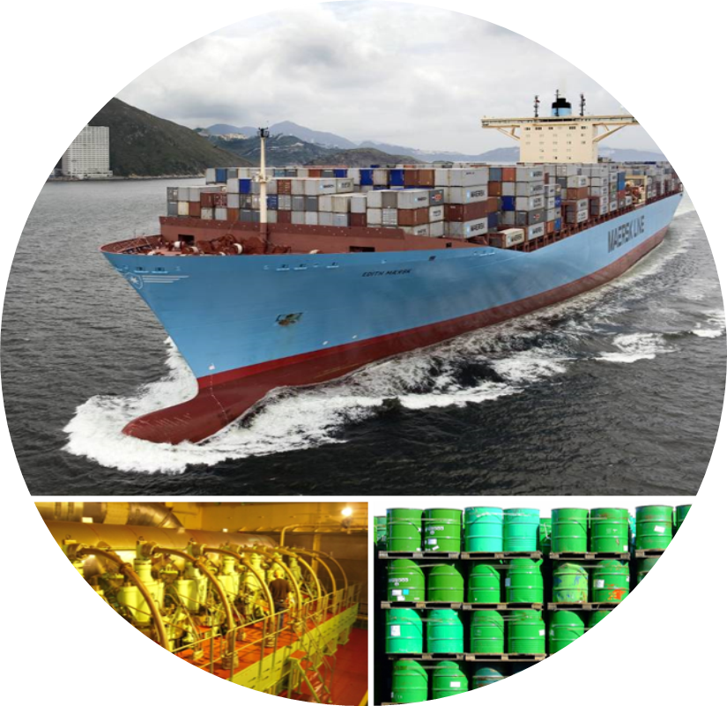
Biofuels for the marine shipping sector
Progress report June 2020
Henning Jørgensen, Sune T. Thomsen, Tor I. Simonsen
University of Copenhagen

Slide 2
Changes to Danish NTL
August 1st Henning Jørgensen will start in position as Senior Scientific Manager at the Novo Nordisk Foundation and will have to step out of Task 39 and Task 42.
Sune T. Thomsen will be official Danish NTL in Task 39.
Solange Mussatto from Biosustain-DTU will continue as Danish NTL in Task 42.
Regarding the Marine Fuels Report, Sune will be coordinating this work assisted by Tor Ivan Simonsen.
Sune T. Thomsen
Tor Ivan Simonsen

Slide 3
Aim of report
We aim to frame the report to answer the following research question:
“How can marine biofuels be brought to the marked?”
Report will provide update on technologies related to engines and biofuels production including also recent focus on e-power and power-to-x. But not a comprehensive description (repetition) of content from previous report
Focus will be on bottlenecks for implementation and deployment:
Production capacity
  Biomass logistic and availability
  Upscale of technologies incl research
Fuel logistics – drop-in and mixing issues
Legislation
Fuel specifications
Global initiatives for GHG reduction targets, decarbonisation of shipping sector
Survey among stakeholders in the sector to analyze what they see as barriers, their view on most promissing biofuels and is needed to increase the use of biofuels.

Slide 4
Since last meeting
Online-meeting with people Steve, Stephen, Paul and Dina from Task 39, Kim Winther from AMF and Johannes Schürmann from Good Fuels to align with AMF on aim of report
Collecting contact information on stakeholders and preparing questionnaire for stakeholder interview. Stakeholder list include:
  Fuel producers
                Emerging technologies
    Established technologies (Biofuels)
    Traditional fuels (fossil)
  Fuel distributors
  Original equipment manufacturers, OEM’s (Including engine manufacturers)
  Cargo ship owners
  Ferry ship owners
  Cargo owners
  Ports
  Regulatory bodies

Slide 5
Plan for update
April-May 2020 – Scope report and agree on outline, agree on collaboration with other tasks
June-September 2020 – Data collection and writing first draft
  Conduct interviews with stakeholders
  Analyze stakeholder response
  Collecting information on status technologies and regulations since last report
October 2020 – Circulate and get feedback on first draft from the reference group.
November-December 2020 – Revise manuscript
January 2021 – Circulation of revised manuscript and draft executive summary.
February 2021 – Final review of report
March 2021 – Final update of manuscript and executive summary
April 2021 – Final approval of report incl. executive summary
May 2021 – Final layout and report ready for sharing on member’s site
June 2021 – Presentation of report on IEA Bioenergy webinar (tentative).

Slide 6
Sune T. Thomsen
stt@ign.ku.dk

