Slide 1

Update on drop-in biofuel report
The key role of co-processing
Jianping Su, Susan van Dyk, Mahmood Ebadian, Jack Saddler
June 2020

Slide 2
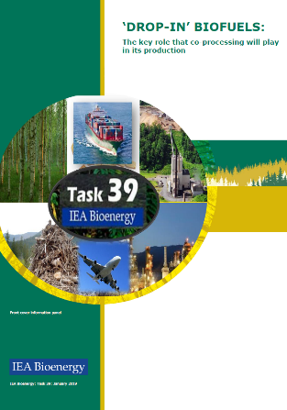
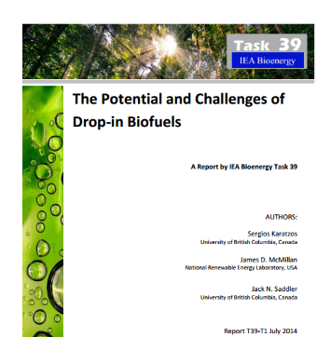
Drop-in biofuels reports (2014 & 2019)
Definition of “drop-in” biofuels
Drop-in biofuels: are “liquid bio-hydrocarbons that are: functionally equivalent to petroleum fuels and fully compatible with existing petroleum infrastructure”

Slide 3
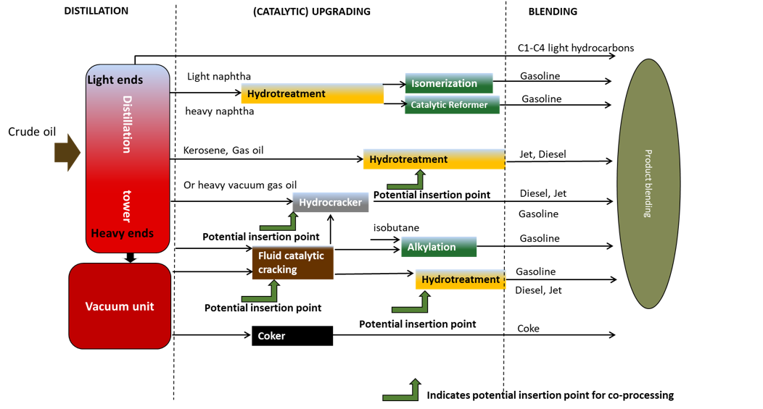
What is co-processing?

Slide 4
Who are co-processing?
Commercialisation of co-processing | Comments
Preem in Sweden | Tall oil and other feedstocks
Spanish and Portuguese refineries | Cepsa, Repsol, Galp
BP Cherry point , US | Tallow hydrotreater co-processing
Marathon Dickinson Refinery, US | Soybean oil hydrotreater co-processing/revamp into a standalone unit
Parkland Burnaby Refinery, Canada | FCC co-processing
Chevon El Segundo, California | Announced FCC co-processing

Slide 5
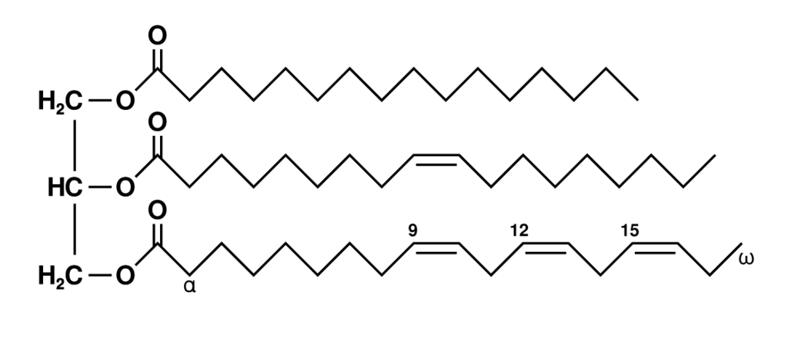
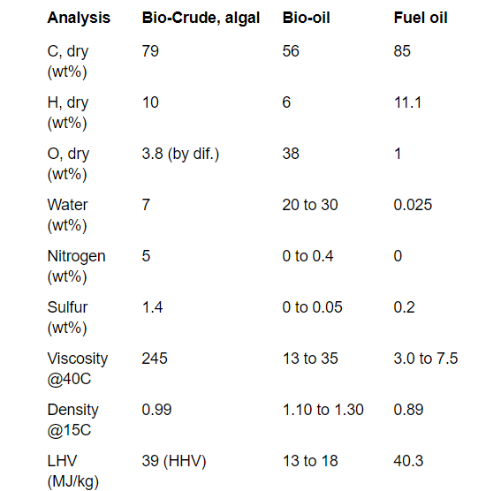
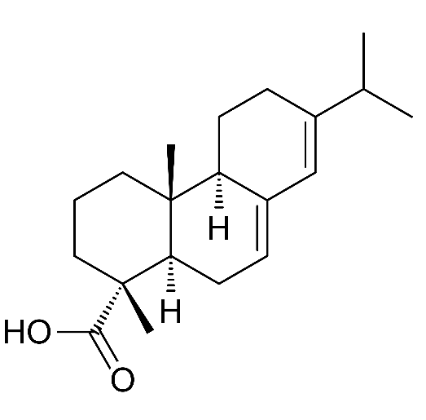
What can be co-processed?
Oleochemical feedstocks
Advanced biocrudes
https://task34.ieabioenergy.com/bio-crude/

Slide 6
Opportunities and challenges
Oleochemical feedstocks are being co-processed right now
Significant amounts of low-carbon-intensity, drop-in fuels can be readily produced via co-processing
However, lipids/oleochemicals are expensive and come with “sustainability” concerns, while supplies of biocrudes/bio-oils are VERY limited
Different configurations and insertion points influence the carbon intensity of the various fuels
Focus on lowering the CI of the jet/diesel fractions
Determining the Carbon Intensity (CI) of the various fuels produced via co-processing is challenging
Unclear how co-processing will generate credits (LCFS) to bridge the price gap
What is in it/what incentives for the refineries?

Slide 7
Thank you and questions?
Jianping Su, Susan van Dyk, Mahmood Ebadian, Jack Saddler

