Slide 1
Update on advanced biofuels demoplants database
Dina Bacovsky

Slide 2
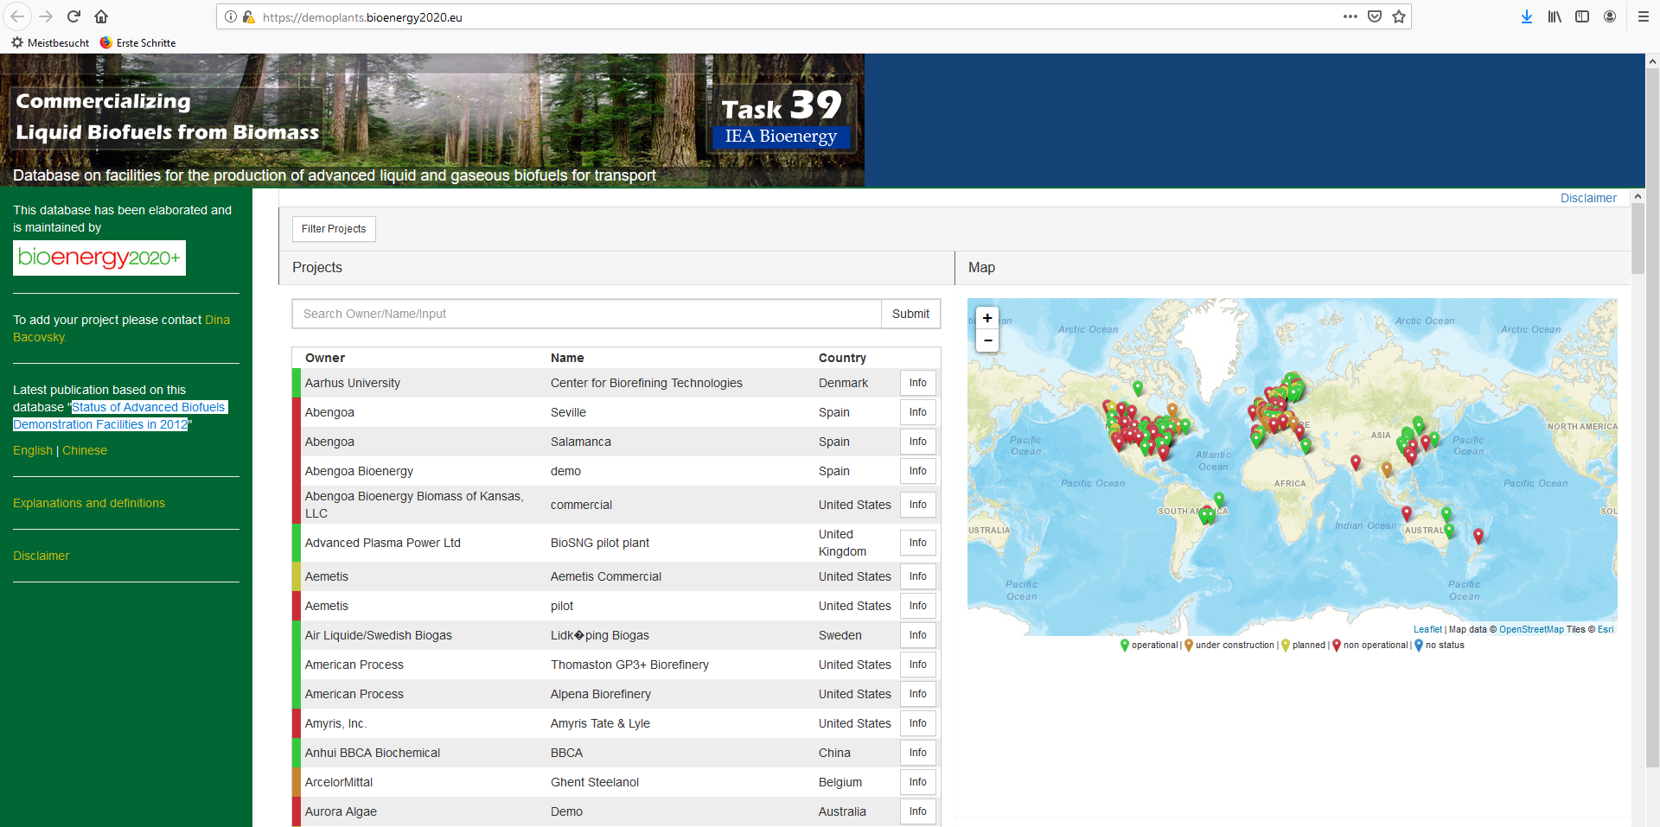
Advanced Biofuels Demoplants Database

Slide 3
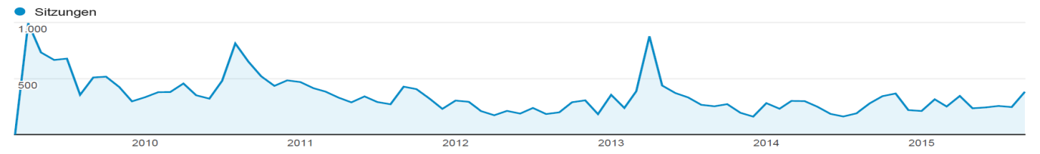
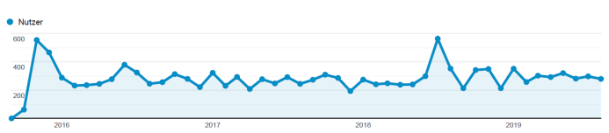
Evolvement through the years
Initiated in Mar 2008
Database first online in Apr 2009
First summary report in Jul 2010
Second summary report in Mar 2013
Major updates produce peaks in visitors
Smaller peaks for conference presentations
Continued interest of ~300 visits per month
Notes:
Previous contracts:
2007-2009: USD 75,000
Jan 2010 – Jun 2011: USD 35,000
2011: USD 25,000
2012: USD 25,000
2013: 0
2014: USD 10,000
2015: 0

Slide 4
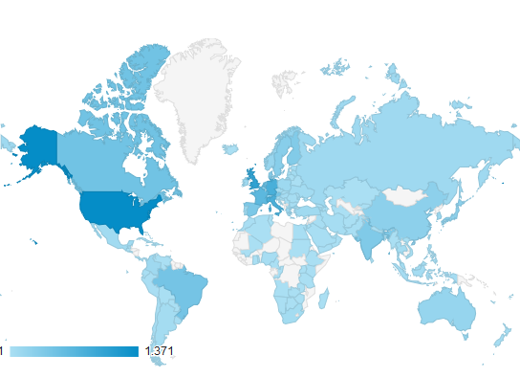
Global Interest
Top Ten visiting countries during the last year:
United States
Germany
United Kingdom
France
Netherlands
Canada
India
Spain
Italy
Denmark

Slide 5
Cooperations for updating
Task 39 members
Task 33 members
ETIP Bioenergy
F3centre (Sweden)
NREL
ART Fuels Forum

Slide 6
Most cited technologies
208 entries in total | active entries | operational and TRL 6-9 | planned and TRL 6-9
fermentation of lignocellulosics to ethanol | 60 | 25 | 6
gasification-derived fuels | 48 | 7 | 7
hydrotreating for renewable diesel | 25 | 12 | 3
gas fermentation to ethanol | 12 | 4 | 4

Slide 7
Follow more closely?
Co-processing in refineries
Integration with pulp & paper mills
Jet fuel production
China

Slide 8
Thanks for your attention!
Dina Bacovsky
+43-7416-52238-35
dina.bacovsky@bioenergy2020.eu
www.bioenergy2020.eu

Slide 9
Lignocellulosic ethanol - planned
Company | Country | Raw material | capacity
Fiberight LLC | USA | MSW | 18,000 t/y
Clariant | Romania | Wheat straw | 50,000 t/y
Enviral | Slovakia | Agri-residues | 50,000 t/y
COFCO Zhaodong Co. | China | Agri-residues | 50,000 t/y
Henan Tianguan Group | China | Agri-residues | 150,000 t/y
AustroCel Hallein | Austria | Spent sulphite liquor | 30,000 t/y

Slide 10
Gasification - planned
Company | Country | Feedstock | Capacity [t/y] | Product
Vanerco | Canada | waste | 30,000 | ethanol
Total | France | Straw | 8,000 | FT liquids
Go Green Fuels Ltd | United Kingdom | Waste wood | 1,500 | SNG
Sunshine Kaidi | Finland | forest residues | 200,000 | FT liquids
ECN | Netherlands | lignocellulosics | 300 | SNG
VaermlandsMetanol AB | Sweden | lignocellulosics | 130,000 | methanol
Red Rock Biofuels | United States | forest residues | 44,000 | FT liquids
Sundrop Fuels | United States | forest residues | 600,000 | gasoline-type fuels

Slide 11
HVO - planned
Company | Country | Capacity [t/y]
Preem | Sweden | 1,300,000
SunPine | Sweden | 39,000
St1 | Sweden | 200,000

Slide 12
Gas-to-ethanol - planned
Company | Country | Capacity [t/y]
ArcelorMittal | Belgium | 63,000
Indian Oil | India | 34,000
Swayana | South Africa | 52,000
Aemetis | United States | 35,000

