Slide 1
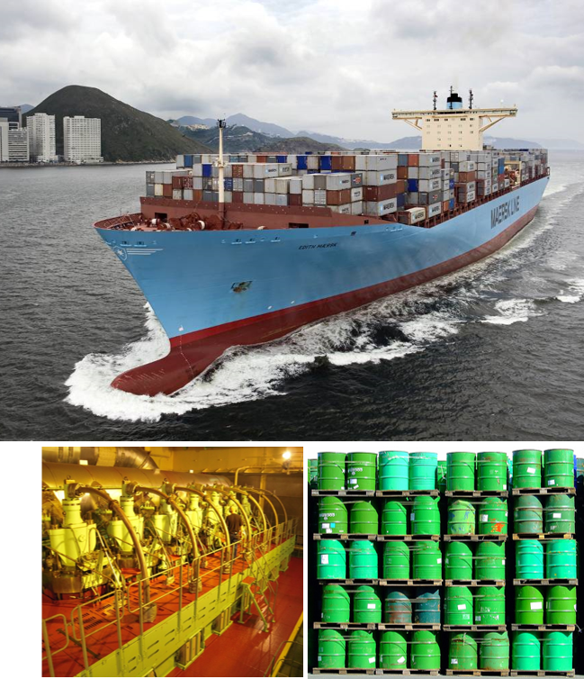
Update
Biofuels for the marine shipping sector
Henning Jørgensen &
Sune T. Thomsen
University of Copenhagen

Slide 2
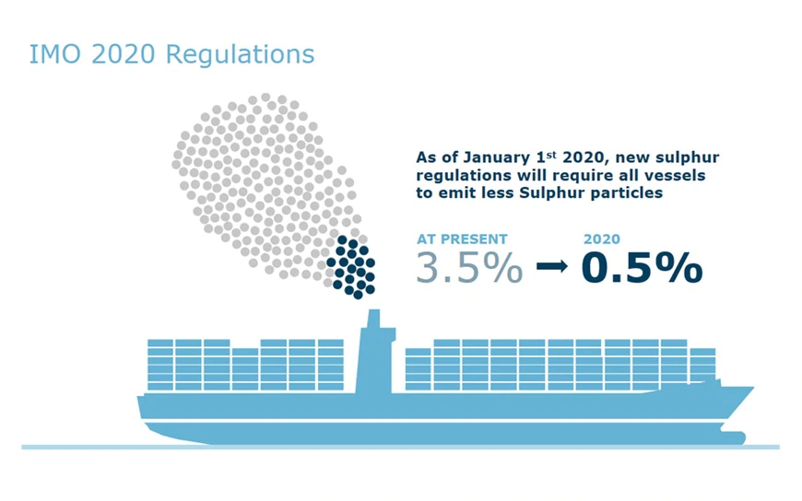
Update of marine biofuel report
Motivation
The previous report was published in 2017
The marine sector will rely on liquid/gaseous fuels for many years – particular for international shipping
By January 2020, the marine sector will be challenged by the IMO 2020 regulations on lower sulphur -> hugh demand for low sulphur (high cost) fuels
New technology developments in the area for production of renewable marine fuels
There is in the sector and among large global players large interest in renewable fuels - Mærsk Shippping (Denmark)

Slide 3

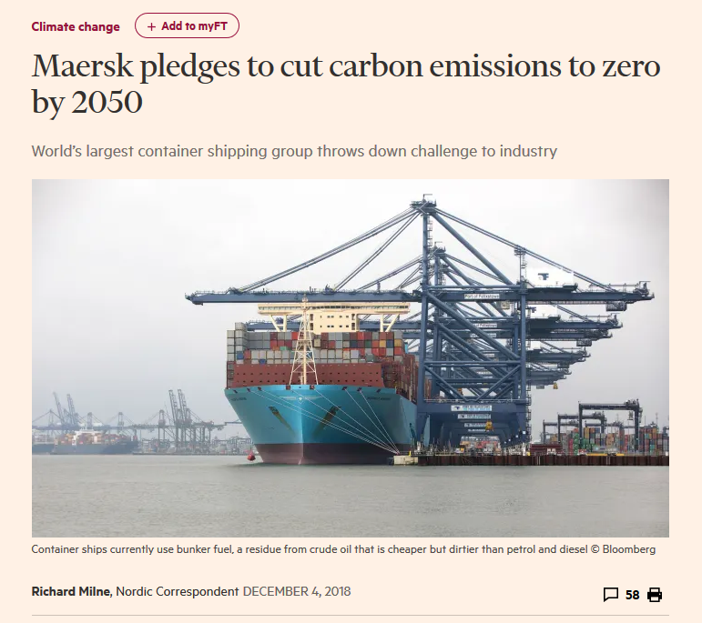
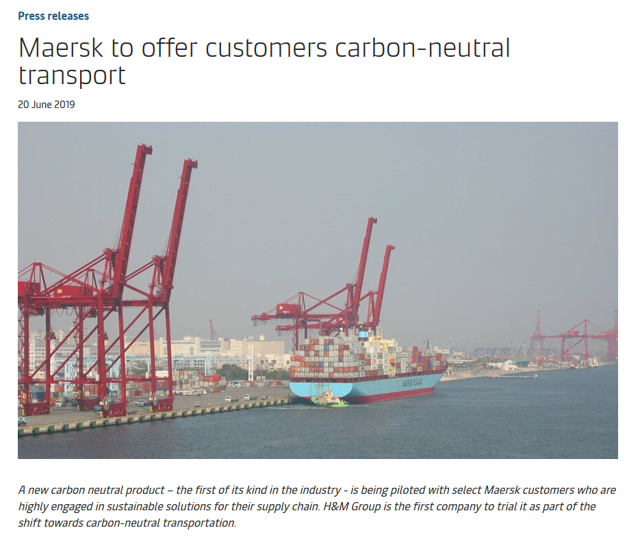
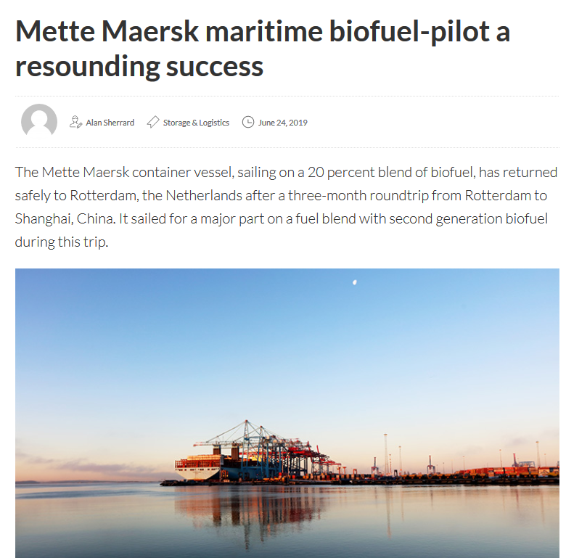

Slide 4

Plan for update
Deadline end 2020
Include updates on:
  Engine technologies
  Fuels and fuel specifications
  Conversion technologies
  Feedstock logistics
Proposed new subjects:
  Integration of technologies – biorefinery co-production options
  Technical, Economic and Environmental Assessment
Collaboration with other tasks:
  Task 34 - Direct Thermochemical Liquefaction
  Task 42 - Biorefining in a Circular Economy
  Task 45 - Climate and Sustainability Effects of Bioenergy within the broader Bioeconomy

