Slide 1


Transport biofuels in Sweden
-Biofuels policy in Sweden – status and outlook
-Update on supported R&D in biofuels and large Swedish demo projects
Jonas Lindmark, Swedish Energy Agency
IEA Bioenergy Task 39 meeting 2019-09-17

Slide 2
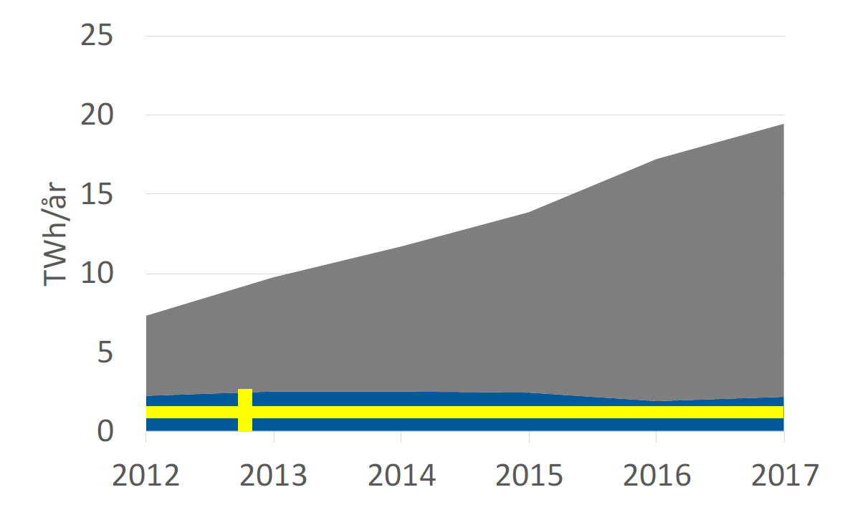
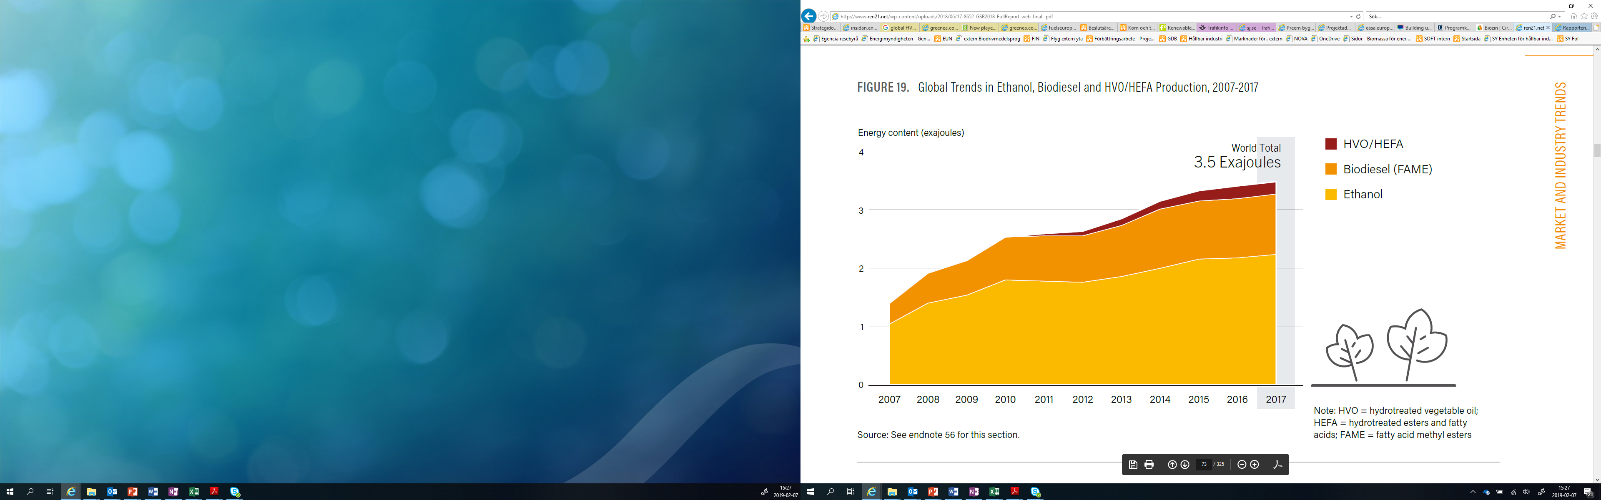
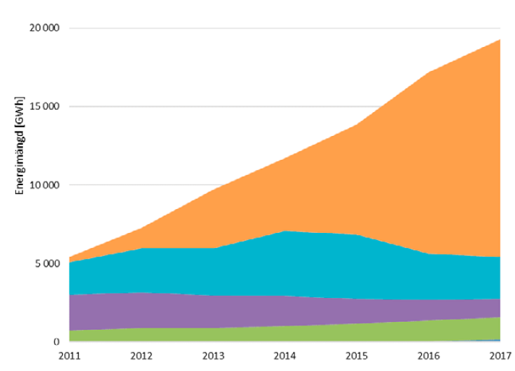
Background–biofuels in Sweden
A majority of the fuels used in Sweden are imported or produced from imported feedstock
HVO is an important fuel in Sweden. Access to sustainable feedstock is an issue
A further increase in biofuels use will require production from feedstocks that are available in larger quantities (e.g. resifues and waste from forestry/forest industry and agriculture
TWh/year
Imported feedstock or fuel
( Total: 835 TWh)
20
HVO
15
FAME
TWh/year
HVO
10
Etanol
5
FAME
Global biofuels consumption
Ethanol
Biogas
0

Slide 3

Biofuels policy – tax exemption/reduction
Pure biofuels and the renewable part of high proportion blends (e.g. E85) are currently exempt from CO₂ tax and for energy tax reductions or exemptions are granted.
Governed by EU state aid rules. Only allowed if production cost (including distribution and infrastructure) of a biofuel is not lower than its fossil equivalent.
Follows up on this twice a year. Government adjusts the tax reduction if necessary. Such adjustments have occurred on several occasions.
Swedish tax exemptions have been approved by the EU Commission until 2020.

Slide 4
Biofuels policy – Reduction quota
GHG emissions of biofuel componets (LCA)
Energy content of the fossil fuel and biofuel
Emission factor for fossil reference fuel
Emission reduction (%)
Policy introduced 1 July 2018
Proposed levels roughly corresponds to situation before the policy was introduced
Separate quotas for gasoline and diesel. For 2019:
  Gasoline 2,6 % reduction
  Diesel 20 % reduction
Check-up every three years with possibility to make adjustments

Slide 5

Assumptions and issues
Important assumptions/uncertainties
  Future transport demand
  Level of electrification in the vehicle fleet
  Long term fate of tax exemption for pure biofuels
  Future energy and CO₂ tax on diesel and gasoline
  Introduction of E10

Slide 6
Follow up assignment for Swedish Energy Agency in 2019 (”kontrollstation 2019”)
Swedish Energy Agency was requested to provide:
Reduction levels 2021-2030 that will contribute to reaching the target of 70% reduction of GHG emissions from road traffic to 2030 compared to 2010.
And recommendations concerning:
Common or separated quotas for gasolike and diesel
How to support high proportion blends and pure biofuels
Flexibility mechanisms

Slide 7
Follow up assignment for SEA in 2019 (”kontrollstation 2019”)
Reduction levels 2021-2030 were proposed. Linear increase. Levels in 2030:
  Gasoline: 27,6% reduction, Diesel: 60% reduction
Separated quotas for gasoline and diesel
Positive to continued tax exemption for high proportion blends and pure biofuels
New flexibility mechanisms allowing companies to trade reductions during the year and also save some reductions from one year to the next

Slide 8

Public inquiry in 2018 – policy instruments for sustainable aviation fuels
The objective of the inquiry was to:
analyse how aviation’s use of sustainable biofuels with low lifecycle emissions can be promoted
propose, if necessary, how the policy instrument or instruments best suited to reducing flight emissions through the use of sustainable biofuels should be designed
highlight which policy instruments can best promote the long term and large-scale production of biofuels for aviation in Sweden;

Slide 9
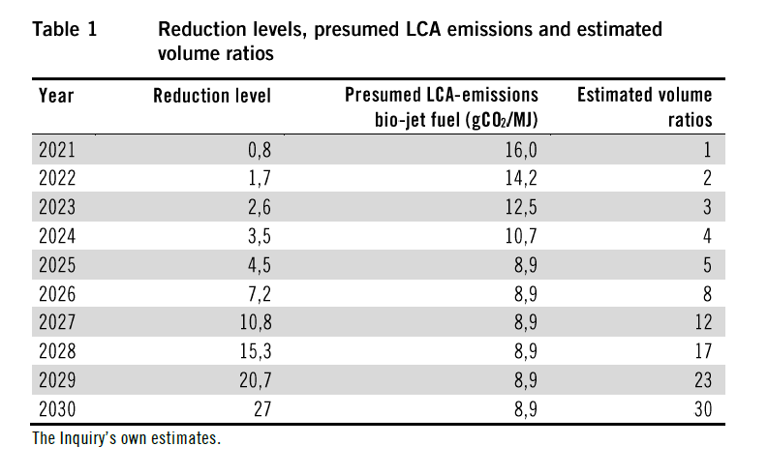
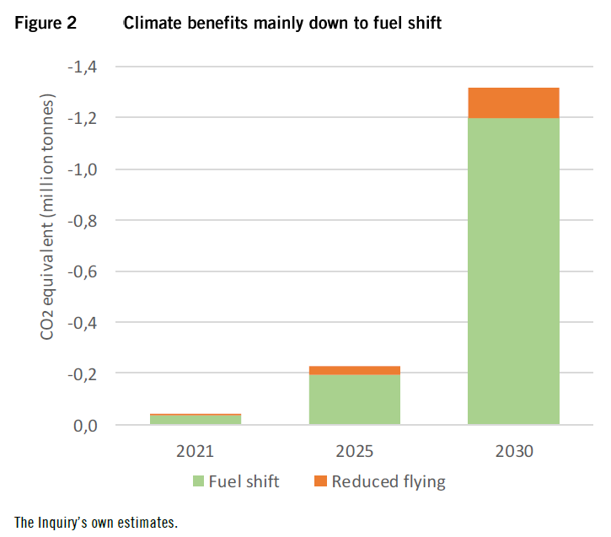
Main proposal: A greenhouse gas emissions reduction quota for jet fuel
Proposed introduction in 2021. Very low levels the first few years
The reduction quota would apply to all fueling at Swedish airports, both for domestic and international flights
Public consultation ongoing. Response before 18th of september

Slide 10
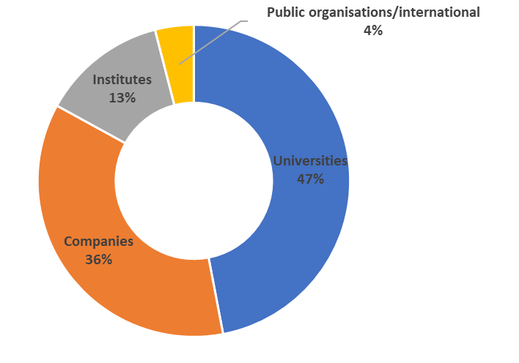

Research funding – the Swedish Energy Agency
  Total yearly budget approx.140 million €
  Co-funded with industry with similar amount
  From fundamental research to demonstration and introduction on international markets
Research policy
Energy- and climate policy
Business policy

Slide 11

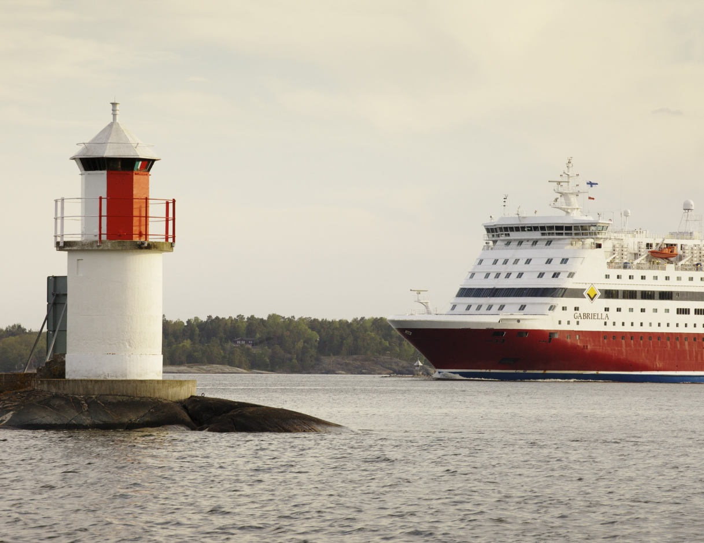


Biofuels research programs cover all user sectors
The same basic technologies
Synergies in production. Multiple products from the same plants.
Road traffic is main focus
Both drop-in fuels and pure biofuels
Total budget about 9 M€

Slide 12

What do we want the research to contribute to ?
Effective production processes
Production processes for biofuels with:
High energy efficiency
Small GHG emission (LCA)
Low production cost
Large feedstock base
Actors and consortia
Actors and consortia who cooperate in the pilot phase and have resources and an interest to build large plants when the conditions are acceptable
Knowledge base
Better knowledge base for development of policy
Better understanding of the whole system (technology, economy, policy etc) among researchers, government agencies, politicians and companies.
Competence provision
Established cooperations between academy and industry
Competent potential employees for industry
Notes:
Research is a complement to other activities and the ambition is to contribute in the areas where research is an effective tool.

Slide 13

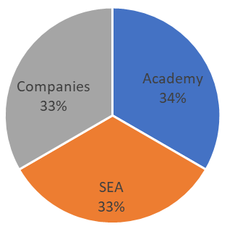
Swedish gasification center
Annual budget approx 5,5 M€/year for 10 years until 2021
In total, 20 companies, 8 universities and one institute
25-30 senior researchers and 30-35 PhD students (>20% funding from SFC)
Strengthen and coordinate Swedish gasification R&D, act as a network for knowledge base and facilitate commercialization of gasification technology

Slide 14

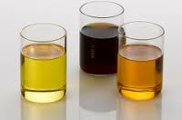
The biofuels program
Research program with yearly calls.
Budget 4 M€/year
Focus on development and improvement of processes for production of biofuels from lignocellulose and lignin
Covers a wide range of technologies:
  Gasification and synthesis
  Ethanol and other alcohols from cellulosa
  Lignin, pyrolysis and hydrothermal liquifaction
  etc

Slide 15

Renewable transportation fuels and systems
Collaborative research program between the Swedish Energy Agency and f3, The Swedish Knowledge Centre for Renewable Transportation Fuels
Budget 3 M€ during 2018-2021
Reports available at https://f3centre.se/en/publications/

Slide 16
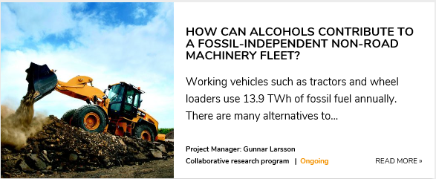
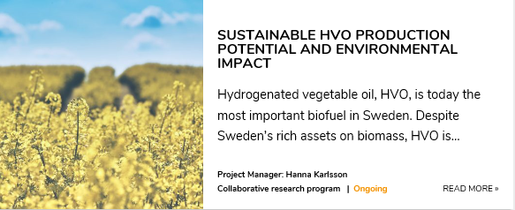
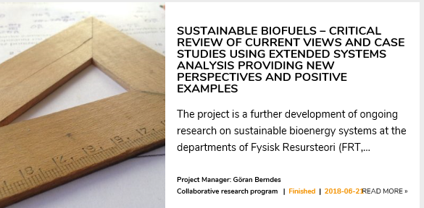
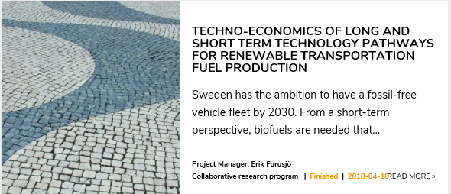
Examples of projects
Renewable transportation fuels and systems

Slide 17
Biofuels for aviation
Government assignment to support research and development of sustainable biofuels for aviation
9 M€ budget, 2018-2020.
17 projects have received funding so far including:
  An innovation cluster that brings together the entire value chain
  CHP integrated aviation fuel production
  Oil-containing yeasts for the production of aviation fuel from sawmill residues

Slide 18
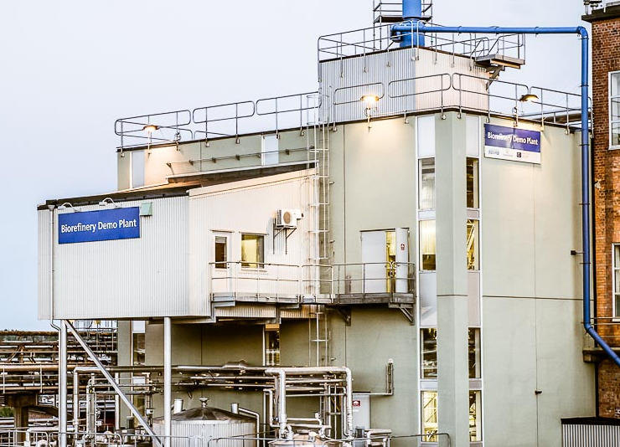
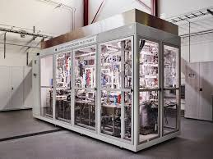
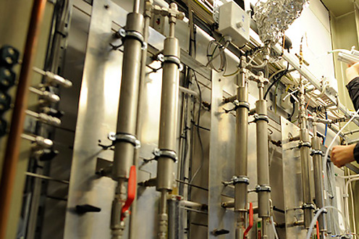
R&D infrastructure in pilot/demo scale. Examples
Biorefinery demo plant – pretreatment and biological processes
Slurry hydrocracker – reseach infrastructure for testing bio-oils in refining processes
Gasification research in an industrial environment at the Chalmers power central

Slide 19
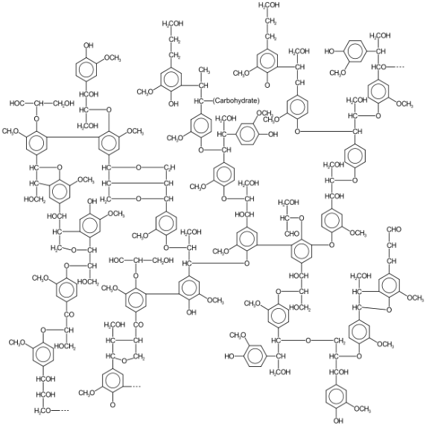
Commercial developments in lignin biofuels
Renfuel
  Plans to have first plant (30 000 tons/year) running by 2021
Suncarbon
  Plans to have first plant (45 000 tons/year) running by 2022
Both projects will produce a lignin oil that will be further processed to gasoline and diesel components in a refinery
Both initatives have received support from the Swedish Energy Agency to develop their technology and perform tests in pilot scale

Slide 20
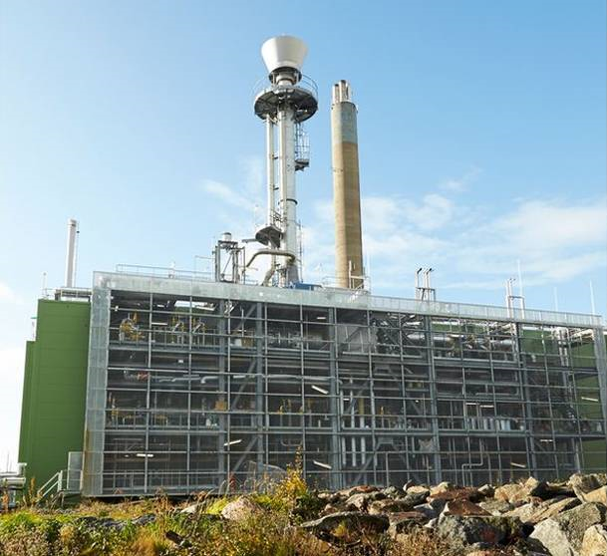
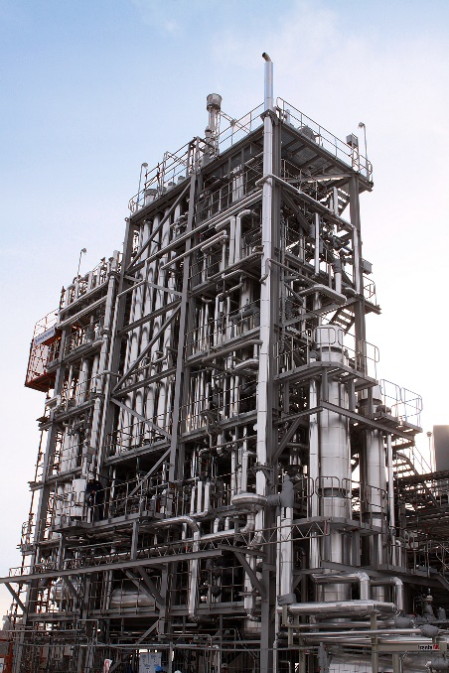
Two mothballed gasification plants
Chemrec plant in Piteå (black liquor gasification – DME/methanol)
GoBiGas in Gothenburg (wood residue gasification – methane)
Successful from a technical standpoint but problems with economy and market

Slide 21

Pyrocell – pyrolysis and co-processing in refinery
Company co-owned by Setra (forest industry) and Preem (refinery operator)
Located at a sawmill outside Gävle
  Feedstock: Sawdust and cutter shavings
  Capacity: 25 000 tons/year pyrolysis oil
Pyrolysis technology from BTG-BTL
Investment decision in spring of 2019 and construction starting in the fall of 2019
https://www.setragroup.com/sv/pyrocell/pyrolysanlaggningen-pa-kastet2/

Slide 22

A few conclusions
Strong demand for drop-in fuels (both diesel and gasoline)
Uncertainties around policy for pure biofuels after 2020
Several investments in HVO production capacity. Mostly imported feedstock
Slow increase in domestic production from lignocellulose – still very dependent on imports. Some additional instrument probably needed

Slide 23

Thank you for your attention !
Contact details:
jonas.lindmark@energimyndigheten.se
+46 (0)16 544 22 94

