Slide 1
Transport Decarbonisation
Dina Bacovsky

Slide 2
Project overview
“The contribution of Advanced Renewable Transport Fuels to transport decarbonisation in 2030 and beyond”
Joint project between IEA Bioenergy TCP and Advanced Motor Fuels TCP
Key question:
How much can advanced renewable transport fuels contribute to the decarbonisation of the transport sector?
Audience: policy makers

Slide 3
Project objectives
Bring together the expertise of AMF, IEA Bioenergy and national experts to showcase the role of advanced renewable transport fuels to transport decarbonisation in 2030 and beyond.
Analyse national strategies for transport decarbonisation.
Identify possible challenges and hurdles for the implementation of advanced renewable transport fuels (both regarding fuel production and end-use in vehicles)
Identify policy gaps and provide recommendations how to overcome them

Slide 4
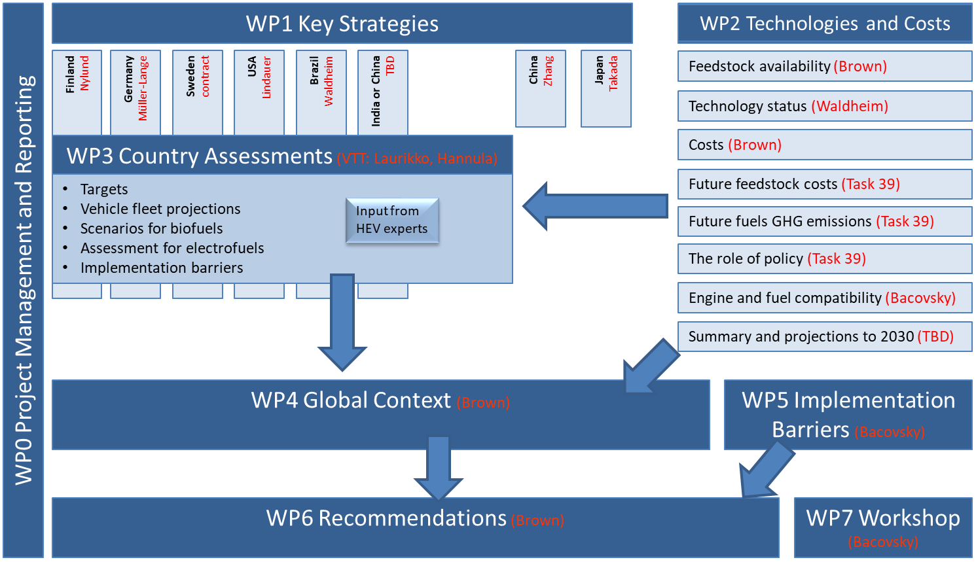
Work package flow and contributors

Slide 5
Timeline

Slide 6
Workshop on 18.11.2019 in Brussels
https://iea-amf.org/content/news/TD-WS

Slide 7
Thanks for your time!

