Slide 1

The production of low carbon intensity fuels through co-processing in existing petroleum refineries
– Ongoing work in Task 39
& upcoming webinar
Susan van Dyk, Mahmood Ebadian, Jianping Su, James McMillan and Jack Saddler
Forest Products Biotechnology/Bioenergy Group
International Energy Agency Bioenergy Task 39

Slide 2
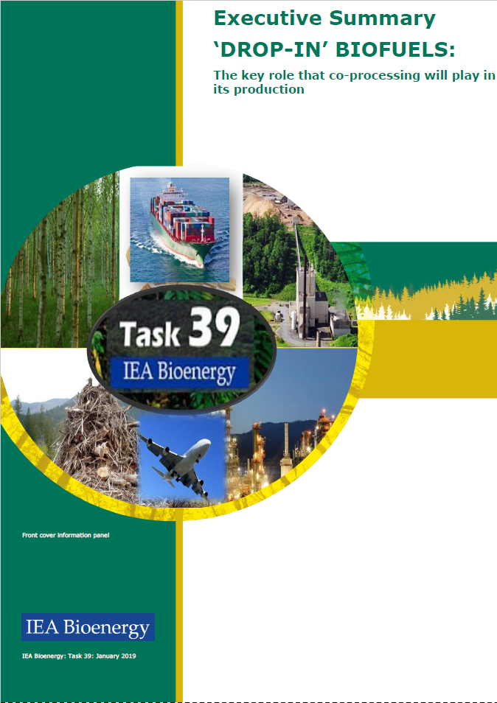
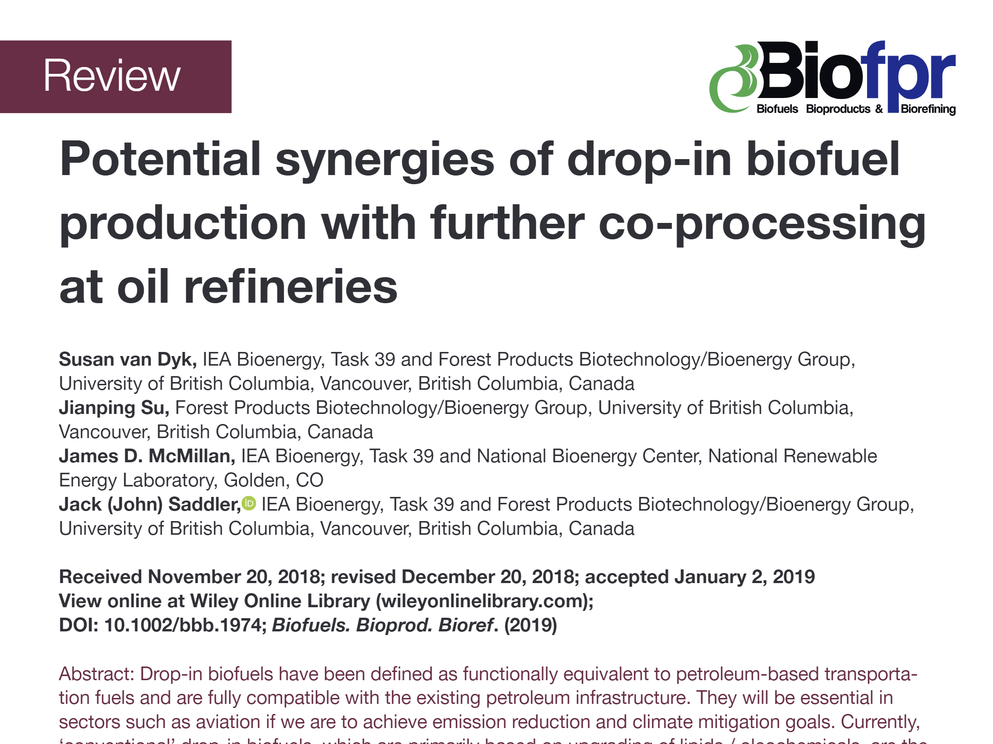
‘DROP-IN’ BIOFUELS: The key role that co-processing will play in its production
www.task39.org

Slide 3
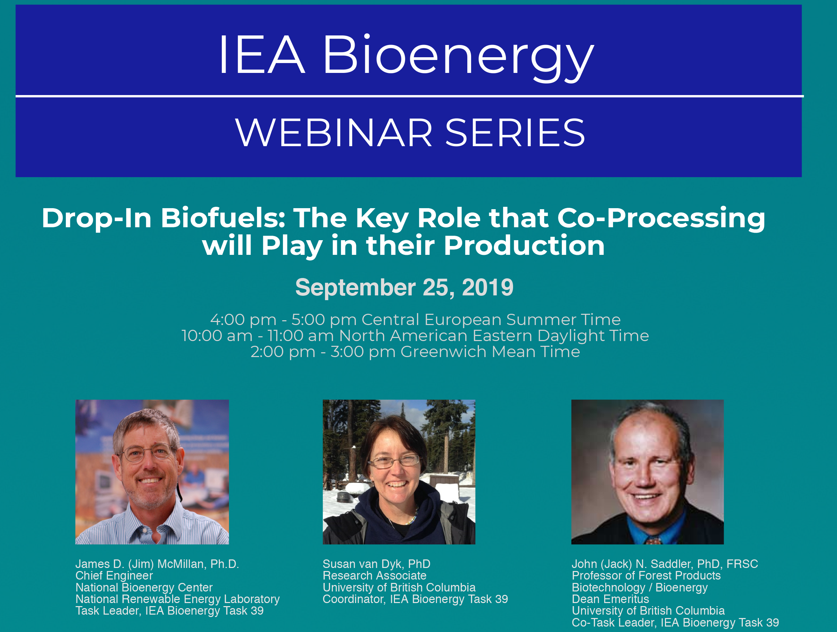
Webinar on 25 September 2019
Insert poster

Slide 4
Options for increased biofuel production through refinery integration
Build stand-alone infrastructure for drop-in biofuel production
Co-location/piggy-backing (e.g. for access to hydrogen)
Repurpose existing infrastructure (e.g. ENI, TOTAL, WorldEnergy, Marathon)
Co-processing of biobased intermediates in existing refineries to produce fossil fuels with renewable content & lower carbon intensity
Capital
Refinery
RISK

Slide 5
Co-processing as a key strategy to expand drop-in biofuel production?
- Benefits of coprocessing and refinery integration
Drop-in biofuel production uses similar processes to petroleum refining
  catalytic cracking, hydroprocessing
High hydrogen requirements for removal of oxygen
Fractionation and blending into finished fuels
Many of these processes require high investment cost and economics rely on large scale
Refinery coprocessing can:
  reduce investment cost of freestanding biorefineries
  Produce lower carbon intensity fuels
  Improve properties of final fuels e.g. lower sulfur
Biofuel producer vs Petroleum Refinery

Slide 6
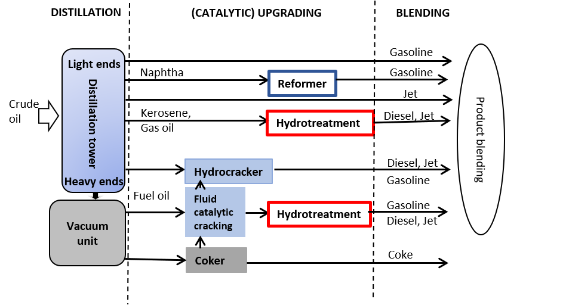
Multiple refinery configurations and potential insertion points

Slide 7
Refinery challenges & pathways to coprocessing
Recent work with several refineries, e.g. Canadian and US refineries, has highlighted the attraction and challenges that refineries have and will encounter making low CI fuels
Challenges
  infrastructure cost to facilitate coprocessing, (in some cases, minimal)
  unplanned shutdowns due to catalyst inhibition etc. (minimal so far)
  Increased cost of maintenance (minimal, so far)
  Increased demand for hydrogen (“green” hydrogen preferred)
  Cost, supply and CI of biobased feedstocks e.g. lipids (ongoing)
  impact of coprocessing on fuel product quality & ASTM certification

Slide 8
Advantages of coprocessing for refineries
Production of low CI fuels and access to incentives
Accessing a niche market for biobased fuels e.g. biojet
Improved fuel qualities possible – e.g.
  higher octane gasoline;
  higher cetane diesel;
  lower sulfur content of finished fuels
Key obstacles to expanded refinery coprocessing
  shortage of refinery level data e.g.
    impacts on products,
    long-term impact on catalysts and operations
    Optimal blends for different feedstocks
  Need for clear standards for biobased intermediates, e.g. oxygen levels, contaminants

Slide 9
Biobased feedstocks for coprocessing
“Conventional” lower carbon intensity (CI) drop-in biofuels - Lipids will be the initial intermediate inserted into the refinery
  Lipids easier to upgrade & readily available
  But an expensive feedstock and sustainability concerns
  Waste feedstocks, e.g. used cooking oil and tallow, limited availability
“Advanced” lower carbon intensity (CI) drop-in biofuels
Bio-oils and biocrudes (based on pyrolysis, HTL, etc.)
  Long-term choice for refinery insertion
  Lower cost than lipids although more complex
  Biggest challenge – availability
  Sufficient volumes will be challenging for several years

Slide 10
Comparison FCC and hydrotreater insertion points
FCC | Hydrotreater
Lower risk as catalyst continuously regenerated Good for feedstocks that require cracking Key product from FCC is gasoline No additional hydrogen required | Higher risk of catalyst deactivation which would be costly as regeneration takes place offsite every few years Additional hydrogen required Potential impact on desulfurization

Slide 11
Tracking renewable content during co-processing
Ongoing debate about the best method
  C14 isotopic method
  Potential mass balance approach
    Mass balance based on observed yields
    Carbon mass balance method
Life cycle assessment of coprocessing (T39 work led by Antonio and now Don and T39 colleagues)
Policy incentives linked to renewable content in liquid products

Slide 12
Role of policy
Policy has been essential for
development of conventional biofuels
Blending mandates, Subsidies, Tax credits,
market based measures (carbon tax, low carbon fuel standards)
Drop-in biofuels not competitive at low oil prices
Biojet vs Renewable diesel
Coprocessing policy considerations – LCA and incentives

Slide 13
Conclusions on coprocessing update
Co-processing uses existing refinery infrastructure to produce lower CI fuels at lower cost
Significant interest in coprocessing from many refineries – partially driven by policy (California and British Columbia)
Co-processing and other types of refinery integration can increase the production of drop-in biofuels
Key role that the cost, availability and sustainability of the feedstocks/intermediates will play in co-processing (“conventional” (oleochemical/lipids in the short-to-mid term, “advanced” (Biocrude/bio-oils) longer term

Slide 14
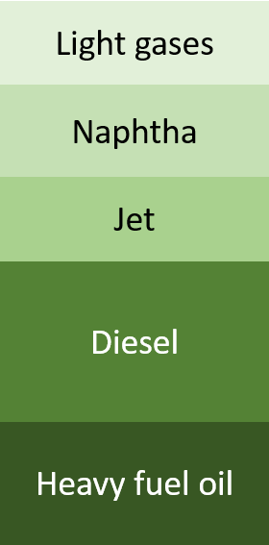
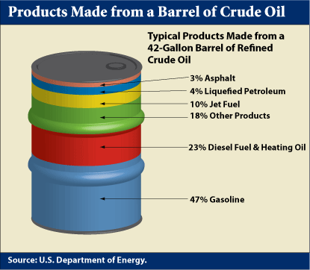
Oil refinery vs co-processing refinery
- Synergy around multiple products produced simultaneously
- Coprocessing produces products for long-distance sectors such as aviation, marine, trucking, rail

Slide 15
Future T39 work on coprocessing
Feedstock variability and impact on coprocessing in different reactors e.g. saturated vs unsaturated lipids
Identifying pretreatments based on biofeedstock characteristics e.g. alkali metals, phosphorous, chlorine
Optimal blend ratios for different feedstocks and different refinery insertion points
Impacts of coprocessing on product yields and quality
Refinery infrastructure modifications and cost e.g. impact of TAN levels on infrastructure modifications such as high quality stainless steel for piping, pumps and storage

Slide 16
Future work – collaboration with other Tasks e.g. Tasks 33,34,43 &45
Anticipated that direct thermochemical liquefaction technologies will become the main feedstock for coprocessing in the long-term
  Collaboration with Task 34 – differences in feedstocks and production technology (FP, CFP, HTL) and impact on coprocessing and product quality
  Standards for refinery-ready biobased intermediates and consistent analytical methods
Collaboration with Task 33 – Coprocessing of Fischer-Tropsch liquids, insertion points and impact on products
Collaboration with Task 43 -Sustainable biomass supply integration for bioenergy within the broader bioeconomy
Collaboration with Task 45 (Sustainability) – LCA of coprocessing and impact on carbon intensity of coprocessed fuels

Slide 17
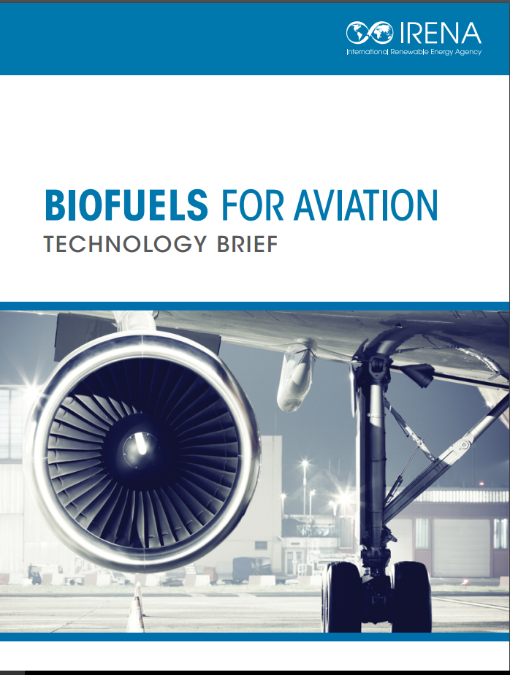
Future work – update biojet fuel production & commercialisation
Biojet fuels – last comprehensive review in 2015
Significant developments - urgent need for an update
  Technology developments
  Current status of production incl. coprocessing
  Progress in ASTM certification
  Policy developments e.g. CORSIA & carbon offsets
Coordinate Task 39 members activities
  Contributions from country representatives regrading their-country’s developments in biojet fuel commercialisation and policies

Slide 18
Future work - Contribute to the Marine report update (Denmark?)
The role of coprocessing in production of lower CI and lower sulfur marine fuels
Overview of the IMO fuel sulfur limits in 2020 and challenges/approaches for meeting sulfur specifications

