Slide 1
Implementation Agendas Report: 2019-2020 Update
(compare-and-contrast policies used to develop biofuels)
Mahmood Ebadian
IEA Bioenergy Task 39, Business Meeting
Stockholm, Sweden
September 16-17, 2019
Commercializing Conventional and Advanced Transport Biofuels from Biomass and Other Renewable Feedstocks
Notes:
First, I would like to say hi to all of our member countries and welcome our new members Irland and it seems that everything going well. Thanks a lot Adrian and Luara again for all the efforst you made in the last three months to oranzie both bsuiiness menneign andjoing workshop.

Slide 2
Commercializing Conventional and Advanced Transport Biofuels from Biomass and Other Renewable Feedstocks
Implementation Agendas Report
Compares and contrasts developments in transport biofuels production and use in member countries
Focuses on biofuel policies and the extent to which these biofuels policies have been effective
Assesses the measures taken by member countries to develop or stimulate their respective biofuels sectors, including incentives and investment in research, development and commercialization
Provides an update on the current status of biofuel sustainability assessments and related discussions that factor into policy development
Notes:
China: top 10 producers
India: ambionsu plans to increase the production and use
Since we have some new members, I’d like to give an overiow wha is the impenayion agenda nd why we are doing this.
What is the implmenationdgane ans why
What policies we have out three, how they are impct the biofuels use and productiona dn how
Market pull and technology push

Slide 3
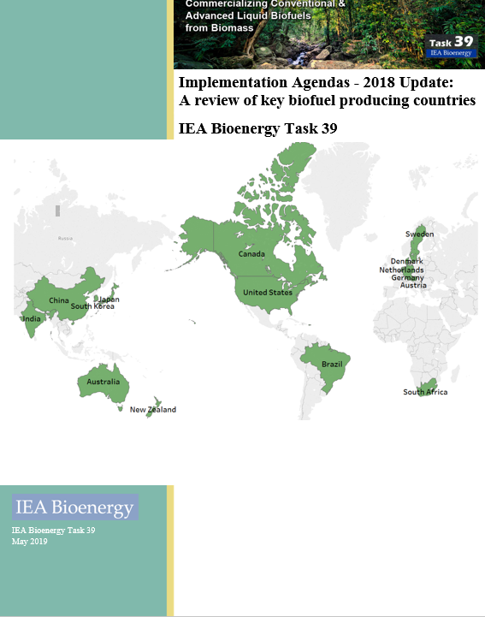
Commercializing Conventional and Advanced Transport Biofuels from Biomass and Other Renewable Feedstocks
Implementation agenda report- 2018 Update
Four updates of the report has been published by Task 39 in the past including 2007, 2009, 2014 and 2017
180-page report comprised of 18 chapters
Chapter 1: global biofuels production and use
Chapters 2-17: biofuel policies in 16 countries (country chapters)
Chapter 18: Compare and contrast biofuel policies
The full report and executive summary are available at “Member Only” section of the Task 39 website. The embargo period ends in December 2019.

Slide 4
Methodology
1. Developed a new questionnaire
2. Sent out the questionnaire to member countries
3. Collected the completed questionnaires from country representatives, complied the information and reviewed/ incorporated recent related publications
4. “Polished” each country’s contribution to try to make them more comparable
5. Shared the draft country sections with each country representatives for their review/feedback
6. Prepared a draft implementation agendas report
Commercializing Conventional and Advanced Transport Biofuels from Biomass and Other Renewable Feedstocks
Notes:
In addition to these information, we did a litertaire rebeow to make sure we are covering all rlvenat knowledge and data on a global scope

Slide 5
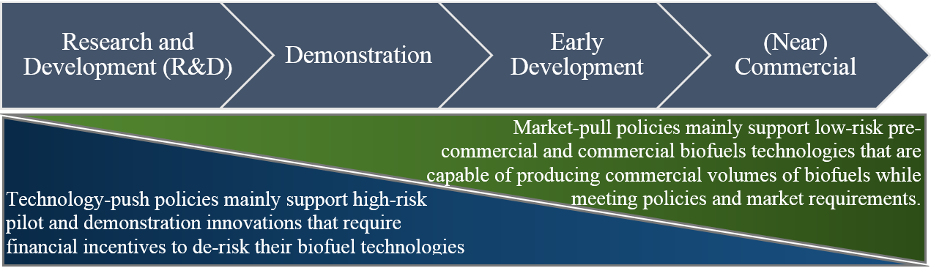
Commercializing Conventional and Advanced Transport Biofuels from Biomass and Other Renewable Feedstocks
Existing policies and incentives for biofuel production and use
Notes:
A combination of market-pull and technology-push policies have been implemented to propel the production and use of biofuels at different stages of technology and market development.
The technology-push policies provide direct funding to the technology development at the pilot, demonstration and pre-commercialization scales to de-risk the technology development and deployment.
On the other hands, the market-pull policies assist in increasing the market penetration and cost-competitiveness of biofuels. Market-pull policies usually support biofuels that have proven and close-to-the-market technology pathways.

Slide 6
Commercializing Conventional and Advanced Transport Biofuels from Biomass and Other Renewable Feedstocks
Implementation agenda report
Main drivers for biofuels policy
Biofuels policy
Market-pull
Biofuels obligations (e.g. blending mandates)
Excise duty reductions
Fiscal incentives
Investment subsidies
Technology Push
Grant programs (pilot scale, demo scale…)
Loan guarantees and credit lines
Financial incentives for feedstock development and logistics
Promotion of advanced biofuels
Market development and policy effectiveness
Notes:
To see if each county has a specifc acititves to support the development of advanced biofuels

Slide 7
Commercializing Conventional and Advanced Transport Biofuels from Biomass and Other Renewable Feedstocks
Market-pull policies for biofuel production and use
Country | Biofuels mandates | Fuel excise tax reduction/exemption | Other policy mechanisms
Australia | - No national renewable fuels target - New South Wales: 5% biodiesel and 6% ethanol (volume) - Queensland: 0.5% biodiesel and 4% ethanol (volume) | - Producer grant scheme (fuel excise reduction) | -
Austria | - 6.3% biodiesel, 3.4% ethanol and 5.75% biofuels (energy content) - 0.2% advanced biofuels target by 2022 (energy content) | - Tax concessions for fuels with a biofuel share of at least 4.4% - Pure biofuels exempted from mineral oil tax | -
Brazil | - 27% ethanol and 10% biodiesel (volume) - 100% hydrous ethanol is also marketed in all gas stations in Brazil | - There are tax incentives for biofuel producers, blenders and users including tax incentives for ethanol-flex fuel vehicles, tax incentives for ethanol fuel and federal tax exemptions and incentives for biodiesel production | -
Canada | - Federal use mandates: 5% ethanol and 2% biodiesel (volume) - Five provinces of British Columbia, Alberta, Saskatchewan, Manitoba and Ontario established a blending requirement of 5% to 8.5% for ethanol and 2% to 4% for biodiesel (volume) | - | - British Columbia’s Carbon Tax and Low Carbon Fuel Standard - Ontario’s auction for carbon allowances - Alberta’s carbon levy
Denmark | - 5.75% biofuels (both ethanol and biodiesel) (volume) - 0.9% for advanced biofuels by 2020 | - CO₂ excise exemptions for biofuels | -
European Union (EU) | - Cap on food and feed crops of max 1% above 2020 consumption with a maximum of 7% (energy content) - Sub-target for advanced biofuels of 0.2% for 2023, 1.0% for 2025 and 3.5 for 2030 (energy content) - Use of high iLUC crops should gradually decrease to 0% in 2030 unless they are certified to be low-iLUC | - | -
Germany | - GHG reduction of 3.5%/4%/6% in the fuel mix for the entire fuel sector from 2015/2017/2020 onwards | There is no tax relief for FAME biodiesel, HVO/HEFA fuels, vegetable oils and ethanol: - FAME biodiesel, HVO/HEFA fuels and vegetable oils have the same fuel tax as diesel fuel (€ 0.4104/liter) - Ethanol has the same fuel tax as gasoline fuel (€ 0.6545/liter) - The fuel tax for CNG and biomethane is € 0.0139/kWh until 2023 | - A carbon tax is indirectly applied via CO₂ tax for passenger cars
Japan | - 500 million liter ethanol mandate (volume) - Introducing 10 million liters (crude oil equivalent) of second generation biofuels (volume) | - No diesel oil delivery tax for B100 - A special tax incentive for the consumption of ethanol - Import of bio-ETBE encouraged through a zero tariff | -

Slide 8
Commercializing Conventional and Advanced Transport Biofuels from Biomass and Other Renewable Feedstocks
Market-pull policies for biofuel production and use
Country | Biofuels mandates | Fuel excise reduction/exemption | Other policy mechanisms
Netherlands | - 16.4% biofuels (both ethanol and biodiesel, double counting advanced biofuels) (energy content) - 1.0% for advanced biofuels in 2020 | - | -
New Zealand | - No mandate on biofuel use or any biofuel volume obligations | - Fuel excise exemption for ethanol (including imported ethanol) - No excise exemption for biodiesel | - Emissions trading scheme
South Africa | - No mandate on biofuel use or any biofuel volume obligations | - Fuel excise exemption for ethanol - Biodiesel manufacturers receive a rebate of 50% on the general fuel levy | -
South Korea | - 2.5% mandate for biodiesel (volume) | - | -
Sweden | - GHG emissions reduction of 2.6% for gasoline and 19.3% for diesel | - The tax exemption has varied from full to reduced tax exemption but from January 2018 all biofuels are fully exempted from tax | -
The United States (US) | - Volume targets for biofuels including conventional corn-based ethanol and advanced, cellulosic and diesel biofuels | - | - California’s Low-Carbon Fuel Standard (LCFS) - Biodiesel producer’s credit
China | - No official national mandate for ethanol and biodiesel use in the transportation sector - 11 provinces and cities (known as pilot provinces and cities) selected as fuel ethanol pilot zones for mandatory E10 blending (volume) - Small trial program using 2% and 5% biodiesel blends carried out in a few provinces (volume) | - An excise tax exemption for waste oil-based biodiesel production - No excise tax exemption for ethanol | - Fuel ethanol subsidies: halted since 2016 for conventional grain ethanol (1 G); subsidies for 1.5 generation ethanol (from cassava or sweet sorghum) since 2013-2017 but phased out in 2018; cellulosic ethanol production subsidy of $0.07 per liter (600 RMB per ton) - Import tariffs on US-origin ethanol
India | - No official national mandate for ethanol and biodiesel use in the transportation sector - The 20% and 5% blending targets are proposed (volume) | - No excise tax exemption/reductions for ethanol and biodiesel | - Deregulated diesel prices - Allow 100% foreign direct investment in biofuel technologies - Over $30 million USD investment in biofuel R&D and second generation ethanol technology - Biofuel imports are banned but the import of feedstock for production of biodiesel is permitted to the extent necessary

Slide 9
Commercializing Conventional and Advanced Transport Biofuels from Biomass and Other Renewable Feedstocks
Technology-push policies: Financial schemes, investment subsidies and incentives
Member countries have various funding programs to further encourage production and use of biofuels, especially advanced biofuels.
Technology-push incentives | Country
Grants for conversion technology development to increase technology readiness levels and to de-risk the technology and supply chain development. | Australia, Austria, Brazil, Canada, Germany, South Korea, Sweden, US, China, India
Loan guarantees and credit lines to buy down the financial risk of constructing first-of-a-kind larger-scale commercial facilities | US and Brazil
Rebate and tax incentives on bioenergy R&D expenses | Australia
Rebates and bonuses to car buyers for the purchase of certain vehicles such as flex-fuel vehicles (FFVs) and other rebates such as reduced license fees and tax credits | Austria, Brazil, Sweden
Fiscal incentives and subsidies (e.g. reduced property tax, corporate tax, renewable energy depreciation on assists) | Brazil, Japan, China
Financial incentives for feedstock development and logistics | Brazil, USA, China, India
Grants for storage and distribution infrastructure | Canada, The Netherlands, Sweden
Notes:
market-pull instruments including biofuels blending mandates and fuel/CO₂ excise tax reduction/exemptions are broadly effective to support technologies that are relatively mature, as they create a demand for biofuels, which is typically met with commercial conversion technologies such as conventional ethanol or biodiesel. However, such instruments can be limited in their capacity to pull early-stage technologies into the market, since these are often not yet commercially viable, typically more expensive and struggling to compete against fossil fuels and already established biofuels.
In contrast, regulatory frameworks such as California’s LCFS, Brazil’s RenovaBio and Canada’s Clean Fuel Standard (CFS) are examples of policies that aim to pull second generation biofuels into the market by providing a fuel agnostic incentive to products with the lowest carbon intensity.
Despite the dominance of market-pull instruments (i.e. biofuels blending mandates, fuel/CO₂ excise reduction/exemptions and LCFS), a signiﬁcant policy focus has been to support technology research, development and demonstration (RD&D) through grant instruments, particularly for advanced biofuels. Such technology-push instruments or measures are typically effective for driving early stage technologies such as advanced biofuels towards demonstration and commercialization. Technology-push instruments reduce the cost of research and development to drive new ideas and reduce technology cost, helping take early stage technologies through the valley of death that so often exists between early technology development and profitable commercial operation (Biofuture Platform, 2018).

Slide 10
Commercializing Conventional and Advanced Transport Biofuels from Biomass and Other Renewable Feedstocks
Existing Policies for biofuel production and use
Policy instrument | Strengths | Limitations
Biofuel blending mandates | - Effective for developing a biofuel market at early stages - Effective in establishing biofuels markets and in shielding biofuels from low oil prices - Greater certainty of increased development - broadly effective to support technologies that are relatively mature, as they create a demand for biofuels, which is typically met with commercial conversion technologies such as conventional ethanol or biodiesel | - Need to balance costs of infrastructure while demand is low in early stages - Need suitable governance to ensure compliance - Not necessarily so useful in expanding /maintaining markets - Not necessarily successful for meeting GHG reduction targets - Limited in their capacity to pull early-stage technologies into the market, since these are often not commercially viable, or are typically more expensive to be produced commercially - struggling to compete against ﬁrst generation biofuels
Excise duty reductions/exemptions | - Increases the competitiveness of biofuels with fossil fuels, especially at early stages of development, if fossil vs renewable fuels are taxed differently - Can be also considered for the production of biomass such as dedicated biomass crops (e.g. switchgrass, carinata, willow) in order to ensure sufficient feedstocks for production of conventional and advanced biofuels and ultimately achievement of mandates for use - Broadly effective to support technologies that are relatively mature, as they create a demand for biofuels, which is typically met with commercial conversion technologies such as conventional ethanol or biodiesel | - As fuel excise rates vary, this may not be a strong enough driver to foster the biofuels market as an stand-alone policy - Limited in their capacity to pull early-stage technologies into the market, since these are often not commercially viable, or are typically more expensive to be produced commercially - struggling to compete against ﬁrst generation biofuels
Low carbon fuel standards (LCFS) | - Technology neutral - Favours technologies able to offer the most significant decarbonisation relative to cost - Spurs the development and production of more life cycle efficient advanced biofuels | - Unlikely to simulate demand for higher cost, less-developed technologies with long-term potential - Determining life cycle emissions is complex and time consuming and requiring big data collection

Slide 11
Commercializing Conventional and Advanced Transport Biofuels from Biomass and Other Renewable Feedstocks
Existing Policies for biofuel production and use
Policy instrument | Strengths | Limitations
Low carbon fuel standards (LCFS) | - Encourages conventional biofuel producers to lower their carbon footprint by transitioning away from fossil fuel-based energy and making better use of their by-products such as CO₂ | - Results of life cycle analysis depend on system boundaries, allocation methods and other assumptions and are subject to debate - Need suitable governance to ensure compliance - Need suitable verification process to measure the carbon intensity of biofuels produced from different feedstock-conversion technology pathways
Research and development, demonstration funding and financial de-risking measures, mainly for advanced biofuels | - Necessary to support early market technology development and initial commercial projects with longer-term market potential but high investment risk - Successful in de-risking technology and catalysing private investment for subsequent stages, somewhat sparing public budgets as technologies advance into commercial stages | - Financial risks associated with potential project failures
Sustainability policy | - Propel the production and use of advanced biofuels using non-food crop feedstocks such as municipal solid waste (MSW), used cooking oil, and agricultural and forest residues | - Could constrain further production of conventional biofuels from food crops, even for cases where there is little potential for detrimental indirect land use changes - Could make waste production profitable, which is not in line with overall waste reduction initiatives and polices

Slide 12
Commercializing Conventional and Advanced Transport Biofuels from Biomass and Other Renewable Feedstocks
Proposed plan for the implementation report for the current triennium (2019-2021)
Two updates of implementation agendas will be published
2019-first half of 2020 Update
Second half of 2020-2021 Update
Mostly use the same format as before??
In addition, collect information on the global trade of biofuels at the regional level (e.g., Europe, Asia, North and South America, Australia, Africa) and imposed tariffs/duties on biofuels import/export
Collect and compile information on the compliance mechanisms used to enforce biofuel policies (add a new section to the report)
Investigate/recommend optimal types of policies for aviation and marine sectors given their distinctive international characteristics

Slide 13
Commercializing Conventional and Advanced Transport Biofuels from Biomass and Other Renewable Feedstocks
Proposed plan for the implementation report for the current triennium (2019-2021)
Greater emphasis on Low Carbon Fuel Standards Policies, especially the RenovaBio in Brazil and Clean Fuel Standard in Canada
Greater emphasis on biomass and biofuels sustainability criteria and existing/emerging sustainability certification schemes
Add other non-member countries (e.g. mainly Asia including China, India, Indonesia, Malaysia)

Slide 14
Commercializing Conventional and Advanced Transport Biofuels from Biomass and Other Renewable Feedstocks
Next steps for 2019-first half of 2020 Update
Send a copy of the revised questionnaire to member countries for their review and feedback- October 2019
Finalize the revised questionnaire based on the received feedbacks from member countries- December 2019
Request completion of the revised questionnaire by end of March 2020
For established members: Share a copy of their respective country chapters, asking for an update of their chapters (e.g. changes in biofuels policies, biofuels production and use)
For new members: Share a copy of the revised questionnaire, asking for completion and submission
Develop the draft report of the implementation agenda and distribute among member countries for review and comments- May 2019
Collect comments and feedbacks from member countries on the initial draft- July 2020
Finalize and publish the implementation agenda- 2019-2020 Update- August 2020

