Slide 1
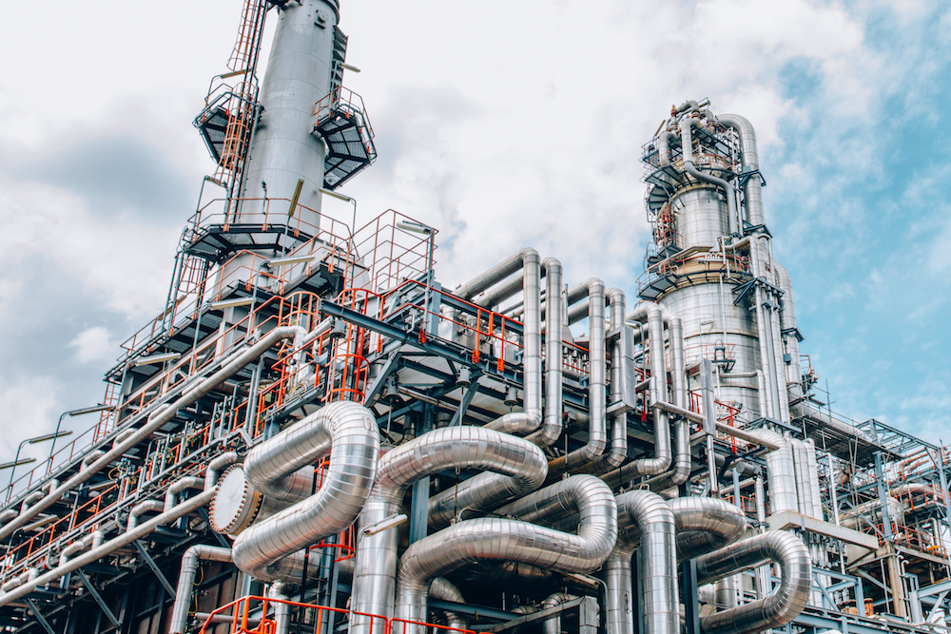
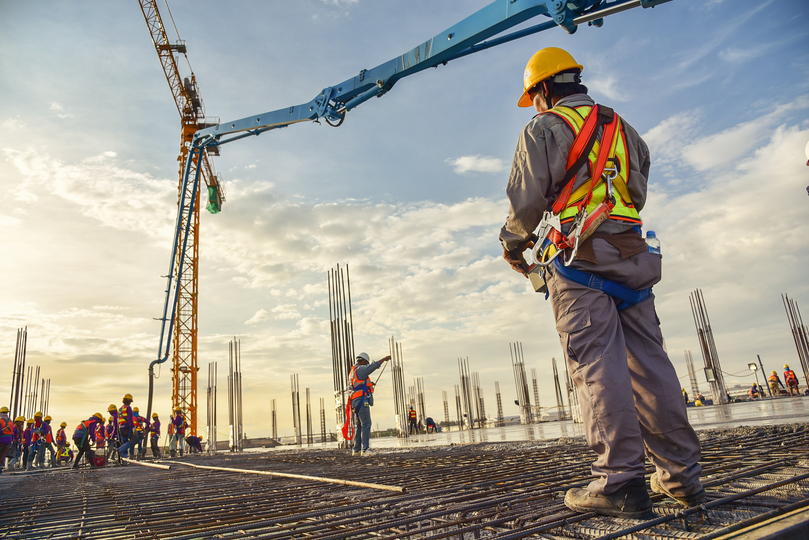
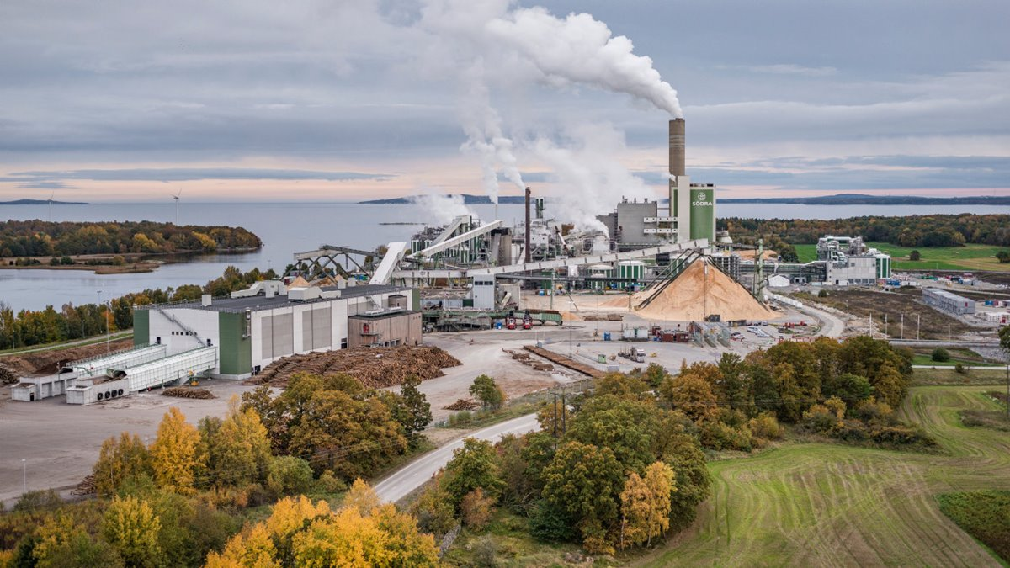
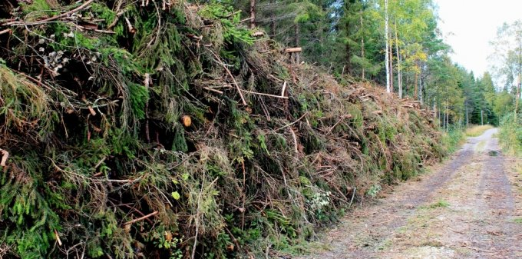

Status of Swedish gasification and pyrolysis technologies to biofuels
Joakim Lundgren, Professor
Division of Energy Science, Luleå University of Technology
Director of Swedish Gasification Centre (SFC)
Swedish representative in IEA Bioenergy Task 33
Notes:
Max 10 min
5 min frågor

Slide 2
Agenda
Historical development
Pyrolysis to biofuels
Gasification to biofuels
Advanced biofuels performances under the new reduction quota
Summary

Slide 3
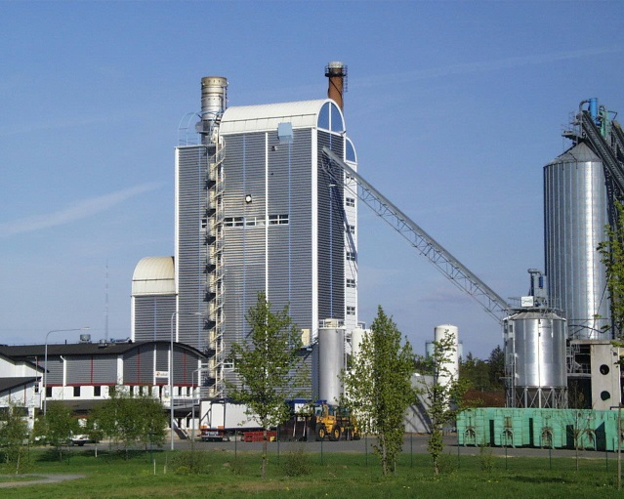
Swedish biomass gasification and pyrolysis activities since 1970’s
1970’s: Oil crises, expected fuel shortage
  Focus on gasification to biomethanol and pyrolysis for fossil oil replacement
1980’s-90’s: End oil crisis, nuclear phase out, expected high electricity prices
  Focus on gasification shifted to electricity production (Värnamo BIGCC plant). Low activities on pyrolysis
2000’s-2008’s: Climate issues, EU directive*, no nuclear phase out, climbing oil prices
  Decreased interest for gasification based electricity
  Renewed interest for gasification biofuels production
  Fast and large-scale initiatives (ex. Värnamo, Chemrec, Göteborg Energi)
Värnamo biomass gasification plant
*Directive 2003/30/EG on promotion of renewable transportation ^{fuels}

Slide 4
Swedish biomass gasification and pyrolysis activities since 1970’s
2010-2013: High oil prices, NER 300 funding opportunities
  New large industrial projects initiated such as Pyrogrot (BillerudKorsnäs), BLG (Domsjö Fabriker), GoBiGas (Göteborg Energi), Bio2G (E.ON)
  The Swedish Gasification Centre was established
2014-recently: Low oil price, ILUC debate, high national ambitions, but lack of long term policies
  Large market uncertainties for all biofuels
  None of the planned NER 300 biofuel projects was realized and all of them are more or less currently inactive
Present: Still low oil price, RED II, introduction of a reduction obligation
  Technology tracks for drop-in fuels stimulated
  Pyrolysis liquid production for further upgrading at refineries
  Gasification based biofuels still struggling

Slide 5
Activities on pyrolysis to biofuels

Slide 6



  Setra & Preem
Pyrolysis of sawdust at the Kastet Sawmill outside Gävle to produce 25,000 tonnes of pyrolysis liquid per year
A new company, Pyrocell AB, has been set up together with Preem, who will refine the liquid to biofuels at the Preem’s refinery in Lysekil
Pyrocell has announced the selection of the Dutch companies TechnipFMC and BTG BioLiquids (BTG-BTL) to design and build the plant.
Construction is expected to be completed in 2021

Slide 7
Preem, Fortum & Valmet
Fortum and Valmet aim to develop and commercialize a pyrolysis technology for upgraded pyrolysis liquid suitable e.g. as refinery co-feed (based on a technology platform similar to Fortum’s Joensuu bio-oil plant, supplied by Valmet)
Preem will process the upgraded pyrolysis liquid into transportation fuels at their refineries
The project is co-financed by the Swedish Energy Agency and Business Finland

Slide 8
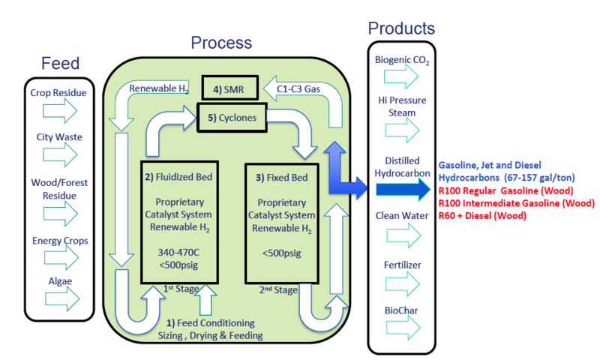
Preem & Bergene Holm
The Norwegian company Bergene Holm has initiated a pre-study together with Preem in its subsidiary Biozin to on using a hydro-catalyzed pyrolysis process (the IH² process) for the production of biofuels from saw mill residues

Slide 9

Scandinavian Enviro Systems & RISE
Pyrolysis liquid from old car tires for upgrading to transportation fuels
Depending on how much natural rubber the tire contains, the liquid can be more or less renewable. A high percentage of natural rubber provides more bio-based oil
Ref: RISE, 2019 https://www.ri.se/en/our-stories/old-tyres-becomes-fuel-cars

Slide 10
Activities on gasification to biofuels

Slide 11
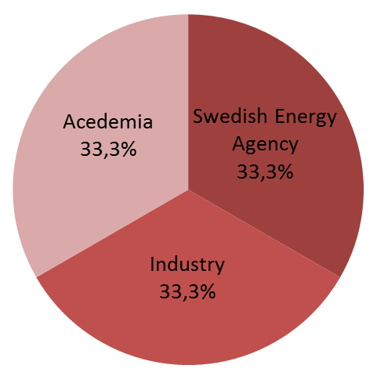

SFC- A Centre of Excellence
Strengthen and coordinate Swedish gasification R&D
In total, 19 companies, 8 universities and one institute
Annual budget of approx. 6 million Euros for 10 years (until 2021)
Fundamental and applied R&D to support the development of biomass gasification technologies
Foster a new generation of gasification competence in Swedish academy and industry
More info at www.sfc-sweden.se

Slide 12
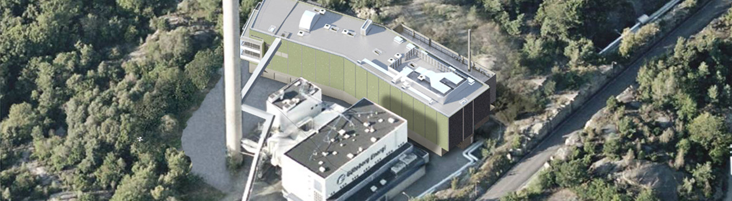
GoBiGas phase I
The gasifier was operated in total ~ 12 000 hours. 1 800 hours continuously 2017-2018
100% bio-SNG production capacity (20 MW) was reached in the beginning of 2018
Approx. 65 GWh bio-SNG was produced
All performance targets were reached
GoBiGas project was for economic reasons stopped in March 2018 and is currently in conservation state

Slide 13
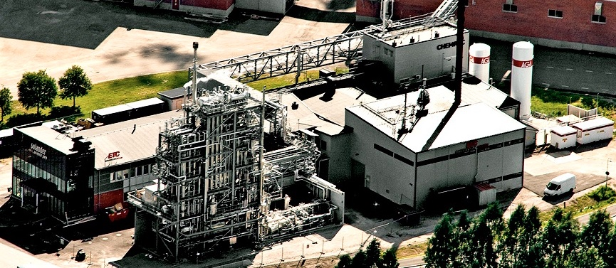
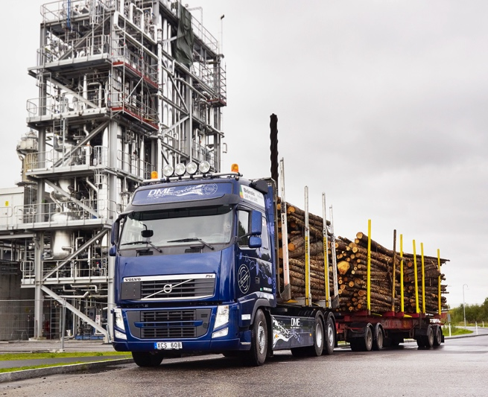
LTU Green Fuels (former Chemrec tech.)
Pilot BL gasification | Pilot methanol + DME | Field testing
3 MW, 20 t DS/d | 4 t/d methanol/DME | Volvo Trucks DME 8 trucks, >1 500 000 km
>28 000 h since 2005 | >12 000 h since 2011
Recovery of cooking chemicals without difficulties |  | DME and methanol in industrial applications
Opportunities for exp. campaigns 24/7, high availability

Slide 14
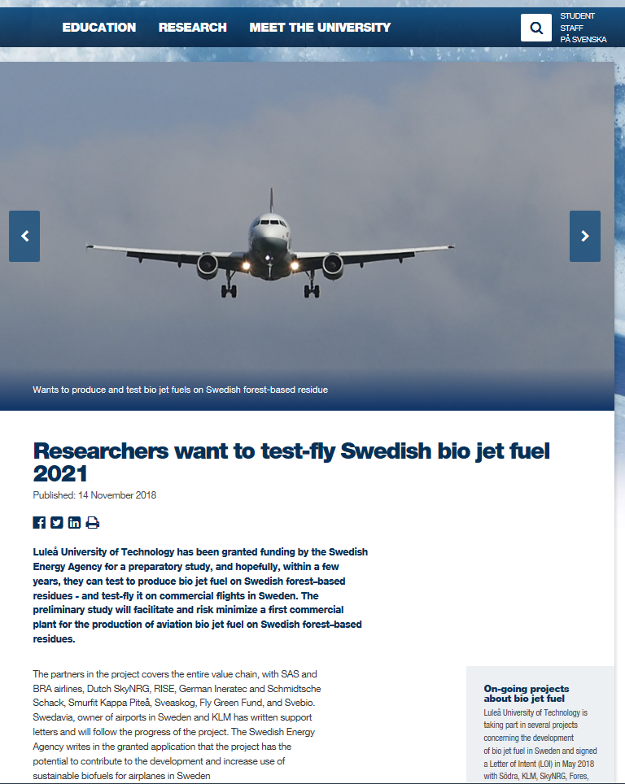
LTU Green Fuels
Several projects on development of bio jet fuel in Sweden
Collaborations with KLM, SkyNRG, Södra, Fores, RISE, airports, municipalities, energy companies

Slide 15
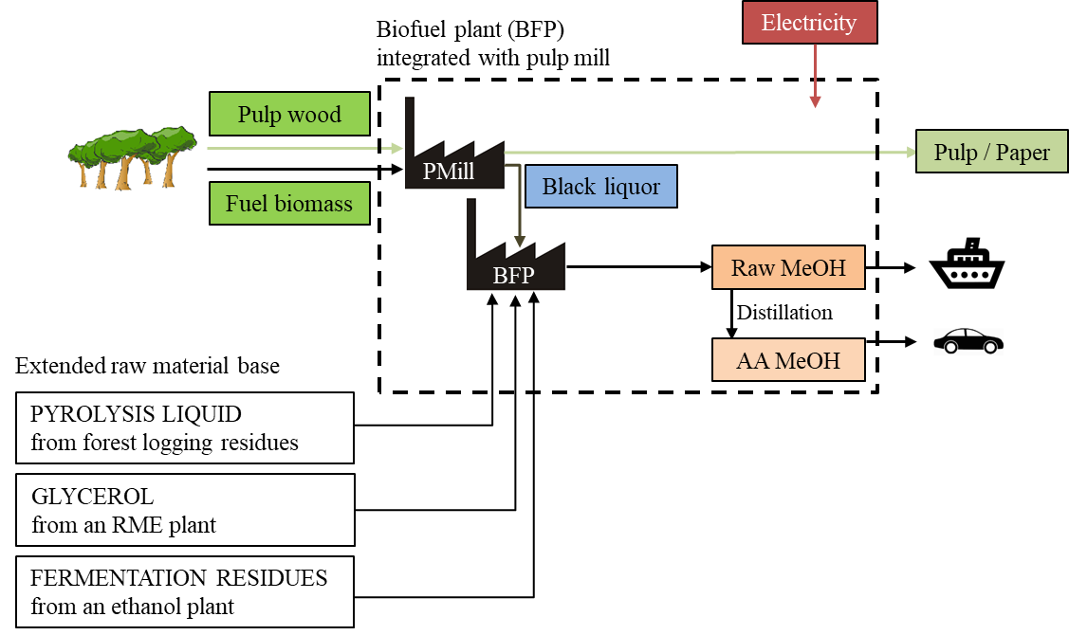
LTU Green Fuels
Co-gasification of black liquor with extended feedstock base*
  The BL reactivity can be kept even if the black liquor is significantly diluted with a secondary feedstock.
  As a way to increase the operation flexibility and the biofuel production capacity of a mill integrated gasifier, a secondary biomass feedstock could be blended into the black liquor and co-gasified
Gasification of partial black liquor streams for drop-in fuels (methanol-to-gasoline)
*Carvalho et al.(2018). Methanol production via black liquor co-gasification
with expanded raw material base – Techno-economic assessment.
Applied Energy 225, pp 570-584

Slide 16

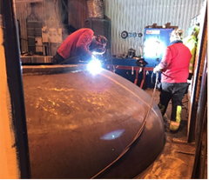
Cortus Energy - WoodRoll®
Two biofuels projects in pipeline
  Agreement with Swedish Biofuels AB to start projecting production of bio jet fuels based on forest biomass and alcohols for the Arlanda Airport needs
  Project on hydrogen production with Engie. FID expected in 2019
(Other Cortus non-biofuels projects are natural gas replacement at Höganäs steel plant (Swe) and electricity production in Mariposa (CA, USA)

Slide 17
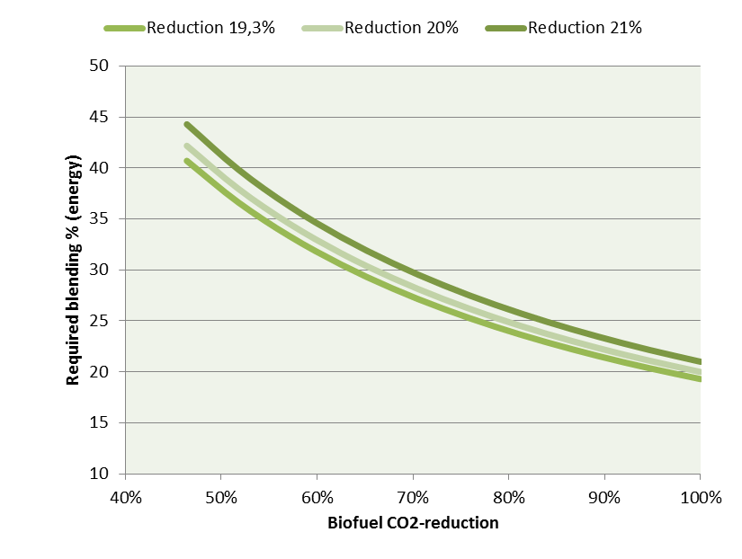

New reduction obligation for transportation fuel distributors
Year | Petrol | Diesel
2018 | >2,6 % | >19,3 %
2019 | >2,6 % | 20 %
2020 | 4,2 % | 21 %
The greenhouse gas performance directly influences the economic value the biofuels
Ref: Furusjö E & Lundgren J, Utvärdering av produktionskostnader för biodrivmedel med hänsyn till reduktionsplikten. f³- report 2017:17

Slide 18
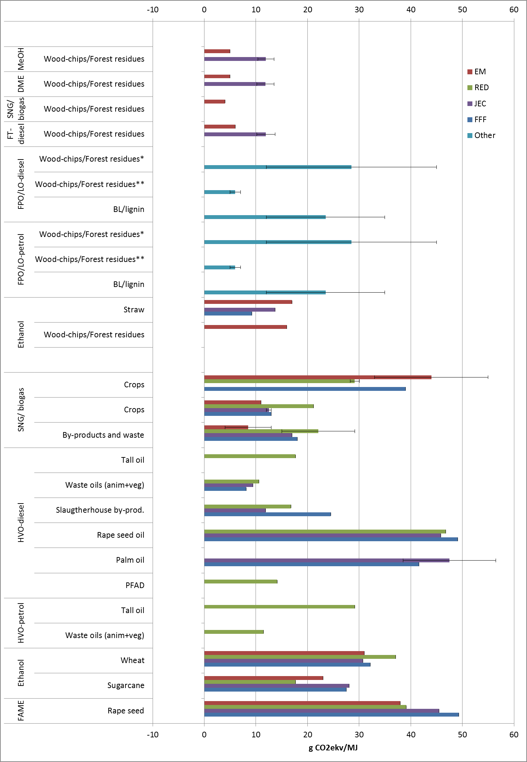
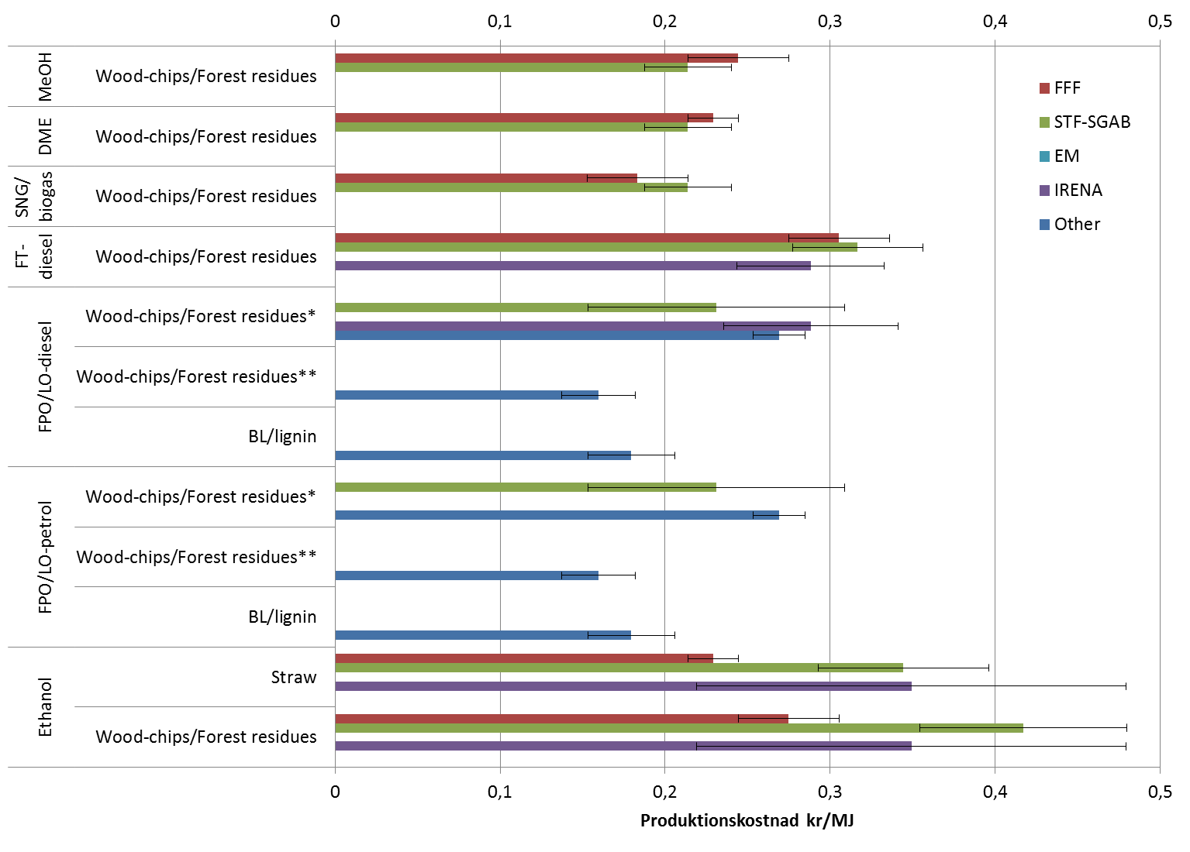
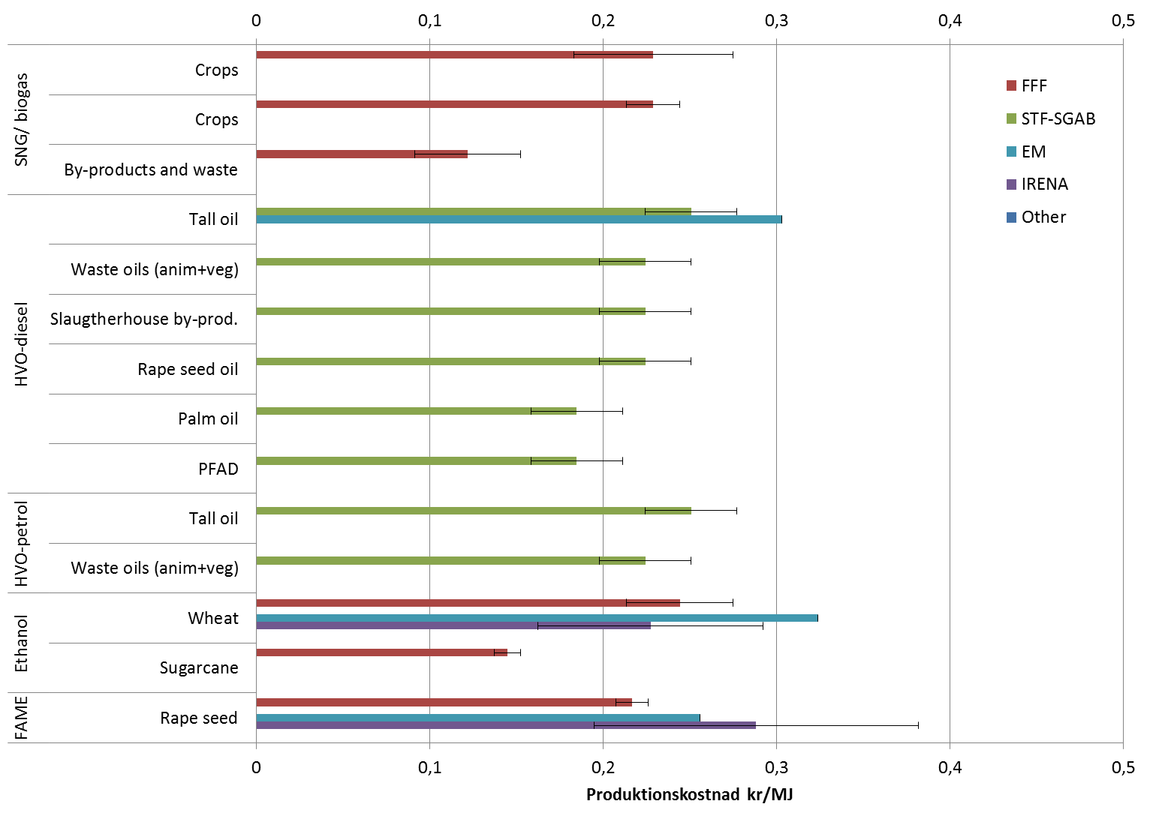
Collection of GHG data and production costs

Slide 19
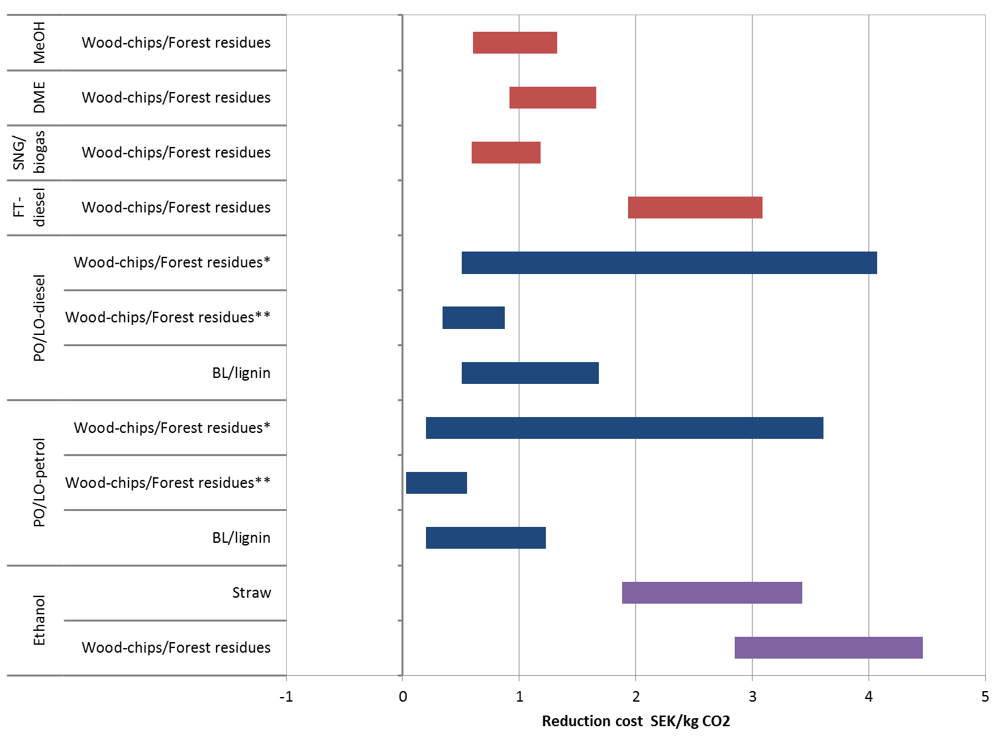
Reduction costs advanced biofuels
Gasification
Pyrolysis
Ref: Furusjö E & Lundgren J, Utvärdering av produktionskostnader för biodrivmedel med hänsyn till reduktionsplikten. f³- report 2017:17

Slide 20
Summary
The objectives of gasification and pyrolysis technologies have shifted over time. Also, the intensity of the technological development and commercial efforts have varied
Currently, pyrolysis to drop-in biofuels are favored with the new reduction obligation scheme – several industrial projects initiated
Gasification is ready for scale-up. The pilot plants GoBiGas and LTU Green Fuels plants are technical successes – both currently in conservation state
Thermochemical transportation fuels results in low GHG reduction costs – however significant uncertainties for pyrolysis based fuels depending on hydrogen origin

Slide 21
Thanks!
Joakim Lundgren, Professor
Director of Swedish Centre for Biomass Gasification (SFC)
Division of Energy Science
Luleå University of Technology
joakim@ltu.se

