Slide 1


Slide 2
$800 million climate support programme; Klimatklivet
The Climate leap – support for local and regional climate investments in fossil free transport
Production of advanced biofuels - 25 million Euro for two projects.
Biogas production – 100 million Euro
Filling stations – 75 million Euro to
  90 biogas, including 45 LBG
  45 HVO100
  10 ED95
400 LBG-trucks
Notes:
Repetition - snabbt

Slide 3
Aim of the Climate leap
“The Government has taken several steps to facilitate climate actions by businesses, local authorities, regions and organisations. The Government has created a platform for dialogue and cooperation through the Fossil Free Sweden initiative. The Government has also appointed a national coordinator that will support the Government in reinforcing and expanding the work within the initiative. The Climate Leap investment support scheme has been introduced to enable concrete climate investments. Municipalities, companies, organisations, etc., can apply for investment support for measures that reduce
climate impact, such as investments in biogas or charging stations for electric vehicles.”

Slide 4


Klimatklivet – the Climate leap
A state programme for local climate investments totalling SEK 6-10 billion (for the period 2015–2020).
Enables support for investments that can reduce emissions and influence the transition to a low-carbon economy.
Joint financing: Average grant is 47 % of investment costs.
Both public and private sector organisations can apply.
Competition: The ‘Climate leap’ investment support will target actions that have the greatest effect on climate emissions.
Naturvårdsverket | Swedish Environmental Protection Agency
2019-09-16
4

Slide 5
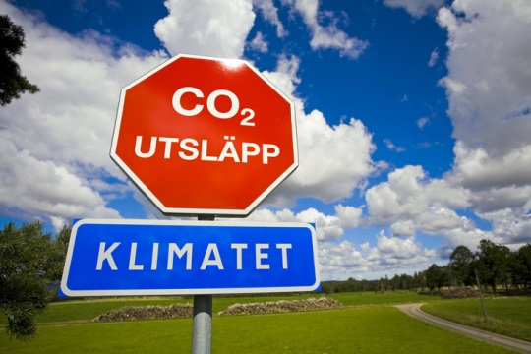
Klimatklivet – results 2015- 2018
6 200 applications 2015-2018
3 200 measures granted
Total amount in grants 4,7 billion kronor
Private sector is main aid recipient
The measures are calcutated to reduce greenhouse gas emissions, based on aplications:
  1 450 000 ton CO2-eqv. per year

Slide 6

30 %
More biogas
39 projects for biogas production

Slide 7

Ordinance on support for local
climate investments (2015:517) :
Aid shall be given in the first place to the measure or measures judged in each round of applications to give the largest lasting reduction of emissions of greenhouse gases per krona invested. If the reduction of emissions of greenhouse gases is equivalent for several applications, consideration shall also be given to
1. the ability of the measures to contribute to reduced emissions of greenhouse gases in agriculture
2. the ability of the measures to spread of technology and to market introduction and also
3. the effects of the measures on other environmental quality objectives , health and employment.

Slide 8
Restrictions
Aid may not be given to private individuals.
Aid may not be given for an activity that requires a permit under Section 17 a of the Emissions Trading Ordinance (2004:1205).
Aid may not be given to measures that:
  must be implemented to fulfil an obligation under an act of law or other statute or according to a condition in a permit:
  give entitlement to electricity certificates
  were begun before the decision to give aid was made; or
  are marketing under the definition in Section 3 of the Marketing Act

Slide 9
Learnings - biofuels
EU and state aid rules
Market and partners – use i vehicle fleets
What scenario is the alternative – what will happen to the sawdust? What fuel is replaced?
Finansing
Time, patience and flexibility

Slide 10
Klimatklivet – learnings
Many applications – growing interest to apply for funding of climate investments
Thin line to find projects with incentive effect
Several applications are withdrawn even with support
The broad approach can be flexible and meet new technologies – for example trucks on LBG
We need a mix of policy instruments. Investment support is needed as a complement to carbon tax.

Slide 11
When can climate investment grants
produce results?
When investments have a long life-span
Where other climate-policy instruments are weak
When the consequences of other policy instruments are problematic
Within sectors with low taxes/charges on greenhousegas emissions

Slide 12

Thank you!
Questions?
Nanna.wikholm@naturvardsverket.se
naturvardsverket.se/klimatklivet

